Slide 1
identifying effective policy to address THE MULTIPLE BURDENS OF malnutrition
A value chain approach
Dr Corinna Hawkes
Head of Policy and Public Affairs, WCRF International
Second International Conference on Nutrition (ICN2) - Preparatory Technical Meeting, FAO, Rome 13-15 November 2013
Notes:
What is a value chain approach?

Slide 2
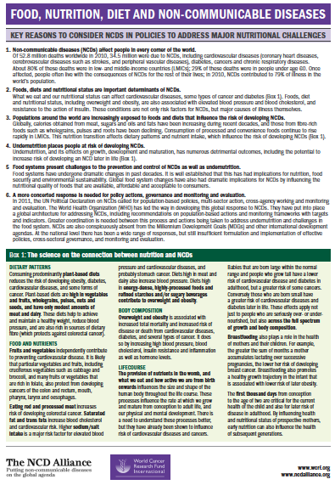

Slide 3
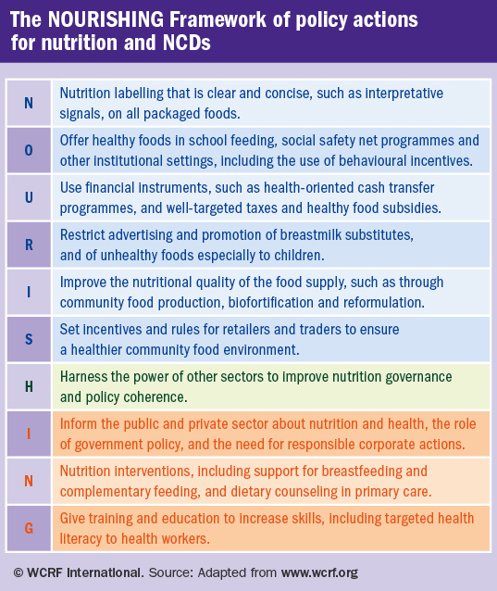
1. WE KNOW THE POLICIES & INTERVENTIONS AVAILABLE TO ADDRESS MALNUTRITION
2. WE KNOW THIS REQUIRES MULTI-SECTORAL ACTION – INCLUDING IN THE FOOD SYSTEM
Notes:
HOW DO WE IDENTIFY WHAT WE NEED TO DO?

Slide 4
3. ONE way of understanding the food system IS AS FOOD SUPPLY CHAINS
Inputs into production
Crop breeders; extension services
Food production
Farmers, agricultural laborers,
Primary food storage and processing
Packers, millers, crushers, refiners
Secondary food processing
Processed foods manufacturers
Food distribution, transport, and trade
Importers, exporters, brokers,
Food retailing and catering
Informal retailers, supermarket chains,
Food promotion and labeling
Advertising agencies
Activities
Actors
Notes:
Well, there are many reasons. I am going to highlight four.
Reason 1): The first reason is that value chain approaches have the potential to lead to what we know is needed to improve diet quality of the poor, which is more availability, more affordability and higher nutritional quality of nutritious foods. And that’s because with a value chain approach we can go back to the underlying causes right through the supply chain with all its actors, activities and sectors, so increasing the potential to find the opportunities and bottlenecks for change, from local to global, and in places we may never have otherwise thought to look.
Reason 2): The second reason is that value chain thinking recognizes that the problem is not just one of supply, but one of demand. How can we “add value” to the product to make it more acceptable to the consumer?
Reason 3): The third reason is that we know that nutritional problems require multi sectoral solutions. Look here at these actors - and this is a highly simplified way of simply illustrating an enormous variety of actors that influence decision making in the chain and the way they are organised - and we can see this value chains is all about linkages across sectors. Moreover, the concept of “value chains” is based on the premise that its is the INTERACTIONS between the actors as a SYSTEM that enhances the ability of businesses or sectors to create value, so it is an explicitly coordinated approach, or, at least, it should be
Reason 4) The fourth reason is that this is a framework which enables the identification and creation of economic value for the actors involved, AND value for nutrition for food consumers. This is not nutrition as a sucker on our resources, but looking at how nutrition can becomes a SOLUTION to economic development. That’ not to say there are not limitations to this approach: there are and we recognize what they are, but at the very least it provides a framework for assessing the trade offs between the economic and nutritional benefits and risks by activities through the value chain.

Slide 5
4. FOOD SUPPLY CHAINS, & THE POLICIES THAT AFFECT THEM, INFLUENCE DIETS – the 3As
Agricultural policies
Trade policies
Production policies
Food consuming industries in the food supply chain & the policies that affect them
Influence on the consumer food environment
Acceptability
Input policies
Affordability
Availability
Influence on production
Food Availability
Food Acceptability
Food Affordability
Marketing
Distribution
Secondary processing
Retail
Primary processing
Diets
Storage

Slide 6
5. CONSUMER DIETS, & THE POLICIES DESIGNED TO IMPROVE THEM, INFLUENCE FOOD SUPPLY CHAINs
Both supply and demaND-SIDE DYNAMICS MATTER….
UP
DOWN
Notes:
Ag poli have down stream repercussions for food 3As. It creates incentives – as do incentives created by the way the food supply chain is organised, technology and cost structures for the production of certain foods over others and what they cost. This then influences dietary intake.
At the same time, you have consumer-oriented policies designed to improve the 3As. These have upstream repercussions for the actors in the food supply chain which, from an economic perspective, could be perceived as positive or negative. Either way, they may work against – or with – the objectives of agriculture and other food supply chain policies. Likewise, the ag and other food supply chain policies may work against or with the health policies. If the policies work to achieve objectives which conflict with each other – then you have policy incoherence. If you have policies that aim to lever the whole system so it is acting synergistically, then you have coherence.
More broadly, throughout the chain, there are a whole series of incentives and disincentives, including those created by policy. which could be levered for positive nutritional and health outcomes. From a public health perspective, that’s what we would like to see, in full cognisance of the critical importance of agriculture and food systems to positive economic development.
Now, these principles apply to all nutritional challenges, but we are talking in this session about NCDs. What is so different about agriculture, food systems and healthy eating relative the underconsumption of energy or nutrients? Well, there are most certainly overlaps, but we need to recognise that for NCDs, we are not just talking about the “short” chains that oten dominate discussions and practices around agriculture and nutrition, but long chains.

Slide 7
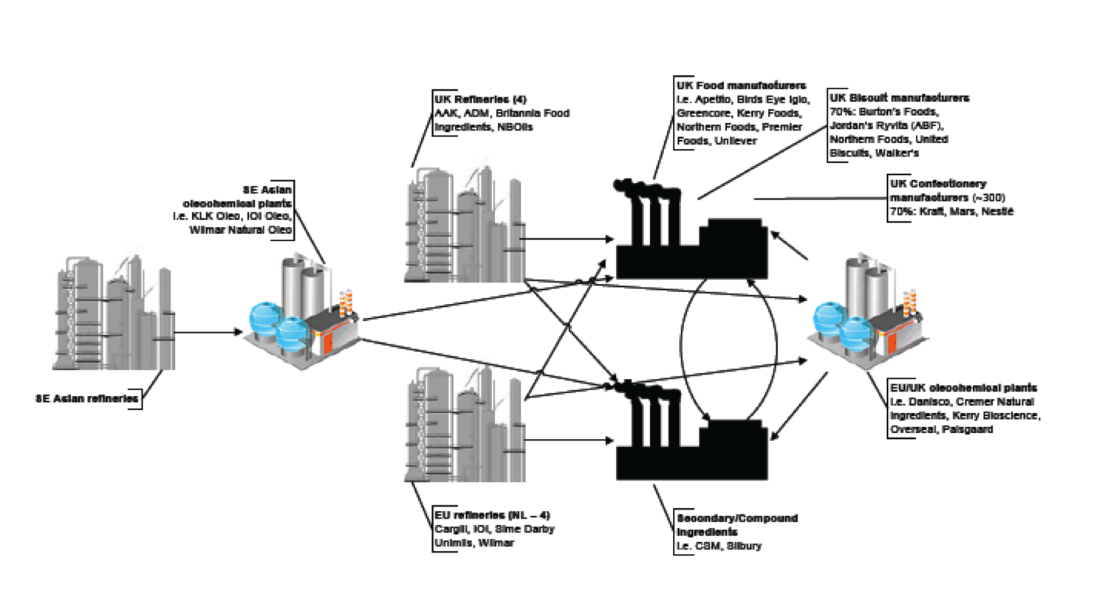
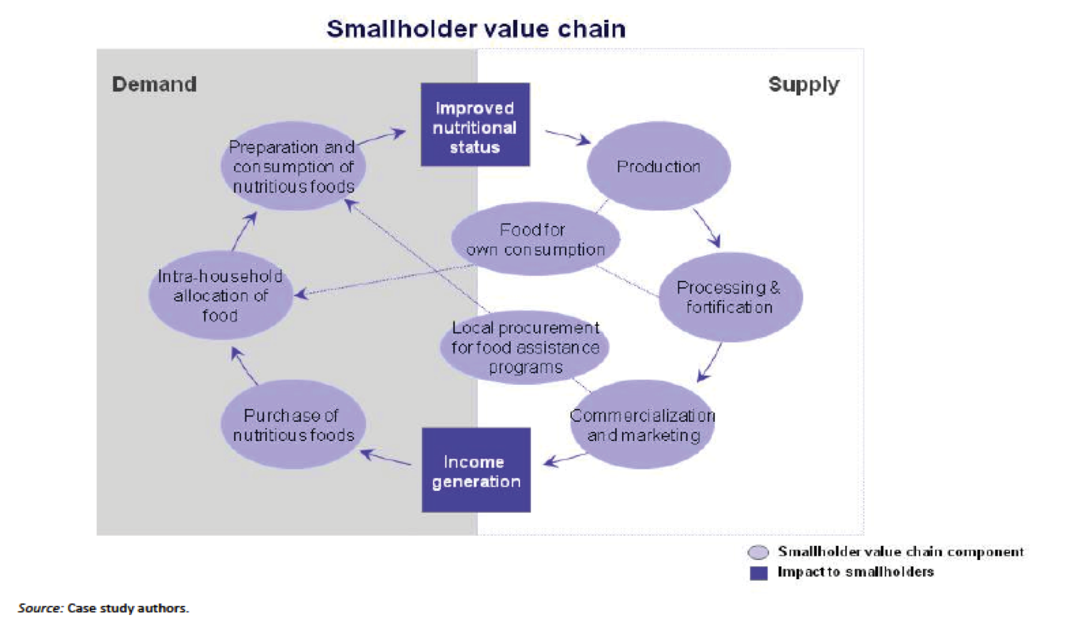
6. THERE ARE DIFFERENT INTERACTIONS IN SHORT & LONG CHAINS
Title here XXXXXXXXXXXXX
SECOND LINE for longer titles
LONG CHAINS
Longer, more complex, often involving a number of steps “midstream” which lead to significant transformations
  Blunts relationship – not always a direct link with “agricultural production”
  Commodities, processed foods, fruits & veg, fish etc
  Focus on private sector
SHORT CHAINS
Rural areas in low/middle income countries; Island communities; local markets for farmers; farm to school
  Able to transmit changes in production to consumers
  Staples, legumes, fruits, vegetables
  Focus on smallholder/family farmer
Agriculture
Food consuming industries
Consumers

Slide 8
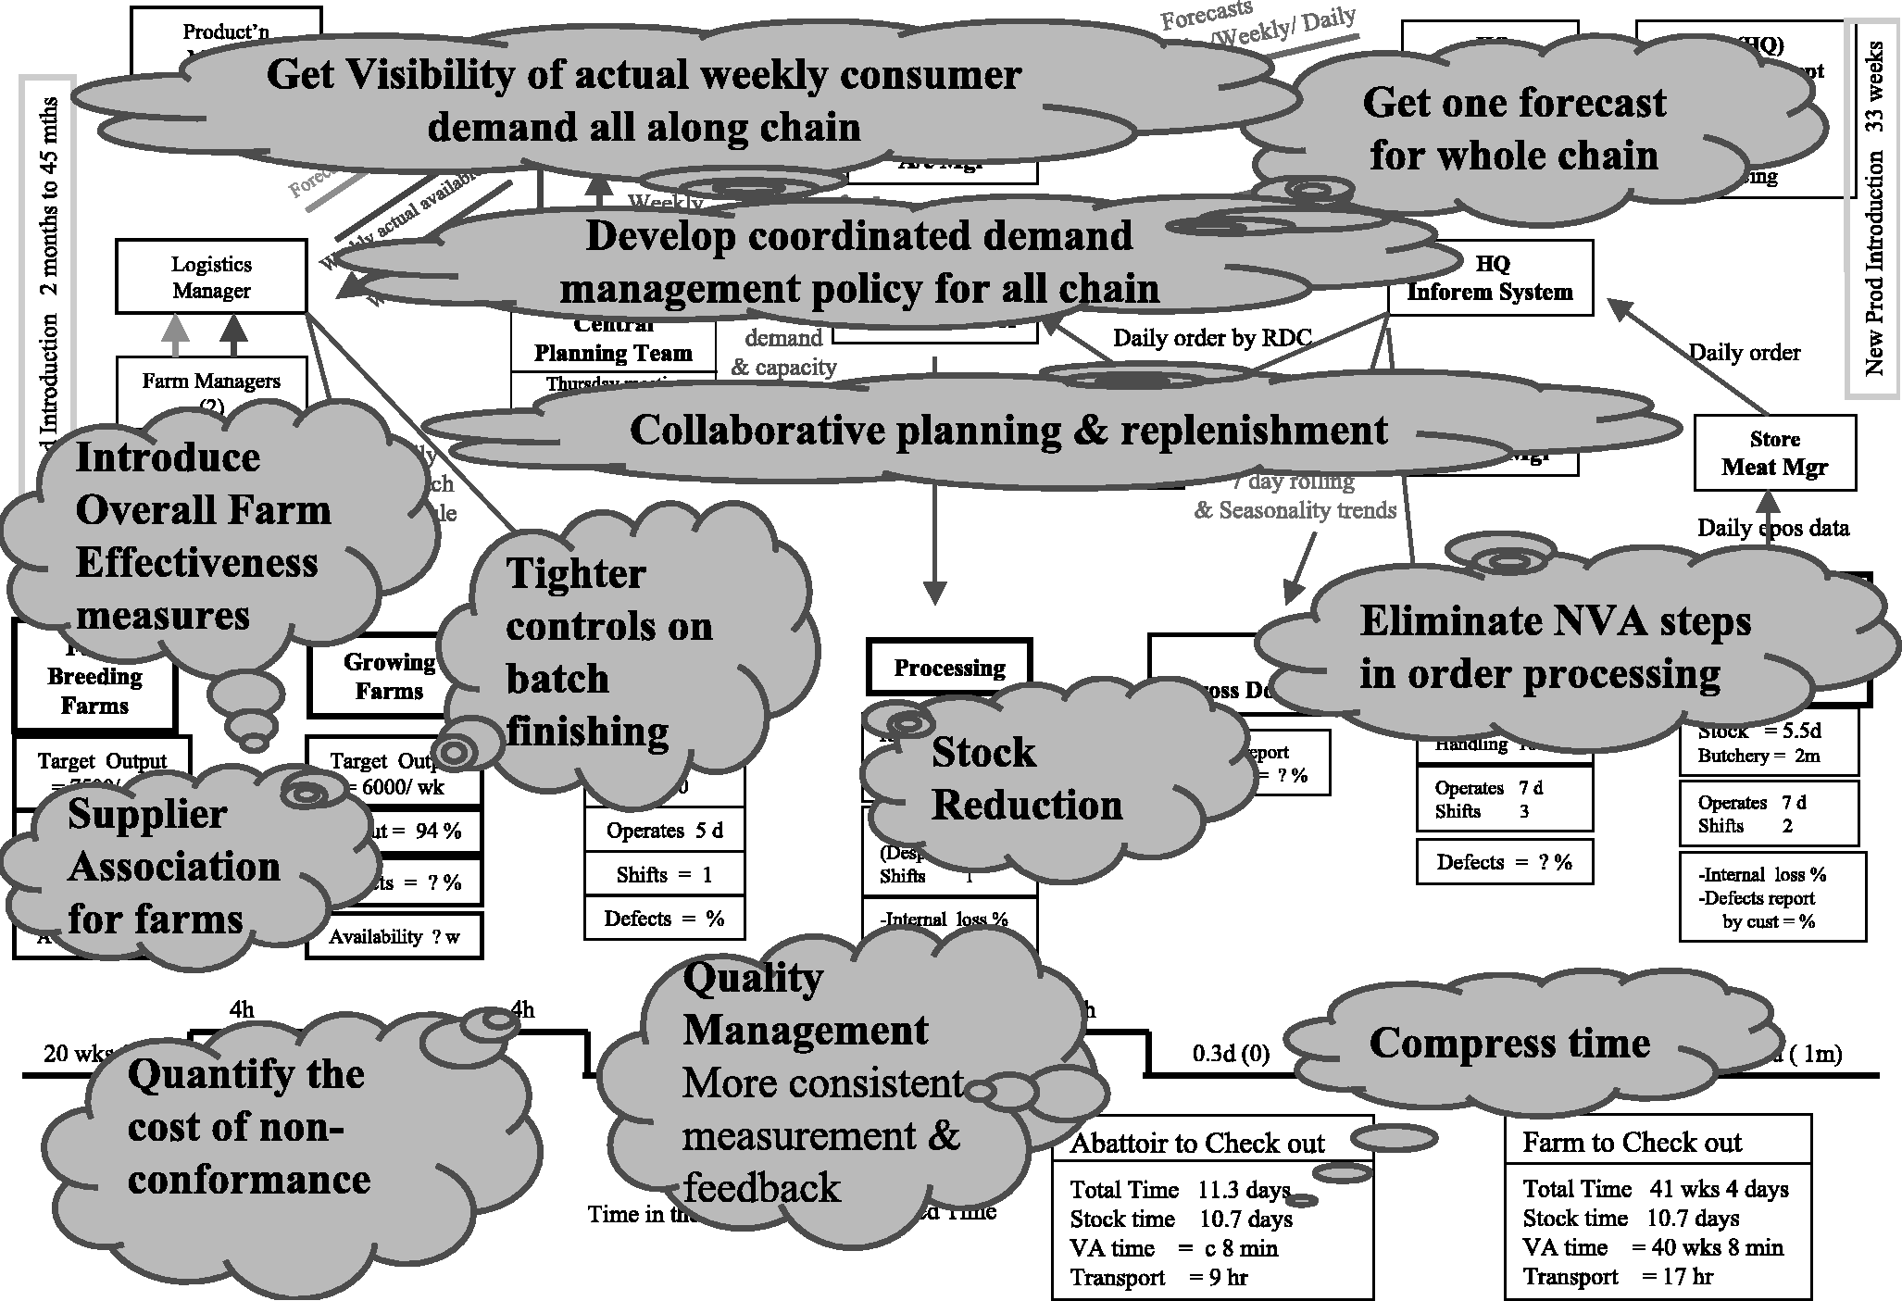
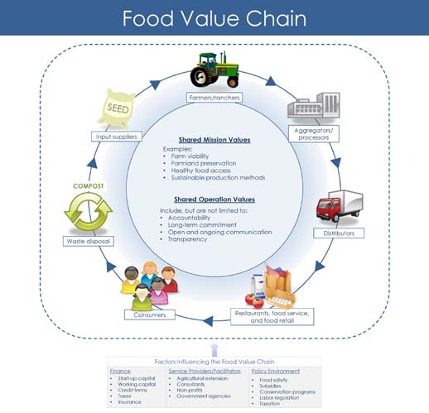
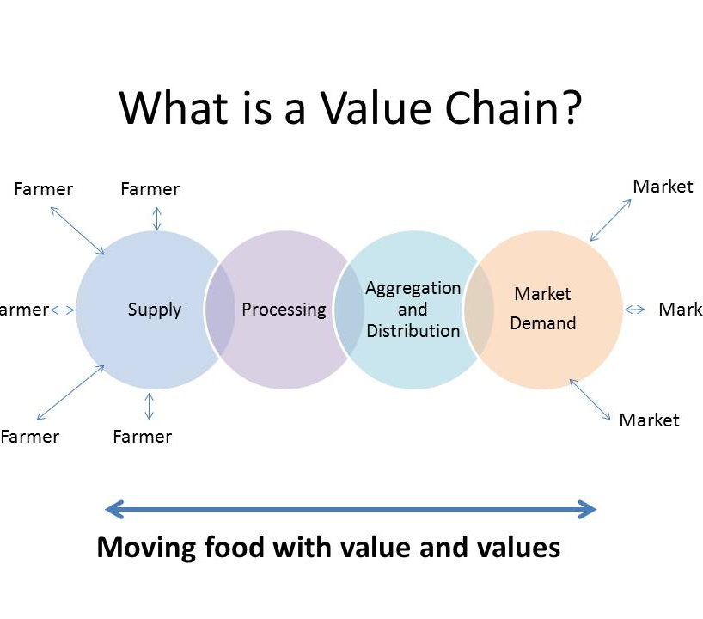
7. “VALUE CHAINs” can HELP IDENTIFY food systems SOLUTIONS to poor dietS
Aim = to create value for actors in the chain to meet economic & social goals
Analysis = how much “value” is created by & for the actors by the activities

Slide 9
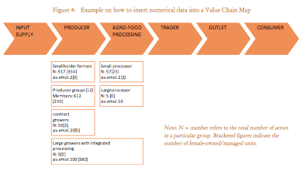
8. “Value chainS” ARE A KEY component of THE agricultural development LANDSCAPE
How can poor people in agriculture benefit more from supplying food?
  increase efficiency between farmers & markets
  greater involvement of farmers in value addition
  participation in commercial supply chains
… but value chain development in agriculture has generally not considered nutrition
Notes:
Since we are talking about creating value for actors and activites in the chain, and analysing how to get that value, perhaps not surprising that this is a concept applied in international development
Value-chain approaches are now an active component of the development landscape, particularly for pro-poor economic development
Poor people working in agriculture are vulnerable to the globalization of agrifood markets, but there are opportunities presented by growing consumer demand for “high value” products

Slide 10
9. Value chainS IDENTIFY LEVERAGE POINTS to improve diets THROUGHOUT THE FOOD SYSTEM
3) Enables identification of coordinated, multi-sectoral solutions which we know are needed to address malnutrition in all its forms
Activities
Crop breeders; extension services
Inputs into production
4) Can help meet agricultural goals by identifying leverage points where economic value for agriculture and food system actors and value for nutrition can be created, where there is incoherence, and assess the trade-offs
Food production
Farmers, agricultural laborers,
Primary food storage and processing
Packers, millers, crushers, refiners
Secondary food processing
Processed foods manufacturers
Food distribution, transport, and trade
Importers, exporters, brokers,
Food retailing and catering
Informal retailers, supermarket chains,
Food promotion and labeling
Advertising agencies
1) Focus on creating value for nutrition through supply
2) … and demand
Food
availability
Food
affordability
Food
acceptability
Diet
Notes:
Value chains could lever agricultural development for nutrition
So what are the examples of these kinds of approaches in. Well, not many: this is a new field. Nutrition is scarcely considered in current value chain approaches at the moment. But there are some emerging, which you can read about in the background paper. Just let me highlight one now.
Well, there are many reasons. I am going to highlight four.
Reason 1): The first reason is that value chain approaches have the potential to lead to what we know is needed to improve diet quality of the poor, which is more availability, more affordability and higher nutritional quality of nutritious foods. And that’s because with a value chain approach we can go back to the underlying causes right through the supply chain with all its actors, activities and sectors, so increasing the potential to find the opportunities and bottlenecks for change, from local to global, and in places we may never have otherwise thought to look.
Reason 2): The second reason is that value chain thinking recognizes that the problem is not just one of supply, but one of demand. How can we “add value” to the product to make it more acceptable to the consumer?
Reason 3): The third reason is that we know that nutritional problems require multi sectoral solutions. Look here at these actors - and this is a highly simplified way of simply illustrating an enormous variety of actors that influence decision making in the chain and the way they are organised - and we can see this value chains is all about linkages across sectors. Moreover, the concept of “value chains” is based on the premise that its is the INTERACTIONS between the actors as a SYSTEM that enhances the ability of businesses or sectors to create value, so it is an explicitly coordinated approach, or, at least, it should be
Reason 4) This is not just about meeting nutritional goals, but agricultural goals at the same time.
fourth reason is that this is a framework which enables the identification and creation of economic value for the actors involved, AND value for nutrition for food consumers. This is not nutrition as a sucker on our resources, but looking at how nutrition can becomes a SOLUTION to economic development. That’ not to say there are not limitations to this approach: there are and we recognize what they are, but at the very least it provides a framework for assessing the trade offs between the economic and nutritional benefits and risks by activities through the value chain.

Slide 11

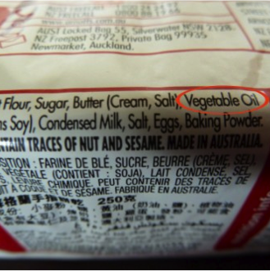
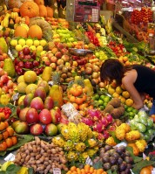
10. Value chain approaches SHOULD FOCUS ON SPECIFIC PROBLEMS IN THE CONTEXT OF THE TOTAL DIET

Slide 12
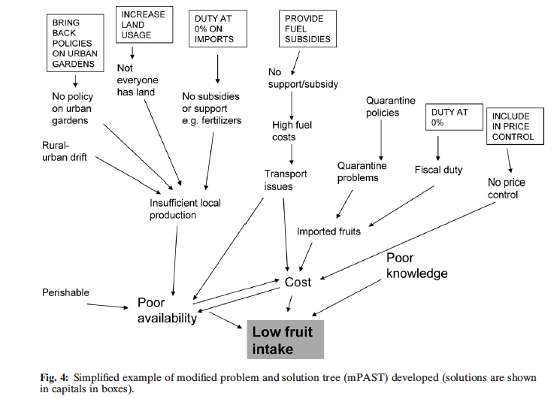
Source: Snowdon et al 2009
Example 1. Identifying policy actions to promote fruit intake in the Pacific Islands

Slide 13
Example 2. Global policy incoherence in fats
Input policies
Research funding (e.g. Oil Palm Research Institute)
Inputs into production
Production policies
Opening of new, degraded lands for cultivation
Lower limits on plantation size
Nucleus Estate Smallholder scheme
Private sector investment
World Bank investment in palm oil 1965 – 2007 US$ 1848.8 million; International Finance Corporation investment in palm oil in 1990-2007 = US$168.5 mill
Food production
Primary food storage and processing
Trade policies
Promotion of Investment Act
Lower export taxes
Low import tariffs
Food distribution, transport, and trade
Secondary food processing
Promotion policies
Promotion of health benefits of palm oil
Food retailing and catering
Nutrition policies
WHO recommendations to reduce saturated fat
Food promotion and labeling
Notes:
By 1997, Indonesia government had approved US$23.55 billion worth of oil palm investment projects by the private sector

Slide 14

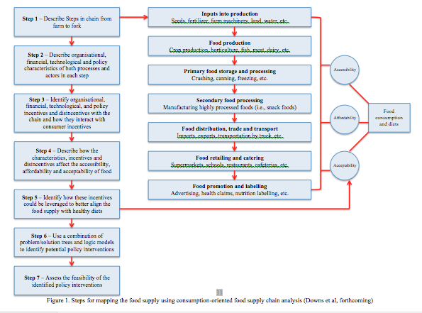
Source: Downs et al forthcoming
Example 3. Trans fats policy in India
Limited investment in domestic production of mustard/rapeseed, groundnut, safflower & sesame with healthier fatty acids profiles, but low cost palm oils favoured as trans fat replacement
Food processing is a priority investment sector = incentives for food processors and increasing the affordability of processed foods
Vanaspati widely used by (price-conscious) street vendors.
HHH
Food Safety and Standards Authority of India (FSSAI) proposed a regulation to set an upper limit of 10% trans fat in partially hydrogenated vegetable oils

Slide 15
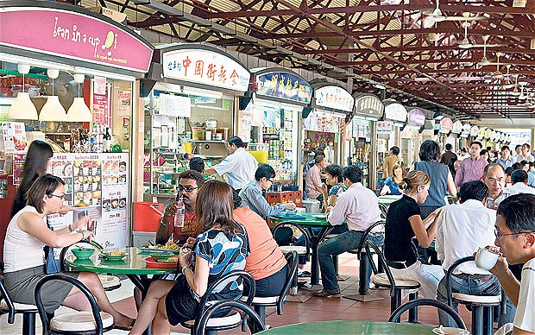
Source: Ling, HPB
Example 4. Saturated fats policy in Singapore
Health Promotion Board wanted “Hawkers” to use less oils with less sat fat – but found resistance due to price disincentives
Invested in supply-side solutions - research into reducing sat fat; logistics to improve efficiency of producers of lower sat fat oil
Despite success, existing relationships between hawkers and local suppliers impeded uptake; now assessing how to engage local markets

Slide 16
ACTING IN FOOD SYSTEMS ON THE BASIS OF VALUE CHAIN ANALYSIS IS PART OF THE PACKAGE OF APPROACHES TO ADDRESSING MALNUTRITION
Thank you
For further information contact:
Dr Corinna Hawkes
Head of Policy and Public Affairs, WCRF International
policy@wcrf.org and c.hawkes@wcrf.org
@wcrfint @corinnahawkes facebook.com/wcrfint youtube.com/wcrfint wcrf.org/blog
www.wcrf.org/policy_public_affairs

