Slide 1
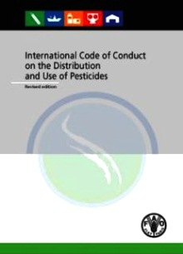
Code of Conduct on Pesticide Management
A brief overview of Technical Guidelines
in support of the Code
Training Module
Notes:
1

Slide 2
Code of Conduct
Established in 1985, amended/revised in 1989, 2002 and 2013
It is a voluntary standard that covers all aspects of pesticide management and serves as a point of reference for governments and the pesticide industry
Is accepted by all main stakeholders, i.e. governments, industry, public interest groups and farmer organizations
Considers pesticide management a part of chemical management as well as sustainable agricultural development
New Code incorporates public health pesticides & vector control - attention to health & environmental aspects of pesticides

Slide 3
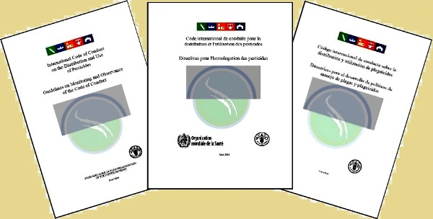
Technical Guidelines in support of the Code of Conduct
Provide more detailed guidance on specific areas of the Code of Conduct.
Are developed by the FAO/WHO Joint Meeting on Pesticide Management, which guides the preparation and ensures their independence and quality.

Slide 4
Framework of Technical Guidelines
Legislation
Policy
Registration
Compliance and enforcement
Distribution and Sales
Use
Application Equipment
Prevention and disposal of obsolete stocks
Post registration Surveillance
Monitoring observance of the Code

Slide 5
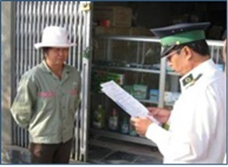
Legislation Guidelines for legislation on the control of pesticides [1989]
These guidelines & FAO Legislative Study on Designing national pesticide legislation are intended for Governments wishing to develop, review, update or strengthen national legislation for the control of pesticides.
They cover all elements of comprehensive pesticide legislation, but also provide guidance on how to reflect the specific national context for pesticide legislation.
Updating or strengthening may for instance be required to:
Clearly establish the institutional responsibilities and mandates for the control of pesticides;
Strengthen enforcement mechanisms;
Reflect requirements of international instruments
that the country has ratified;
Address overlap and inconsistencies with related legislation (e.g: chemicals; environment; health)
Address new concerns or new developments.

Slide 6
Policy Guidance on Pest and Pesticide Management Policy Development [2010]
Provides guidance on pest and pesticide management policy development in support of pesticide risk reduction and sustainable agricultural production.
Encourages governments and other stakeholders: - to consider the question to what extent current pesticide use is actually justified. - to place pesticide management in the broader context of pest management.
Special attention is given to: - The concept of pesticide risk reduction, - Integrated Pest Management (IPM) to reduce reliance on pesticides, - Linkages between sustainable pest management and policy objectives related to environmental protection, human health, food safety and trade.
Governments are encouraged to analyse their pest and pesticide management situation, to identify areas for improvement, and to develop plans to realize these improvements.
An overview of policy tools that can play a role in such plans is provided

Slide 7
Registration Guidelines for the Registration of Pesticides [2010]
These guidelines provide guidance on how to establish and implement a pesticide registration scheme.
They provide general advice on principles, process and requirements for registration of pesticides, including institutional and administrative organization.
They also provide guidance on post-registration activities; coordination and collaboration; regular review of registered pesticides; funding of pesticide registration.
A number of specific issues are discussed, such as: formulants; equivalence determination; minor uses; comparative risk assessment; registration of biopesticides.
It is recognized that there are large differences between countries and therefore scenarios for the phased establishment of registration schemes are provided. Resource poor countries can start with initial schemes that can be elaborated later on.

Slide 8
Registration Guidelines on Data Requirements for the Registration of Pesticides [2013]
These guidelines focus on the scientific data and other information that generally may be required to determine what pesticides can be permitted for use and for what purposes.
It includes description of:
the types of data and information required and why;
how the data may be used in decision-making;
factors that affect data requirements.
The guidelines also address some special situations such as, biological pest control agents, emergency approvals and experimental use.
The annexes provide comprehensive lists of recommended data requirements.

Slide 9
Registration Guidelines on efficacy evaluation of plant protection products [2006]
These guidelines provide guidance for both the pesticide industry and governments on the design, conduct and evaluation of pesticide efficacy trials, as stipulated by the Code of Conduct.
They elaborate on the general principles of a harmonized pesticide efficacy testing method and evaluation of plant protection products for registration purposes.
The guidelines focus on: pesticides for plant protection, including: plant growth regulators and desiccants or defoliants; biological control agents; behaviour modifying chemicals and plant extracts.

Slide 10
Registration Guidelines on good labelling practice for pesticides [1995]
These guidelines aim to establish common, harmonized, requirements for pesticide labelling.
They are intended to be used when designing regulations for pesticide labelling and by registration authorities responsible for the approval of labels, as well as by those in industry involved with label preparation.
They identify the main objectives and considerations in preparing a label and provide guidance for the layout and required information.
Details are provided on toxicity and hazard classifications, pictograms, text for warnings and hazard statements, etc., including sample labels.
Guidance is also given on considering the level of knowledge of users when writing a label.

Slide 11
Registration Revised guidelines on environmental criteria for the registration of pesticides [1989]
Part I explains the principles for environmental impact assessment
Part II provides guidance for appropriate test procedures, including a stepwise approach to data production for each assessment procedure.
The assessment of effects on the environment is an integral part of the process of pesticide development and registration.
It is explained how such assessments should be designed to identify potential hazards and to enable identified risks of adverse effects on the environment to be quantified and evaluated in relation to benefits.

Slide 12
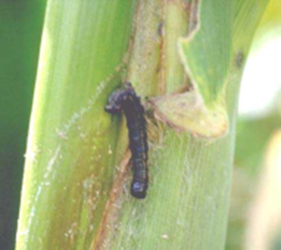
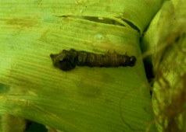
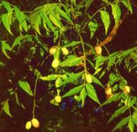
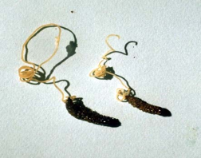
Registration Guidelines on the registration of biological pest control agents [1988]
These guidelines define the various types of biological pest control agents and the data requirements for their registration.
Biological pest control agents are naturally occurring agents that are distinguished from conventional chemical pesticides by their unique modes of action, low use volume, and target species specificity.
There are two major categories of biological pest control agents: the biochemical and microbial ones.

Slide 13
Compliance and Enforcement Guidelines for quality control of pesticides [2011]
Quality control of pesticides is a crucial and integral part of pesticide management and enforcement of pesticide legislation.
Guidance is provided on the legislative, administrative, organizational and infrastructure (facilities and trained staff) requirements and procedures to implement a scheme of regulatory quality control of pesticides.
This includes guidance on sample selection and sampling procedures.
Specific attention is paid to solutions for countries that face constraints in the setting up of an effective pesticide quality control system.

Slide 14
Compliance and Enforcement Guidelines on compliance and enforcement of a pesticide regulatory programme [2006]
This document provides a comprehensive source of compliance and enforcement guidance to support the implementation of the regulatory framework for the control of pesticides.
Special attention is given to:
Legal tools and instruments to achieve this;
The core principles of compliance and enforcement;
basic information about the policy and theoretical framework for achieving compliance;
The major steps or elements which must be considered to establish an effective system.

Slide 15
Distribution and Sales Guidelines on Pesticide Advertising [2010]
The guidelines provide directions for: the pesticide industry, trade associations and others developing advertising or other promotional material for pesticide products; as well as public interest organizations monitoring pesticide sales and distribution, and other interested parties.
The guidance supplements Article 11 of the Code of Conduct and elaborates on both self-regulation and statutory measures.
Best advertising practices are provided and are applicable to advertising in relation to all pesticide uses.
They also serve to suggest a framework for monitoring pesticide advertisements, and indicate steps to take when encountering non-compliance with national legislation or non-observance of the Code of Conduct.

Slide 16
Distribution and Sales Provisional guidelines on tender procedures for the procurement of pesticides [1994]
Guidance is provided to both suppliers and procurers of pesticides, on the steps to be taken to ensure that pesticides obtained are of the required quality and are suitably packaged and labelled, taking into account local transport and warehousing facilities.
The guidance is relevant to all procurement agencies - government agencies, donor agencies or other organizations and private procurers, regardless of whether the pesticides concerned are for use by farmers or others.
Note: The document was prepared in collaboration with the pesticide industry and is called provisional because it has not been reviewed and endorsed by an FAO/WHO expert panel.

Slide 17
Distribution and Sales Guidelines for retail distribution of pesticides with particular reference to storage and handling at the point of supply to users in developing countries [1988]
Pesticides present risks to health and environment
from manufacturing to use or disposal
Risks tend to be greater in developing countries where distributors and retailers often lack knowledge and infrastructure, and where government inspections schemes are often not well established.
Advice is provided on proper storage and handling to reduce risk and to prevent accelerated product deterioration.

Slide 18
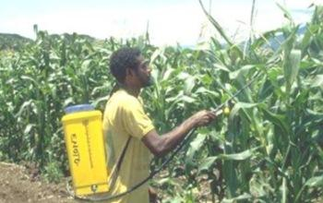
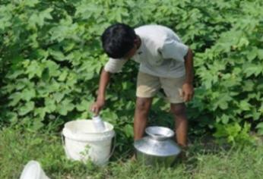
Use Guidelines for personal protection when working with pesticides in tropical climates [1990]
They offer practical and realistic advice, taking into account the protection needs of the user, but also practicalities of its use in hot humid climates and possible budgetary constraints of poor farmers.
They provide an introduction on understanding hazards and the principles of personal protection. The various modes of protection and associated gear are described.
They may provide guidance to drafting of regulations, to preparation of extension programmes and to reviewing and approving of label instructions.
Bad examples of field realities that need to be addressed

Slide 19
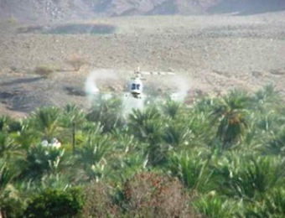
Use Guidelines on good practice for ground application of pesticides [2001] Guidelines on good practice for aerial application of pesticides [2001]
Practical help and guidance is offered to decision-makers, managers, field supervisors and spray operatives and all those involved in using pesticides.
They cover the main terrestrial and aerial spray application techniques and provide information and practical advice on good application practices once a decision has been taken to use a pesticide.

Slide 20
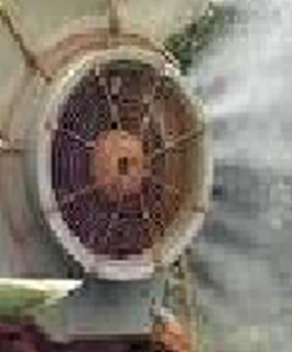
Application Equipment Various guidelines related to registration, certification, testing and use of pesticide application equipment
This comprehensive set of 9 guidelines aims to ensure that application equipment is:
Low risk to users and to the environment
Efficient and durable in operation
Properly used
They explain how to control the quality of the pesticide application equipment manufactured in- or imported into the country through regulatory control, and testing and certification procedures, and how to encourage their proper use.
* Separate volumes are available for different types of spray equipment.

Slide 21
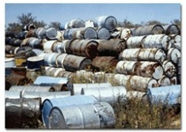
Prevention and Disposal of Obsolete Stocks Guidelines on management options for empty containers [2008]
Unless empty pesticide containers are managed correctly,
they are hazardous to health and the environment !
There is a danger that empty containers could be reused for
storing food and water, which could result in pesticide
poisonings ! Containers abandoned in the environment
can lead to pesticide pollution in soil and groundwater !
A container management scheme can minimize these risks and is part of the
“life-cycle concept”, requiring the engagement and support of all stakeholders in
the supply chain for pesticides.
This guideline identifies how stakeholders can contribute to a container management scheme. It considers the role of manufacturers in the design of the containers and the formulation of the product, as well as their responsibility in product stewardship.

Slide 22
Prevention and Disposal of Obsolete Stocks Guidelines for the management of small quantities of unwanted and obsolete pesticides [1999]
Guidance is provided on what to do with the small quantities of unwanted and obsolete pesticides that are often found on farms, in homes and in many other situations.
Special attention is given to concerns about undesirable disposal practices for small quantities of unwanted pesticides, empty containers and other contaminated waste, such as burning or burying.
Recommendations are provided on preventing the accumulation of unusable pesticides at user level and removing waste where it exists.

Slide 23
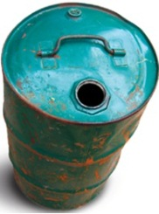
Prevention and Disposal of Obsolete Stocks Disposal of bulk quantities of obsolete pesticides in developing countries [1996]
These guidelines address the widespread problem of large obsolete stocks of pesticides in developing countries and the need for their containment and disposal.
They offer guidance on what to do with obsolete pesticides, and warn against improvised disposal methods that may cause severe environmental and health problems.
The cost of mitigating the effects of irresponsible disposal can be many times higher than the cost of proper environmentally sound disposal as recommended in these guidelines that were prepared in close collaboration with UNEP and WHO

Slide 24
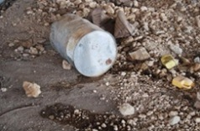
Prevention and Disposal of Obsolete Stocks Prevention of accumulation of obsolete stocks [1995]
These guidelines raise awareness about the mechanisms through which obsolete pesticide stocks accumulate and to enhance the formulation and implementation of policies and procedures aimed at preventing such accumulation.
These guidelines are particularly aimed at governments of developing countries, aid agencies and the pesticide industry.
The guidelines analyse the causes of accumulation and recommend how it can be prevented.

Slide 25
Post Registration Surveillance Guidelines on Prevention and Management of Pesticide Resistance [2012]
These guidelines address the problem of pesticide resistance in agriculture and how to limit its development while continuing to protect crops from pests.
Detailed guidance is provided on evaluating risk of resistance, and on resistance prevention and management.

Slide 26
Post Registration Surveillance Guidelines on post-registration surveillance and other activities in the field of pesticides [1988]
Registration involves a number of activities undertaken before a pesticide product is introduced in the market. A well-devised and operated registration scheme does not stop at this pre-market evaluation stage.
Post-registration activities provide the needed follow-up to ensure that the registered product is properly handled, distributed, and used safely and in accordance with applicable rules and regulations.
Post-registration activities provide a means of measuring the validity of predictions based on registration data, regarding efficacy, safety and environmental effects of a particular pesticide.
These activities should be basic components of any law regulating the trade, production and use of pesticides.

Slide 27
Post Registration Surveillance Guidelines on developing a reporting system for health and environmental incidents resulting from exposure to pesticides [2010]
This guideline assists governments in the development of a basic reporting scheme for pesticide incidents that resulted in health or environmental problems.
It provides directions on how to collect information about pesticide incidents, the type of information that should be collected, and how to analyze the data in order to determine if the use of a pesticide requires further risk mitigation actions or further in-depth monitoring.
Information on incidents should be provided to pesticide regulatory authorities as a means of strengthening national decision making on pesticides.
Incident information should be used in the context of the Rotterdam Convention on the Prior Informed Consent Procedure (PIC) for Certain Hazardous Chemicals and Pesticides in International Trade.

Slide 28
Monitoring and Observance of the Code of Conduct Guidelines on monitoring and observance of the Code [2006]
These guidelines encourage monitoring of the implementation of provisions of the Code of Conduct with the aim of improving implementation.
Procedures are proposed for:
Regular monitoring to provide an ongoing source of information to evaluate progress in observing the CoC, and to identify critical areas in pesticide management where further work is needed.
Ad hoc monitoring to encourage stakeholders to notify FAO of cases of non-compliance that can have health or environmental implications. Such cases will be brought to the attention of the government concerned and, if needed, to the FAO/WHO Joint Meeting on Pesticide Management, which then may provide recommendations for follow-up actions.
Monitoring is also encouraged as a tool for self-assessment that can help governments improve decision-making on pesticide management and environmental performance.

Slide 29
Further Tools
Examples of what is available on the FAO Website
In addition to the Guidelines, there are specific Tools for each subject area that can be found through the FAO webpage for the technical guidelines.
These include Manuals, reference material, and further technical guidance that has not been reviewed by the FAO/WHO Joint Meeting on Pesticide Management
Some examples (Tools)
Legislation: FAOLEX database on national laws, including pesticide laws.
Obsolete pesticides: Various guidance documents on prevention, disposal, soil contamination and management of empty containers.
Quality control: FAO\WHO Pesticide Specifications.

Slide 30
The Guidelines and Tools can be found at: http://www.fao.org/agriculture/pesticides
FAO Pesticide Risk Reduction Group
Viale Delle Terme di Caracalla.
I-00153 Rome, Italy
Email to: Pesticide-Management@fao.org;
Tel: +39 06 5705 5192; +39 06 5705 5

