Slide 1
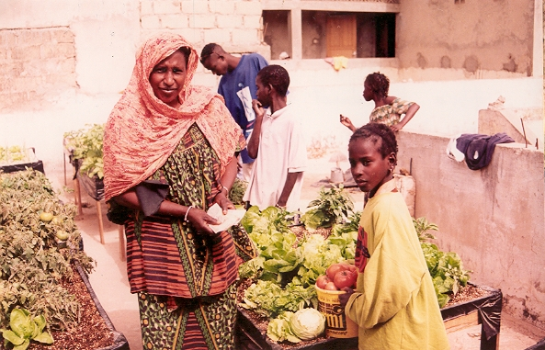
Clean and high quality vegetable production for home consumption and income generation in Dakar, Senegal.

Slide 2
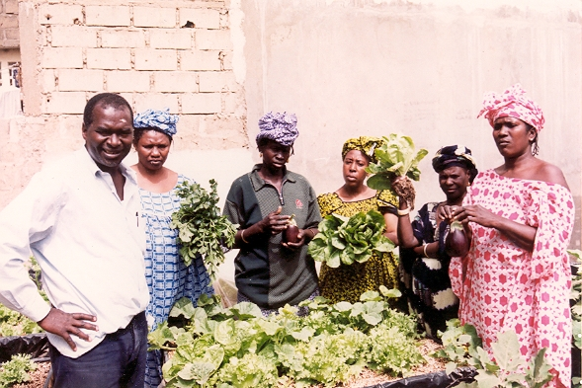
Ladies enjoy exhibiting the wonderful results obtained by producing high quality vegetables at home, Dakar, Senegal.

Slide 3
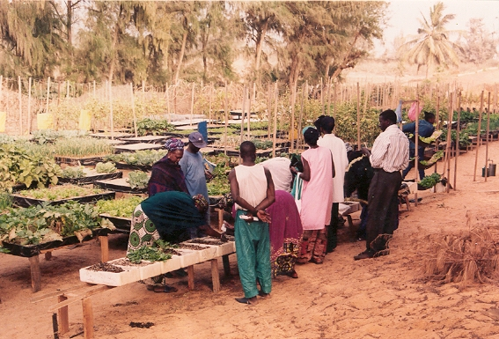
If the soil quality doesn’t allow to grow vegetables, in Micro gardens systems you can do it, Dakar, Senegal.

Slide 4
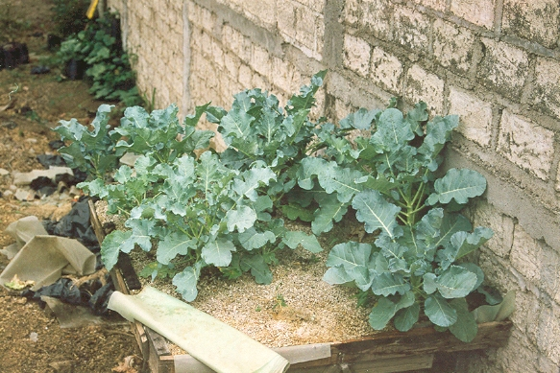
In very confined areas Micro gardens allow to grow high nutritional vegetables such as broccoli. El Salvador, C.A.

Slide 5
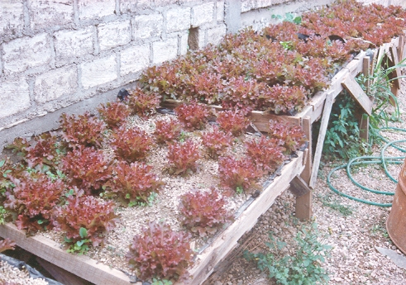
In very confined areas Micro gardens allow to grow high nutritional vegetables such as crispy lettuce. El Salvador, C.A.

Slide 6
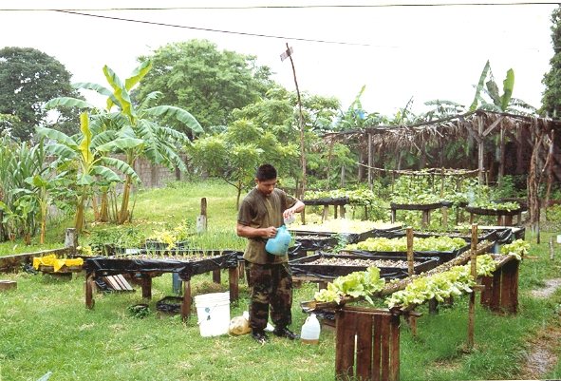
By applying very small amount of nutrients it is possible to harvest high yields of vegetables, San Salvador, C.A.

Slide 7
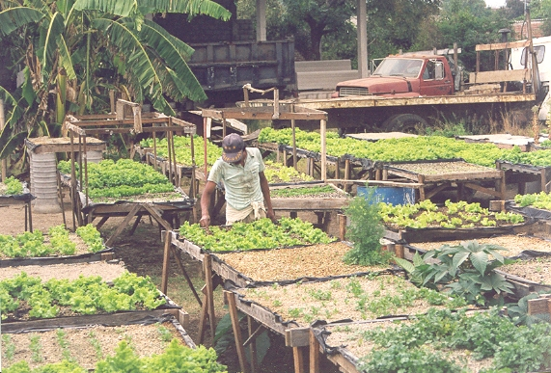
Micro gardens help to generate income and food for the family when high unemployment prevails in the urban environment, El Salvador.

Slide 8
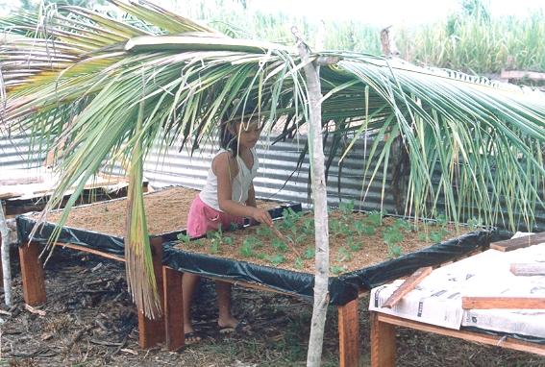
Children enjoy taking care of Micro gardens at home even in the rainy season, Belize

Slide 9
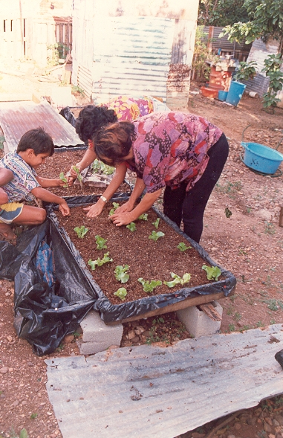
All the family members can participate in producing fresh vegetables at home, Las Peñas, Batquisimeto, Venezuela.

Slide 10
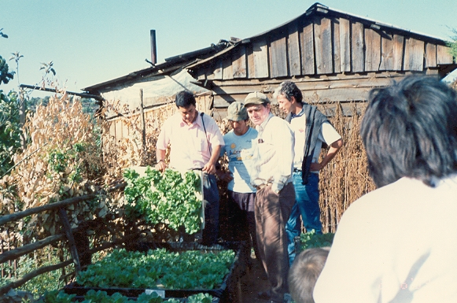
The floating system is very efficient for getting high yields of many kinds of fresh leafy vegetables, Conception, Chile

Slide 11
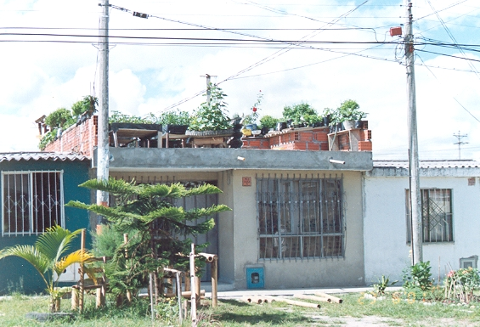
Roof tops are most useful to host Micro Gardens, Armenia, Colombia

Slide 12
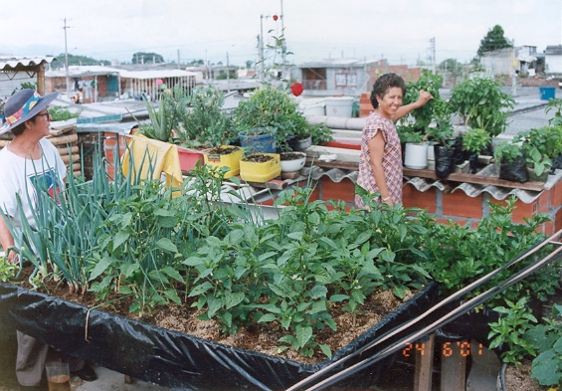
Roof tops are most useful to host Micro Gardens, Armenia, Colombia

Slide 13
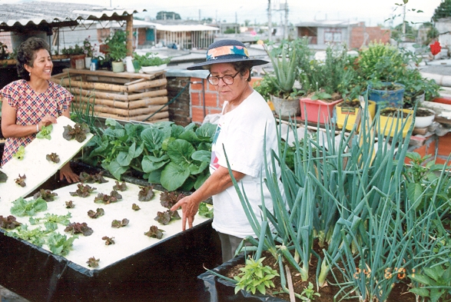
Both floating and substrate Micro garden system can be applied in roof top micro gardens, Armenia, Colombia.

Slide 14
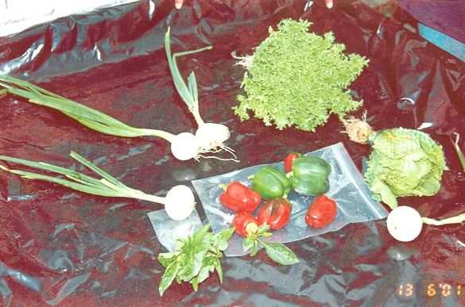
A broad range of vegetables can be successfully produced in Micro garden systems, Pereira, Colombia.

Slide 15
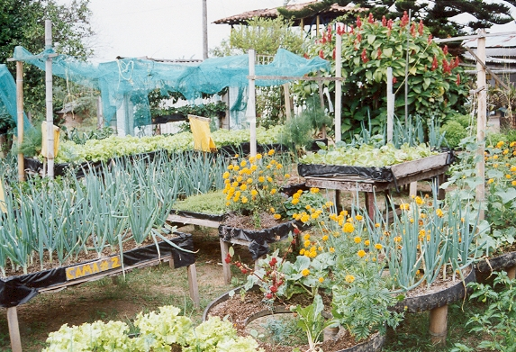
Waste materials can be usefully recycled for growing vegetables in confined spaces, Armenia, Colombia.

Slide 16
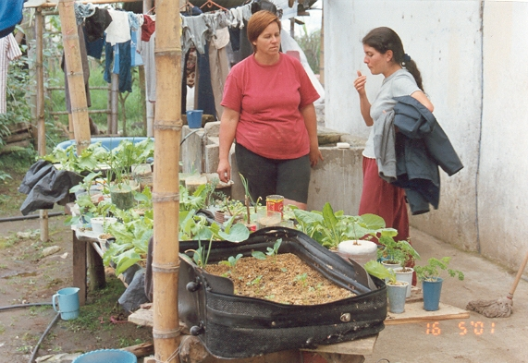
Many kinds and sizes of container are adapted for growing vegetables in Micro garden systems, Colombia.

Slide 17
Teachers and students during their free time grow Micro gardens, Alfredo Garcia College, Pereira, Colombia

Slide 18
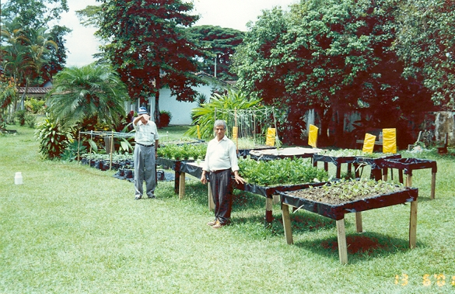
Pensioners produce fresh vegetables in an old people’s home in Pereira, Colombia.

Slide 19
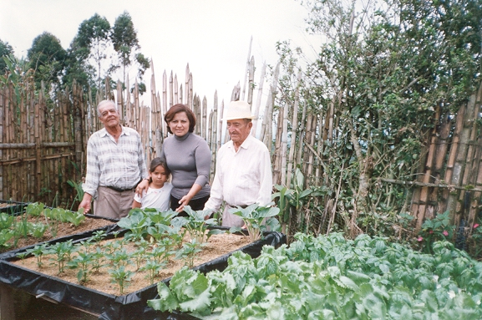
Several generations of the same family are equally fit to care the Micro garden systems, Salento, Colombia

Slide 20
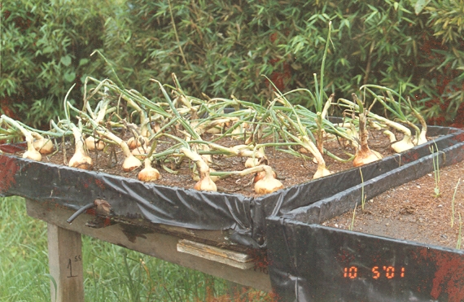
Onions perform very well in Micro gardens, Santa Rosa de Cabal, Colombia

Slide 21
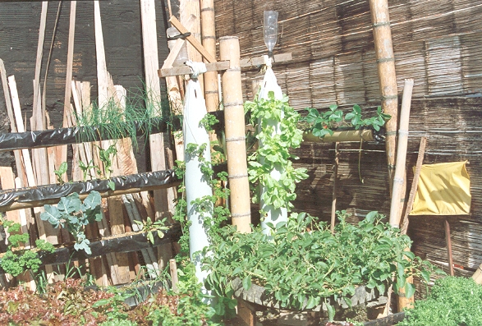
Diversified technologies can be adapted for growing vegetables in Micro gardens systems, Armenia, Colombia

Slide 22
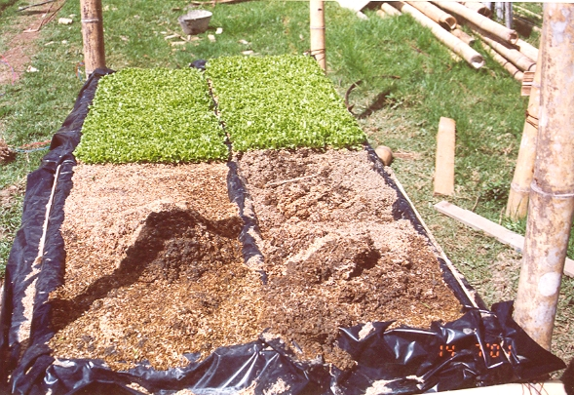
Rice hulls mixed with coarse sand at a ratio 50:50 is an adequate substrate for Micro gardens, Salento, Colombia

Slide 23
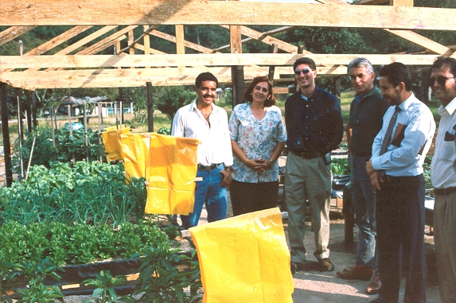
Good results with Micro gardens encourage local authorities to promote this technology for the urban poor, Guatemala

Slide 24
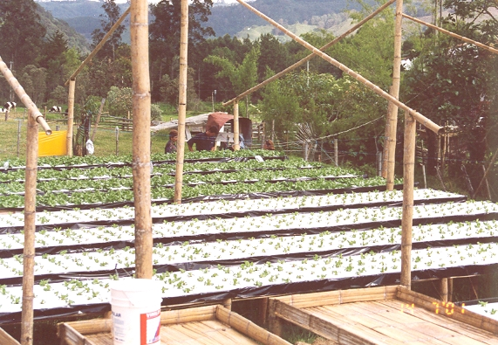
The successful adoption of Micro garden system can lead to expansion into larger areas of cultivation, Salento, Colombia.

Slide 25
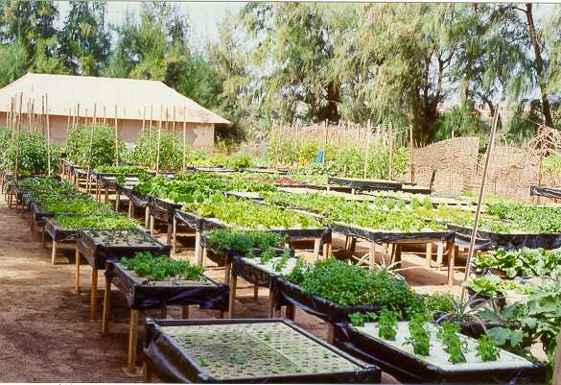

Slide 26
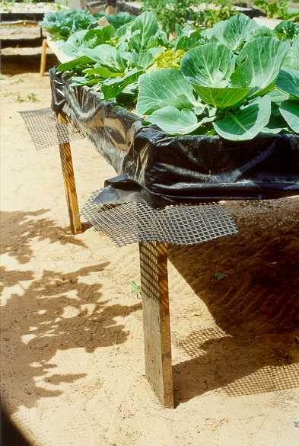

Slide 27
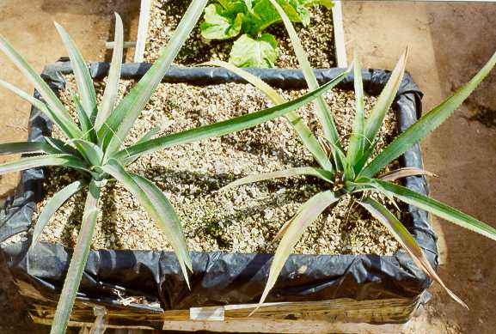

Slide 28
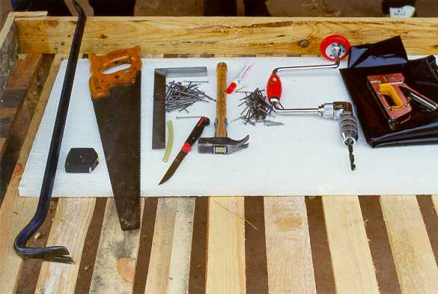

Slide 29
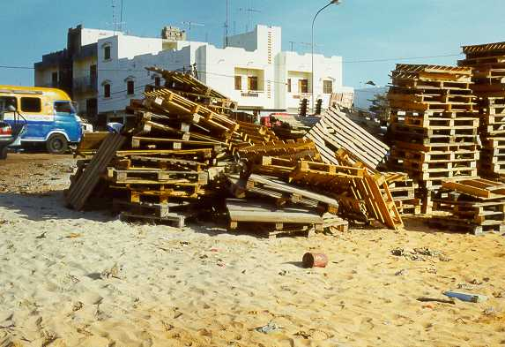

Slide 30
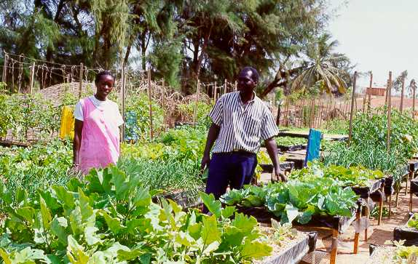

Slide 31
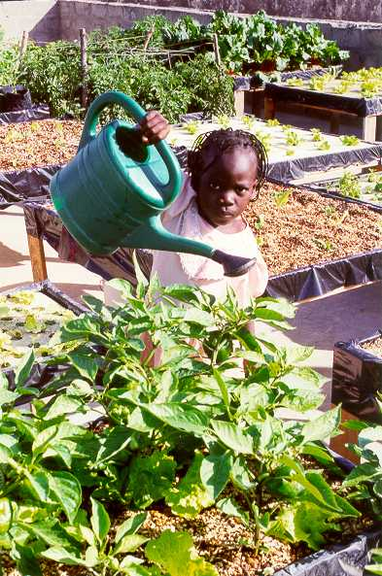

Slide 32
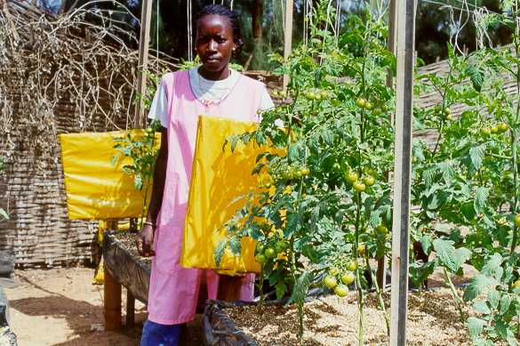

Slide 33
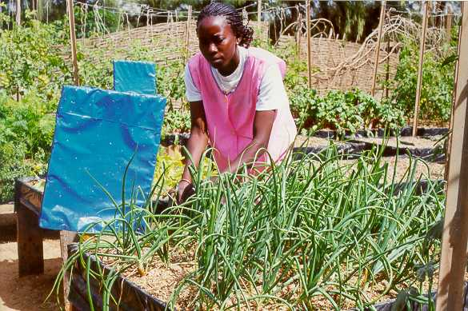

Slide 34
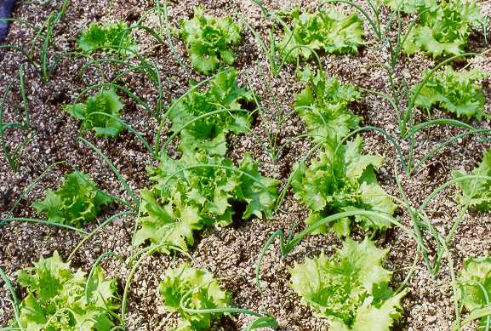

Slide 35
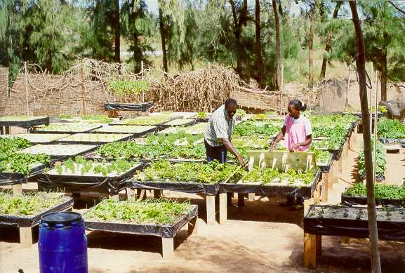

Slide 36
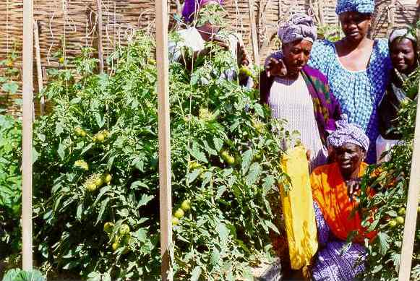

Slide 37
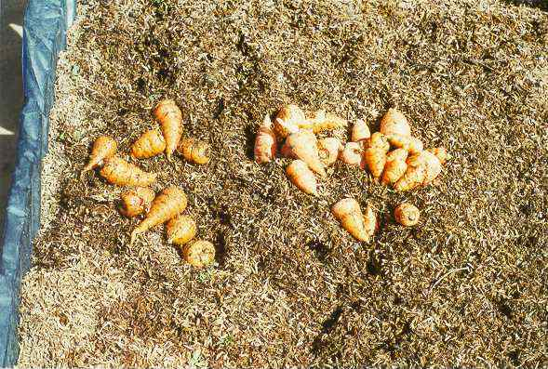

Slide 38
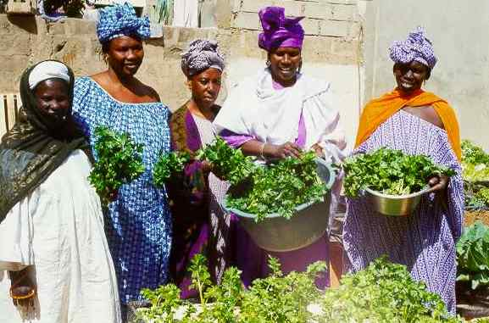

Slide 39
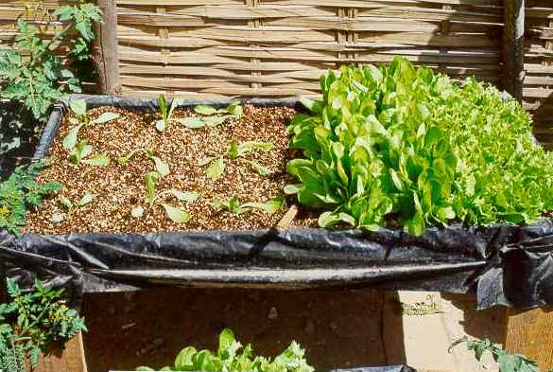

Slide 40
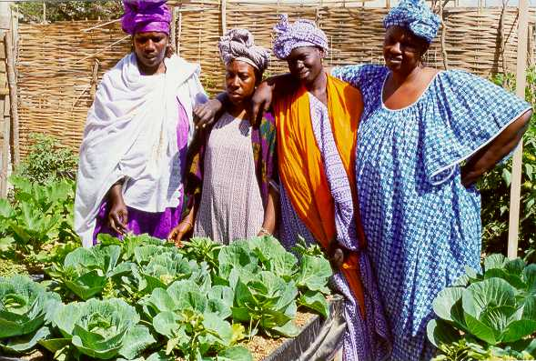

Slide 41
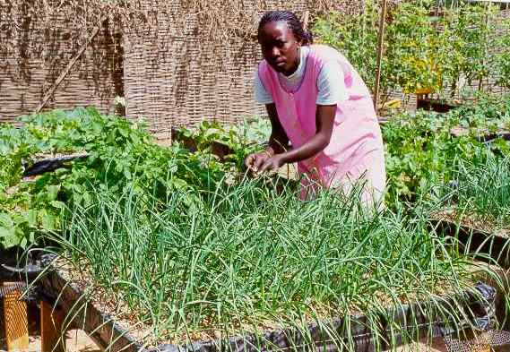

Slide 42
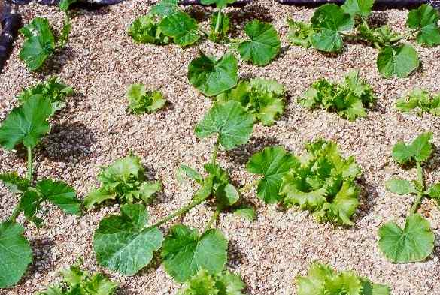

Slide 43
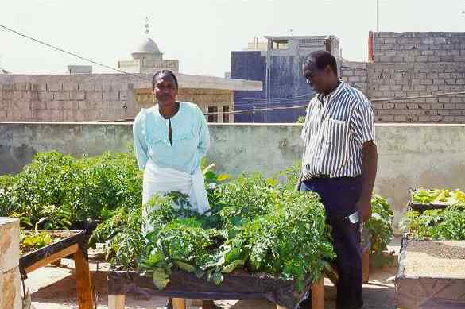

Slide 44
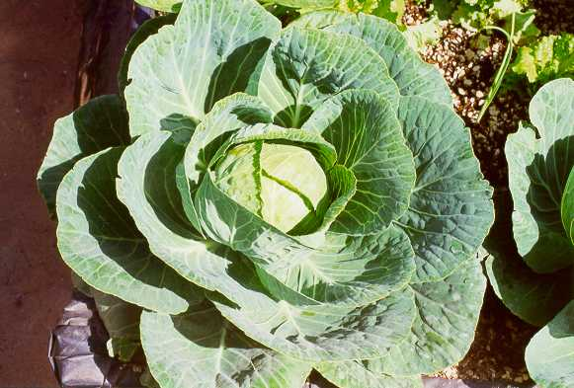

Slide 45
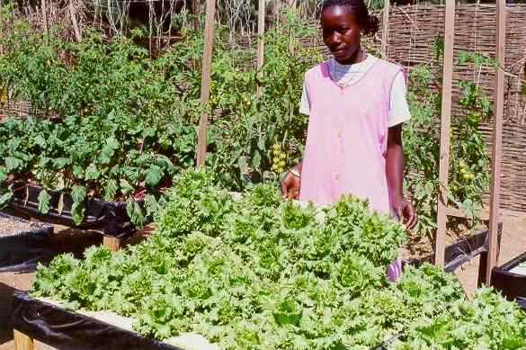

Slide 46
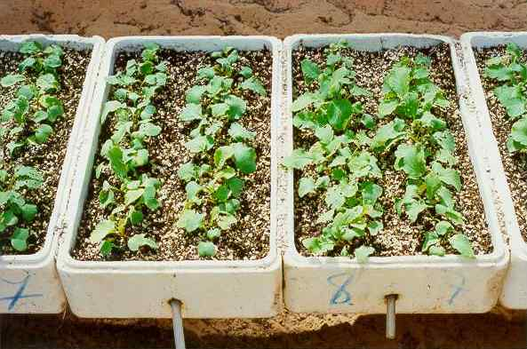

Slide 47
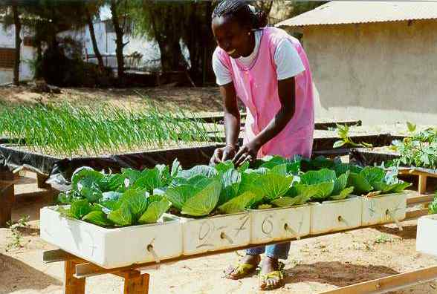

Slide 48
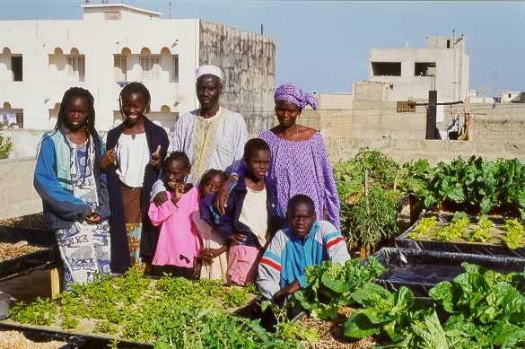

Slide 49
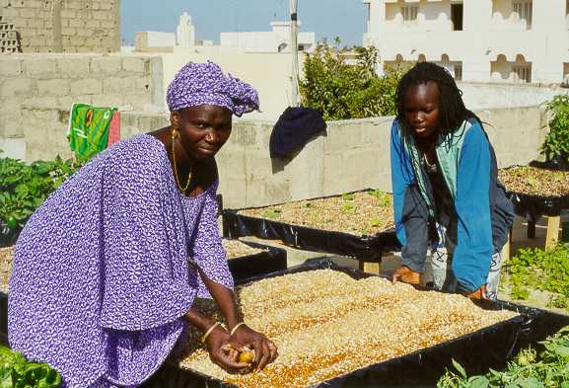

Slide 50
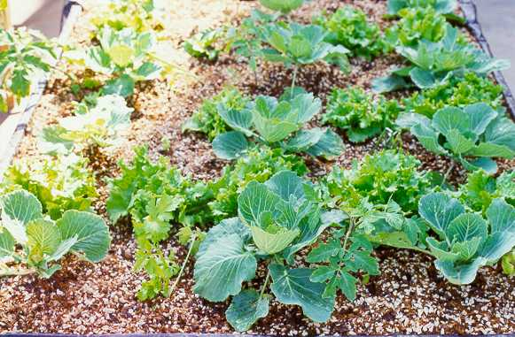

Slide 51
