Slide 1
Regional Roundtable on
World Programme for the Census of Agriculture 2020 Port of Spain, Trinidad and Tobago
22-26 May 2017
The Census of Agriculture 2016: Communications Outreach
Technical Session 17
Etienne Saint-Pierre & Mathieu Thomassin Statistics Canada
etienne.saint-pierre@canada.ca
mathieu.thomassin@canada.ca

Slide 2
Overall Strategy
Encourage on-line completion of electronic questionnaire (EQ)
Partner with agricultural stakeholders to get their support and get the word out!
Promotional materials to highlight how census data is essential for producers, associations and the government to make reasoned decisions
Integration with Census of Population Communication Strategy:
“Your census. Your neighbourhood. Your future.”

Slide 3
Pre-Census Outreach Approach
Farm shows and exhibitions
Seven step approach to contacting agricultural associations to garner “community support”
Engage with governmental entities

Slide 4
Farm Shows and Exhibitions
Census staff ran booths at seven farm shows across Canada with an approximate total of 300 K attendees
Answered visitors questions and comments
Handed out Census promotional materials

Slide 5
Seven Step Approach to get Community Support
Step 0 - Development and verification of lists
Preparation of the list, verification of contacts and input of contact information into a central database
Step 1 - Letter to organizations:
Letters were sent to 483 organizations three months prior to Census Day
Step 2 - First call to organizations
Follow-up calls by outreach officers
310 organizations became active supporters through outreach

Slide 6
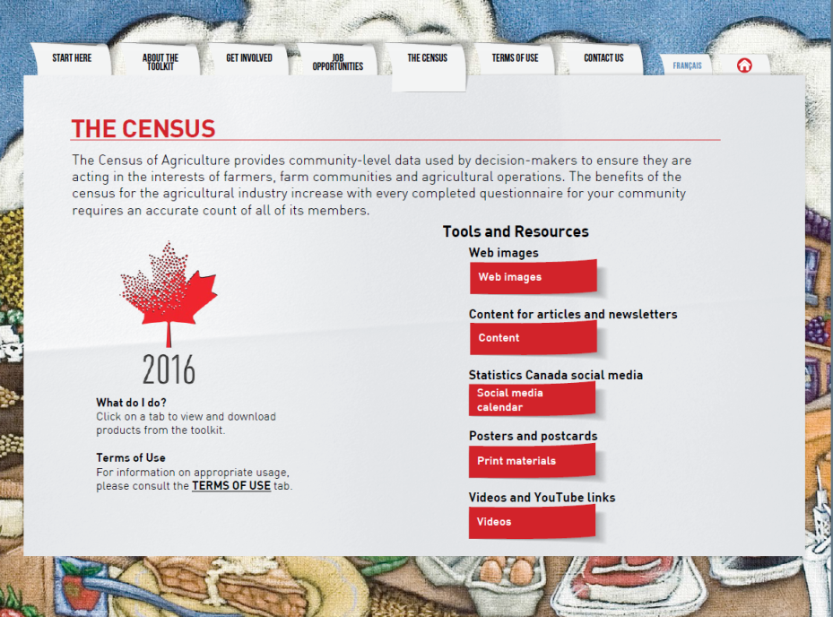
Seven Step Approach to get Community Support (2)
Community supporter toolkit (CST)

Slide 7
Seven Step Approach to get Community Support (3)
Community supporter toolkit (CST) highlights
CST: 85% (263 organizations) requested the CST
Articles: 71% (220 organizations) used ‘2016 Census of Agriculture benefits farmers’
Graphics: 41% (126 organizations) requested the CEAG image/look
Social media calendar: 32% (98 organizations) requested the calendar
Web banners: 26% (80 organizations) requested the CEAG web banner

Slide 8
Seven Step Approach to get Community Support (4)
Step 4 - Implementation support
Outreach officers contacted organizations to verify if they have any questions about the CST and/or downloaded any of the products.
Step 5 - Validation and quantification of reach
Outreach officers contacted the organizations to verify and document usage of CST products and estimated reach.
Step 6 – Thank you Letter
Step 7 – Subscription offer for the census releases

Slide 9
Engage with other governmental entities
Activities:
E-newsletters (January and February)
CEAG image/look on website
Social media calendar
Joint interviews with media

Slide 10
Communication Strategy
Social Media - Two Phases:
Early awareness: April 7 - 30, 2016
Collection: May 2 - July 30, 2016
Facebook, Twitter, YouTube
Editorial Content (Communication firm)
Six articles
One radio segment
One 90 second video

Slide 11
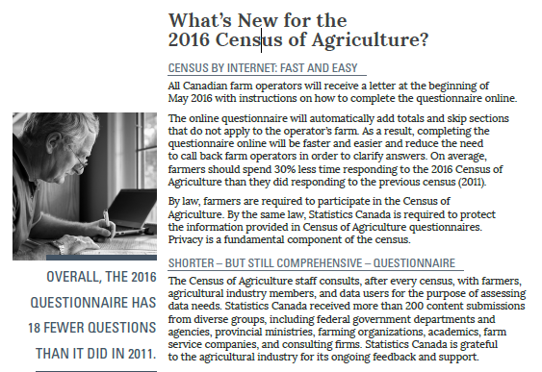
Example: Promotional article

Slide 12
Example: Facebook Post

Slide 13
Example: Popular Tweets

Slide 14
Thank you

