Slide 1
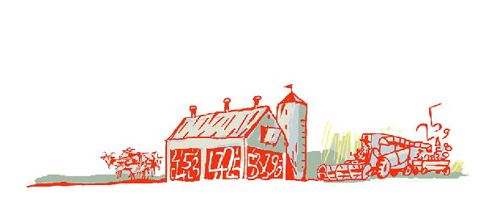
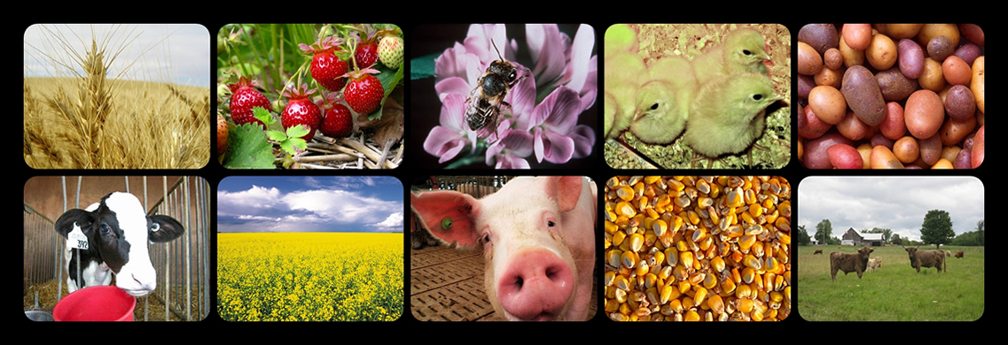
Regional Roundtable on
World Programme for the Census of Agriculture 2020 Port of Spain, Trinidad and Tobago
22-26 May 2017
Theme 1: Identification and General Characteristics – Canada’s Experience
Technical Session 05
Mathieu Thomassin
Director of the Agriculture Division
Statistics Canada
mathieu.thomassin@canada.ca

Slide 2
Presentation outline – the list of items
0101 | Identification and location of agricultural operations
0102 | Respondent for the agricultural operation
0103 | Legal status of agricultural operation
0104 | Sex of agricultural operators
0105 | Age of agricultural operators
0106 | National/ethnic group of household head or agricultural operator
0107 | Main purpose of production of the agricultural operation
0108 | Other economic activities of the household
0109 | Proportion of income from operation’s agricultural production in household’s total income
0110 | Main agricultural activity of the holding 
0111 | Presence of hired manager of the agricultural holding
0112 | Sex of hired manager of the agricultural holding
0113 | Age of hired manager of the agricultural holding

Slide 3
Agricultural Operator & Operations VS Farmer & Farms
The Census of Agriculture (CEAG) uses the word operator to define a person responsible for the management and/or financial decisions made in the production of agricultural commodities. An agricultural operation can have more than one operator, such as a husband and wife, a father and son, two sisters, or two neighbours.
The terms "agricultural operator" and "operation" are used in the census because they are broader in scope than "farmer" and "farm", and better reflect the range of agricultural businesses from which the Census of Agriculture collects data. For example, the term farm would not usually be associated with operations such as maple sugar bushes, mushroom houses, ranches or feedlots.

Slide 4
Identification and location of agricultural operations
Business Register (BR) Contents
Legal Base (Admin) | Statistical BR’s additional information
 | Profiling Activities | Statistical Indicators | Collection Entities
Business Number Operating/Legal Names Address Telephone # Contact Name Activity Description Legal Type Number of employees Salaries and Wages Revenue / Asset Sales Non-Profit Indicators International Activity Code | Operating Entity Number NAICS Links: Ownership Ultimate Parent Country of Control Links: Operating Entities Operating Entities Accounting Types OE Names and Addresses Profiled Revenue Profiled # of Employees Consolidation Information with Attributes | Enterprise Company Establishment Location | Contact Name Address Telephone # Survey Identifier Frequency Coverage Response Burden Indicators __________________ Additional Information Survey Specific Fields Additional Production & Measures

Slide 5
Identification and location of agricultural operations (2)
Statistics Canada’s Business Register
Updated with signals from regular production and financial surveys
Tax data
Agricultural Frame Update Survey
Multiple sources of administrative data
Administrative lists (quotas, crop insurance, traceability, etc.) and Earth observation data

Slide 6
Identification and location of agricultural operations (3)
Questions on the Census of agriculture
Business number issues by the Canada Revenue Agency
Operating name of the farm
Legal or Corporation name (if applicable)
Civic address
Self identification on the Census of Population
Is anyone listed in the Census of population a farm operator who produces at least one agricultural product intended for sale?
Does this farm operator make the day-to-day management decisions related to the farm?

Slide 7
Identification and location of agricultural operations (4)
Operators
Questions on the Census of agriculture
The CEAG allows for up to three operators per farm
First and last name of each of the operators
Gender and Age of each operator on census day: This is vital for producing age demographics and gender analysis of operations.
Telephone number and postal code

Slide 8
Identification and location of agricultural operations (5)
Main Farm Location
The main farm location refers to the location where the main agricultural activities take place
It can be the farm headquarter, main farm building, or main gate of the farm operation
The main farm location can be different from the home address information for the operators
This question further ensures all farms are included and that duplication of agricultural operations is avoided in the Census of Agriculture

Slide 9
Respondent for the agricultural operation
The Census of Agriculture first collects information on the person completing the questionnaire.
This is new as of 2016 CEAG. By requesting the contact information for the person completing the questionnaire, it is no longer necessary to request the contact information for each operator as it was done in previous censuses.
Contact information of respondent:
Name, Address, Telephone number, Mailing address, Name of village, town or city, Province, Postal code, E-mail

Slide 10
Legal status of agricultural operation
Questions on the Census of agriculture
What is the operating arrangement of this operation?
Sole proprietorship - An unincorporated business entirely owned by one person.
Partnership without a written agreement
Partnership with a written agreement
Family corporation (including corporations with one or more shareholders)
Non-family corporation

Slide 11
Legal status of agricultural operation

Slide 12
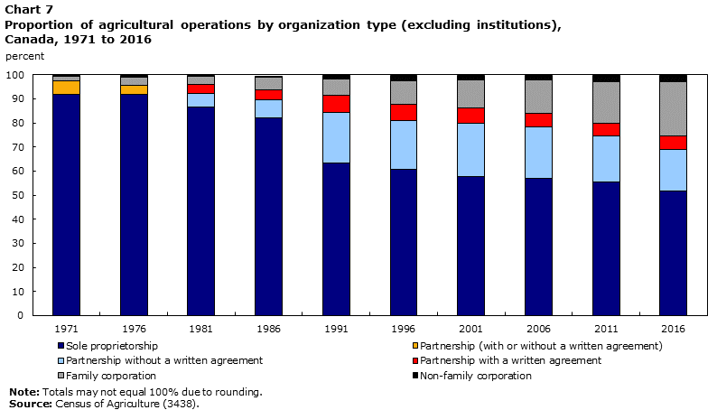
Legal status of agricultural operation

Slide 13
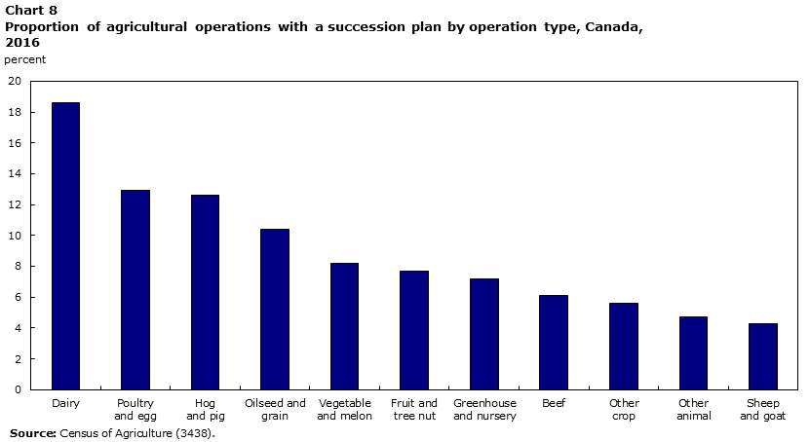
Succession Plan

Slide 14
Sex and Age of agricultural operator
Farm operators by sex and age, Canada, 2001 to 2016
 | 2001 |  | 2006 |  |  | 2011 |  | 2016
 | Operators
 | number | % of total | number | % of total |  | number | % of total | number | % of total
All operators in Canada | 346,195 | 100% | 327,055 | 100% |  | 293,928 | 100% | 271,938 | 100%
Under 35 | 39,920 | 11.5% | 29,925 | 9.1% |  | 24,116 | 8.2% | 24,847 | 9.1%
35 to 54 | 185,575 | 53.6% | 164,160 | 50.2% |  | 127,893 | 43.5% | 98,842 | 36.3%
55 and older | 120,705 | 34.9% | 132,975 | 40.7% |  | 141,919 | 48.3% | 148,249 | 54.5%
Median age | 49 |  | 51 |  |  | 54 |  | 55
Males | 255,015 | 73.7% | 236,220 | 72.2% |  | 213,261 | 72.6% | 193,967 | 71.3%
Under 35 | 29,430 | 8.5% | 22,170 | 6.8% |  | 17,873 | 6.1% | 18,284 | 6.7%
35 to 54 | 132,060 | 38.1% | 114,695 | 35.1% |  | 89,635 | 30.5% | 68,470 | 25.2%
55 and older | 93,530 | 27.0% | 99,360 | 30.4% |  | 105,753 | 36.0% | 107,213 | 39.4%
Median age | 49 |  | 52 |  |  | 54 |  | 56
Females | 91,180 | 26.3% | 90,835 | 27.8% |  | 80,667 | 27.4% | 77,971 | 28.7%
Under 35 | 10,490 | 3.0% | 7,755 | 2.4% |  | 6,243 | 2.1% | 6,563 | 2.4%
35 to 54 | 53,510 | 15.5% | 49,465 | 15.1% |  | 38,258 | 13.0% | 30,372 | 11.2%
55 and older | 27,175 | 7.8% | 33,615 | 10.3% |  | 36,166 | 12.3% | 41,036 | 15.1%
Median age | 48 |  | 50 |  |  | 53 |  | 55
Source: Statistics Canada, Census of Agriculture, 2001 to 2016

Slide 15
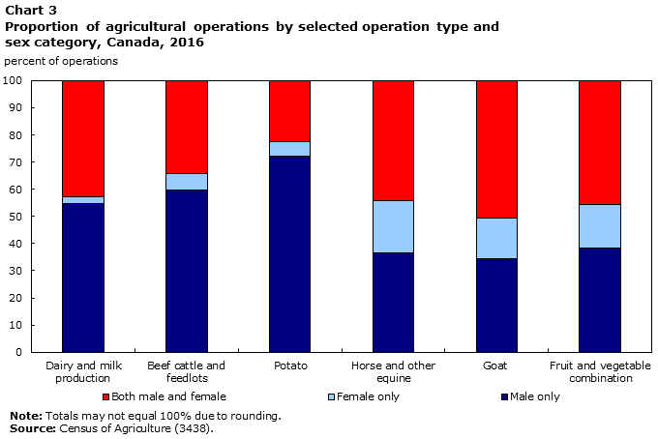

Slide 16
Total number of operator by age group

Slide 17
Age distribution of farm operators

Slide 18
National/ethnic group of household head or agricultural holder
In the Canadian Census of Agriculture, there is no question about national and ethnic groups of the operator/farmer.
However, in order to conduct socio-economic analysis of farm operators, the results of the Census of Agriculture can be linked with the Census of Population.

Slide 19
Main purpose of production of the operation 
The target population of the Census of Agriculture is:
All agricultural operations in Canada that produce any agricultural products with the intention to sell.
Farms with very low farm revenues—commonly called "hobby" farms—are included as long as the agricultural products produced are intended for sale.
The CEAG does not collect data from individuals or households who produce agricultural products for own consumption only.

Slide 20
Other economic activities of the household
Off Farm work
Average time contributed to all other work
As many farm operators use their agricultural operation to supplement income from a full-time job, this question also helps identify the trends in the profile of farm operators

Slide 21
Farm work of each operator
Average the operator’s time worked on the farm over the year to allow for the seasonality of farming.
Respondents include the time spent doing custom work for others, work on the farm, farm office, dealing with suppliers and clients, and work on agricultural associations and boards.
This question is important to identify the trends in the profile of farm operators

Slide 22
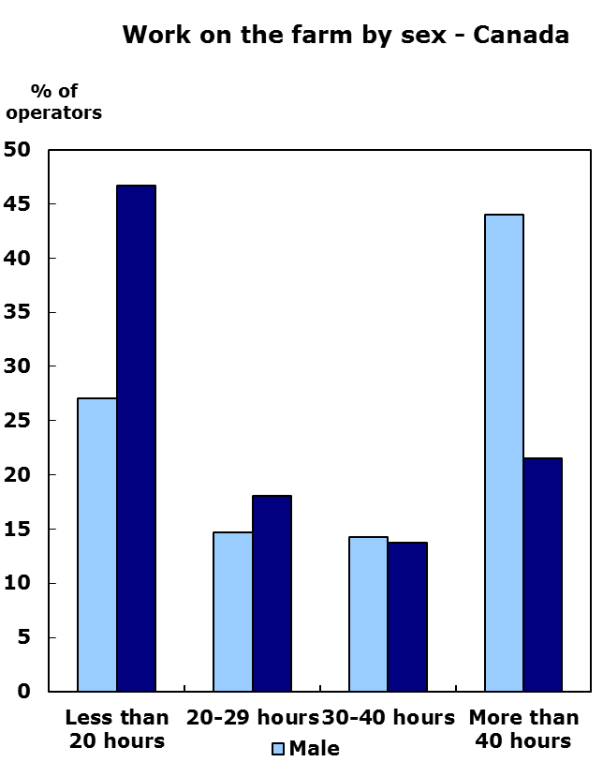
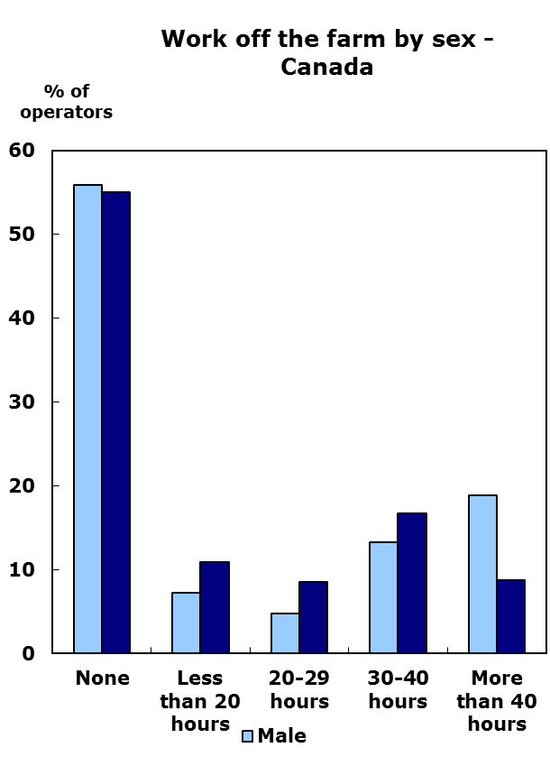
On and Off farm work in Canada
Source: Statistics Canada, Census of Agriculture, 2016

Slide 23
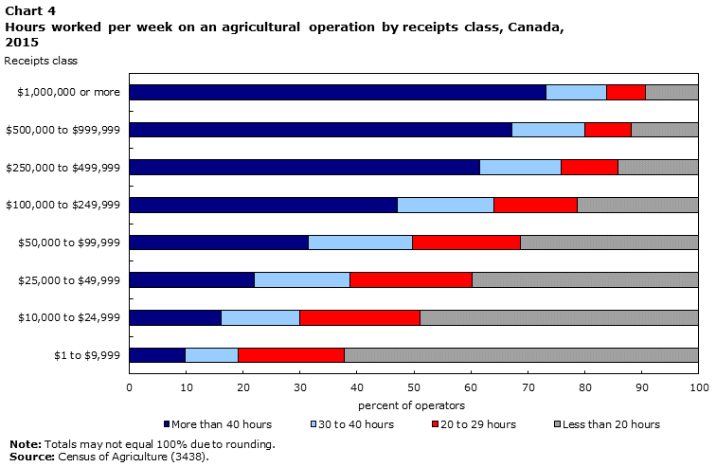
On and Off farm work in Canada

Slide 24
Proportion of income from operation’s agricultural production in household’s total income

Slide 25
Main agricultural activity of the operation
Source: Statistics Canada, Census of Agriculture, 2011 and 2016

Slide 26
Thank you

