Slide 1
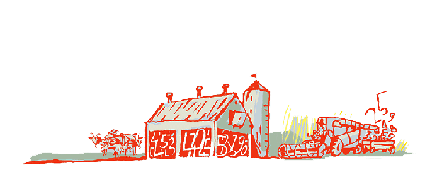
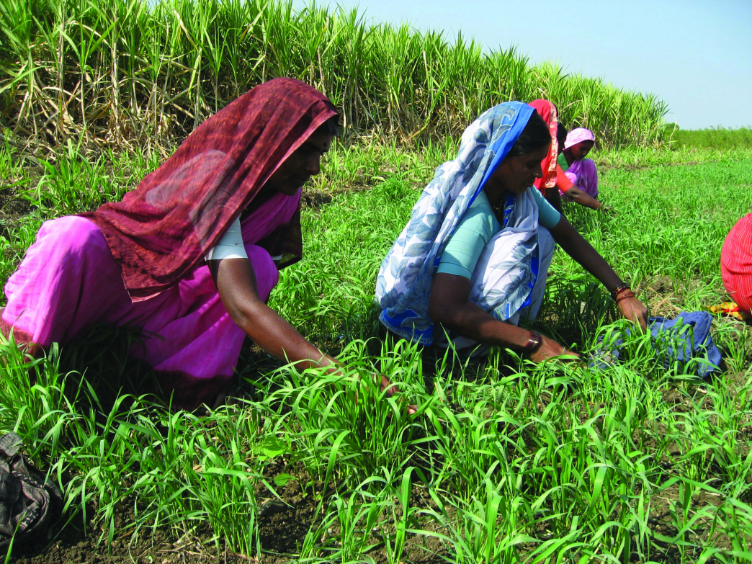
Regional Roundtable on
World Programme for the Census of Agriculture 2020 Port of Spain, Trinidad and Tobago 22-26 May 2017
Theme 6 and 7: Agricultural practices and Services for Agriculture
Technical Session 10
Oleg Cara
Agricultural Census and Survey Team
FAO Statistics Division

Slide 2
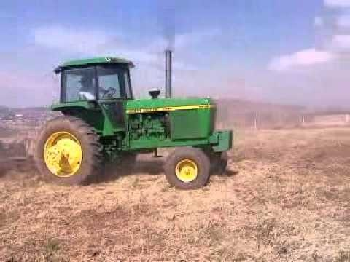
Contents
Background
Importance of the theme
Items, concepts and definitions
Country experiences

Slide 3
Background
In the WCA 2020 Programme this theme has been extended to better cover some critical elements of sustainability in production systems.
Five new items appear in comparison with the last WCA Programme.
Notes:
The Theme on Agricultural Practices has been extended to better cover some critical elements of sustainability in production systems.
It covers only those items suitable for collection in the agricultural census and therefore does not provide a comprehensive set of items needed to measure sustainability of agricultural practices.
Five new items appear in coparison with the last WCA Programme.

Slide 4
Importance of the theme
Countries are more and more aware of the role of agricultural practices in assuring sustainability of agricultural production systems.
Data collected through the agricultural census:
help to measure the adoption of and transition to improved agricultural practices and structural changes that increase and improve the provision of goods and services in agriculture in a sustainable manner.
contribute to defining and measuring key indicators of resource use efficiency and resilience.
Notes:
Countries are more and more aware of the role of agricultural practices in assuring sustainability of agricultural production systems.
Data collected through the agricultural census will help to measure the adoption of and transition to improved agricultural practices and structural changes that increase and improve the provision of goods and services in agriculture in a sustainable manner.
These data can also contribute to defining and measuring key indicators of resource use efficiency and resilience.

Slide 5
Items
Theme 6 comprises :
12 items included specifically in the theme
5 items related to agricultural practices which correspond to other themes:
Whether agroforestry is practised (1304 - Theme 13)
Type of animal grazing practices (1501-Theme 15);
Use of each type of fertilizer (0411-Theme 4);
Area fertilized (0412-Theme 4)
Items on Irrigation (Theme 3)
Notes:
Theme 6 comprises 17 items:
12 are included specifically in the theme
The other 5 although related to agricultural practices, correspond to other themes:
Whether agroforestry is practised (Theme 13)
Type of animal grazing practices (Theme 15); This item is covered in Theme 15 GHG
Use of each type of fertilizer (Theme 4); This item is covered in Theme 4: Use of fertilizers and wheather organic or inorganic practices are followed is important for sustainable agricultural practices.
Area fertilized for each type of fertilizer and major crop type (Theme 4)
Irrigation practices are also important for understanding of sustainable agricultural practices (Theme 3)
These last 5 items have been relisted to highlight their contribution to sustainable practices.

Slide 6
Items (contd)
The 12 items specific to Theme 6 are:
0601 Use of agricultural pesticides | 0607 Use of organic agricultural practices
0602 Use of genetically modified seeds | 0608 Type of seed for each major crop type
0603 Use of genetically modified seeds according to crop type | 0609 Source of seed inputs for each major crop type
0604 Selected machinery and equipment used on the holding by source | 0610 Types of tillage practices
0605 Non-residential buildings | 0611 Presence of conservation agriculture
0606 Percentage of each major agricultural product sold | 0612 Presence of soil conservation practices

Slide 7
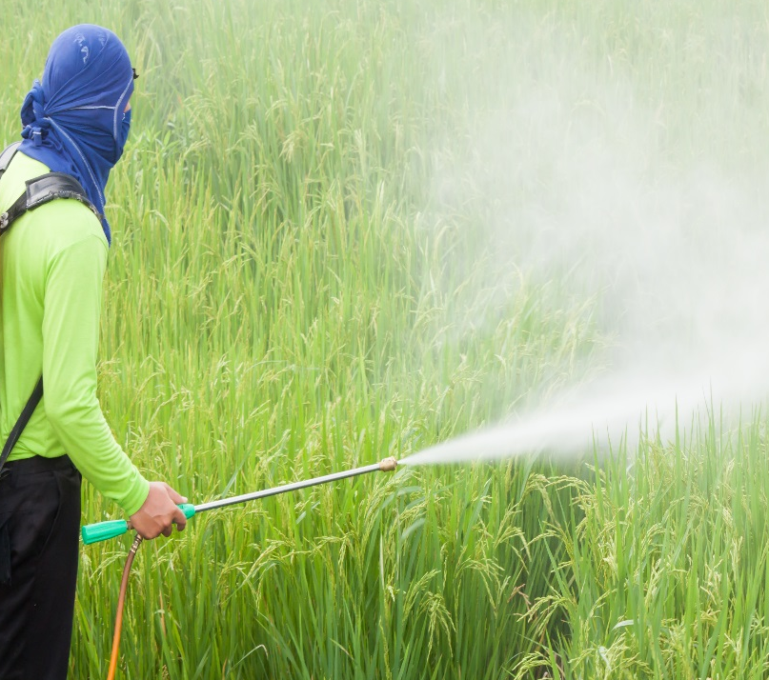
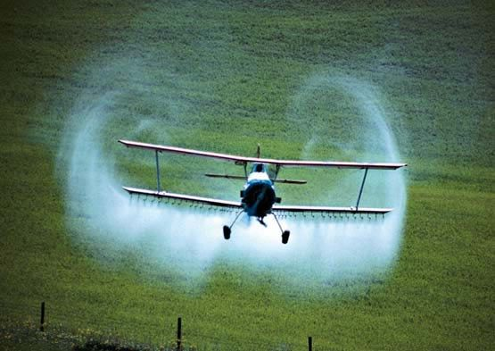
Item 0601: Use of agricultural pesticides (for the holding)
Type: Essential item
Reference period: census reference year
Concept: Pesticides are materials intended to mitigate, control or eliminate pests in plants or animals, or to control the behaviour of physiology of pests or crops during production or storage.
Pesticides may be:
Insecticides (substances used to kill/repel insects)
Herbicides (substances used to destroy or inhibit the growth of plants such as weeds)
Fungicides (substances that destroy or inhibit the growth of fungi)
Rodenticides (substances used to kill/repel/control rodents)
Other
Notes:
Essential items:
Part of the items considered the minimum data set that all countries should collect, regardless the methodological approach used.
They are important to compile the minimum set of national indicators on the agricultural sector needed for agricultural policy making and planning. Data for this item are required for small administratuve units such as district village.
Pesticides (sometimes called ‘’agricultural chimicals’’)

Slide 8
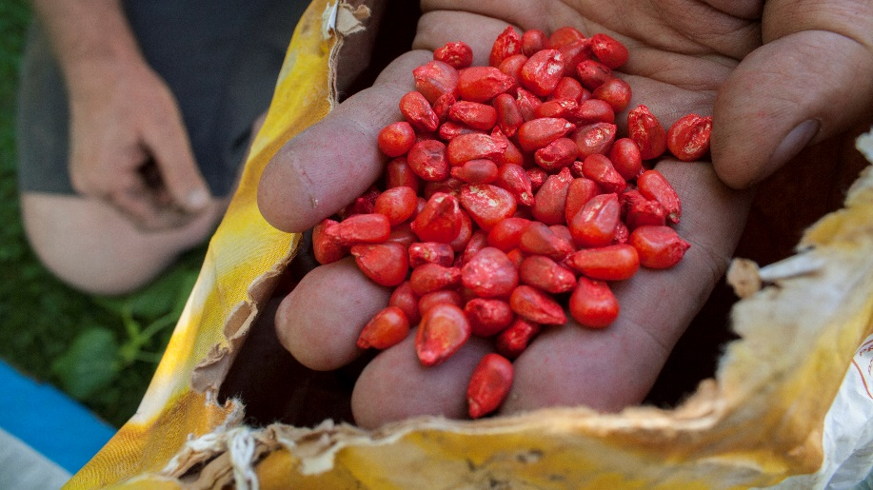
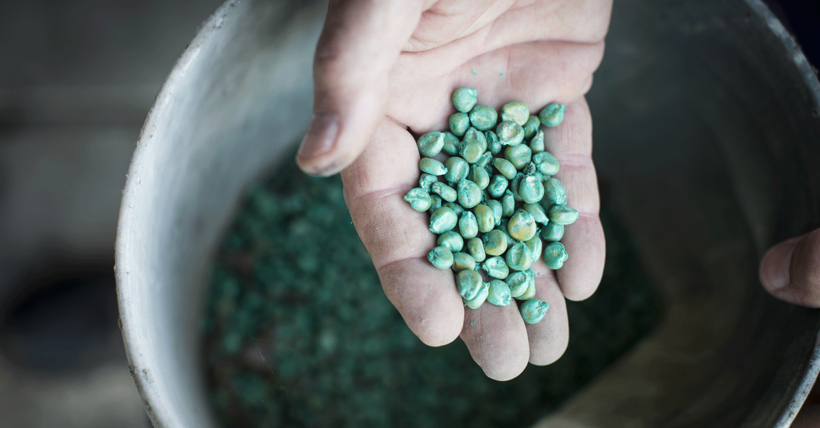
Item 0602: Use of genetically modified (GM) seeds (for the holding)
NEW ITEM
Type: Frame item
Reference period: census reference year
Concept: This item relates to whether any GM seeds were used on the holding. GM crops are grown from GM seeds which are developed and proprietary by the private sector and which poses a novel combination of genetic material obtained through the use of modern biotechnology
Notes:
This is a frame and new item and component of an existent additional item ‘’0603’’ Use of genetically modified (GM) seeds according to crop type’’ in the WCA 2020 Programme. Is directly relevant to frame construction for the suplementary modules for countries using the Modular Approach and for subsequent surveys.

Slide 9
Item 0603: Use of genetically modified (GM) seeds according to crop type (for the holding)
Type: Additional item
Reference period: census reference
year
Concept: This item relates to what types of GM seeds were used on the holding. It identifies the specific types of GM crops that are grown using GM seeds.
Notes:
This item is an additional item that can be included in the census if appropariate for country with no distinction regarding their particular suitability for the classical or modular approach.

Slide 10
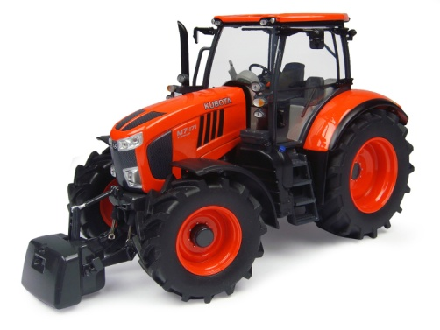
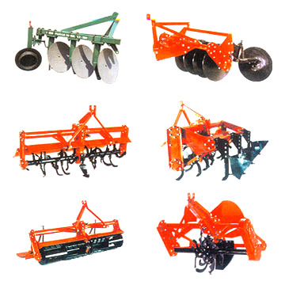
Item 0604: Selected machinery and equipment used on the holding by source (for the holding)
Type: Additional item
Reference period: census reference year
Concept: This item identifies machinery and equipment used on the holding, wholly or partly for agricultural production. It should exclude:
Machinery and equipment used exclusively for purposes other than agricultural production
Machinery and equipment owned by the holder but not used
It includes all machinery, equipment and implements.
Note: In Vol I, Annex 7 a classification of machinery and equipment is provided in order to help identify the type of machinery and equipment to take in the census.
Notes:
A broad concept of machinery and equipment is used for the agricultural census, covering all machinery, equipment and implements used as inputs to agricultural production. This inlcudes everythink from simple hand tools such as HOE, to complex machinery
Examples are: harvesters, tractors, complex machinery, animal powered equipment, hand tools. It includes all type but the main interest centres on farm mechanizatio

Slide 11
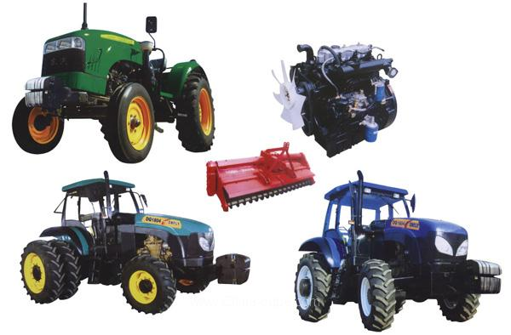
Item 0604: Selected machinery and equipment used on the holding by source (for the holding) contd.
Concept: Source refers to the means by which the holder obtained the right to use the specific item. The following categories are suggested:
Owned solely by the holder or members of his (her) household;
Owned by the holding jointly with other holdings;
Provided by the landlord;
Provided by other private holders (excluding cooperatives);
Provided by a cooperative;
Provided by a private agricultural service establishment;
Provided by a government agency.
Notes:
Examples are: harvesters, tractors, complex machinery, animal powered equipment, hand tools. It includes all type but the main interest centres on farm mechanizatio

Slide 12
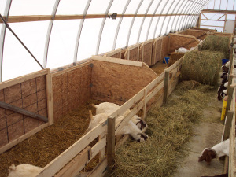
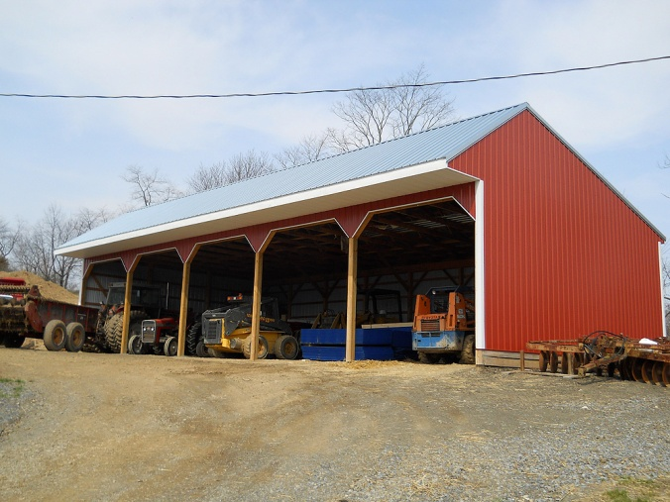
Item 0605: Non-residential buildings (for the holding)
Type: Additional item
Reference period: census reference year
Concept: This item identifies non-residential buildings used by the holding, wholly or partly for agricultural purposes.
Notes:
The item covers all non-residential buildings regardless of their physical location
Buildings such as “community storage facilities” should be included as “other tenure” form;
Non-residential buildings used exclusively for purposes other than agricultural purposes should be excluded.
Data to collect: Number, tenure and size of each building.

Slide 13
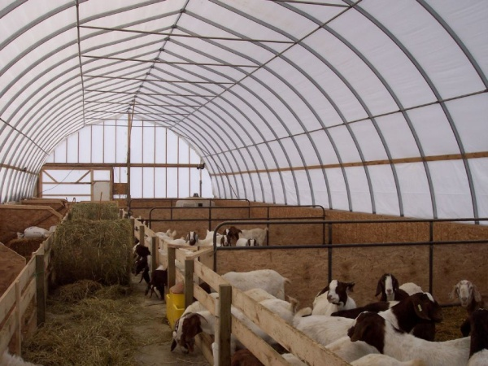
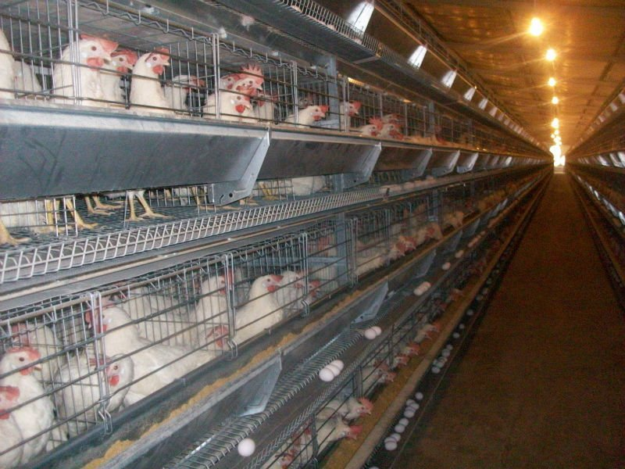
Item 0605: Non-residential buildings (for the holding) (contd.)
Type of non-residential building:
For keeping livestock other than poultry (area)
For keeping poultry (area)
For storing agricultural products (area and volume)
For mixed or other purposes (area)
Type of tenure:
Owned
Rented
Other
Notes:
Identification in the category “For storing agricultural products (area or volume)” together with the detailed categories of Item 0107 “Main purpose of production of the holding” can be used to develop a frame of holdings for a more detailed survey of farm food stocks for sale. For instance, it would allow development of a frame of grain producers entering into the market – that is, holdings with storage facilities producing mainly for sale or mainly for own consumption with some sales, while identifying the capacity of the storage facility.
When intended for the purpose of creating a frame for a detailed stocks survey, the following more detailed categories are recommended for the category “For storing agricultural products (area or volume)” in order to identify the relevant types of storage facilities used by the holding :
‹ For grain crops (area or volume)
‹ For root crops (area or volume)
‹ For fruit and vegetable crops (area or volume)
‹ For livestock products (area or volume)
‹ For other agricultural products (area or volume)

Slide 14
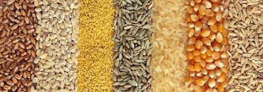
Item 0606: Percentage of each major agricultural product sold (for the holding)
Type: Additional item
Reference period: any suitable reference period, such as the main harvest or the census reference year.
Ranges: Usually, this item is collected in ranges, such as
0-19 percent;
20-49 percent;
50 percent or more.
Where is this item important? In countries with significant home consumption of agricultural produce.
Which products should include? Only the most important staple food crops (such as rice, wheat, maize or cassava).

Slide 15
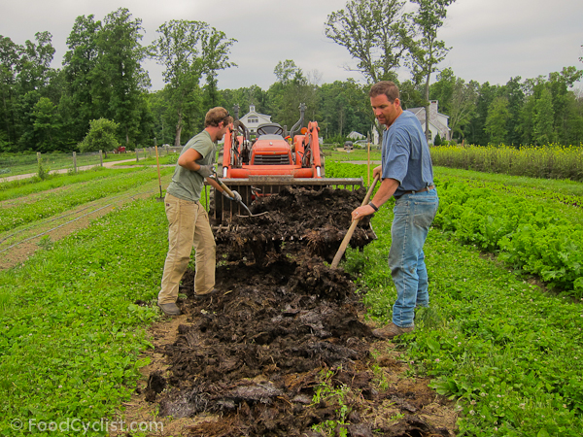
Item 0607: Use of organic agricultural practices (for the holding)
Type: Additional item
Reference period: census reference day
Concept: Organic agriculture is a holistic production management system which promotes and enhances agro-ecosystem health, including biodiversity, biological cycles and soil biological activity*. It includes working toward the achievement of socially, ecologically and economically sustainable agro-ecosystems such as by not using chemical fertilizers, pesticides or GM crops.
Notes:
What is organic agriculture?
According to the Codex definition adopted by the Codex Alimentarius Commission FAO/WHO – Codex Alimantarius Commission 1999
http://www.fao.org/organicag/oa-faq/oa-faq1/en/
http://www.fao.org/docrep/meeting/X0075e.htm
Most recently, the Codex Committee on Food Labelling has debated "Draft Guidelines for the Production, Processing, Labelling and Marketing of Organically Produced Foods"; adoption of a single definition for organic agriculture by the Codex Alimentarius Commission is expected at its next meeting in June, 1999. According to the proposed Codex definition, "organic agriculture is a holistic production management system which promotes and enhances agro-ecosystem health, including biodiversity, biological cycles, and soil biological activity. It emphasises the use of management practices in preference to the use of off-farm inputs, taking into account that regional conditions require locally adapted systems. This is accomplished by using, where possible, agronomic, biological, and mechanical methods, as opposed to using synthetic materials, to fulfil any specific function within the system."
7. Organic agriculture is one of several approaches to sustainable agriculture and many of the techniques used (e.g. inter-cropping, rotation of crops, double-digging, mulching, integration of crops and livestock) are practised under various agricultural systems. What makes organic agriculture unique, as regulated under various laws and certification programmes, is that: (1) almost all synthetic inputs are prohibited,³ and (2) `soil building' crop rotations are mandated.⁴

Slide 16
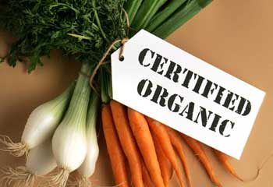
Item 0607: Use of organic agricultural practices (for the holding) contd.
Data collection should include:
Certified organic by a third party accredited certification body or authority or through Participatory Guarantee System (PGS).
In-conversion to certified organic: covering producers undergoing a conversion process to organic agricultural systems certified by third party certification bodies.
It is also possible to recognize non-certified (de facto) organic agriculture or products, which involve agricultural production systems that follow the principles of organic production but are not certified by a certification body or PGS. It excludes systems that do not use synthetic inputs by default (e.g. systems that lack soil building practices and degrade land).

Slide 17
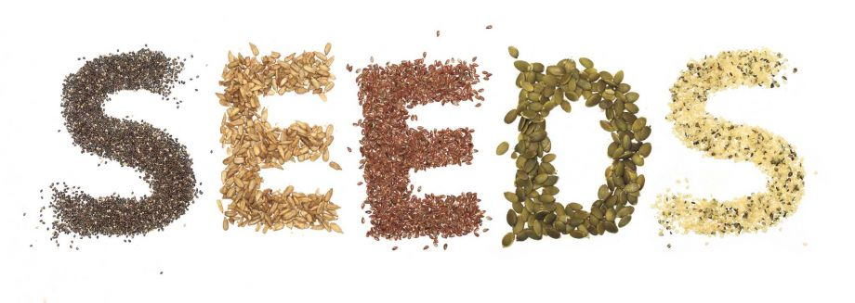
Item 0608: Type of seed for each major crop type (for the holding)
Type: Additional item
Reference period: census reference year
Concept: This item refers to whether certified seeds are being used and whether it belongs to a modern or farmer’s variety. Certified seeds are those that have been certified according to the national certification system.
Types of seeds:
Certified seed of modern variety;
Uncertified seed of modern variety (high yielding or high-response varieties);
Uncertified seed of farmer’s variety (landraces or traditional)
Other.

Slide 18
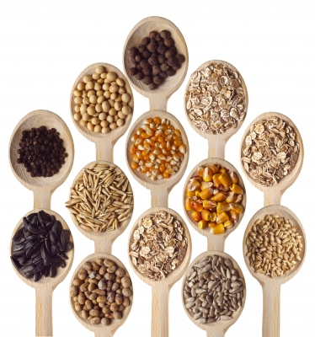
Item 0609: Source of seed inputs for each major crop type (for the holding)
Type: Additional item
Reference period: census reference year
Concept: This item refers how seeds were acquired. The term “seed” in this context refers to any planting material: seed, seedlings, cuttings, small plants or trees
Types of sources:
Self-production: obtained by setting aside a portion of the previous year crop for use as seed for the current crop;
Exchanges with community: seeds obtained through loans, gifts or other forms of reciprocal assistance;
Local market: seeds purchased from markets, itinerant traders or localized trade networks;
Seed company: seeds purchased from a seed producer or supplier through a commercial arrangement;
Donation: from national or international institutions.

Slide 19
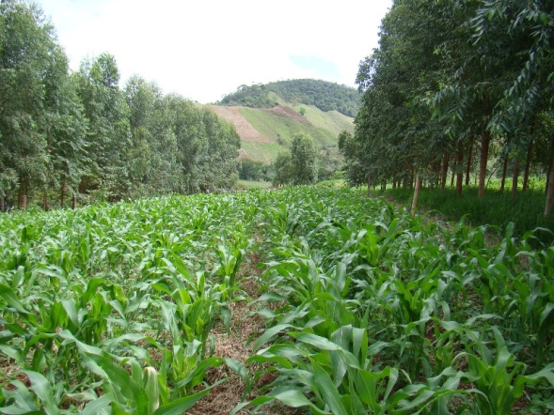
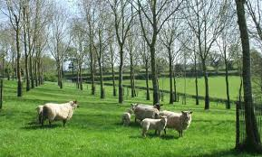
Item 1304: Whether agroforestry is practiced (for the holding)
This item corresponds to Theme # 13 (Forestry)
Type: Frame item
Reference period: census reference year
Concept: Agroforestry is a sustainable land management system in which forest species of trees and other wooded plants are purposely grown on the same land as agricultural crops or livestock, either concurrently or in rotation.
Agroforestry has impact on soil, water, plants, animals and atmospheric relations, constituting a sustainable agricultural practice.

Slide 20
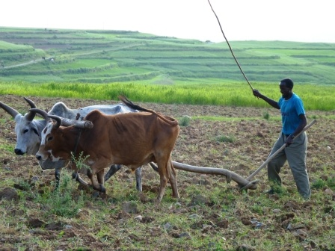
Item 0610: Types of tillage practices (for the holding)
Type: Additional item. New item.
Reference period: census reference year
Concept: Tillage refers to arable land of the holding sown/cultivated in the census reference year. It is the physical loosening of the soil carried out in a range of cultivation operations, either by hand or mechanized.
Which is the reason to include this new item?
Tillage practices are controversial: it was traditionally seen as useful and necessary but when inappropriately practiced, it is one of the major reasons for soil erosion and land degradation. It is a common understanding that tillage practices should be reduced to a minimum in order to achieve sustainable intensification of agriculture.

Slide 21
Item 0610: Types of tillage practices (for the holding) contd.
Types of tillage practices:
Conventional tillage (turning over of the soil over the whole area using tillage tools or equipment such as: mouldboard, disc plough, rotovator, etc. or traditional ploughs of either wood or iron, drawn by animal power;
Conservation (low) tillage which is a tillage practice or practices that leave plant residues (at least 30-35 %) of the soil surface for erosion control and moisture conservation. It can include:
Reduced/minimum tillage: there is no soil inversion and causes little compaction but it leaves some ripping lines (the soil normally remains with a good cover of residues on the surface). A ripper is usually used;
Strip tillage: strips are tilled to receive the seed and the soil along the bands is not disturbed;
Ridge tillage: system of ridges and furrows. The ridges can be permanent or be constructed each year.
Zero tillage or no tillage: does not involve any tillage operations on arable land. After the seeding operation, not more than 25% of the soil surface is allowed to be disturbed.

Slide 22
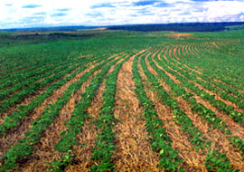
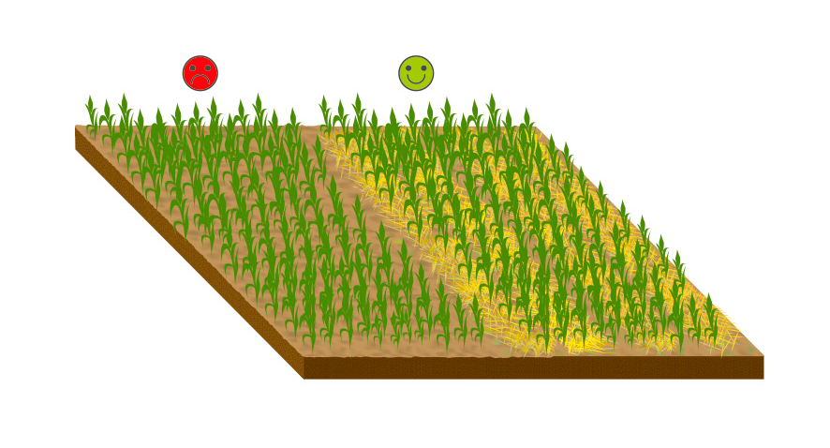
Item 0611: Presence of conservation agriculture (for the holding)
Type: Additional item. New item
Reference period: census reference year
Concept : In addition to sustainable tillage practices, it is also important to keep soils covered for protecting them from the impacts of climatic conditions in order to achieve sustainable intensification of agriculture.
Three Conservation Agricultural Principles:
Zero/no tillage (Item 0610) in combination with
Crop rotations (Item 0612)
Permanent soil cover.
Notes:
When covered, soils are better protected from the physical impact of water, wind and direct insolation (exposure to the sun). Soils can be covered with previous-crop residues or cover crops, which also increase biomass. This farming practice is one of the best ways to turn agricultural land into a carbon sink.

Slide 23
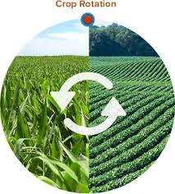
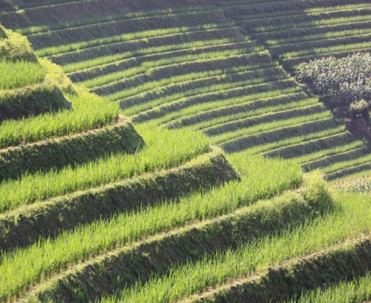
Item 0612: Presence of soil conservation practices (for the holding)
Type: Additional item. New item
Reference period: census reference year
Concept : Soil conservation is a sustainable practice to prevent and reverse soil degradation through appropriate land use and management practices. It includes prevention and reduction of soil erosion, compaction and salinity, conservation or drainage of soil water.
Types of soil conservation practices:
Crop rotation: growing of alternating species or families of crops in a specific in a planned pattern or sequence.
Terracing: terraces on slopping lands mainly used for erosion control and for growing crops.
Notes:
Where feasible, information on the percentage of land area under each type of soil conservation should be taken. Other activies related to crop cover apply to soil conservation but are no recommended for collection during the census.

Slide 24
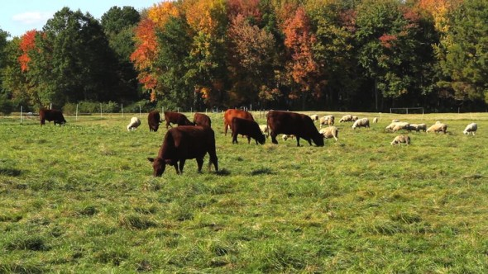
Item 1501: Type of animal grazing practices (for the holding)
This item correspond to Theme # 15 (Environment, GHG emissions).
Type: Additional item. New item
Reference period: census reference year
Concept : Animal grazing is practically the only source of feed for livestock raised under the grazing system (Item 0501).
Which is the reason to include this new item? Animal grazing has a significant impact in the quality of pastures which can be non-degraded, moderately degraded or severely degraded. Combining this information with Theme 5 (Livestock) improves estimation on the status of pastures.

Slide 25
Items 0411 & 0412: Use of each type of fertilizer and area fertilized for each type of fertilizer and major crop type (for the holding)
These items correspond to Theme # 4 (Crops).
Type:
Use of fertilizers: Essential item.
Area fertilized: Additional item.
Reference period: census reference year
Reason to include these items in Theme #6. Use of fertilizers and whether organic or inorganic practices are followed is important for understanding of sustainable agriculture practices.

Slide 26
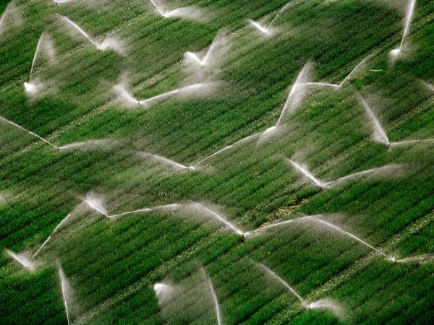
Irrigation
It corresponds to Theme # 3 (Irrigation).
Irrigation practices are important for understanding of sustainable agriculture practices. Relevant items are covered in Theme 3.

Slide 27
Country experiences
Saint Lucia: Agricultural Census 2007
Selected machinery and equipment (manually operated, machine-powered, other machinery/equipment):
Owned
Used in 2006
Use of fertilizers by type on the holding in 2006: 1) Granular (Lime, N.P.K, Sulphate of Ammonia, Urea); 2) Organic (Manure, Plant material); 3) Foliar; 4) Other.
Use of pesticides by type on the holding in 2006 Use and type of used on the holding in 2006:
insecticide, weedcide, nematicide, fungicide,
rodenticide, organic/biological, other.

Slide 28
Country experiences (contd)
Saint Lucia: Agricultural Census 2007
There were used during 2006:
Irrigation
Crop rotation
Farm records
Improved variety of seed/plant
Credit for farming

Slide 29
Regional Roundtable World Programme for the Census of Agriculture 2020 Budapest, Hungary 3-7 April 2017
Theme 7: Services for Agriculture
Technical Session 9
Oleg Cara
Agricultural Census and Survey Team
FAO Statistics Division

Slide 30
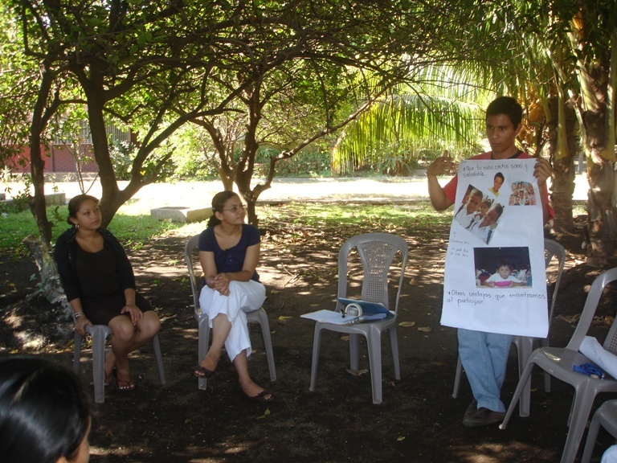
Contents
Background
Importance of Theme 7
Items
Concepts and definitions
Country experiences

Slide 31
Background
Theme 7 refers to services provided for agricultural production mainly from:
Suppliers of credit;
Agricultural information services;
Agricultural extension services.
It also comprises information about travelling time to nearest agricultural produce market.
The theme retains all items as in the WCA 2010.

Slide 32
Importance of Theme 7
The knowledge of services provided to agriculture is an important input for decision makers and researchers in order to assess their influence in agricultural practices and in the final output of agriculture.
A map of the coverage of services can be designed from the information provided by the census of agriculture. Such a map is an important tool for decision-makers.

Slide 33
Items
Theme 7 comprises the following items (all of them to be taken for the holding):
0701 Receipt of credit for agricultural purposes 0702 Sources of credit 0703 Type of collateral for credit 0704 Period of loan or credit 0705 Sources of agricultural information 0706 Sources of agricultural extension services used 0707 Travelling time to nearest periodic or permanent agricultural produce market for selling products.

Slide 34
Concept of credit for agricultural purposes
Credit for agricultural purposes refers to any type of credit approved and available for purposes related to the operation of the agricultural holding.
Notes:
It includes: credit for purchasing crop and livestock inputs, constructing farm buildings, purchasing farm machinery.
It does not include: credit not related to agricultural operations such as for construction of holder’s house, for other family businesses or for consumption expenditure.
The term “credit” is used widely to cover the approved ability to borrow money directly as well as buying goods and services on credit.
Loan is a subset of credit and means financial resources in cash provided by formal or informal sources. “Credit” includes loans (in cash) and any other loan in-kind in the form, for example, of inputs, equipment and machinery.
Notes:
Receipt of credit refers to whether the agricultural holder used a loan for agricultural purposes during the reference year, not whether there were outstanding loans at the time of the census. A holder may have made use of credit on more than one occasion during the year, and therefore more than one source or type of collateral may be reported. Credit received by the holder as well as members of his/her household should be included.
Borrowing money may be done through a lending institution, other organizations, or persons for a specific purpose such as buying a tractor

Slide 35
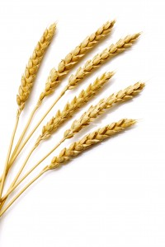
Item 0701: Receipt of credit for agricultural purposes (for the holding)
Type: Additional item.
Reference period: Census reference year.
Concept: Receipt of credit refers to whether the agricultural holder used a loan for agricultural purposes during the reference year and not whether there were outstanding loans at the time of the census. Credit received by the holder as well as members of his/her household should be included.

Slide 36
Item 0702: Source of credit (for the holding)
Type: Additional item.
Reference period: Census reference year.
Concept: Source of credit, refers to who provided the credit. The specific source class will depend on the institutional arrangements for credit in the country.
Typical groups are:
Note: A holder may have made use of credit on more than one occasion during the census reference year and therefore more than one source may be reported.
Commercial bank Agricultural development bank Cooperative credit society Money lender
Input supplier Self-help group Family/friends; Government Other sources.

Slide 37
Item 0703: Type of collateral for credit (for the holding)
Type: Additional item.
Reference period: Census reference year.
Concept: Collateral is defined as assets pledged as security for a loan of money. It means that if the borrower defaults on the terms of the loan, the collateral may be sold and the proceeds used to pay off the loan.
Notes:
In the context of the census, “ collateral” is used in a wider sense to also cover a guarantee provided for the purchase of goods and services.
Types of collaterals are:
The holder’s land
Other assets such as the machinery and equipment purchased with the loan;
Other type of collateral (purchase of goods and services on credit based on agreements to pay at a later date).
Credit may be received without any collateral on a personal guarantee basis.
A holder may have made use of credit on more than one occasion during the census reference year and therefore more than one type of collateral may be reported.

Slide 38
Item 0704: Period of loan or credit (for the holding)
Type: Additional item.
Reference period: Census reference year.
Concept: This item refers to the period over which the loan or credit is to be paid off as agreed at the time the loan was received.
Note: If the credit was received more than once during the reference year, the period to be reported is the one for the loan or credit of highest value.
Typical ranges for reporting on this item are:
Less than 12 months
12-35 months
36 months or more.

Slide 39
Item 0705: Sources of agricultural information (for the holding)
Type: Additional item.
Reference period: Census reference year.
Concept: This item refers to where the holder received information to help manage the agricultural holding.
Sources of agricultural information are:
Examples of type of information included: weather; selection of crop varieties; new agricultural practices; farm machinery; credit facilities; plant diseases and pests; marketing; commodities and crop varieties promoted by the government.
Extension services Radio Television Newspapers | Agricultural newspapers Input agencies Internet Other farmers Other
Notes:
Extension services refers to advice received through government or non-government extension services, and is covered in more detail in Item 0706.

Slide 40
Item 0706: Sources of agricultural extension services used (for the holding)
Type: Additional item.
Reference period: Census reference year.
Concept: Agricultural extension refers to the provision of agricultural advice and information to crop and livestock producers.
Providers of extension services:
Government institutions; Non-government institutions; Farmer organizations; Educational institutions; Informal grassroots organizations; Other
Typical source categories are :
Government organization:
For crop production
For livestock production
Farmer association
Other
Notes:
Item 0706 refers to the source or provider of agricultural extension services used by the holding during the census reference year. It refers to personal contact with extension personnel (including telephone service with user access to a live extension agent) or direct participation in extension activities such as a farm demonstration. It does not include accessing extension material though printed brochures, radio, television, menu-driven recorded telephone messages and services, or the Internet. Also, extension services used should be limited to formal contacts with extension workers specifically employed for that task; advice received from other informal sources should not be included. A farmer may have received extension services from more than one source.
In most countries, the government is the principal provider of extension services through its network of agricultural field staff.
Areas usually covered by extension services:
Farm management; Selection of crop varieties; Use of inputs; Credit; Farm mechanization; Animal health; Plant protection; Sustainable development; Marketing

Slide 41
Item 0707: Travelling time to nearest periodic or permanent agricultural produce market for selling products (for the holding)
Type: Additional item.
Reference period: Census reference year.
Ranges suggested to express the travelling time are:
Up to 30 minutes
More than 30 to 60 minutes
More than 60 to 120 minutes
More than 2 hours.
Notes:
This item is included to help assess how easy is to farmers to access markets.
Sometimes, travelling times vary according to, for example, the wet and dry seasons and some countries may wish to collect these data for the different seasons.
Periodic or permanent agricultural produce market refers to a market where farms can bring their produce for sale and they may operate every day or on certain days of the week.

Slide 42
Country experiences
Haiti: Agricultural Census 2008/2009
In the Holding Questionnaire the following information was collected: Section IX “Information about the credit for agricultural purposes”: Source of credit Family and other individuals Commercial bank Cooperative Input supplier Development project Microcredit institution NGO Purpose of credit Agricultural Inputs Livestock Land Equipment Etc.

Slide 43
Country experiences (contd)
Haiti: Agricultural Census 2008/2009
Section X “Extension services and advices” (actually provided and needs by categories): Crop production Livestock production ( inclusively aviculture, apiculture) Aquaculture Packaging, Storage and Transformation Marketing

Slide 44
Country experiences (contd)
Grenada, Agricultural Census 2012
Where does the farmer sell the products (do not sell, hotel/restaurant, municipal market, road side vending, supermarkets, traffickers/exporters, agro-processors, association, market boarding, farmer’s market, schools other)? Does the farmer belong to Farm Organisations: Fair Trade, GCA, GCNA, Poultry Association, Farm Watch, Livestock Associations, Carriacou Farmers Association? Did the farmer receive any Technical Assistance/Information during the last 12 months from: MOA/DOA, NGO, Farm Organisation, Chinese Mission, Media, CARDI, other institution? Did the farm receive any Credit during the last 12 months from: Development Bank, Commercial Bank, Farm Organisation, Credit Union, MOA, MNIB, NGO, other institution? Production issues: Access Roads, Technical support, Access to credit, etc.

Slide 45
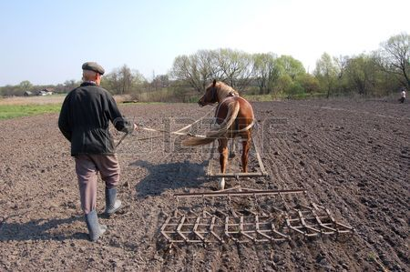
MANY THANKS

