Slide 1
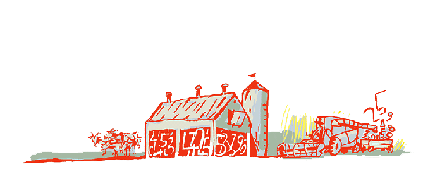
Regional Roundtable
World Programme for the Census of Agriculture 2020 Port of Spain, Trinidad and Tobago 22-26 May 2017
Theme 8: Demographic and social characteristics
Theme10: Intra-household distribution of managerial decisions and ownership on the holding
Technical Session 11
Adriana Neciu
Agricultural Census and Survey Team
FAO Statistics Division

Slide 2
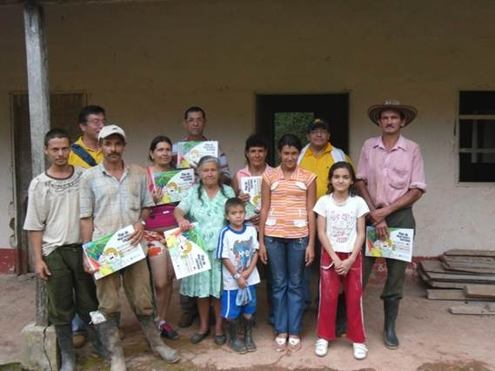
Contents
Theme 8: Demographic and social characteristics
Background
Importance of the theme
Items
Concepts and definitions
Country experience

Slide 3
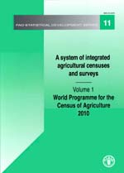
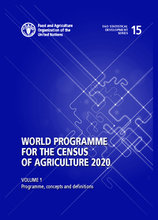
Background
Theme 8 refers to information about the household members. Therefore, it applies only to holdings belonging to the household sector.
Main items of the WCA Programme 2010 are retained and a new item is added: “Agricultural training/education of the holder”.
One “complementary” item of the previous Programme was omitted in the WCA 2020: “Whether holding is part of an agricultural household”
Another complementary item “National/ethnic group of household head or agricultural holder” was moved to Theme 1.

Slide 4
Importance of the theme
The WCA 2020 re-emphasizes the relationship between the agricultural census and the population census. Demographic and social data are essentially covered by the population census.
Specific information about demographic and social characteristics of households operating holdings are crucial to understand farm management, agricultural decision processes, structure of holders’ families by sex and age, etc.
Researchers, decision-makers and planners benefit from such understanding of the demography behind the operation of holdings in the household sector in the country.
Notes:
However, Specific information about demographic and social characteristics of households operating holdings are crucial to understand farm management, agricultural decision processes, structure of holders’ families by sex and age, etc.

Slide 5
Items
Theme 8 Demographic and social characteristics, comprises 7 items:
For the holding (2):
0801 Household size by sex and age groups (essential item) 0807 Agricultural training/education of holder (new item)
NEW ITEM
For each household member (5):
0802 Sex; 0803 Age 0804 Relationship to household head or other reference person; 0805 Marital status; 0806 Educational attainment;
Notes:
Theme 8 Demographic and social characteristics comprises 7 items:
2 for the holding (one essential item –part of the minimum data set that all country should collect regardless the methodological aproach uses and one new item)
5 for each household members (all 5 additional items)

Slide 6
Item 0801: Household size by sex and age groups
Type: Essential item
Reference period: Relates to the persons who, at the time of the census, are usually resident in the household.
Concept: Household size - the number of members of the holder’s household, classified by sex and age groups.
Notes:
It is recommended to take this information only for households with a single holding
(to avoid duplications)
The age groups could be determined according to national circumstances. However they should allow the distinction between children, adults of working age and older persons.
It is suggested to use the “residence approach”: persons who are usually resident in the household.
Notes:
Reference period: This item relates to the persons who, at the time of the census, are usually resident in the household.
Household size can be measured in two ways:
persons present on the day of enumeration;
or (ii) persons who are usually resident in the household. The usual residence approach – called the de jure concept – is recommended for the agricultural census, and is the way official population estimates are normally made. Usually, it is not difficult to identify a person’s place of usual residence. However, sometimes members of a family are studying or working away from the family home but return home regularly. The treatment of such cases should be clearly stipulated (see UN, 2015b, paragraph 4.128).

Slide 7
Item 0802: Sex (for each household member); Item 0803: Age (for each household member)
Type: Additional items
Reference period: Census reference day
Concept: For each household member, the sex (male; female) and age in completed years at the moment of the census should be recorded.
Notes: In some countries there may be difficulties to collect data about age or date of birth: sometimes because an alternative calendar such a lunar calendar is used or people can only identify their date of birth in relation to major events or may only know the season, not the date. There are various data collection tools available to help overcome these problems.

Slide 8
Item 0804: Relationship to household head or other reference person (for each household member)
Type: Additional item
Reference period: Census reference day
Concept:
In the agricultural census, relationship data are only collected to determine household and family composition. Therefore, it doesn’t matter who the reference person is or, if it is the household head, whether that title reflects the person’s role.
Notes:
Relationship data are collected by
first identifying the household head (or any other reference person)
and then recording the relationship of each other household member to that person.

Slide 9
Item 0804: Relationship to household head or other reference person (for each household member) cont’d.
Relationship categories*:
Head
Spouse
Partner in consensual union (cohabiting partner)
Child
Spouse of child
Grandchild or great grandchild
Parent or parent of spouse
Other relative
Other unrelated person
Notes:
The relationship categories are based on international standards used in the population census programme (UN 2015b, paragraph 4.136) to ensure consistency with other national statistics. The recomended categories are given here. Some countries may wish to identify more complex structures, such as child/parent relationships for different family units within a household.

Slide 10
Item 0804: Relationship to household head or other reference person (for each household member) cont’d.
Household composition types*:
One-person household
Nuclear household
Married couple family with child(ren)
Married couple family without child(ren)
Partner in consensual union (cohabiting partner) with child(ren)
Partner in consensual union (cohabiting partner) without child(ren)
Father with children
Mother with children
Extended household
Composite household
Notes:
Households should be divided into household composition types based on the family nucleus. The following groupings used in the population census are usually suitable.

Slide 11
Item 0805: Marital status (for each household member)
Type: Additional item
Reference period: Census reference day
Concept: marital status refers to the status of the household member in relation to the marriage laws or customs of the country.
Recommended groups*:
Never married
Married
Married but separated
Partner in consensual union (cohabiting partner), where applicable
Widowed and not remarried
Divorced and not remarried
Notes:
Data on marital status are sometimes collected for all persons, regardless of age, but often the category is restricted to those above the minimum legal marriage age. Whichever approach is taken, countries should show marital status data in the census tables for persons aged 15 years and over, to provide international comparisons.

Slide 12
Item 0806: Educational attainment (for each household member)
Type: Additional item
Reference period: Census reference day
Concept: Educational attainment - the highest grade of formal education completed or attended by a person. In the agricultural census, educational attainment data should include both the agricultural holder and the agricultural holder’s spouse, if present. (educational levels of both can be important factors in agricultural and household activities)
Note:
Three levels of education:
Primary
Secondary
Post-secondary. (for international comparison purposes).
(Each level may be further subdivided to meet national needs).
Notes:
For international comparison purposes, educational attainment should be classified into at least three levels of education: primary, secondary, and post-secondary. Each level may be further subdivided to meet national needs.

Slide 13
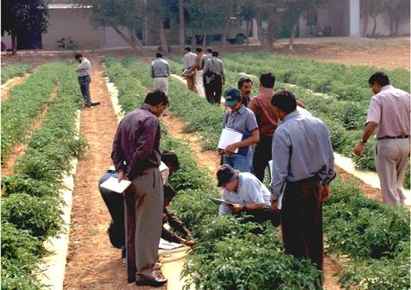
Item 0807: Agricultural training/education of holder
NEW ITEM
Type: Additional item.
Reference period: Census reference day
Concept: Relates to the training or education received by the holder for a specific field or task in agriculture
Suggested categories:
Informal learning in agriculture – practical agricultural training/education, i.e. experience acquired through practical work (field tours, etc);
Non-formal education in agriculture – short-term, ad hoc courses in agriculture, completed at or provided by a gov. institution, int’l organization or any specialized institution in agriculture;
Secondary education in agriculture – any education in agriculture completed at the secondary education level;
Tertiary education in agriculture – high level education training, acquired at the tertiary education level.
Notes:
This item relates to the training or education received by the holder for a specific field or task in agriculture

Slide 14
Country experience
Grenada, Agricultural census 2012.
Information on Theme 8 were collected in Section IV “Farmer and household population information”.
Each household member 15 years and over was numbered and the following information was reported:
Included in Theme 8:
Sex (male, female);
Age;
Other information corresponding to Theme 9 (Work on the holding) was reported in the same section (hours worked per week on the farm).
Number of persons in the household under 15 years by sex.
Highest level of formal education attained by the farmer (none, primary, secondary, vocational, tertiary)

Slide 15
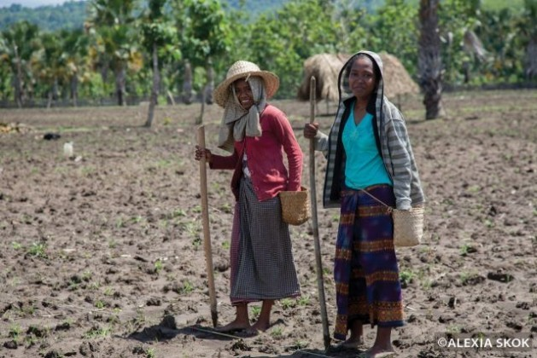
Contents
Theme 10: Intra –hh distribution of managerial decisions and ownership on the holding
Background
General description of the theme
Concept of “Distribution of managerial decisions”
Items
Concepts and definitions
Country experiences

Slide 16
Background
The WCA 2010 introduced the theme “Management of the holding” that included the concepts of “sub-holding” and “sub-holder” in order to assess the role of women in agriculture.
The past experience showed that those items were not suitable for such objective. Therefore in the WCA 2020 Programme that theme has been changed to Theme 10: “Intra-household distribution of managerial decisions and ownership” looking for an improved approach to a gender oriented census.
The items referred to sub-holding and sub-holder and those related to them were changed as:
sex of household members making managerial decisions;
area of crops by sex of the person managing them;
number of livestock by sex of the person managing them;
area of land owned by sex of the owner;
number of livestock owned by sex of the owner.
Notes:
In consequence the items referred to sub-holding and sub-holder and those related to them were changed as:
sex of household members making managerial decisions;
area of crops by sex of the person managing them;
number of livestock by sex of the person managing them;
area of land owned by sex of the owner; number of livestock owned by sex of the owner.

Slide 17
General characteristics of the theme
Theme 10 improves the approach for assessing the distribution of managerial decisions and introduces the identification of ownership within the household.
The main purpose of this theme is to assess the role of gender in decision-making on the holding.
Some countries may wish to reflect more precisely the intra-household distribution of decision- making and ownership within the holding, particularly to investigate the gender-based differences in decision-making and owning key agricultural assets, such as land and livestock (items 1004 & 1005). Such understanding should lead to improved gender sensitivity in policies and programmes.
It is recommended that countries collect data on these items for each individual household member. This may require some effort to implement but it allows for the possibility of analysing managerial decisions not only by sex but also by other characteristics such as age and education.

Slide 18
Items
Theme 10 comprises 5 items:
For the holdings in the household sector
Management
+ | 1001 | Sex of household members making managerial decisions;
+ | 1002 | Area of crops by sex of the person managing them;
+ | 1003 | Number of livestock by sex of the person managing them.
Ownership
+ | 1004 | Area of land owned by sex of the owner
+ | 1005 | Number of livestock owned by sex of the owner
+ new items (additional)
Notes:
The first three refer to management while the last two refer to ownership:
The items included in the theme are 5: 3 for distribution of decisions and 2 for distribution of land and livestock ownership
All the items are additional and intended for those countries wishing to collect such in-depth supplementary data.
In terms of distribution of decisions we have included :...
In terms of distribution of land and livestock ownership we have included:...

Slide 19
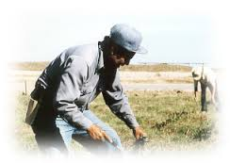
Distribution of managerial decisions (items 1001, 1002 & 1003)
In general, two different levels of decisions can be distinguished on the holding:
managerial decisions – for example “this year we plant maize” or “this year we market all our bean production”
day-to-day operational decisions, such as when to weed or spray the crops or graze the livestock.
When collecting data for items 1001-1003, countries should focus on the managerial decisions. The holder or joint holders are responsible for major decisions made on the holding. This theme aims to capture not only managerial decisions made by the holder and joint holder but also by other household members.

Slide 20
Item 1001: Sex of household members making managerial decisions
These data may be collected by indicating:
(i) for each hh member the managerial decision(s) made by him/her (recommended way);
(ii) for each managerial decision, whether it was made by a male, a female or jointly by male and female hh members.
NEW ITEM
Type: Additional item
Reference period: Census reference year.
Concept: This item collects the sex of any household members (not just the holder or joint holder) making managerial decisions on the holding.
Possible categories of managerial decisions:
Area of land cultivated and area of land left fallow
Types of crops grown
Types of livestock raised
Applying for agricultural credit
Investing in capital assets
Marketing of agricultural products and/or livestock
Types of inputs used
Notes:
The list of managerial decisions to be investigated depends on country specificities. The list provided is merely indicative.

Slide 21
Item 1002: Area of crops by sex of the person managing them
These data may be collected by:
(i) Identifying, for each hh member the areas of crops under his/her sole or joint management
( recommended way);
(ii) Indicating which of the crop areas already reported in the crop section, are under the management of a male, a female or jointly by male and female household members
NEW ITEM
Type: Additional item
Reference period: Census reference year.
Possible groups: It may be suitable to group the crops. The following groups may be considered:
Cereals
Vegetables and melons
Other temporary crops
Permanent crops

Slide 22
Item 1003: Number of livestock by sex of the person managing them
These data may be collected by:
(i) Identifying, for each hh member the number and types of livestock under his/her sole or joint management
( recommended way);
(ii) Indicating out of the total number of each livestock type already reported in the livestock section, the number under the management of a male, a female or jointly by male and female household members.
NEW ITEM
Type: Additional item
Reference period: Census reference year.
Possible groups: It may be suitable to group the types of livestock.
The following groups may be considered:
Bovine animals;
Sheep and goats;
Swine/pigs;
Camels and camelids;
Poultry and birds;
Other animals.

Slide 23
Distribution of land and livestock ownership (items 1004 and 1005)
Countries wishing to cover also the distribution of land and livestock ownership on the holding may include the items below that relate to all household members, including the holder and joint holders:
1004 Area of land owned by sex of the owner
1005 Number of livestock owned by sex of the owner

Slide 24
Item 1004: Area of land owned by sex of the owner
These data may be collected by:
(i) Identifying, for each hh member the area owned solely or jointly by him/her.*
( recommended way);
(ii) Disaggregating the owned area already reported in Theme 2 Land into areas owned by a male, a female or jointly by male and female household members.
NEW ITEM
Type: Additional item
Reference period: Census reference year.
Concept: This item refers to ownership of land. It applies only to that part of the holding’s land which is owned by household members, including the holder.
Note: Countries are recommended to use the ownership forms that are most appropriate to their circumstances but fitting into one of the broad land tenure categories, “Legal ownership or legal owner-like possession” and “Non-legal ownership or non-legal owner-like possession” described in Theme #2, Land.
* If an area is owned jointly by more than one household member, then it should be recorded as owned by each of them;

Slide 25
Item 1005: Number of livestock by sex of the owner.
These data may be collected by:
(i) Identifying, for each hh member the number and type of livestock owned solely or jointly by him/her.*
( recommended way);
(ii) Indicating out of the total number of each livestock type already reported in Theme 5. Livestock the number owned by a male, a female or jointly by male and female household members, including the holder.
NEW ITEM
Type: Additional item
Reference period: Census reference day.
Concept: This item applies only to the number of the livestock being kept on the holding that are owned by household members, including the holder. Countries should decide which forms of ownership to investigate.
Note: It may be suitable to group the livestock in broad categories, the ones suggested for item 1003 may be used.
* If a livestock item is owned jointly by more than one household member, then it should be recorded as owned by each of them.

Slide 26
Country experience
Country example refers to the implementation of the theme “Management of the holding” from the WCA 2010 Programme. Therefore they use concepts and items from that Programme. According to the assessment about the accomplishment of the WCA 2010 recommendations, only a few countries took information on the Theme “Management of the holding”. In particular, there was no example in our region. Therefore an example from other region is given
2007 St Lucia Census of agriculture and fisheries
Section J of the census questionnaire collected information about persons responsible for managerial decisions by means of two questions in form of tables:
Q.37 State sex and age of person mainly responsible for farming activities. It opened in 10 options: 1) Permanent crops; 2) Temporary crops; 3) Cattle; 4) Pigs; 5) Poultry; 6) Sheep; 7) Goats; 8) Rabbits; 9) Beehives; 10) Other animals.
Q.38 State other activities of household members during 2006 and the number of members involved by sex according to income obtained. It was opened in 15 economic activities accordingly to ISIC (Rev. 3) and for each activity, the number of males and number of females either obtaining and not obtaining any income was recorded.

Slide 27
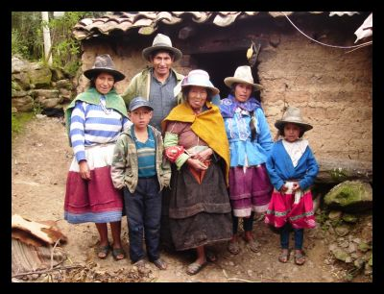
MANY THANKS

