Slide 1
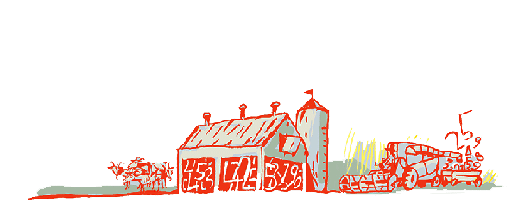
Regional Roundtable on
World Programme for the Census of Agriculture 2020 Port of Spain, Trinidad and Tobago 22-26 May 2017
Theme 1: Identification and General Characteristics
Technical Session 5
Oleg Cara
Agricultural Census and Survey Team
FAO Statistics Division

Slide 2
Contents
Background
Items: type, reference periods, importance of the item, concepts and special characteristics
Country experiences

Slide 3
Background
Chapter 8 (Vol I) of the WCA 2020 is devoted to the description of themes and items for the census. The Programme encompasses 15 themes comprising 128 items.
In Theme 1, some items from Programmes previous to WCA 2010 were reintroduced:
Respondent for the agricultural holding
Presence of hired manager
Some items are new :
Proportion of income from holding’s agricultural production
Main agricultural activity of the holding
Sex of hired manager
Age of hired manager

Slide 4
Theme 1: The list of items
E F | 0101 | Identification and location of agricultural holding
+ | 0102 | Respondent for the agricultural holding
E | 0103 | Legal status of agricultural holder (type of holder)
E | 0104 | Sex of agricultural holder
E | 0105 | Age of agricultural holder
 | 0106 | National/ethnic group of household head or agricultural holder
E F | 0107 | Main purpose of production of the holding
E F | 0108 | Other economic activities of the household
+ | 0109 | Proportion of income from holding’s agricultural production in household’s total income
+ | 0110 | Main agricultural activity of the holding
+ | 0111 | Presence of hired manager of the agricultural holding
+ | 0112 | Sex of hired manager of the agricultural holding
+ | 0113 | Age of hired manager of the agricultural holding

Slide 5
Item 0101: Identification and location of agricultural holding
Type: essential and a frame item.
Reference period: census reference day.
Identification: usually includes holding’s name, holder’s name, holder’s address and other contact information
Location: usually is the place where all, or most, of the agricultural production occurs (where administrative or farm buildings and agricultural machinery are located or, alternatively, where the majority of land is located)
How identify the location? Normally through a geographic coding system (based on the administrative structure of the country; use of GPS or cadastral maps)
Note: holding’s location may be different from the holder’s address.
Notes:
The statistical unit for a data collection is the basic unit for which data are collected. In previous agricultural census programmes, the statistical unit used has been the agricultural holding and this is used again in WCA 2020.
The definition of an agricultural holding remains the same as in previous programmes; that is:
“An agricultural holding is an economic unit of agricultural production under single management comprising all livestock kept and all land used wholly or partly for agricultural production purposes, without regard to title, legal form or size. Single management may be exercised by an individual or household, jointly by two or more individuals or households, by a clan or tribe, or by a juridical person such as a corporation, cooperative or government agency. The holding's land may consist of one or more parcels, located in one or more separate areas or in one or more territorial or administrative divisions, providing the parcels share the same production means, such as labour, farm buildings, machinery or draught animals.”
There are two types of agricultural holdings: (i) holdings in the household sector – that is, those operated by household members; and (ii) holdings in the non-household sector, such as corporations and government institutions. In most developing countries, the majority of agricultural production is in the household sector. The concept of “agricultural holding” is therefore closely related to the concept of “household”.
The household is one of the basic elements of a national statistics system and standards for defining a household have been laid down by the UN in its guidelines for population and housing censuses as follows:
"The concept of household is based on the arrangements made by persons, individually or in groups, for providing themselves with food or other essentials for living. A household may be either (a) a one‑person household, that is to say, a person who makes provision for his or her own food or other essentials for living without combining with any other person to form part of a multi-person household, or (b) a multi-person household, that is to say, a group of two or more persons living together who make common provision for food or other essentials for living. The persons in the group may pool their resources and may have a common budget; they may be related or unrelated persons, or constitute a combination of persons both related and unrelated” (UN, 2015b, paragraph 2.33).
Care must be taken in defining the statistical unit for the non-household sector. Corporations and government institutions may have complex structures, in which different activities are undertaken by different parts of the organization. The national accounting concept of establishment should be used (see Annex1), whereby an establishment is an economic unit engaged in one main productive activity, operating in a single location

Slide 6
Item 0101: Identification and location of agricultural holding (contd)
Holdings covered by the agricultural census need to be identified for several reasons:
coverage checking,
links with the population and other censuses and surveys,
link with other sources,
the list of holdings constitute an important component of every sampling frame of the on-going system of agricultural surveys and in many cases, such list is the first step for building (or updating) a farm register.
The location of the agricultural holding is needed to assign them to administrative units or agro-ecological zones, which are key classification items in the tabulation of agricultural census results
Therefore each holding should be unambiguously identified and its location defined
For the definition of an agricultural holding, see WCA 2020, Vol. 1, paragraph 6.2.

Slide 7
Item 0101: Identification and location of agricultural holding (contd)
An agricultural holding is an economic unit of agricultural production under single management comprising all livestock kept and all land used wholly or partly for agricultural production purposes.
The holding's land may consist of one or more parcels, located in one or more separate areas or in one or more territorial or administrative divisions, providing the parcels share the same production means, such as labour, farm buildings, machinery or draught animals.
Thus, parcels of land, e.g. a few hundred kilometres apart should not be considered part of the same holding because they cannot share the same inputs.

Slide 8
Item 0101: Identification and location of agricultural holding (contd)
When the agricultural activity of the holding is operated across different geographical areas or administrative units the location of parcels (and livestock as well) could differ from the main location of the holding.
Countries should review the application of the definition to their local conditions.
Countries may wish to:
use special sections in the census questionnare to collect key data (on land) depending on the location of parcels (and livestock)
to define a holding as being within a single administrative unit, such as a district or province.
Notes:
See also para 6.12

Slide 9
Item 0102: Respondent for the agricultural holding
Type: new item, additional item.
Reference period: census reference day.
Concept: Respondent is the person from whom data are collected about the holding. The respondent should be someone sufficiently knowledgeable to answer the census questions accurately; usually is the holder or hired manager.
Importance: This item could be used for quality assessments and checks

Slide 10
Item 0103: Legal status of agricultural holder
Type: essential item.
Reference period: census reference day.
Concept: A holding may be operated by:
One civil person;
A group of civil persons;
A juridical person (such as a corporation, cooperative, governmental institution, a church, etc.)
Importance: The legal status (type of holder) is an important classification item.
Holding’s sector: A holding may belong to the household sector (operated by household members from one or different households) or to the non-household sector (operated by a corporation, cooperative, a tribe, etc.)
Correspondence between legal status and the sector is not straightforward. It depends on the country legal system and context.

Slide 11
Item 0104: Sex of agricultural holder
Type: essential item.
Reference period: census reference day.
Importance: This item is crucial for analyzing the gender aspects of agricultural production. It also could be useful as a basis of sampling frame for gender surveys.
Where to collect this information? Only in holdings belonging to the household sector. In case of joint holders in a holding of the household sector, the sex of each person should be reported.

Slide 12
Item 0105: Age of agricultural holder
Type: essential item.
Reference period: census reference day.
Importance: Age of holder is important for analyzing the relationship between age and characteristics of agricultural holdings and also for studying gender issues.
Where to collect this information? Only in holdings belonging to the household sector. In case of joint holders in a holding of the household sector, the age of each person should be reported.
For the definition of an agricultural holder, see WCA 2020, Vol. 1, paragraphs 6.17- 6.19

Slide 13
Item 0106: National/ethnic group of household head or agricultural holder
Type: additional and new item.
Reference period: census reference day.
Importance: In some countries there are differences in agricultural practices between national/ethnic groups.
Where to collect this information? Only in holdings belonging to the household sector.

Slide 14
Item 0107: Main purpose of production of holding
Type: essential and frame item.
Reference period: census reference year or other suitable reference period (such as the main harvest).
Importance: It is a broad indicator of the extent to which agricultural holdings participate in the market economy. It is also important for developing a frame for surveys on farm food stocks for sale.
Where to collect this information? Usually for holdings belonging to the household sector but can be collected for holdings in non-household sector.
Suggested (main) categories: producing mainly for:
Own consumption
Sale
Note: Sale includes selling produce for cash or in exchange for other produce (barter).
Notes:
In cases where a holding sells some produce and uses the rest for own consumption, main purpose should be which of the two – own consumption or sale – represents the larger value of agricultural production. Sale includes selling produce for cash or in exchange for other produce (barter). Disposal of agricultural produce in other ways – for example, for payment of labour, sending to family members, as gifts or as payment of taxes – should not be considered in assessing the main purpose of production. Several questions may be needed to obtain data for this item.

Slide 15
Item 0108: Other economic activities of the household
Type: essential and frame item.
Reference period: census reference year.
Concept: It comprises economic activities undertaken by the household linked to the premises of the agricultural holding or in the close vicinity, other than agricultural production on the holding
Importance: It is important to help understand the relationship between such activities and the agricultural production and to find out more about life and economics in rural areas.
Where to collect this information? Only for holdings belonging to the household sector.

Slide 16
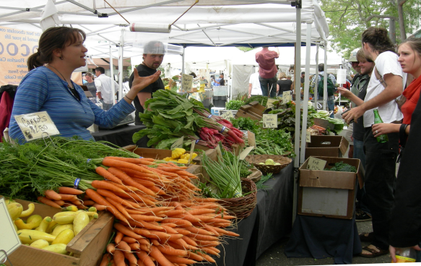
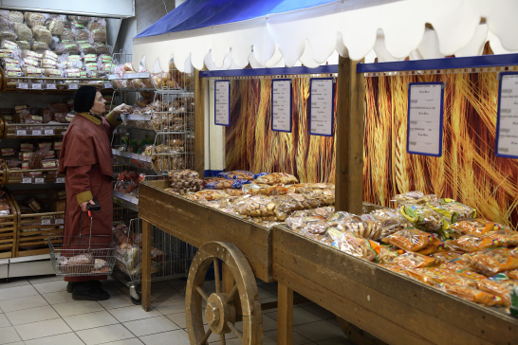
Item 0108: Other economic activities of the household (contd)
Suggested activities to investigate are:
Support activities to agriculture and post-harvest crop activities Hunting, trapping and related service activities Forestry and logging Fishing and aquaculture Manufacturing (agro-processing and handicrafts) Wholesale and retail trade, repair of motor vehicles or motorcycles Hotels and restaurants (excluding Agrotourism) Agrotourism Other

Slide 17
Item 0109: Proportion of income from holding’s agricultural production in household’s total income
Type: new and additional item
Reference period: census reference year.
Importance: It is important to get a broad indicator of the extent of which agricultural holdings rely on their own production for the total household income.
Where to collect this information? Only for holdings belonging to the household sector.
How is calculated the income: The total value of the available agricultural production sold, used as means of production, processed or consumed by HH, put into storage or used as own-account produced fixed capital
Suggested categories are:
Less than a quarter
A quarter or less than a half
A half or less than three quarters
Three quarters to less than all
All income

Slide 18
Item 0110: Main agricultural activity on the holding
Type: new and additional item
Reference period: census reference year
Importance: combined with other items it could be used for formulation of policies for the sector
Where to collect this information? All holdings
Suggested categories are:
Mainly crop production (at least two-thirds of the total value of the holding’s production in the census reference year comes from crop production)
Mainly livestock production (equal as before for livestock production)
Mixed (crop and livestock) (neither crop nor livestock production account for at least two-thirds of the total value of the holding’s production in the census reference year)

Slide 19
Items: 0111 Presence of hired manager; 0112 & 0113 Sex and Age of hired manager
Type: new and additional items
Reference period: census reference day
Concept: the hired manager of the holding is the paid employee who manages the agricultural holding on behalf of the holder and is responsible for the normal daily financial and production routines of running the holding.
Importance: these items are important for analyzing the management of agricultural holding and gender aspects of agricultural production as well as the relationship between age and the characteristics of holdings. They could also be used as basis for sampling frames for special surveys.

Slide 20
Saint Lucia - Agricultural Census 2007 In the Agriculture Censal Questionnaire - CAF A the following information was collected on the Identification and location of the agricultural holding:
Country experiences
Section A. Identification and location of agricultural holding
Administrative district
Enumeration district
Name of holding
Location of holding (address, phone)
Section B. Identification and legal status of holder
If the respondent is the holder
If the respondent is the head of the household
Legal status (individual or household/joint individuals/cooperatives/ company or corporation/government/ other)
Main activity of the holder (agricultural/non-agricultural)
Partnership (name, sex, address and age)
For cooperatives, companies, corporations and government institutions: name, address

Slide 21
Saint Lucia - Agricultural Census 2007 (Questionnaire - CAF A)
Country experiences (contd)
Section C. Population and Employment
Sex of agricultural holder
Age of agricultural holder
Section J. Other
Proportion of income from holding’s agricultural production in household’s total income:
None
Less than 25%
25% and less than 50%
50% and less than 75%
75% and over
Other economic activities of the household (by selected types)

Slide 22
Thank You

