Slide 1
Climate Change Stories from the HKH Region: `Even the Himalayas Have Stopped Smiling’* (courtesy, OXFAM)
Dr Madhav Karki, Deputy Director General

Slide 2
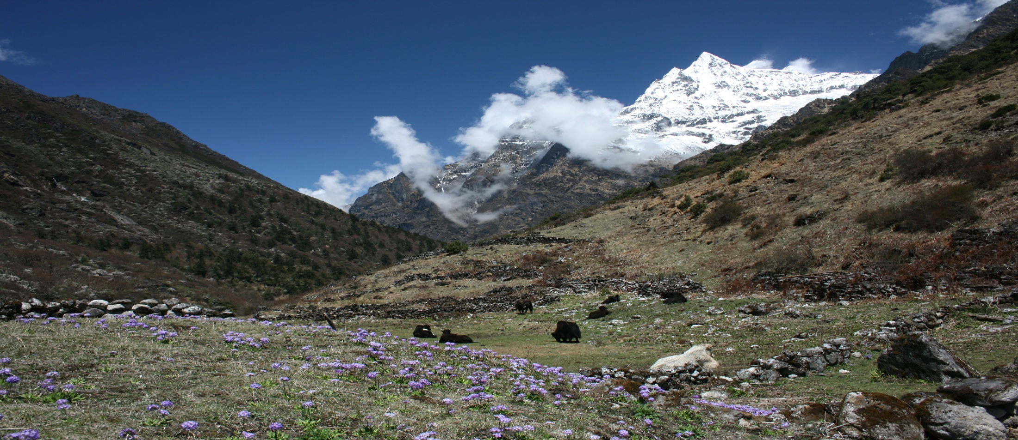
Storyline
Changing Greater Himalayas
Major Climate Change Impacts
Community Responses – from local to global adaptation
Key story messages

Slide 3
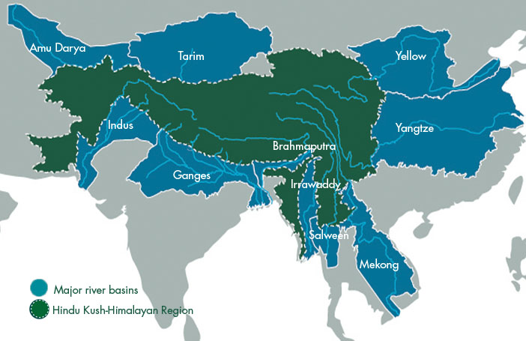
Greater Himalayan Region

Slide 4
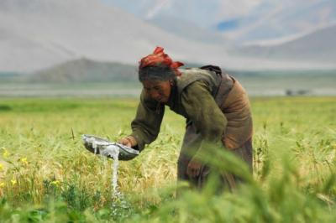
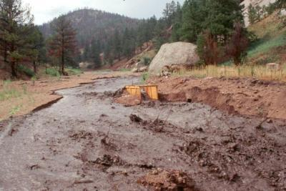
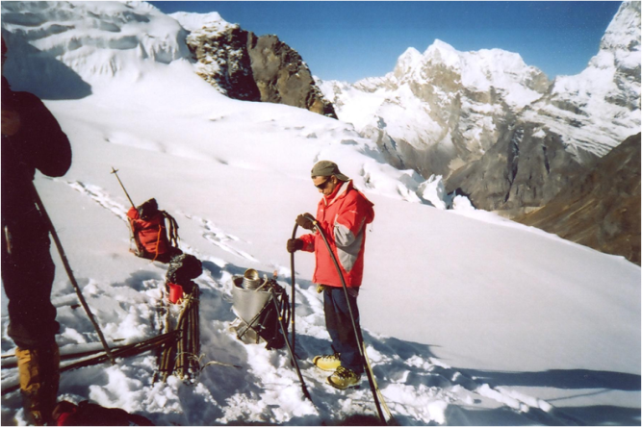
Major Challenges
Himalayas are warming faster than any other parts of the globe (1.5 0 C in last 25 yrs.);
Increased extreme events
Changing habitats of plants and animals
Outmigration and feminization of agriculture
Acceleration of glacier and snow melt

Slide 5
Threatened community living at the edge – 2010, Pakistan floods

Slide 6
Devastated urban landscape - Indus Floods in Pakistan, 2010

Slide 7
Flash Flood in Pokhara, Nepal, 2012

Slide 8
Flood in Brahmaputra, Assam, India, 2012

Slide 9
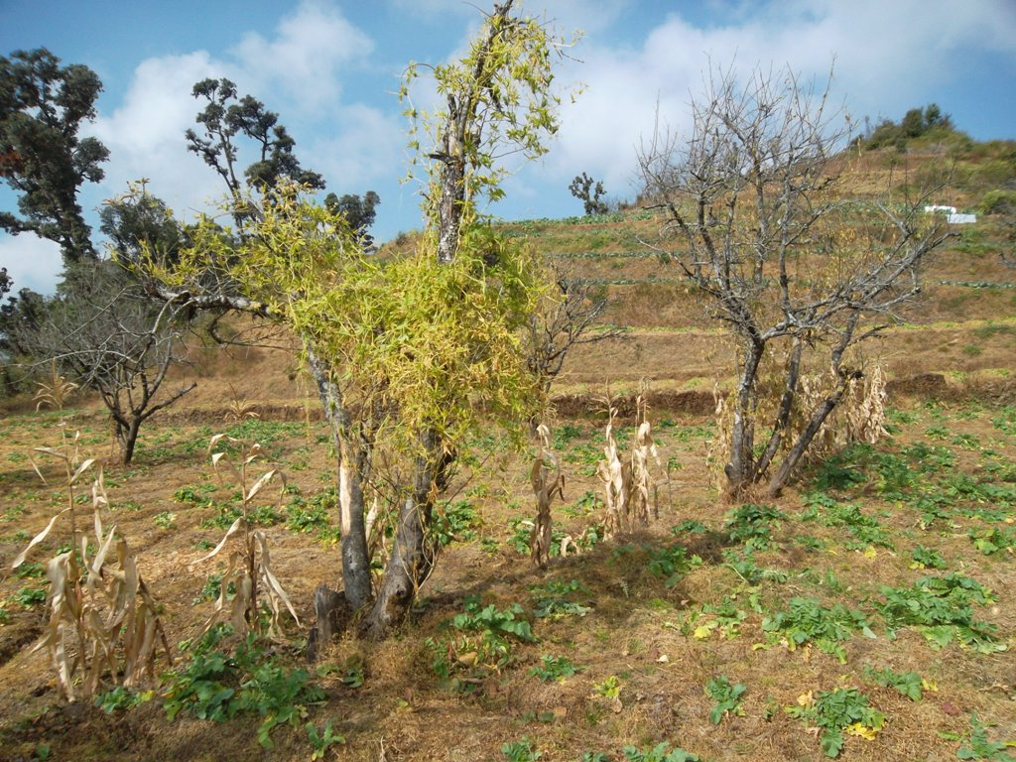
Impacts on Food Security:
Expected impact on cereal production in South Asia is a decline of between 18.2 to 22.1% as compared to a global figure of 0.6 to 0.9 %
Source: IFPRI, 2007

Slide 10
Response: global awareness raising

Slide 11
Action: national disaster risk reduction

Slide 12
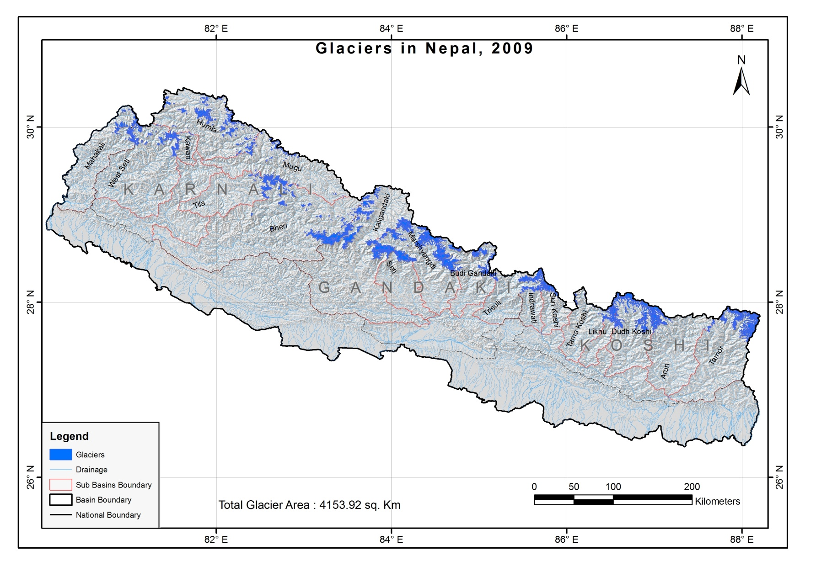
Filling the data gap enhancing information and knowledge sharing
Published by ICIMOD 2001
 | 2001 | 2010 (unpublished)
Number of glaciers | 3252 | 3810
Area of glaciers | 5324 | 4242 km²
Major Source of information | Maps ≤1980 | Landsat TM/ETM+ Images of ≥2005
Pradeep Mool, ICIMOD

Slide 13
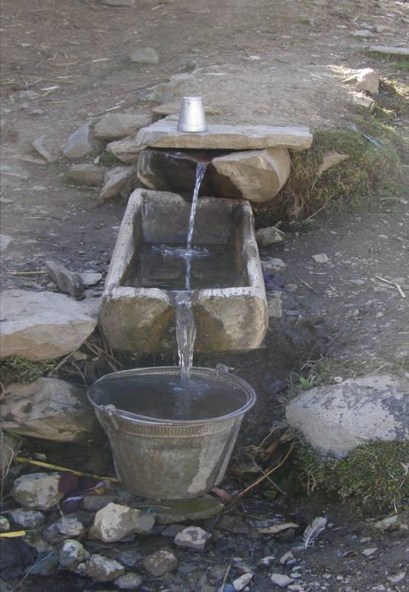
Story No. 1: Local communities are coping; lack knowledge for building long-term adaptive capacity

Slide 14
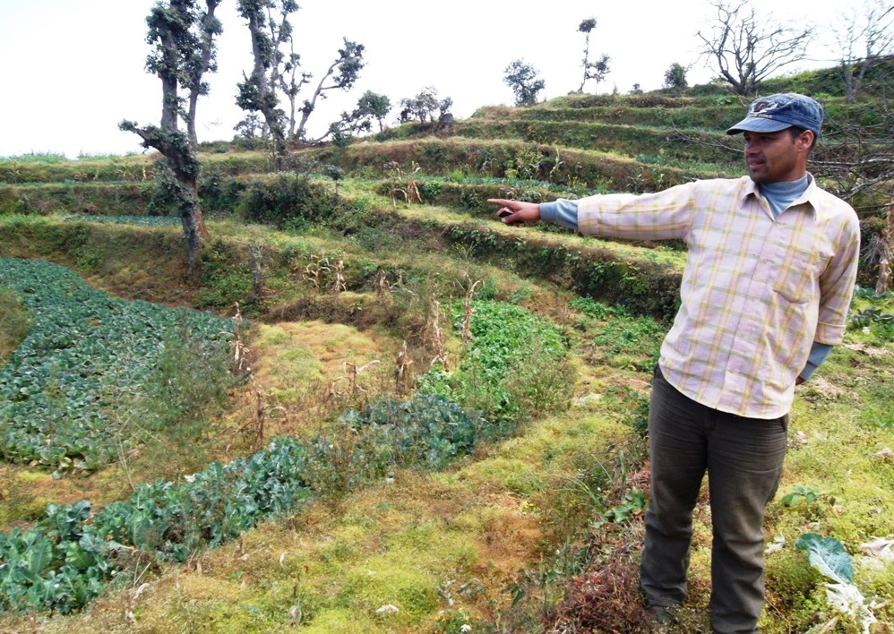
Story No 2: People do not understand the causes of increased floods, droughts and crop failures

Slide 15
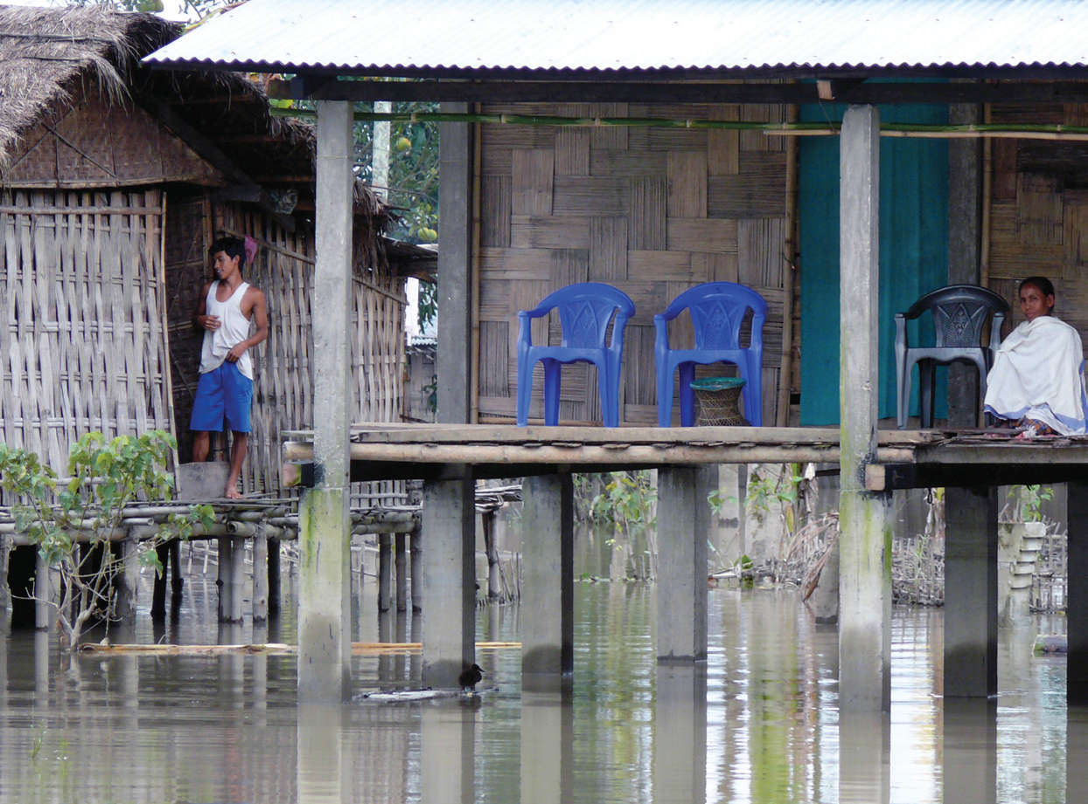
Story no. 3: People are looking for solutions

Slide 16
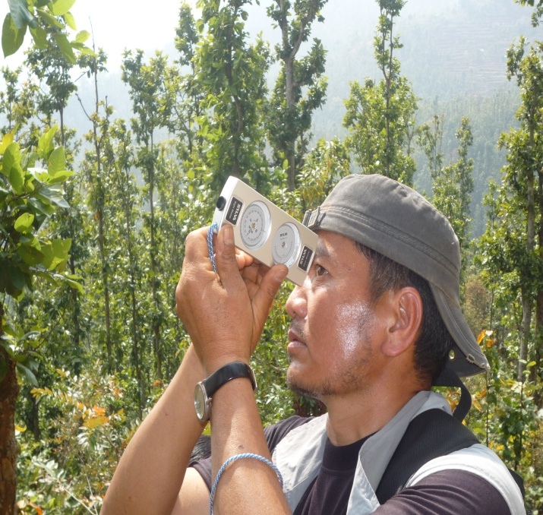
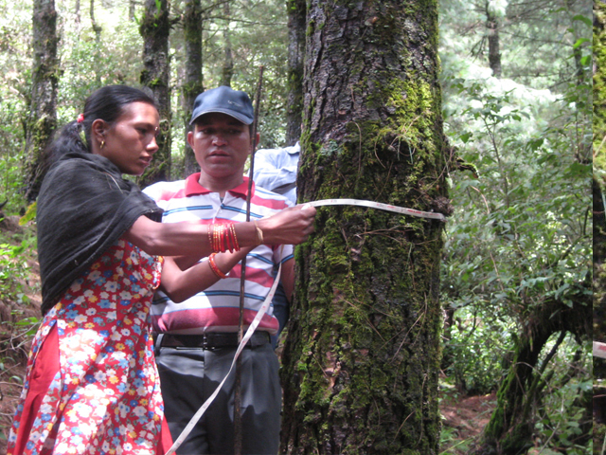
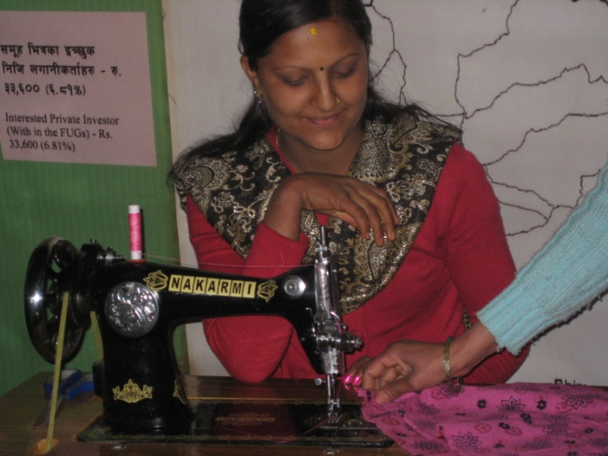
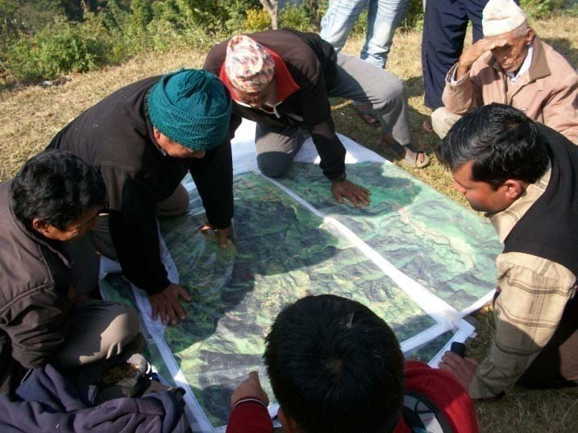
Story no. 4: Pilot projects showing good promises (e.g., REDD+)

Slide 17
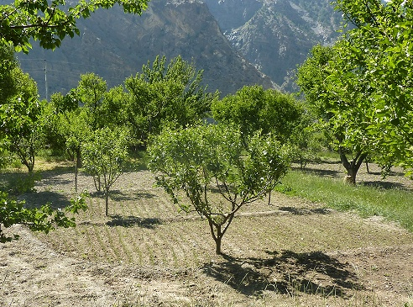
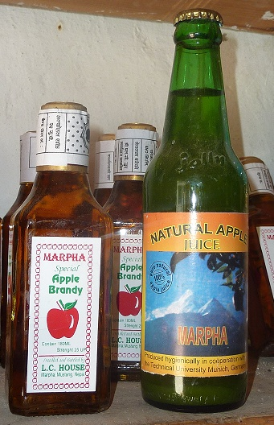
No. 5: Improving livelihoods through value chain and watershed management builds resilience

Slide 18
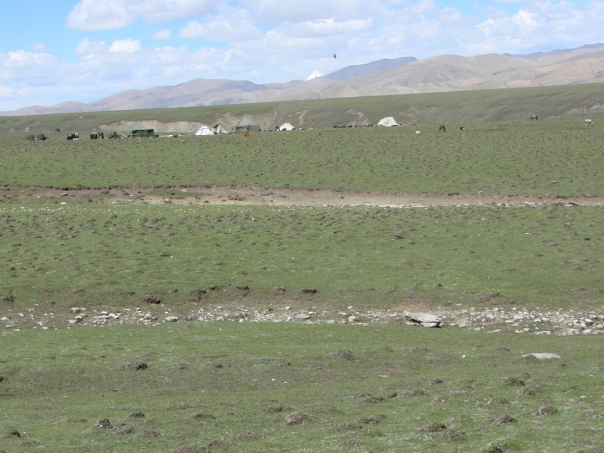
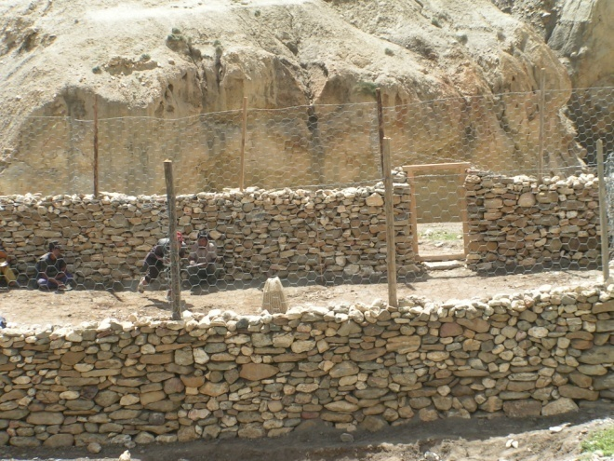
No. 6: Improved watershed management can generate multiple benefits from ecosystem services

Slide 19
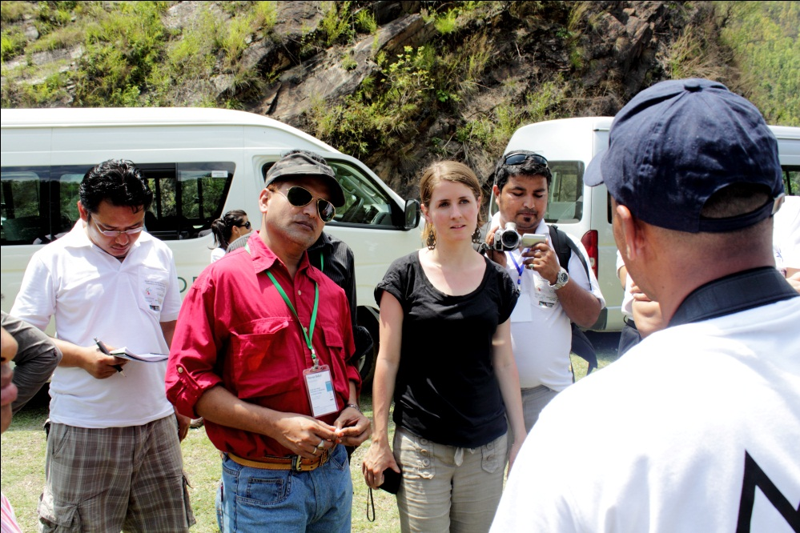
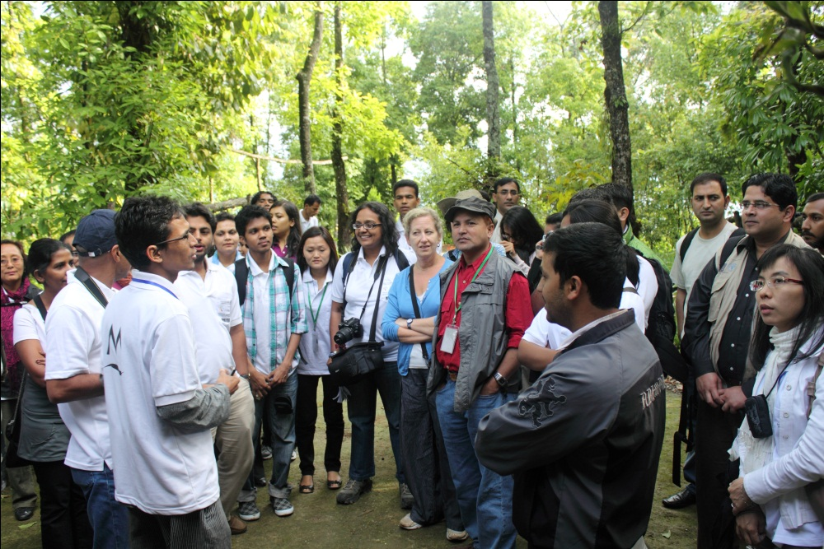
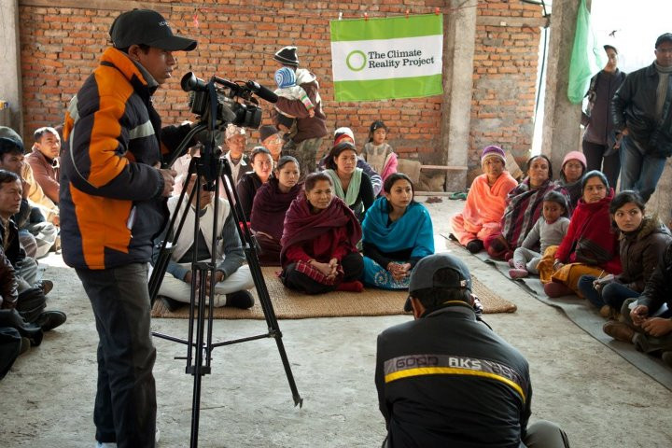
No. 8: Engaging media and the public

Slide 20
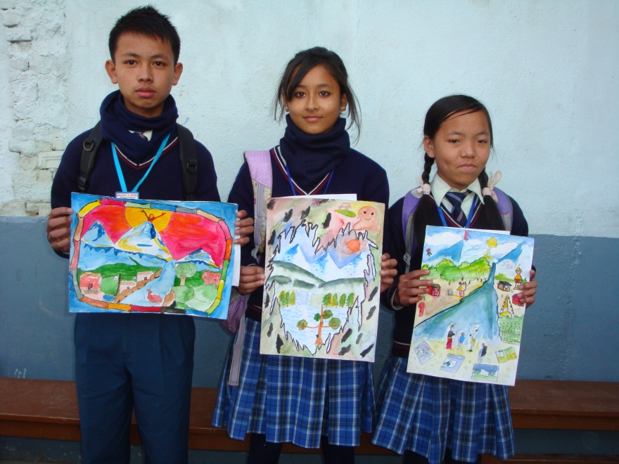
No. 9: Engaging youth and children preparing future generation to adapt

Slide 21
Key learning from the stories from the HKH region
People are desperately waiting to know why the changes are happening?
Shortage of water, food, and increased disaster are the major concerns
General unawareness about the govt. and donor programs and initiatives
Effective communication and dissemination between researchers and community is lacking
Livelihood diversification and early warning for better preparation is the preferred option

Slide 22
