Slide 1
Personal presentation
Mauro Bassignana
Institut Agricole Régional – Aosta
m.bassignana@iaraosta.it
IPROMO
Food Security in Mountain Areas
“EXtraordinary POtential”
Ormea 24 June 2015

Slide 2
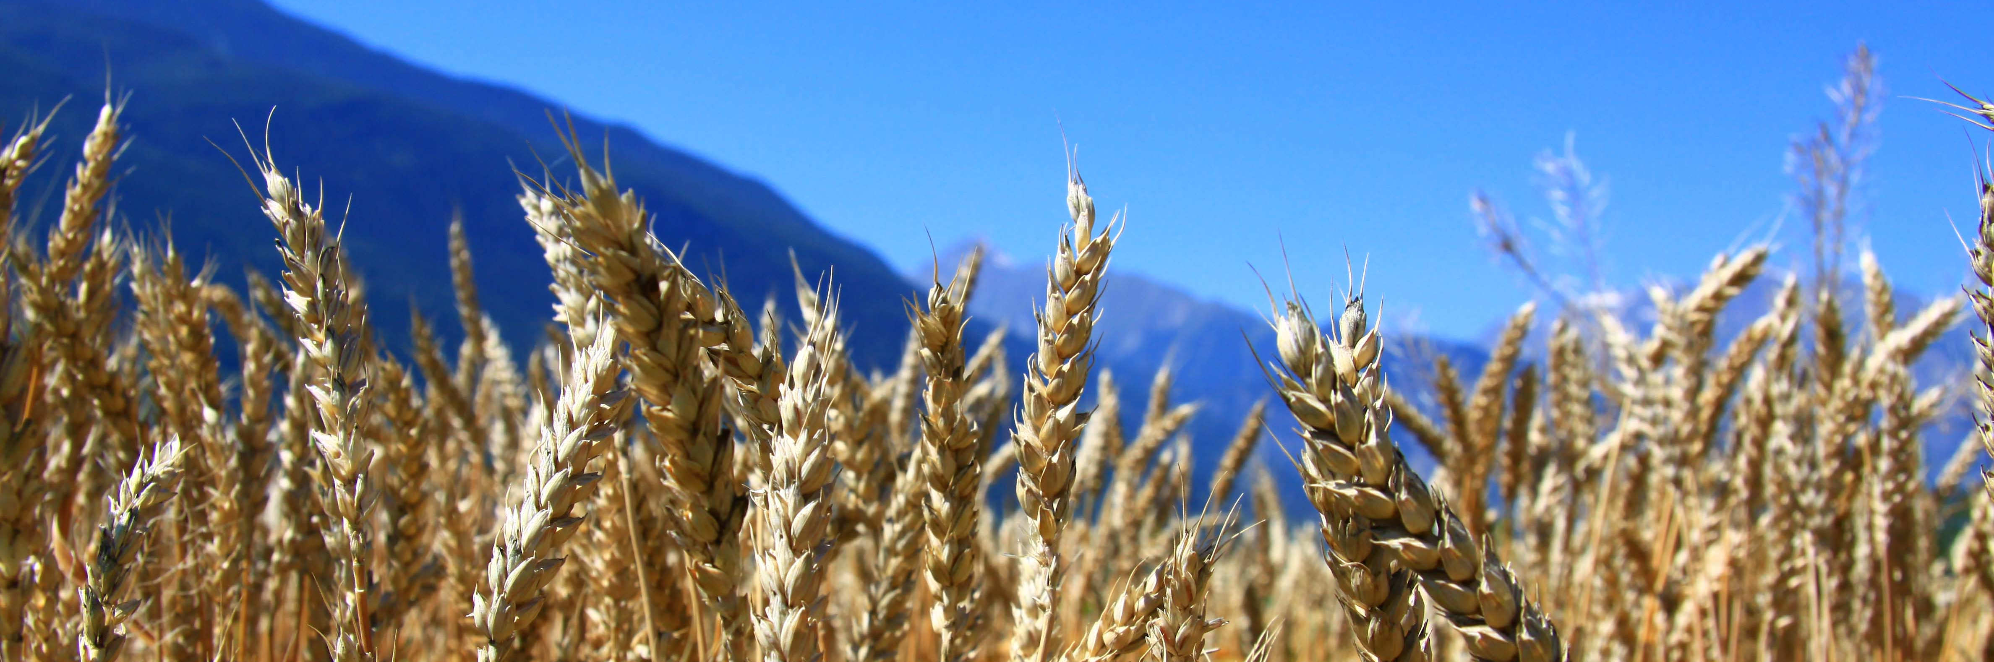
Education
MAgSc, with a thesis on the fertilization of soft wheat.
PhD in Mountain pastoralism and forage production, with a thesis on the plant communities dominated by fine leaved fescues in the
highland summer pastures of the western Alps.

Slide 3
Employment
Since 1996, Head of the Agronomy branch
at Institut Agricole Régional, Aosta (I).
My tasks:
conception, coordination and implementation of applied research in the fields of agriculture and agri-environment in mountain areas
organization of the resources and works of research and production
teaching and vocational training

Slide 4
Applied research
I coordinate a team of six researchers and technicians.
Our focus areas:
forage production
Relationship between agricultural practices and environment
organic waste management
cereal crops
vegetables
medicinal plants

Slide 5
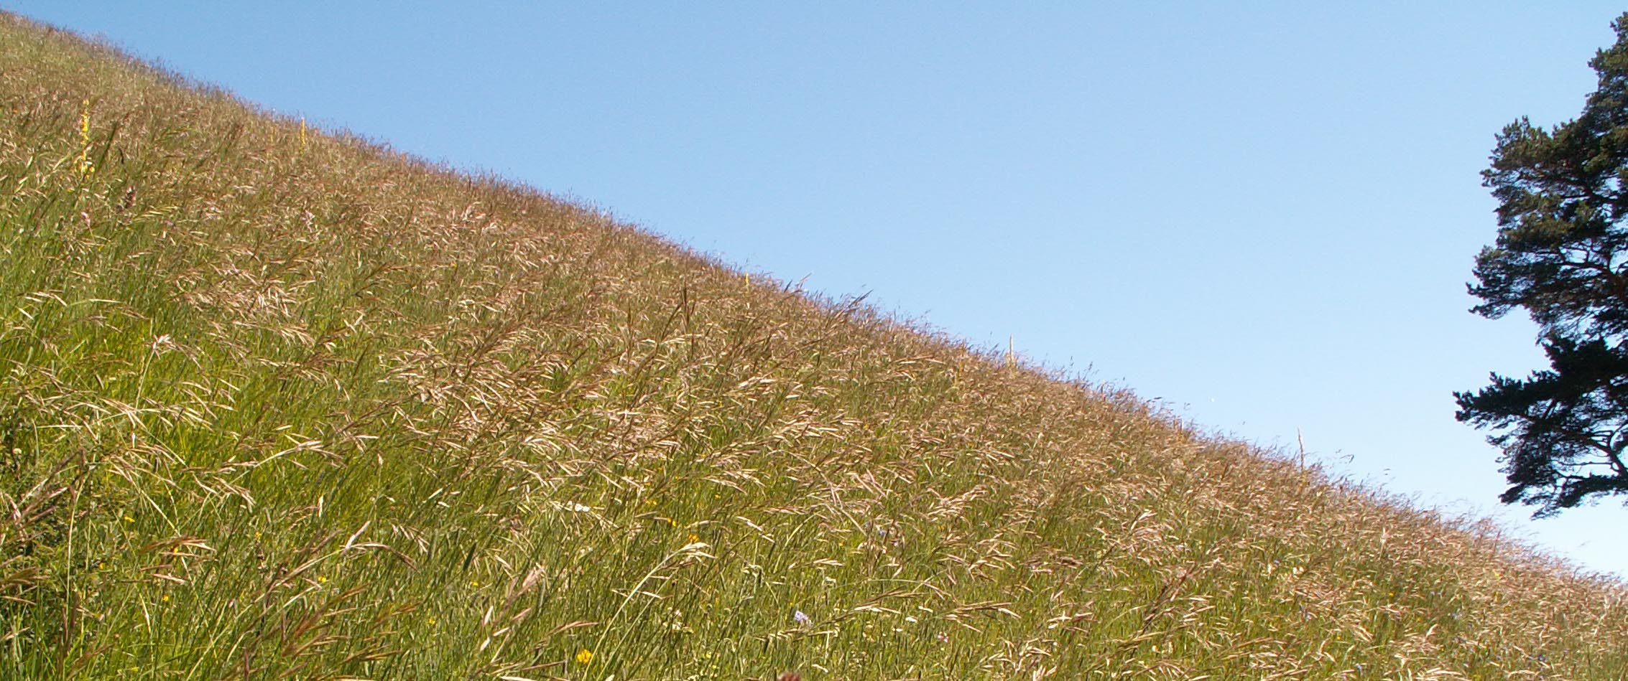
Applied research
Our research activities focus on three main areas:
Characterization and valorisation of natural resources in mountain areas
Farm income diversification
Environmental protection, waste reduction and management

Slide 6
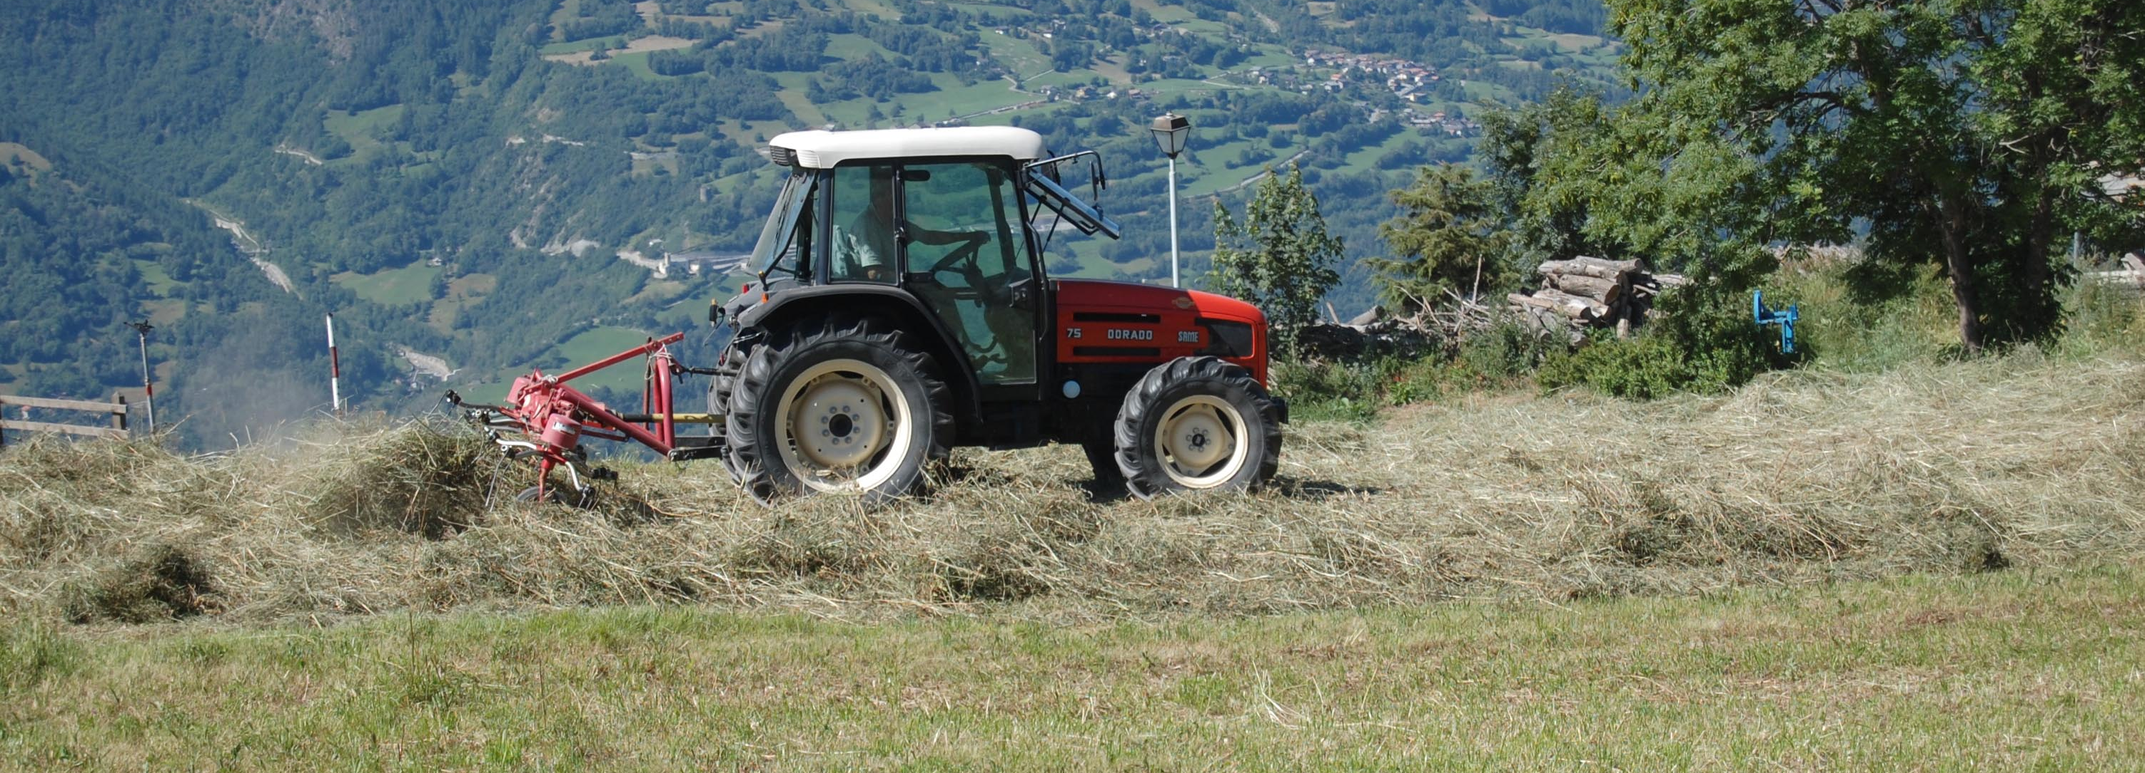
Applied research
Characterization and valorisation of natural resources in mountain areas:
Diversity of mountain meadows and their uses
Typology of alpine vegetations
Management plans for nature reserves and Natura 2000 areas
Grass-cheese relations

Slide 7
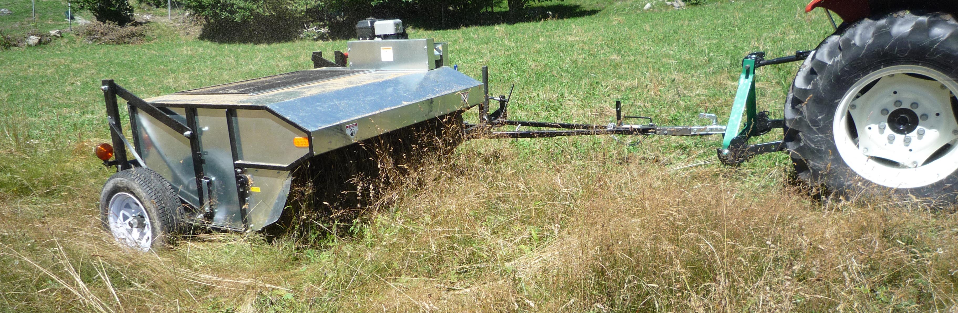
Applied research
Farm income diversification:
Recovery and maintenance, multiplication and dissemination of landraces of cereals (wheat, rye, corn, barley)
Grain and vegetable short production chains
Culture and promotion of mountain medicinal and aromatic plants
Harvest of wild seeds for ecological restoration

Slide 8
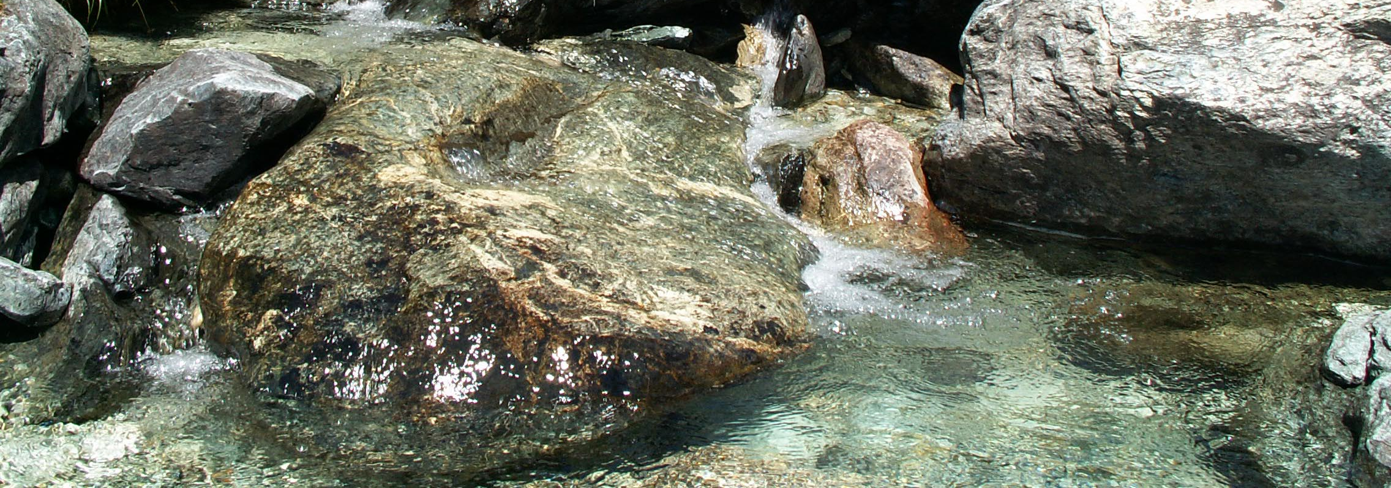
Applied research
Environmental protection, waste reduction and management:
Define best practices for landscape works (land improvements, ski slopes …)
Studies on invasive species in natural grasslands
Nutrient cycling, composting of manure and organic waste
Study of erosion and pesticide runoff in mountain vineyards
Microbiological quality of water in mountain areas

Slide 9
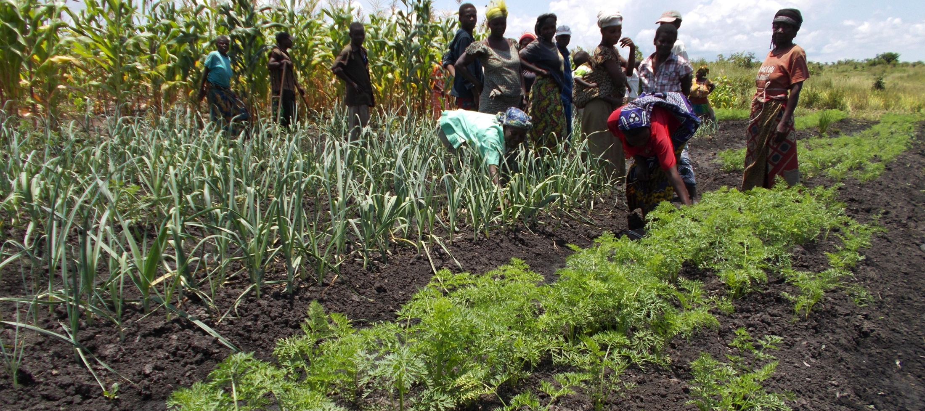
Volunteer work
Development cooperation projects in Africa, Latin America, Asia
Promotion of sustainable production techniques
Protection against soil erosion
Support for community schools and farmers' associations

