Slide 1
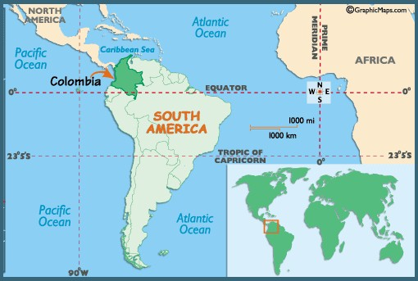
GILMER BELTRAN ROMERO
FORESTRY ENGINEER
ENVIRONMENTAL LAW
SPECIALIST

Slide 2
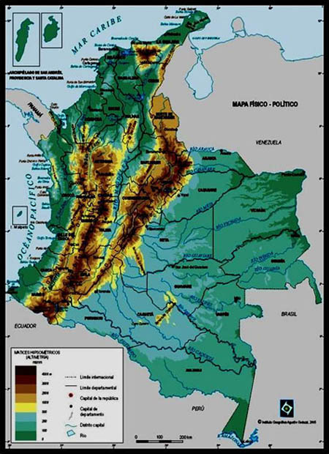
COLOMBIA
Area: 138 M hectares
Population: 46,044,601 person
Econony:
petroleum, natural gas,
Minning: coal, iron, nickel, gold, copper, emeralds.
Coffe
Problems:
Political conflict – Violence
Drug crops - Traffic

Slide 3
MY EXPERIENCE
Goverment programs in forestry and conservation
Work with indigenous people to find alternative ways to deforestation
NGO – Fundeparamos
Reforestation, restoration and conservation in Paramo ecosystems
Ramsar’s site Management Plan Design and establishment of sustainable conservation systems

Slide 4
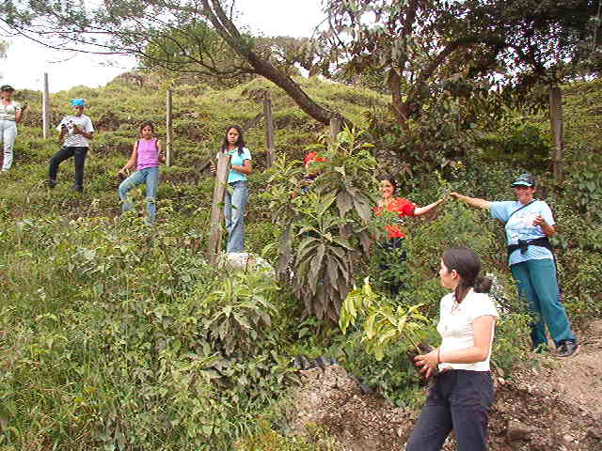
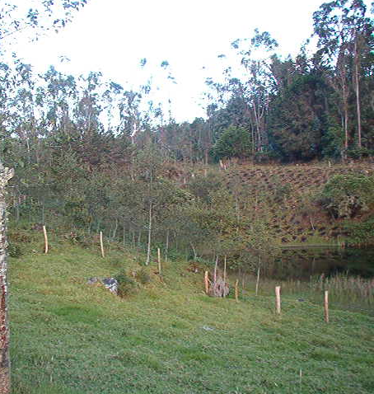
GOVERMENT – Plant trees to protect water sources and change the use of soil
Recovering degradated areas
Actions to protect small wetlands

Slide 5
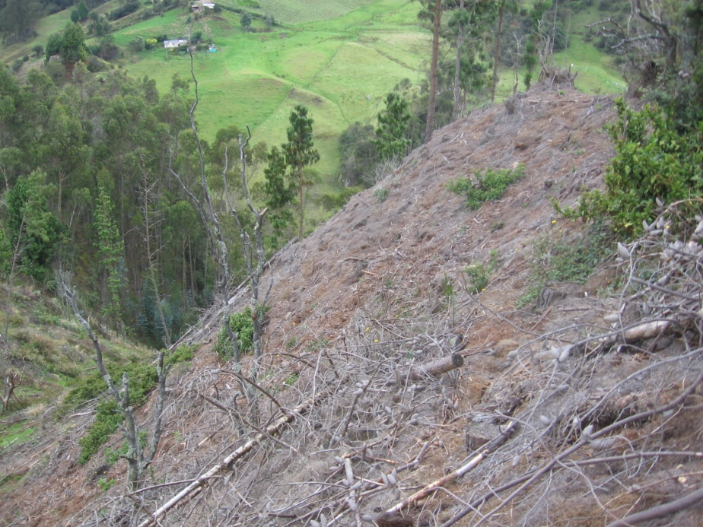
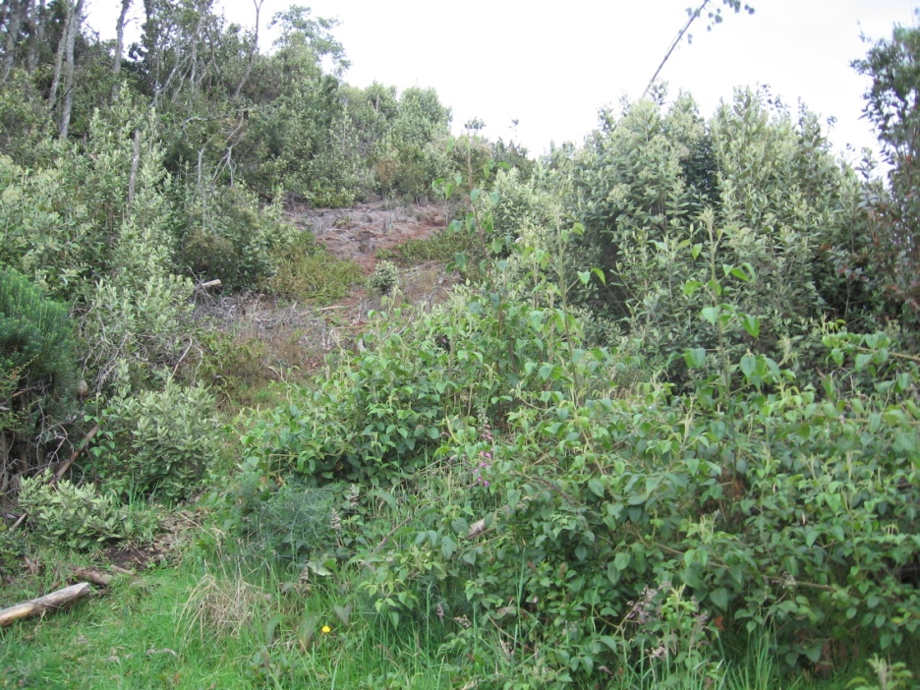
Replacing foreign trees with native species

Slide 6
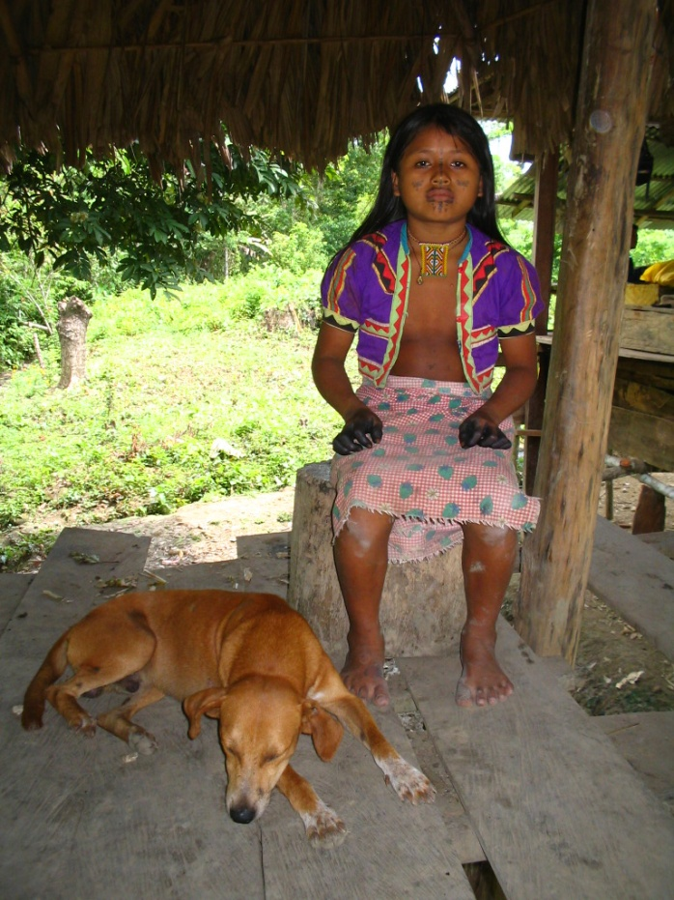
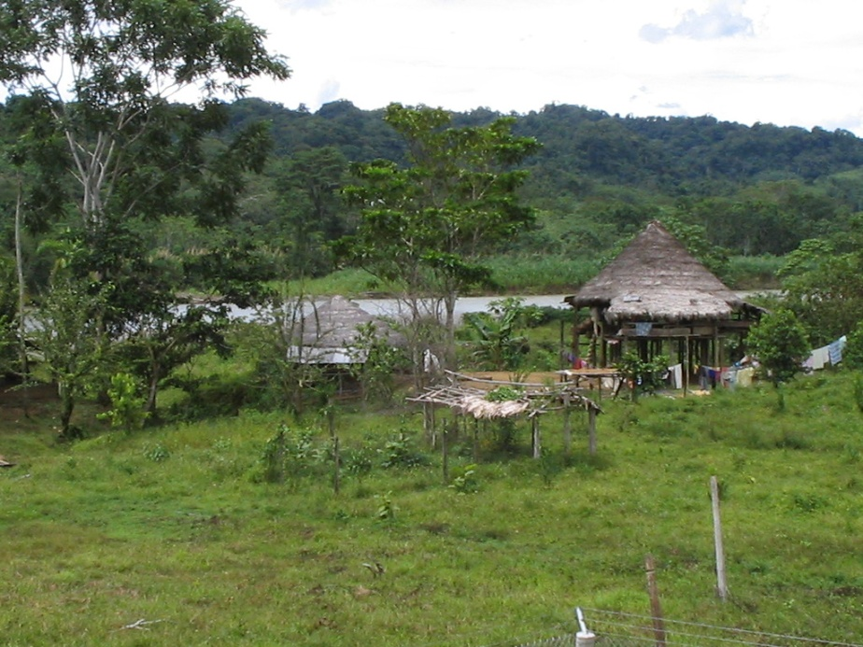
WORK TOGHETER WITH INDIGENOUS PEOPLE – EMBERA KATIO COMUNITY
NUDO DE PARAMILLO – NATIONAL PARK
Understand the forest ecology trough the indigenous knowledge.
Colecting valuable data related to distribution, growth, .and use of the relevant species in the forest.
Notes:
O

Slide 7
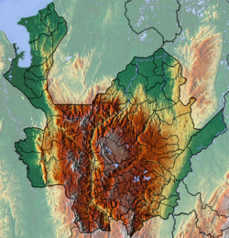
NATIONAL PARK “NUDO DE PARAMILLO”
Area: 400.000 ha
Altitude range: Sea Level -4000 m.
Problems:
Deforestation
Minning
https://es.wikipedia.org/wiki/Nudo_de_Paramillo#/media/File:Antioquia_Topographic_2.png

Slide 8
FUNDEPARAMOS NGO PARAMO ECOSYSTEMS SUSTAINABLE DEVELOPMENT FOUNDATION

Slide 9
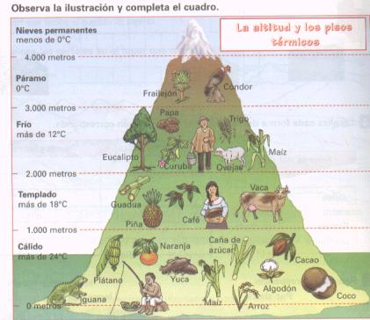
THE PARAMO
High mountain ecosystem, located between the forest and the ice.
Altitude range: 3.000 - 4.000 m
Main Characteristics: high grass, high humidity and fertility and presence of the genus Speteletia sp.
These places are in high risk because they are used for potatoes crops and minning.

Slide 10
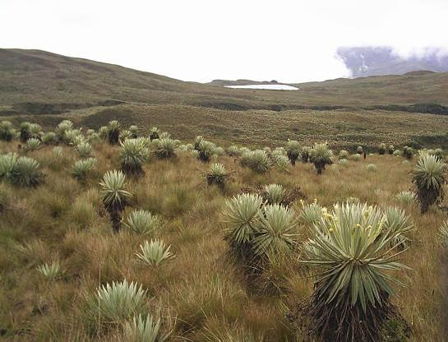

Slide 11
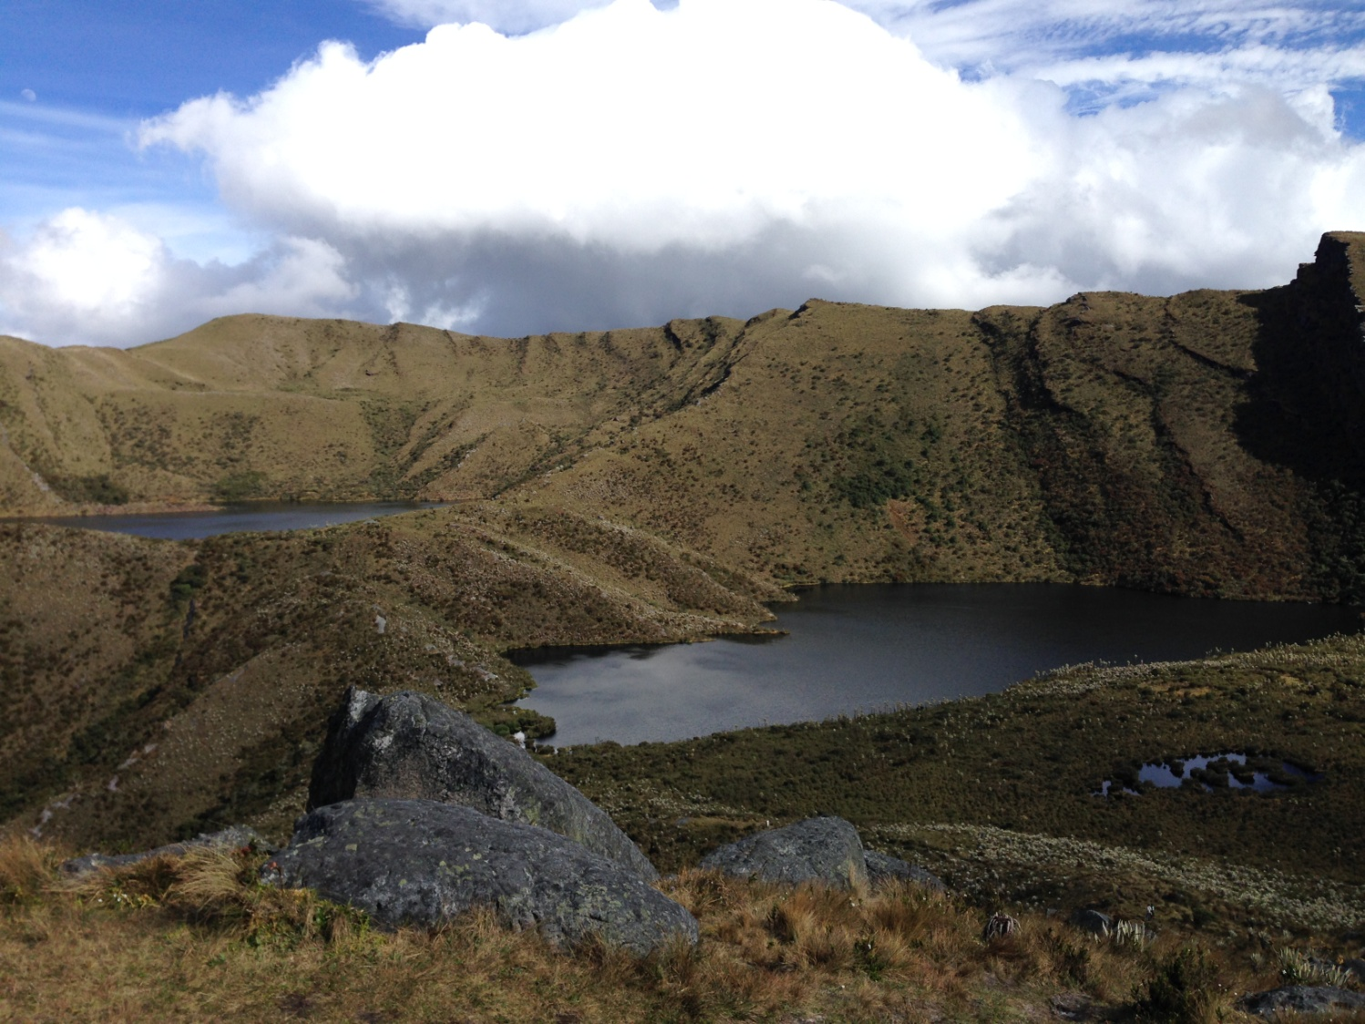

Slide 14
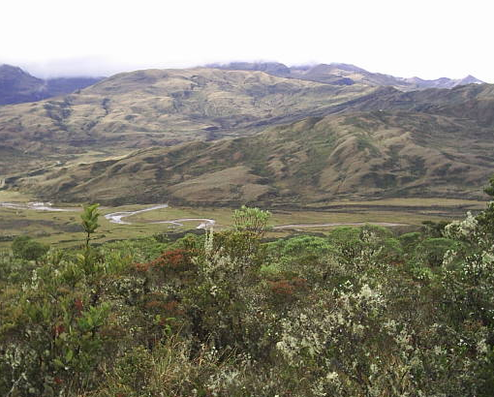
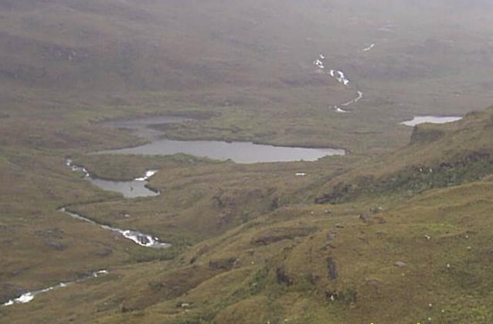
IMPORTANCE OF PARAMO
Capture and storage of CO2
Positionned as a biological corridor for a great diversity of animal and plants species.
Hydrological cycle regulation

Slide 15
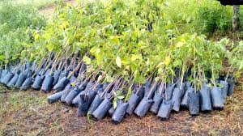
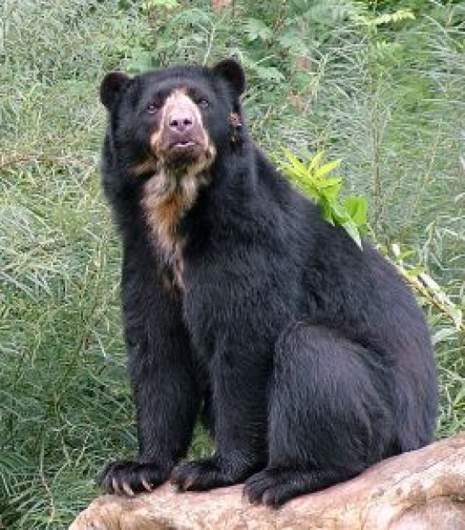
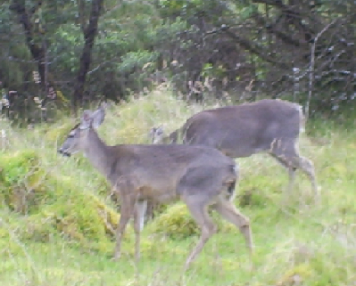
WHAT WE ARE DOING
REFORESTATION
IMPROVING LOCAL PEOPLE’S KNOWLEDGE AROUND WILDLIFE

Slide 16
PREVENTING SOIL EROSION
We encourage people to change the way they work the land.

Slide 17
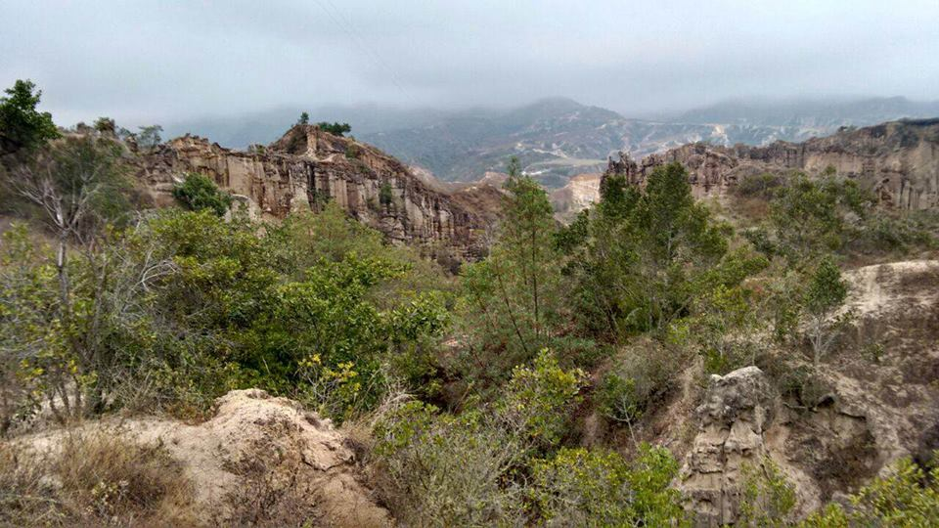
LOS ESTORAQUES NATIONAL PARK
In this Ecosystem of Dry Forest , we are monitoring and colecting seeds for key tree species to resotate de forest cover

Slide 18
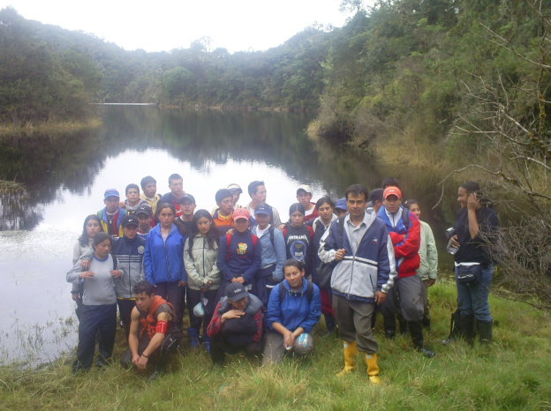
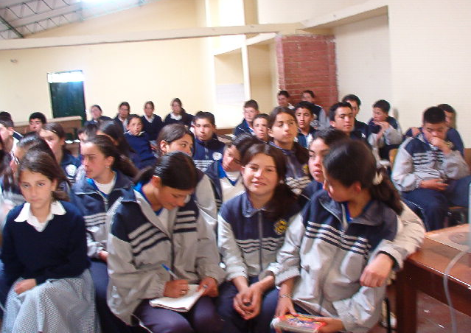
WORKING WITH LOCAL COMMUNITIES
(ENVIRONMENTAL EDUCATION)
SUPORT TO SCHOOLS

Slide 19
THANK YOU

