Slide 1
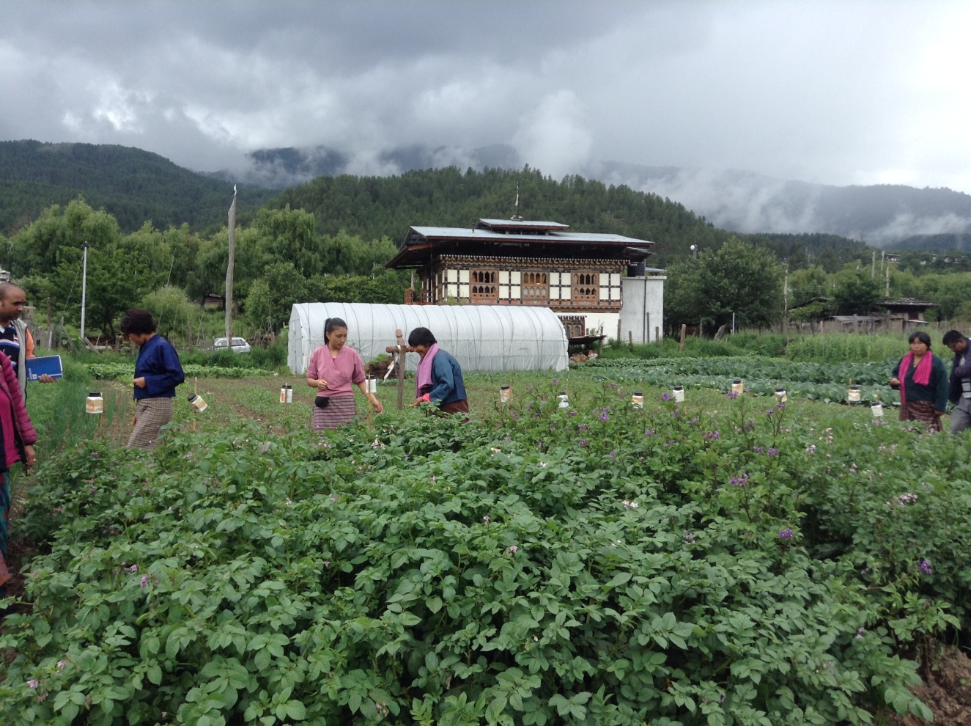
The National Potato Program and Food Security in the Mountains of Bhutan
IPROMO 2015
Ormea, Italy
24th June, 2015

Slide 2
Outline
Country Profile
My Profile
Potato in the Bhutanese highlands
Activities of the National Potato Program

Slide 3
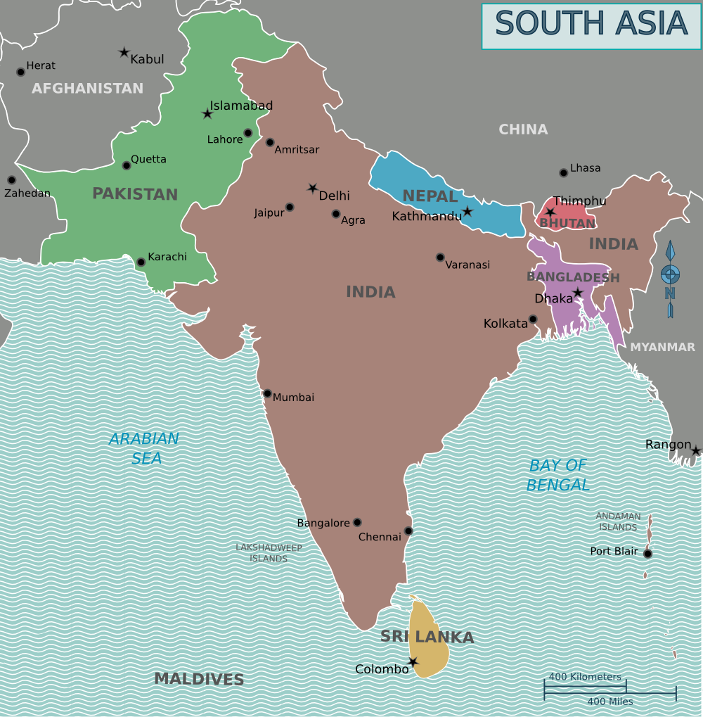
Bhutan: Country Profile

Slide 4
Bhutan: Country Profile
Area: 38,394 square kilometres
Population: ~ 700,000
Rural population: 69%
GDP: USD 1.9 Billion
GDP per capita: USD 2509
Land cover statistics: Forests (70.5%), Arable land (2.9%), Protected areas and biological corridors (51.32%)
Development philosophy: Gross National Happiness (Sustainable and equitable Socio-economic development, Environmental Conservation, Cultural Protection, Good Governance)

Slide 5
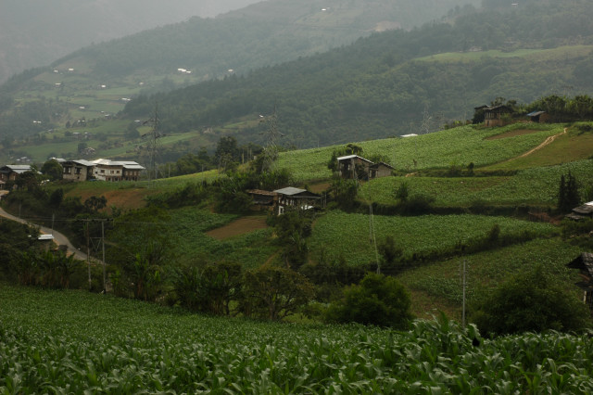
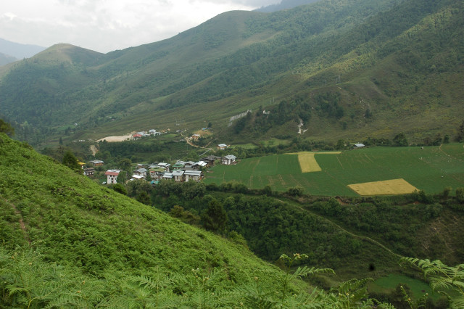

Slide 6
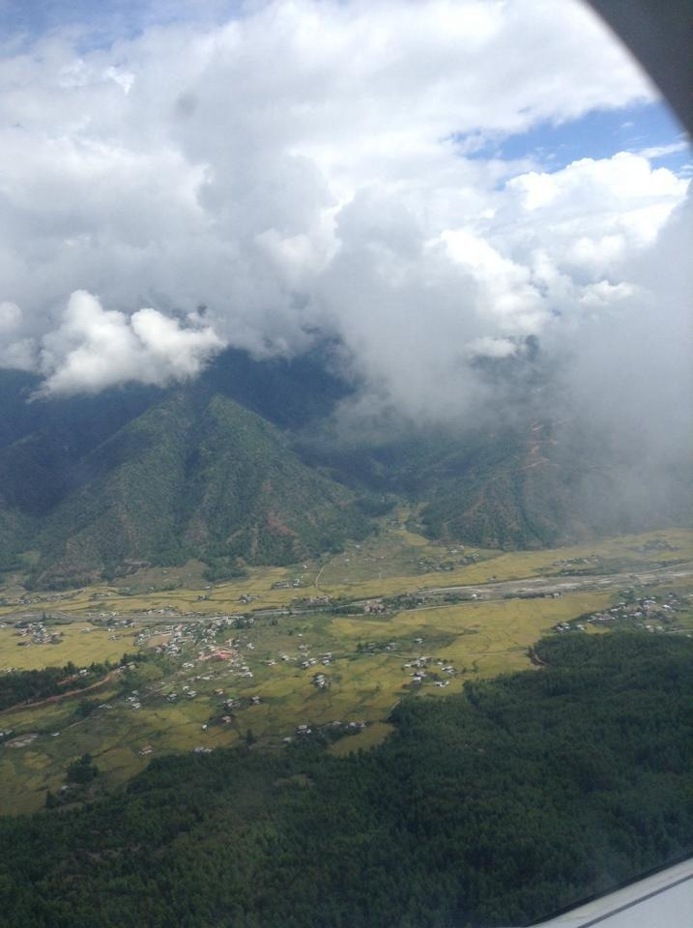
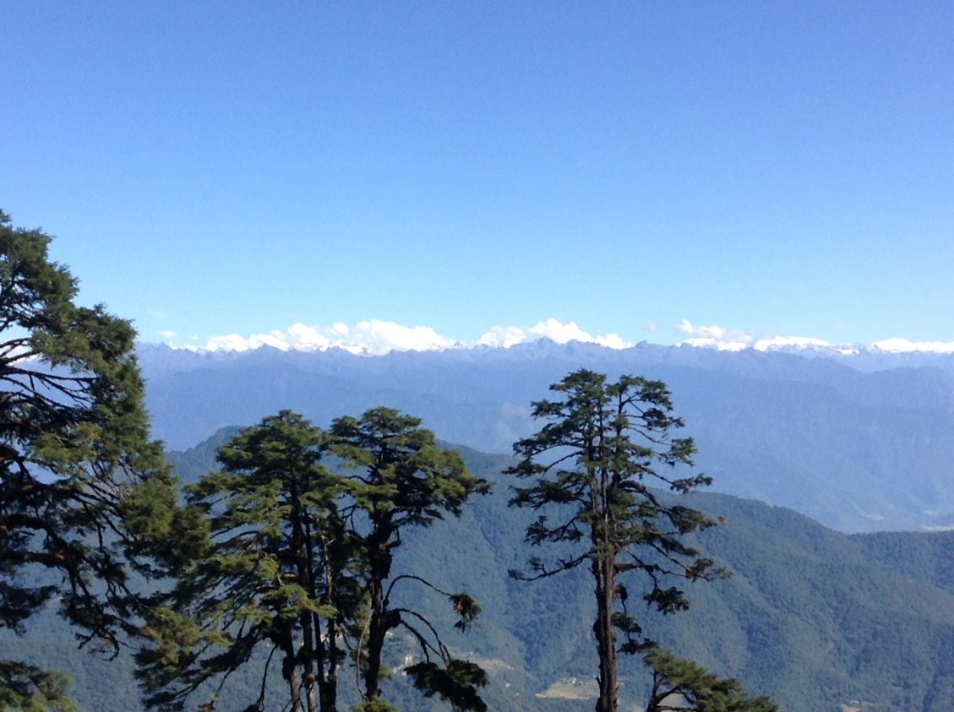

Slide 7
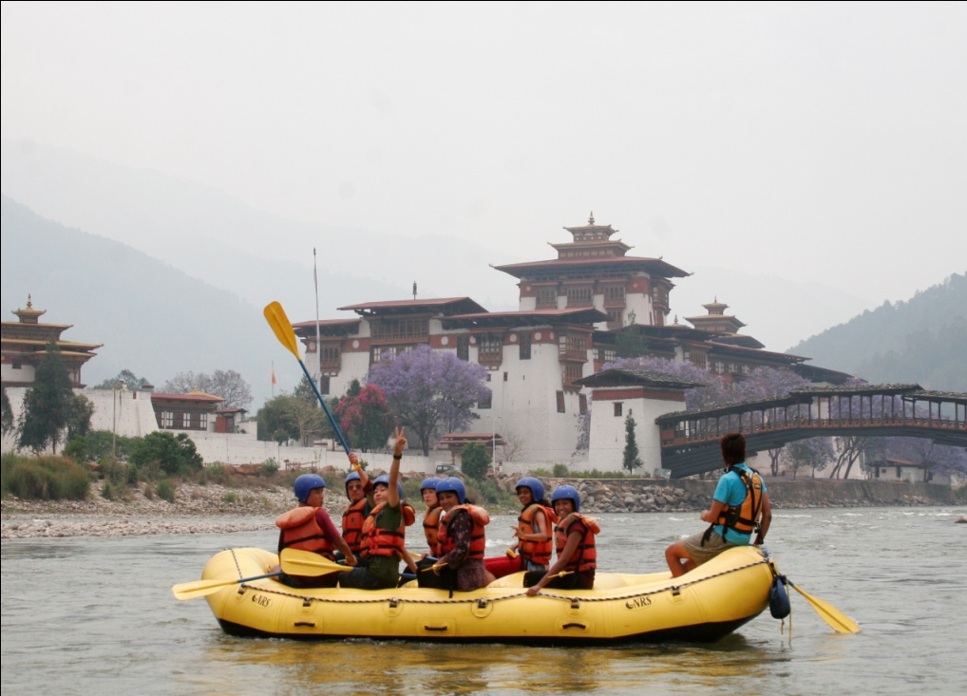
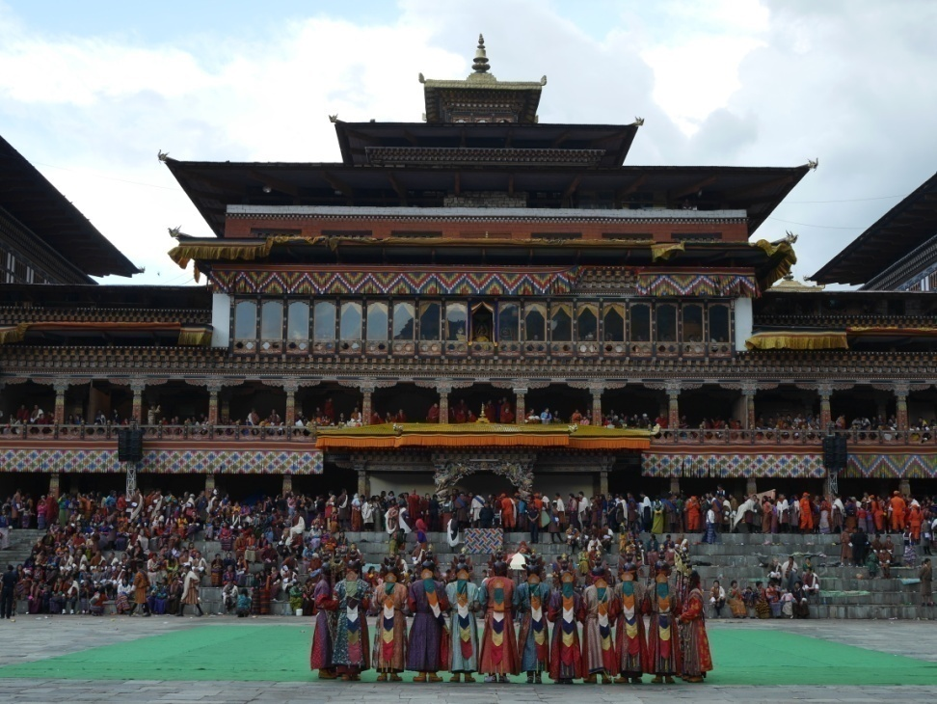

Slide 8
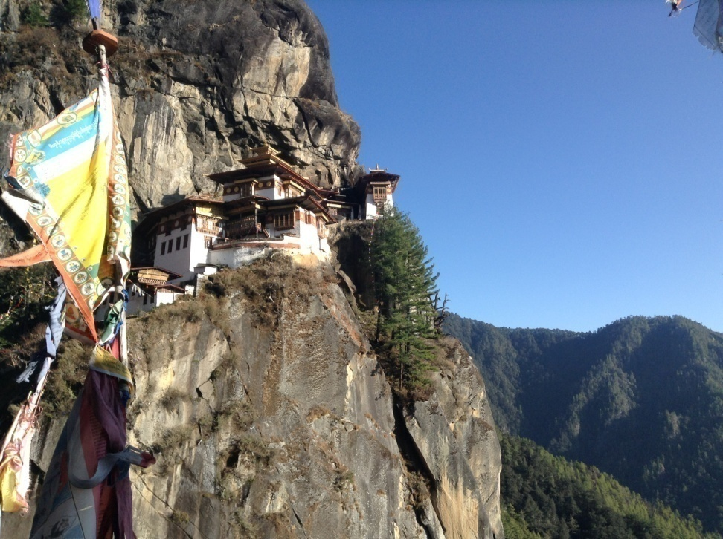
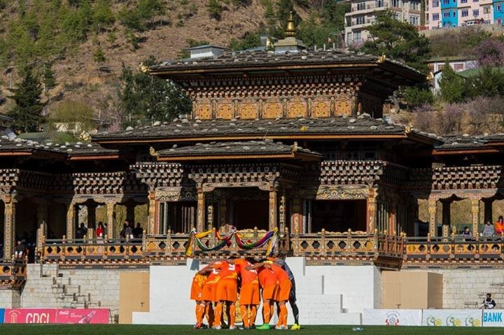

Slide 9
My Profile
Name: Pema Wangchuk
Designation: Coordinator
Organization: National Potato Program
Department of Agriculture
Ministry of Agriculture and Forests
Contact: pwangchuk@moaf.gov.bt, pema.wangchuk@gmail.com
Country: Bhutan

Slide 10

My Town

Slide 11
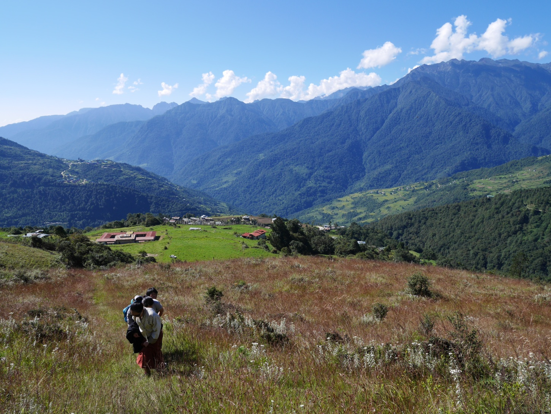
My Home Town

Slide 12
Potato in Bhutan
Important source of income and food for highland rural communities
Top ten commodities exported
Production: 50,390 tons (2013)
Area: 5356 hectares
Productivity: 9.25 tons/ ha
Export (Quantity): 31733 tons
Export (value): USD 13 million
Farm area: <0.25 Ha to >0.5 ha
Cropping systems: potato-maize, potato-buckwheat/wheat/barley, rice-potato, potato-vegetables/mustards

Slide 13
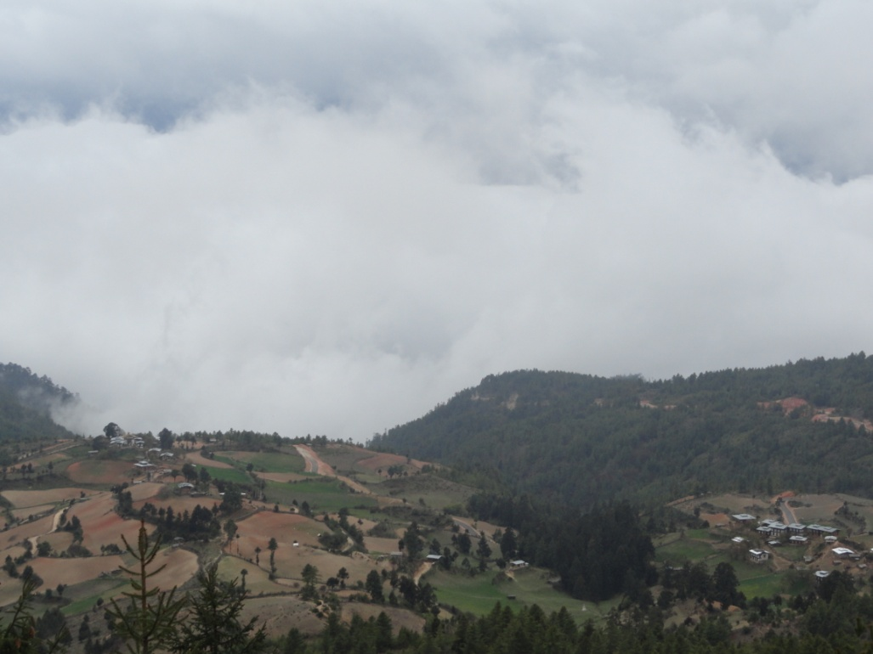
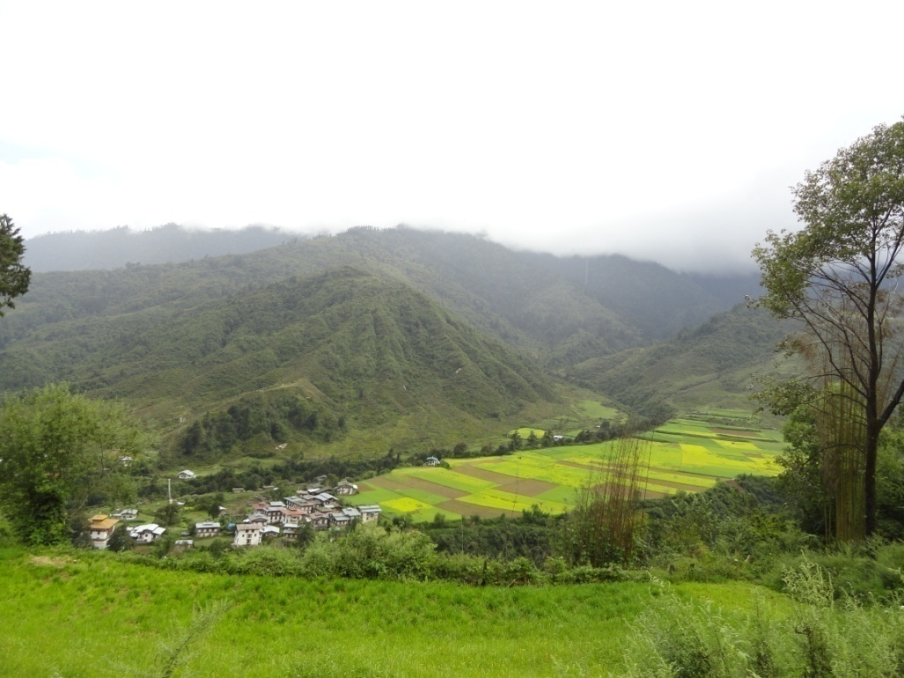

Slide 14
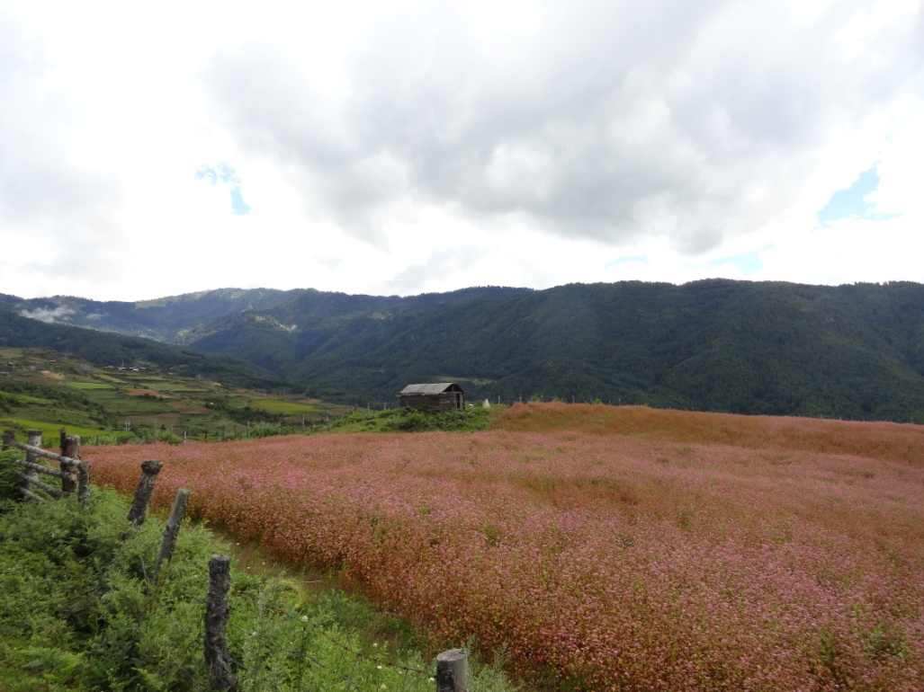
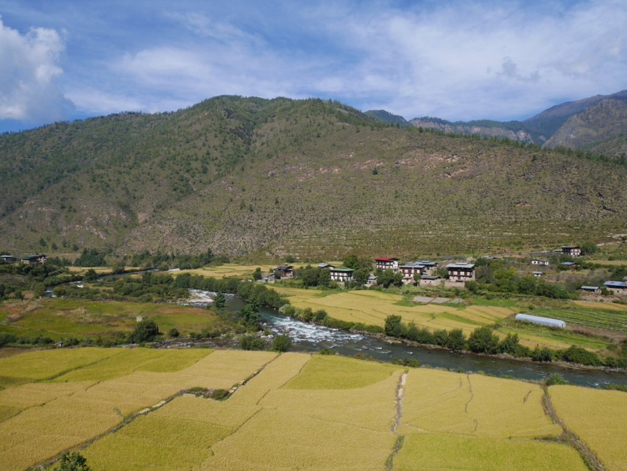

Slide 15
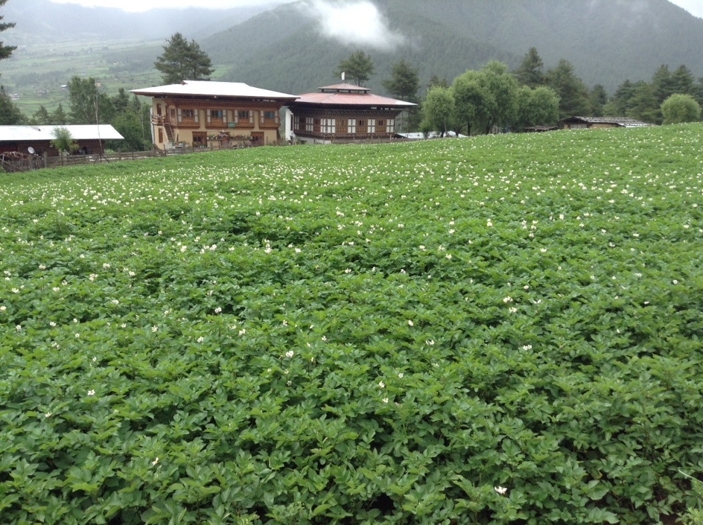
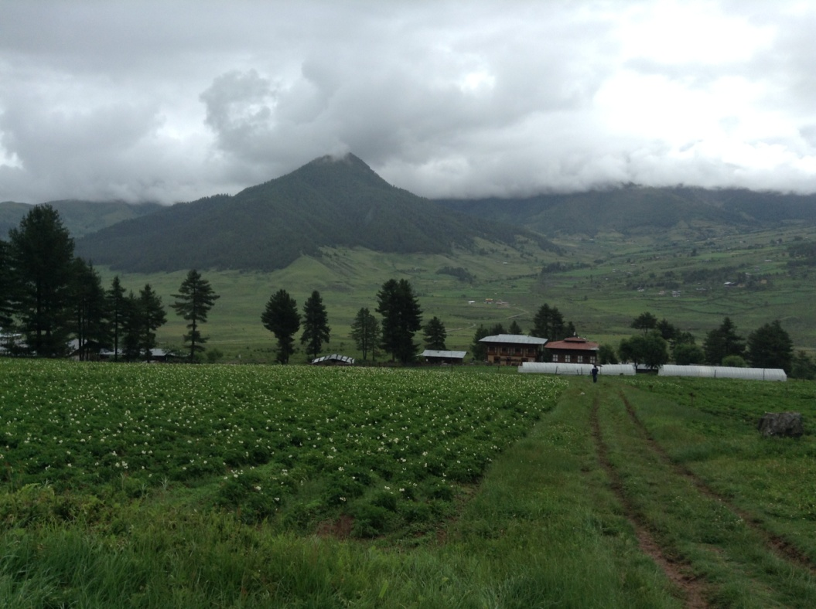

Slide 16
What do we do?
The National Potato Program is the coordinating agency for improving the service delivery of the value chain supporters.
Targets to increase production and productivity to increase income, food and nutrition security:
Improvement of seed system
Crop improvement
Farmers’ training
Post harvest and Marketing

Slide 17
Seed Systems
Rehabilitated the Formal System
Introduction of aeroponics system and 3G seed
Linking the formal and informal system
Seed distribution/flow from high to low altitudes only (>3000m to 2500m to 1500m)
Farmer seed grower groups
Training on seed production (field inspection, negative and positive selection to improve quality of farm saved seed)

Slide 18
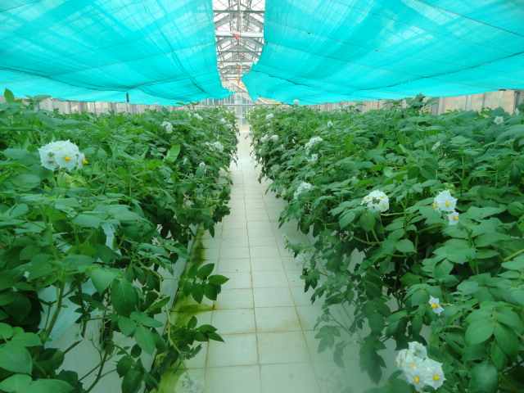
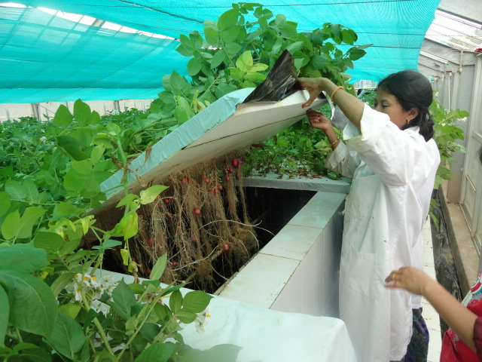
Aeroponic seed production

Slide 19
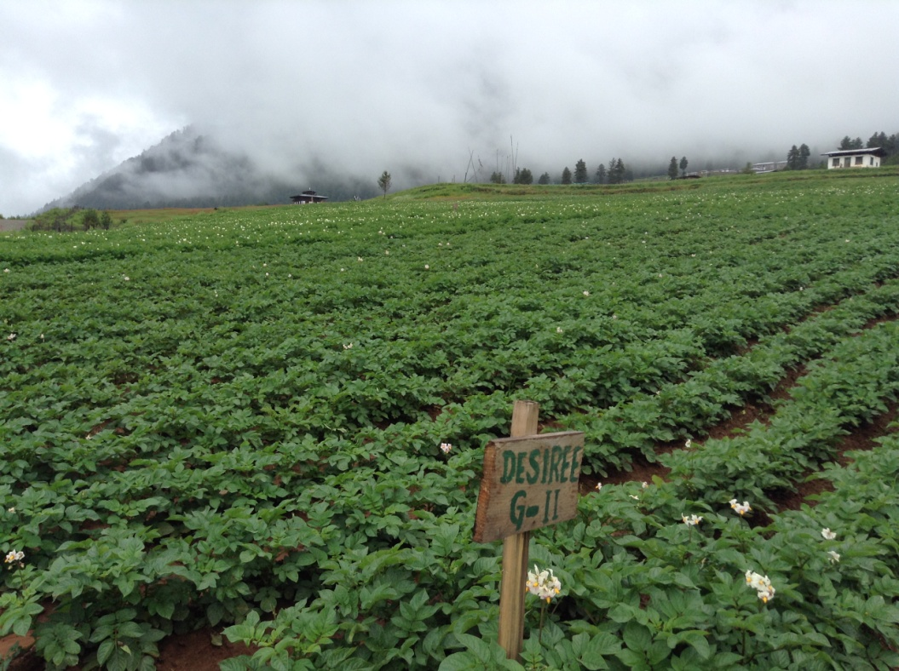
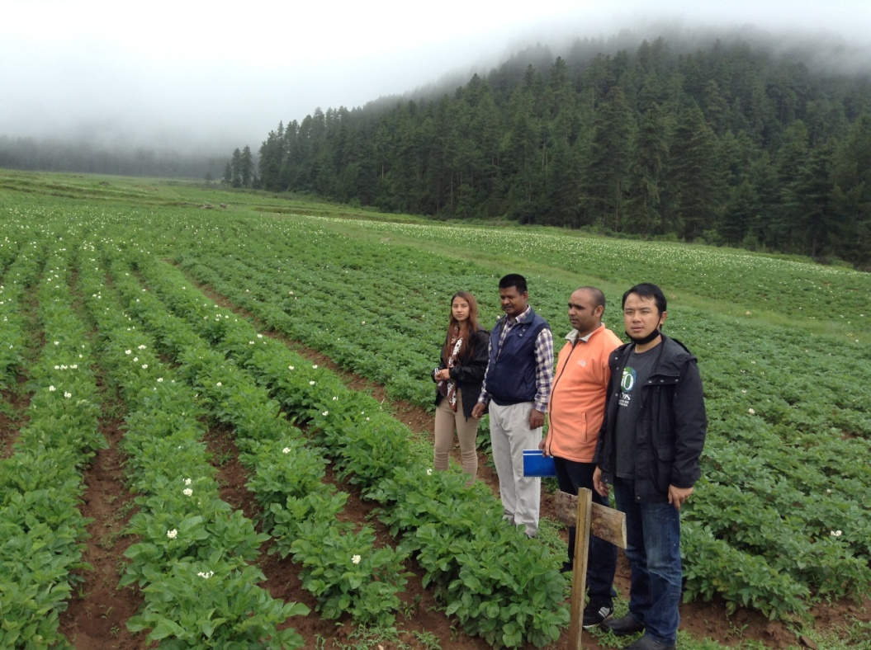
3G seed

Slide 20
Crop Improvement
Selection of advanced clones of potato through participatory approach
Released two (one white and other red skinned) with late blight resistance and high yield
Bio-fortified clones from International Potato Center

Slide 21
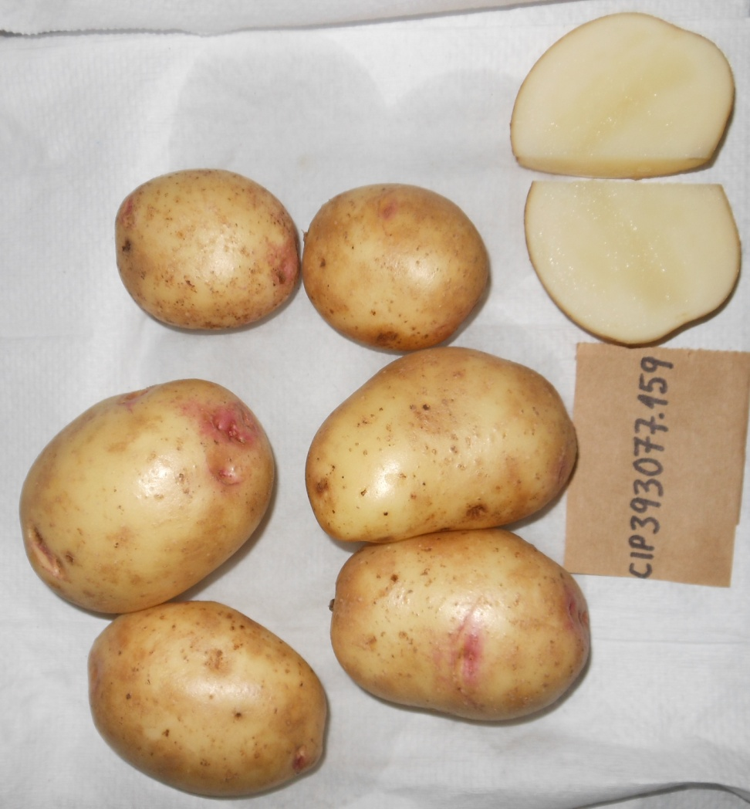
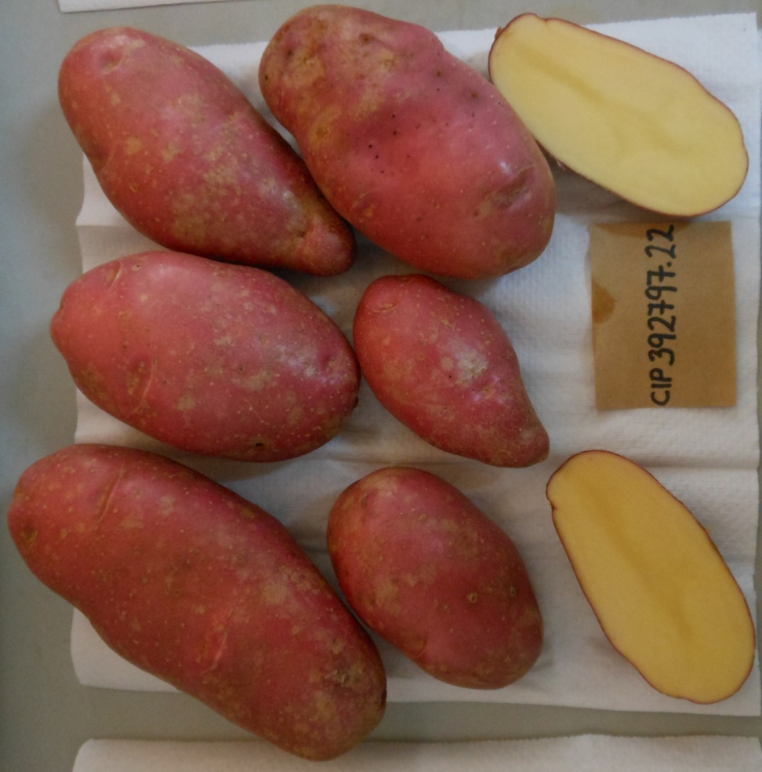

Slide 22
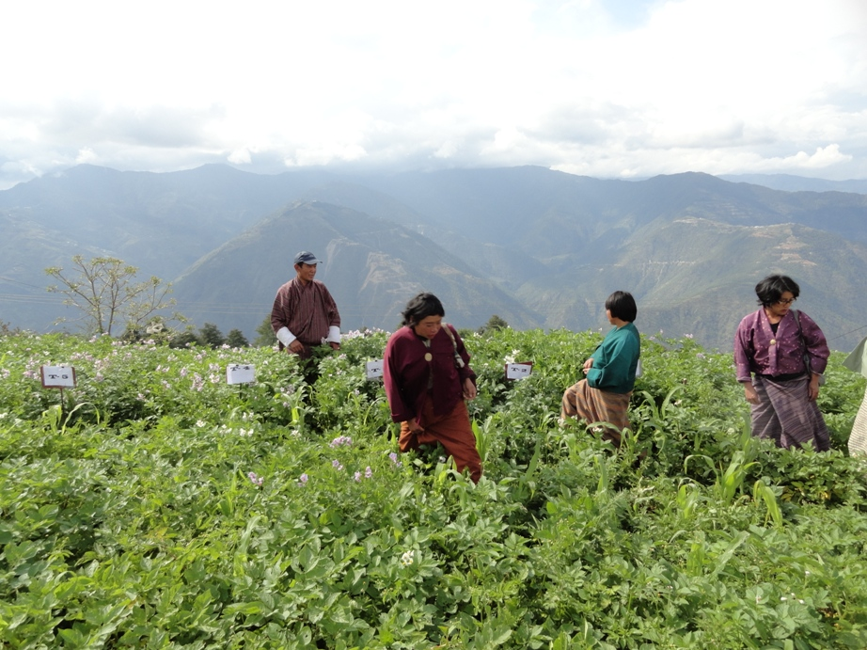
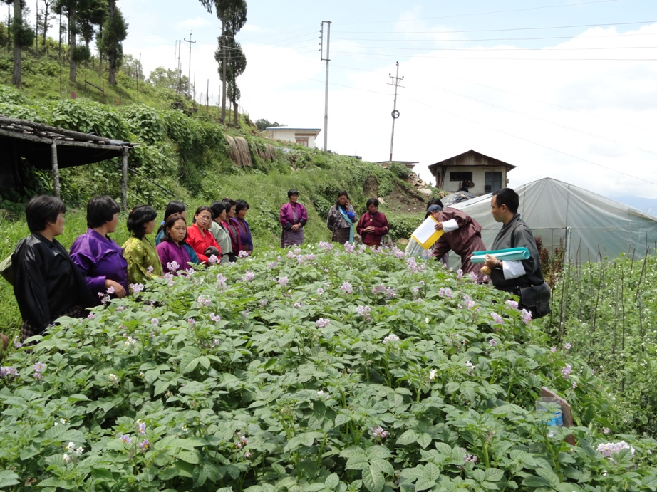
Participatory Varietal Selection

Slide 23
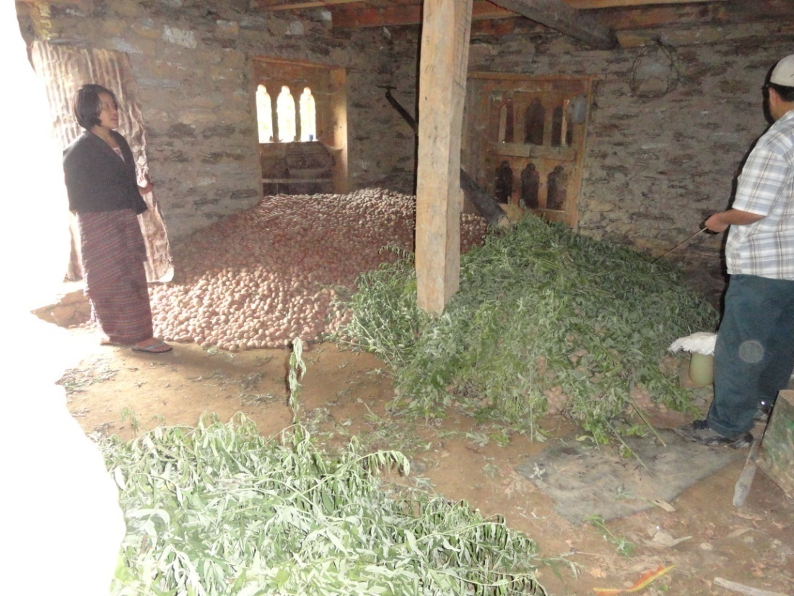
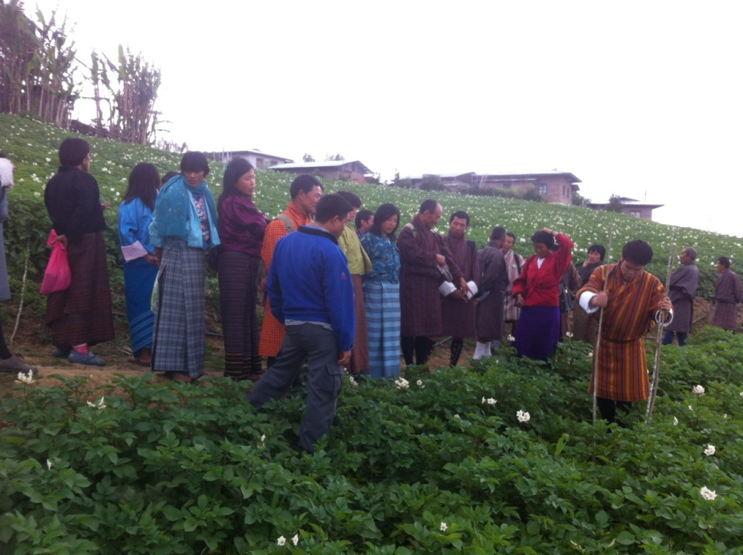
Farmers’ Training
Integrated Pest Management
Informal Seed production

Slide 24
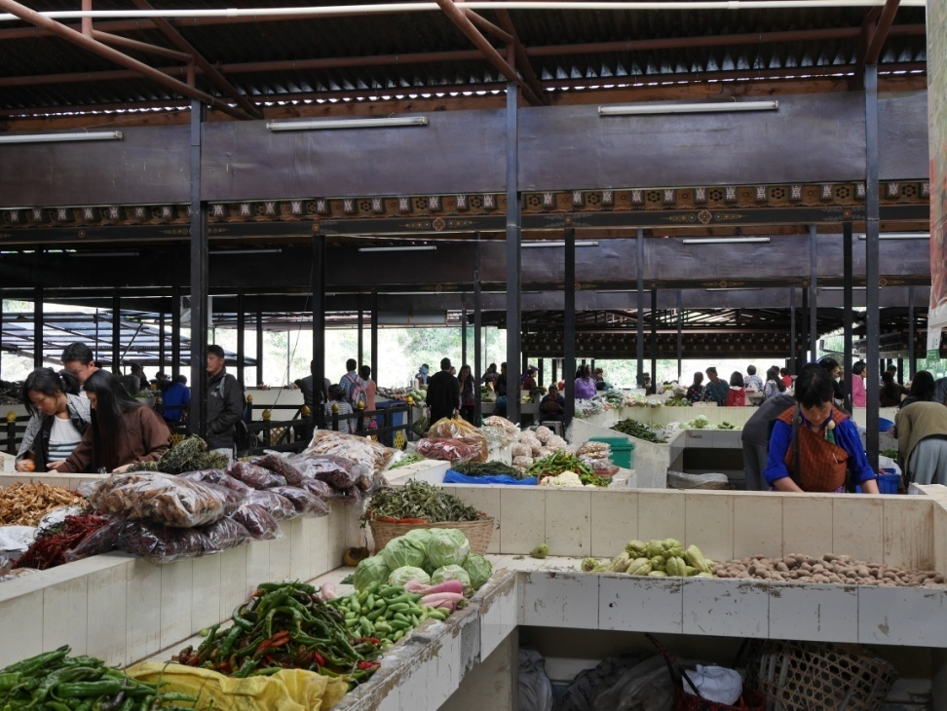
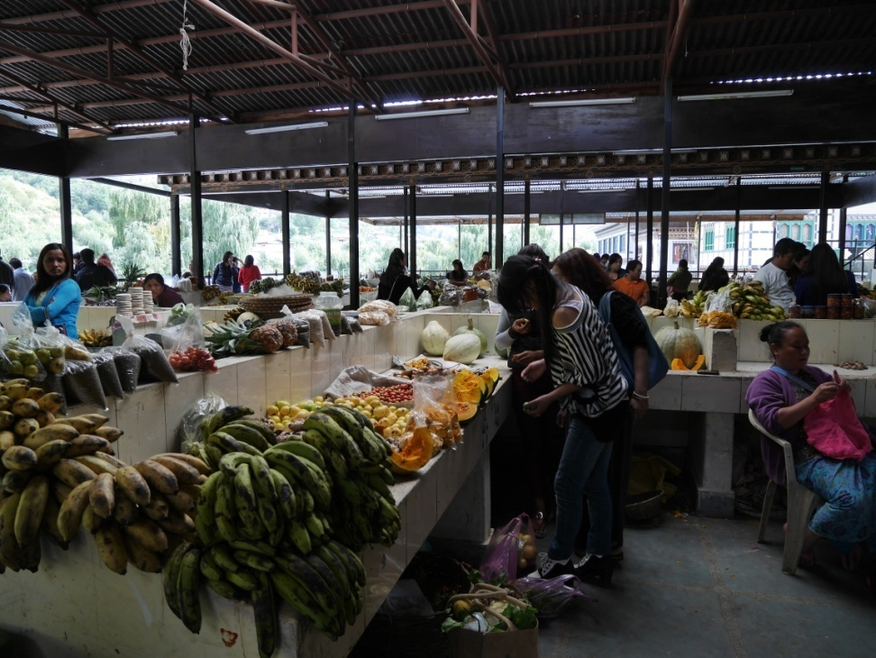
Marketing: Farmers’ Market

Slide 25
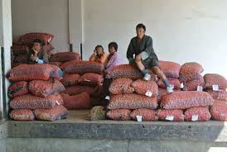
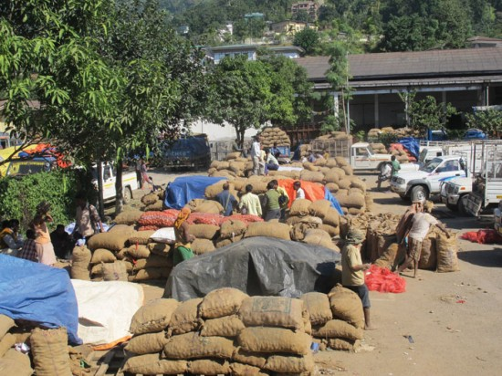
Marketing: Auction
Auction system started in 1980. Farmers bring produce from the highlands to the Indo-Bhutan
Border where it is auctioned to foreign buyers facilitated by the Food Corporation of Bhutan

Slide 26
Thank You

