Slide 1
Promoting mountain products
to improve livelihoods
IPROMO 2017
Alessia Vita

Slide 2
The Mountain Partnership
A United Nations alliance of governments and civil society organizations dedicated to improving the lives of mountain peoples and protecting mountain environments around the world.

Slide 3
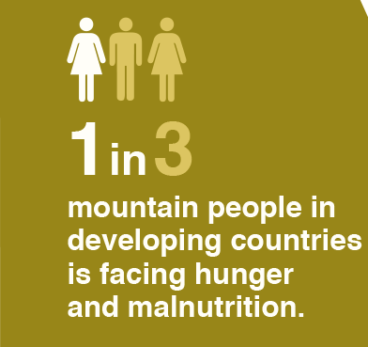
WHY MOUNTAIN PEOPLES
Challenges:
Climate change
Economic hardships
Harsh terrains
Land Degradation
Conflict
Isolation
Migration
Notes:
According to a FAO/MPS study Mapping the vulnerability of mountain peoples to food insecurity 39 percent of mountain population in developing countries were considered vulnerable to food insecurity. This is a 30 percent increase in the number of vulnerable mountain people in 12 years since 2000, while the population has only increased of 16 percent.

Slide 4
Mountain AGRICULTURE
Demand is on the rise for quality foods and beverages produced in mountain areas – e.g. coffee, honey, herbs and spices, traditional grains, handicrafts, cosmetics
Mountain Agriculture is inherently green, low impact, family farming, women, traditional knowledge, high diversity
Small-scale mountain businesses cannot compete with lower prices and larger volumes of lowland production → they can focus on specific markets and tap into the rising demand for sustainable, high quality, fair trade products
Notes:
Reduce middlemen
Emotional story
Organic certification is very expensive

Slide 5
The MounTAIN PARTNERSHIP PRODUCT Initiative
http://www.fao.org/mountain-partnership/our-work/regionalcooperation/climate-change-and-mountain-forests/mountain-products/en/

Slide 6
THE MOUNTAIN PARTNERSHIP PRODUCTS INITIATIVE
Mountain products have great potential to improve livelihoods and boost local economies
The MPS developed in collaboration with Slow Food a voluntary labelling scheme backed up by a value chain and marketing strategy to benefit small mountain producers from developing countries
The label tells the story a mountain product, enabling the consumers to make a more informed purchase, and the producers to sell at a premium price
Notes:
Reduce middlemen
Emotional story
Organic certification is very ex
Many quality foods and beverages are produced in mountain areas, such as coffee, honey, herbs and spices, as well as handicrafts and cosmetics. Inherently green, mountain agriculture has a low impact on the environment - less fossil fuels, mineral fertilizers and pesticides.
The project aims to promote and protect high value mountain products and services as a strategy to develop mountain economies and better livelihoods. It aims to establish a voluntary certification scheme to for mountain products and services so to benefit small local mountain producers in developing countries and help them to better tackle market challenges and fetch premium prices.
pensive

Slide 7
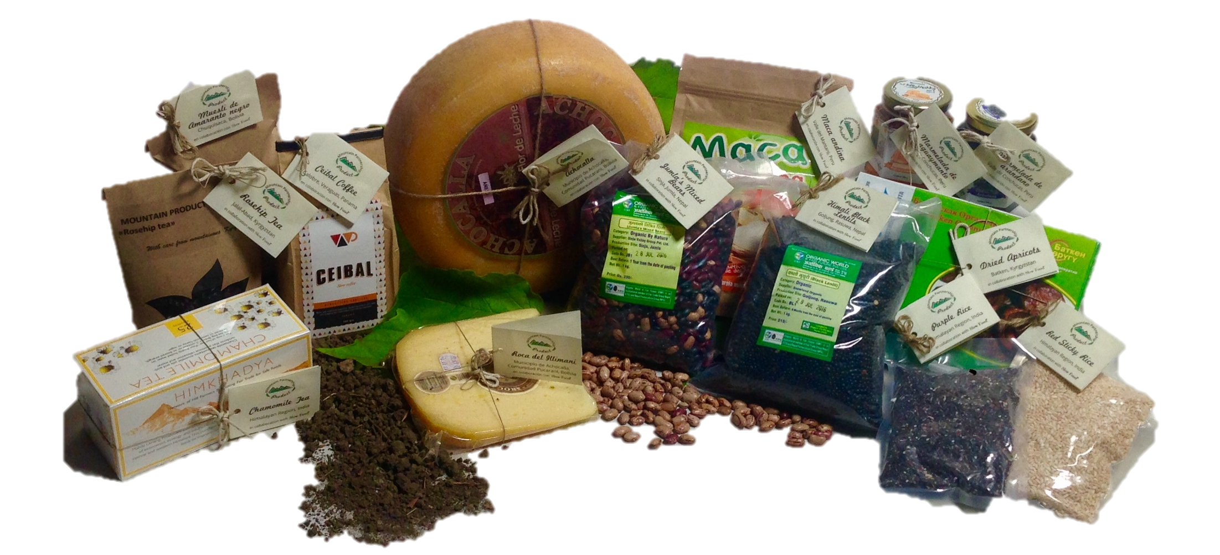
The Mountain Partnership Product LABEL
Consumers often cannot distinguish mountain products in the market, so the label:
Is a powerful communication tool → customized narrative that highlights what makes the product unique
Communicates the added values of a mountain product
Integrates but does not replace existing labels mandatory under the applicable laws
Is voluntary and free

Slide 8
A narrative label

Slide 9
Requirements for the use of the label
Altitude: products produced and processed in the mountains
Small-scale: products from small-scale production; including family farming and small mountain producers cooperatives
Environmental sustainability: production processes respectful of the environment
Equity: fair returns for the producer, equitable distribution of profits along the value chain;
Biodiversity-related products considered with preference
Sustainable value chains
Biodiversity conservation
Cultural and traditional values
Notes:
Sustainable value chains: most mountain products are intrinsically green and carbon neutral. They have a high quality and are often organically produced.
Biodiversity conservation: monoculture almost doesn’t exist in mountains. Farmers base their livelihoods on products diversification, protecting agrobiodiversity and old varieties.
Cultural and traditional values: mountain communities are the custodians of traditional knowledge and techniques. Many products and the related processing methodologies have been fine-tuned through the centuries to become sustainable and adapted to the harsh mountain environment.
Recovering traditional crops that have the potential to adapt to the challenges of a changing climate can help improve the livelihoods mountain populations and increase their resilience.

Slide 10
DISCLAIMER
Drafted by FAO-legal office
MPS does not assume any responsibility
Producers are responsible for ensuring that products comply with any applicable law
The label does not certify the quality, safety or any of the characteristics and components of the product or its suitability for any use
“This label is for information purposes only and is not intended to make any representations or warranties about the characteristics, quality, suitability or any other feature of this product. The Mountain Partnership will not be liable for any loss or damages resulting from use of, reference to, or reliance on this Product or any information relating thereto”

Slide 11
Label-granting system
Application
Any producer may request the authorization to use the label by filling the application form and submitting it to the MPS by email
An expert appointed by the MPS assesses the compliance to the key values and requirements and may visit the production site
The MPS may authorize or deny the use of the label
An expert appointed by the MPS periodically monitors a random sample of products → authorization may be revoked
Assessment
Label granting
Label monitoring

Slide 12
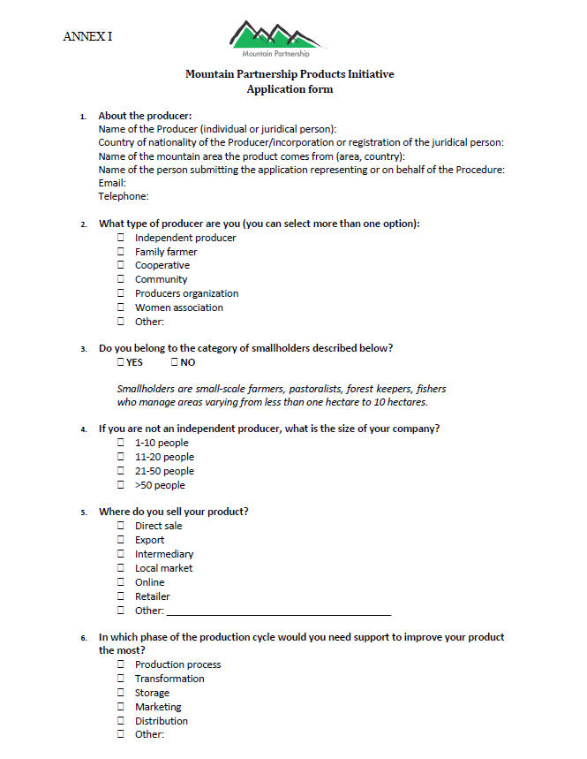
Application form
Information on:
producer
product
distribution channels
phases of the production cycle needing support
production process
production site
links to local culture
environmental sustainability

Slide 13
STEPS so far
Workshop in Rome (May 2015)
Workshop and fair in Delhi (Dec 2015)
Surveys: Bolivia, China, India, Kyrgyzstan, Nepal, Panama, Peru, Russia-Altai Republic, Tajikistan (Oct 2015 – Feb 2016)
Field mission and pilot in Bolivia and Kyrgyzstan (May 2016-ongoing)
Launch of Terms of and conditions to use the label (Sep 2016)
Collection of applications (Sep 2016-ongoing)
Terra Madre forum – launch the of logo (Sep 2016)
Cuba pilot (Nov 2016-ongoing)
Distribution of 1st batch of narrative labels (Apr 2017)
India (March 2017-) and Nepal (July 2017-ongoing) pilots
Online database and map (May 2017)

Slide 14
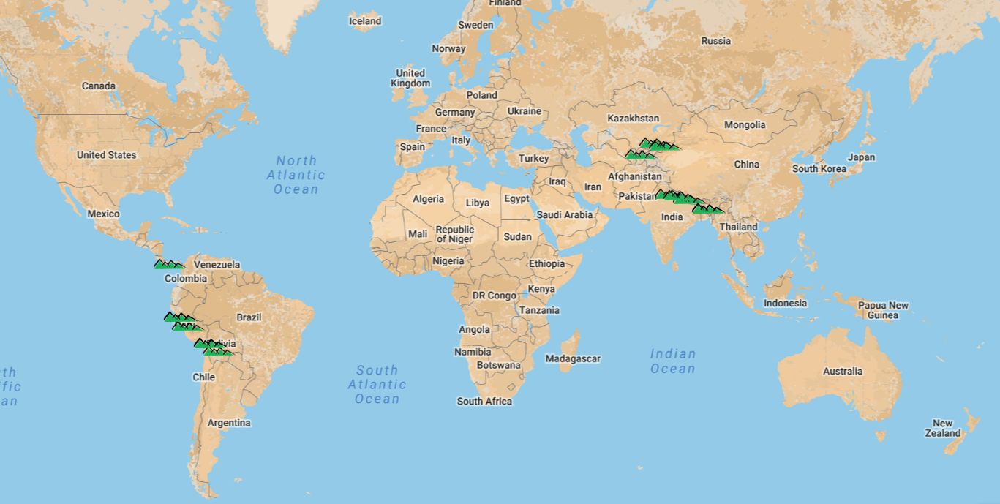
Pilot implementation
Notes:
14 food products were selected from 6 countries (Bolivia, Kyrgyzstan, Peru, Nepal, India, and Panama) and 2 handicraft products from Kyrgyzstan and Mongolia.
Black amaranth; 2 Bolivian cheeses, Peruvian goldenberry and blueberry jams and Maca andina, Nepalese lentils and mixed beans, Indian chamomile tea and purple and pink rice, Panama’s coffee, Kyrgyz dried apricots andf rosehip tea, as well as Kyrgyz silk-and-felt scarves and felt toys from Mongolia.
Plus preliminary activities in Cuba.

Slide 15
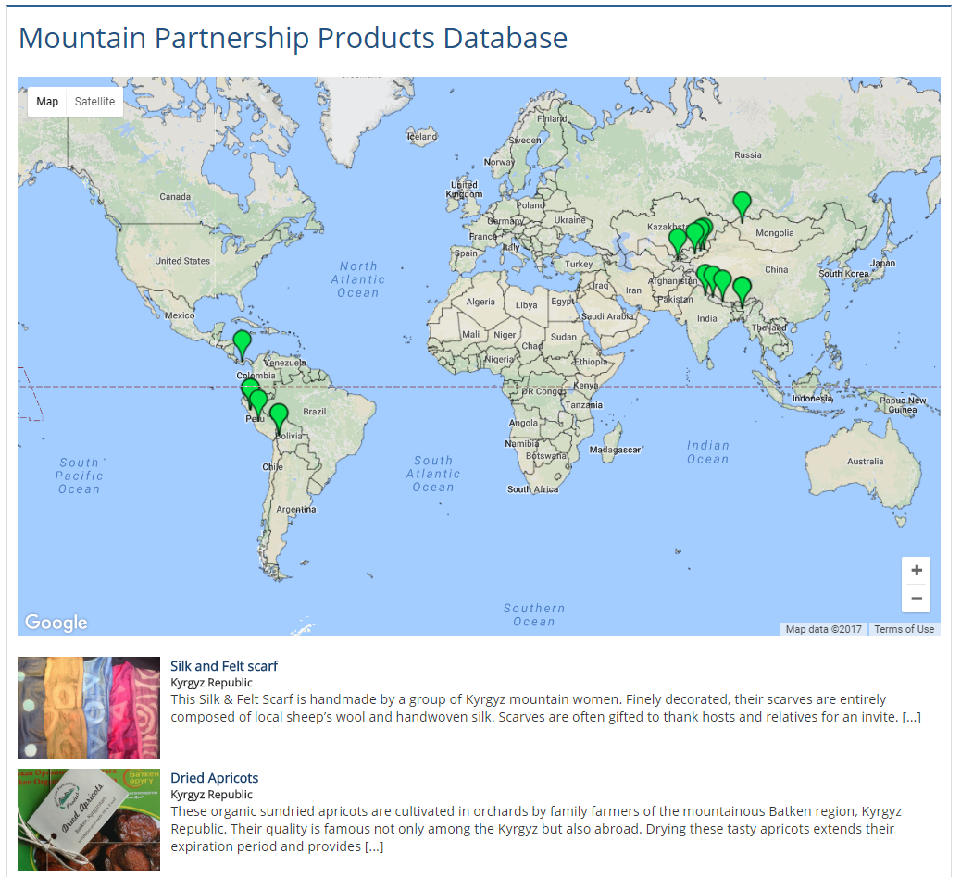
http://www.fao.org/mountain-partnership/map-labelled/en/

Slide 16
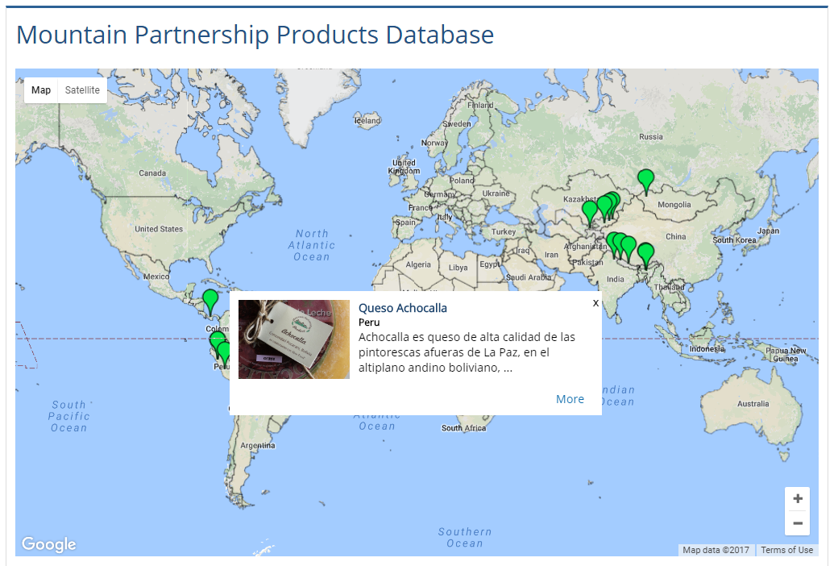
Database: pop-up windows

Slide 17
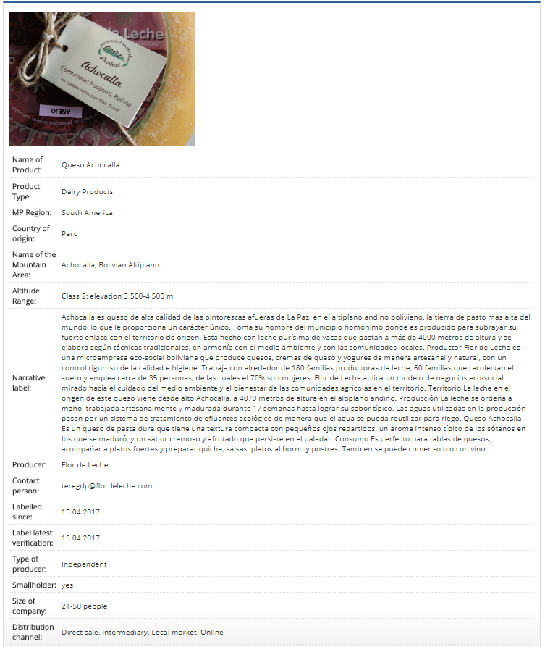

Slide 18
PILOT PROJECT: KYRGYZ dried apricots
Dried apricots, organic apricots from Batken region, the land of apricots → traditional knowledge
Producer: the farmer cooperative Alysh-Dan, member of FOD Bio-KG, one of the pioneers of the organic movement Central Asia
Notes:
Established in 2008, the Farmer Cooperative Alysh Dan comprises 1 200 members, including 63 households of bio-farmers, that produce organic products for domestic and export markets. Located in the Batken Province – commonly known as “the land of apricots” because the region’s native apricots grow here – Alysh Dan is one of the pioneers of the organic movement among apricot farmers in Central Asia. The cooperative is also a member of the national network Federation of Organic Development Bio-KG http://www.mountainpartnership.org/members/members-detail/en/c/88221/, which has established ten organic areas (aimaks) in Kyrgyzstan.
Number of Beneficiaries: 1200 individual small farmers-members of the Alysh Dan cooperative from 63 small scale farmer families from Kara Bak village and farmers from adjacent 2 villages
Support for: Construction of the Storage/Warehouse Facility (14m x 4m x 8m) for storing and completing the primary processing such as removal of kernels and sorting for organic apricots. The price quotation submitted from 2 service providers.
Alysh Dan cultivates and processes organic apricots to produce juices, jams and dried apricots (kuraga in the local language). Apricot farming is one of the main sources of income for the local people.
the former storehouse was built with inappropriate materials and lacked a refrigerating system, making the storage unsafe. This damaged the cooperative because it made it impossible to have a stable supply of products thought the year and thus satisfy the market demand - a possibility that a stock stored in a proper warehouse would instead ensure.
The new storehouse will feature a modern technology, with materials suitable for the specific needs of the products and an efficient refrigerating system. It will be possible to use the storehouse also to perform some preliminary processing activities like the sorting and removal of kernels.
The new storehouse will enable Alysh Dan to store its apricots all year long and better meet the market demand.

Slide 19
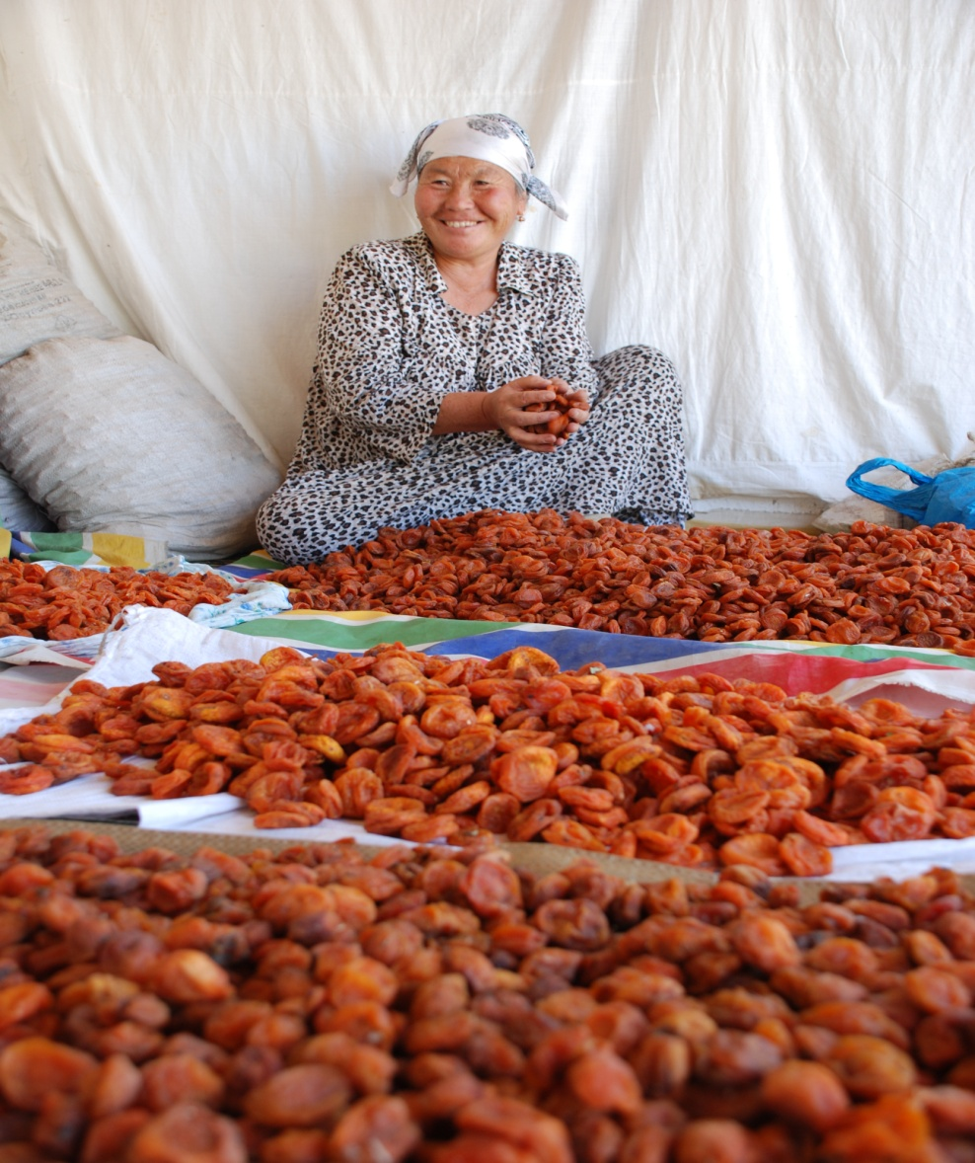
PILOT PROJECT: KYRGYZ dried apricots
Support in scaling up production
Storage facility
Label Granting
Improvement on export
Notes:
Established in 2008, the Farmer Cooperative Alysh Dan comprises 1 200 members, including 63 households of bio-farmers, that produce organic products for domestic and export markets. Located in the Batken Province – commonly known as “the land of apricots” because the region’s native apricots grow here – Alysh Dan is one of the pioneers of the organic movement among apricot farmers in Central Asia. The cooperative is also a member of the national network Federation of Organic Development Bio-KG http://www.mountainpartnership.org/members/members-detail/en/c/88221/, which has established ten organic areas (aimaks) in Kyrgyzstan.
Number of Beneficiaries: 1200 individual small farmers-members of the Alysh Dan cooperative from 63 small scale farmer families from Kara Bak village and farmers from adjacent 2 villages
Support for: Construction of the Storage/Warehouse Facility (14m x 4m x 8m) for storing and completing the primary processing such as removal of kernels and sorting for organic apricots. The price quotation submitted from 2 service providers.
Alysh Dan cultivates and processes organic apricots to produce juices, jams and dried apricots (kuraga in the local language). Apricot farming is one of the main sources of income for the local people.
the former storehouse was built with inappropriate materials and lacked a refrigerating system, making the storage unsafe. This damaged the cooperative because it made it impossible to have a stable supply of products thought the year and thus satisfy the market demand - a possibility that a stock stored in a proper warehouse would instead ensure.
The new storehouse will feature a modern technology, with materials suitable for the specific needs of the products and an efficient refrigerating system. It will be possible to use the storehouse also to perform some preliminary processing activities like the sorting and removal of kernels.
The new storehouse will enable Alysh Dan to store its apricots all year long and better meet the market demand.

Slide 20
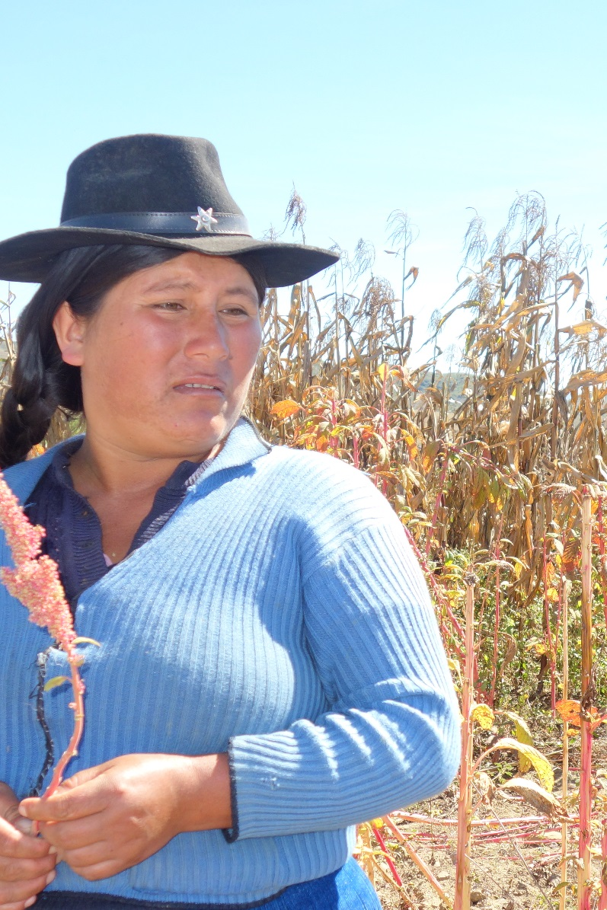
PILOT PROJECT: Bolivian Black Amaranth
Training on agrobiodiversity and cultivation
New storage
Label granting
Packaging and distribution
Launch predicted for Sept 2017
Notes:
Slow Food, the Mountain Partnership and Foundacion PASOS are working together to valorise black amaranth, a native Bolivian variety that only grows at 2800m above sea level, deeply linked to the cultural traditions of the mountain communities of Chuquisaca district. In spite of its higher nutritional properties, climate resilience and resistance to pests and drought, it is heavily under threat, often replaced by non-native varieties. Black amaranth was granted the Mountain Partnership Product label and a farmers’ cooperative of 24 families was assisted with production improvement through training, product development, and marketing, in strict cooperation with Slow Food and local partners. Thanks to the creation of two demonstration plots, training activities have been extended to the whole community;
1. PRODUCTION TRAINING
This phase aims to strengthen the knowledge and understanding of the process through which a product is valorised as well as the technical skills needed for its cultivation:
SF approach to food, product valorisation processes, agro-biodiversity and sustainable food systems (SF Bolivia)
Agro-biodiversity - focus on the native amaranth varieties (FP)
Technical training on amaranth production, cultivation and storage (FP)
2. PRODUCT DEVELOPMENT
This phase focuses on enhancing the knowledge regarding the product and its transformation combining both technical and qualitative aspects. It is necessary to improve the quality of the transformed products (such as bars, muesli and other possible derived products). It is followed by a participatory tasting evaluation (involving the different actors of production chain, included the raw material producers) of the new product elaborated during the process.
Advanced training for product development:
technical training on amaranth production / raw material management and transformation (Irupana)
product quality / tasting and analysis (SF Bolivia)
training on participatory certification (FP)
Product participatory tasting evaluation involving producers and the other actors of the product chain (SF hq)
3. PRODUCT LAUNCH
The product launch phase is structured to combine the different tools of communication in order to promote the product:
article for newsletter, press release, social media
graphic materials for communication
participation to international SF events
Labelling - definition of the product label (*) (SF hq)
Packaging development (SF hq)
Confirmation for the certification process (FP)
Product market launch (FP, Irupana) June 2017

Slide 21
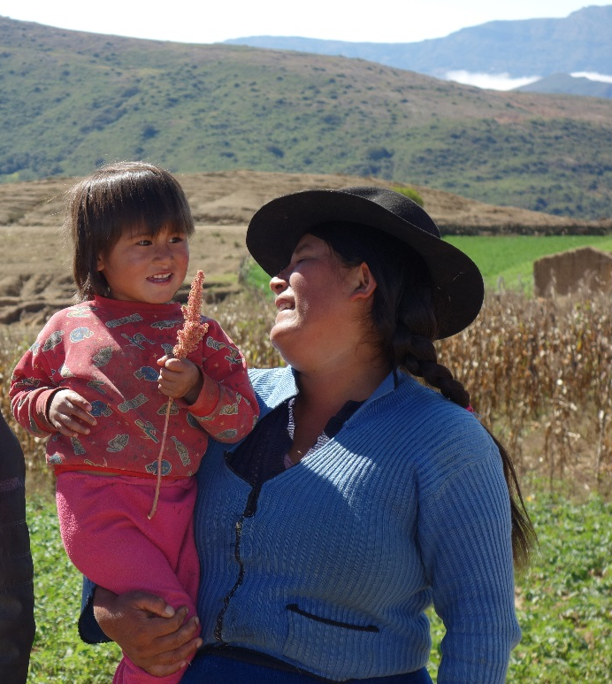
PILOT PROJECT: Bolivian Black Amaranth
BENEFICIARIES: 20 producers from 4 communities involved in the production, 200+ in trainings
PRODUCTION TRAINING (Oct – Dec 2016)
SF approach to food, product valorisation and sustainable food systems
agro-biodiversity - focus on the native amaranth varieties
technical training on amaranth production, cultivation and storage
Adhesion to the national program of participatory certification
PRODUCT DEVELOPMENT (Dec 2016 – Mar 2017)
technical training on amaranth transformation
technical training on product quality and tasting
training on participatory certification
product participatory tasting evaluation involving producers and other actors
PRODUCT LAUNCH (Mar – Jun 2017)
definition of the product label
packaging development
communication activities
participation to international SF events

Slide 22
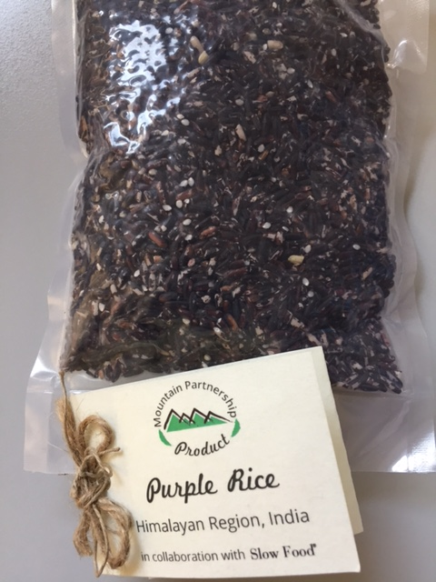
PILOT PROJECT: Indian Pink and purple rice
Indigenous crops cultivated by small-scale Indian Himalayan farmers
Purple rice is also known as forbidden rice
In close collaboration with Pan Himalayan Grassroots Development Foundation in the Ri-Bhoi basin in the State of Meghalaya
Notes:
In India the project supported the production of pink and purple rice in close collaboration with Pan Himalayan Grassroots Development Foundation in the Ri-Bhoi basin in the State of Meghalaya. Activities included training of producer groups on production techniques, agro-biodiversity and sustainable food systems; group management and leadership; accounting; rice storage and marketing; permaculture and sustainability challenges. The project also contributed with a suitable storage to allow for a stable supply of rice along the year.
While farmers have comprehensive knowledge regarding storage of ordinary rice varieties which are locally consumed, scaling-up production of purple and pink rice varieties would imply technical assistance regarding storage for longer periods of time. (Currently these two varieties are grown in meagre quantities simply to fulfill traditional customs.)
Activities:
1. Training of producer groups ~ group-operations, leadership, book keeping, fair trade
2. Documentation ~ process of ongoing permaculture and future sustainability challenges
3. Rentals for stores/packaging ~ space for storage, packaging, labelling, etcetera
4. De-humidifier & Moisture meter ~ for maintenance of appropriate moisture post harvest - prior to hand-pounding as well as during storage in the uplands with high rainfall
5. Storage systems ~ essentially appropriate gunny bags, shelves, bins, etcetera
6. Packages, Labels & Promotional Materials ~ design and production costs for the first season of retail marketing, which would be absorbed in the sale price in the future
7. Exhibitions ~ for promotion amongst urban consumers regarding the benefits of purple and pink rice as exotic yet affordable healthy rice varieties, which are no longer ‘forbidden’
8. Travel, board & Lodging ~ for Grassroots/Mountain High team members to extend assistance to a distant watershed in eastern Himalaya
9. Honorariums ~ for Grassroots/Mountain High resource persons
10. Revolving Fund ~ for immediate payment to producer-groups during procurement of rice varieties in the first harvest season. Funds would reflow through sales for use as revolving fund for the next harvest season

Slide 23
PILOT PROJECT: Indian Pink and purple rice
Training on production techniques and agrobiodiversity
Training on group management and leadership
New storage
Label granting
Support to marketing and distribution
Notes:
In India the project supported the production of pink and purple rice in close collaboration with Pan Himalayan Grassroots Development Foundation in the Ri-Bhoi basin in the State of Meghalaya. Activities included training of producer groups on production techniques, agro-biodiversity and sustainable food systems; group management and leadership; accounting; rice storage and marketing; permaculture and sustainability challenges. The project also contributed with a suitable storage to allow for a stable supply of rice along the year.
While farmers have comprehensive knowledge regarding storage of ordinary rice varieties which are locally consumed, scaling-up production of purple and pink rice varieties would imply technical assistance regarding storage for longer periods of time. (Currently these two varieties are grown in meagre quantities simply to fulfill traditional customs.)
Activities:
1. Training of producer groups ~ group-operations, leadership, book keeping, fair trade
2. Documentation ~ process of ongoing permaculture and future sustainability challenges
3. Rentals for stores/packaging ~ space for storage, packaging, labelling, etcetera
4. De-humidifier & Moisture meter ~ for maintenance of appropriate moisture post harvest - prior to hand-pounding as well as during storage in the uplands with high rainfall
5. Storage systems ~ essentially appropriate gunny bags, shelves, bins, etcetera
6. Packages, Labels & Promotional Materials ~ design and production costs for the first season of retail marketing, which would be absorbed in the sale price in the future
7. Exhibitions ~ for promotion amongst urban consumers regarding the benefits of purple and pink rice as exotic yet affordable healthy rice varieties, which are no longer ‘forbidden’
8. Travel, board & Lodging ~ for Grassroots/Mountain High team members to extend assistance to a distant watershed in eastern Himalaya
9. Honorariums ~ for Grassroots/Mountain High resource persons
10. Revolving Fund ~ for immediate payment to producer-groups during procurement of rice varieties in the first harvest season. Funds would reflow through sales for use as revolving fund for the next harvest season

Slide 24
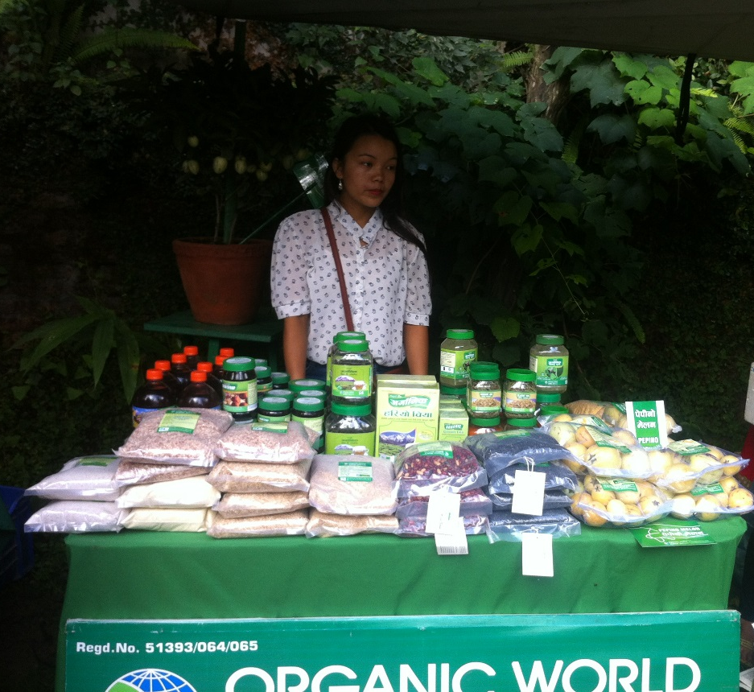
PILOT PROJECT: NEPALI pulses
Himali black lentils, an indigenous Nepali lentil variety mainly cultivated by Tamang and Gurung small-scale mountain farmers produced by Snow Land Organic
Lesherpa farmers market
Jumla’s mixed beans, a traditional Nepali mixture of pulses with a strong link to the local culture and religious festivities produced by the Sinja Valley Group

Slide 25
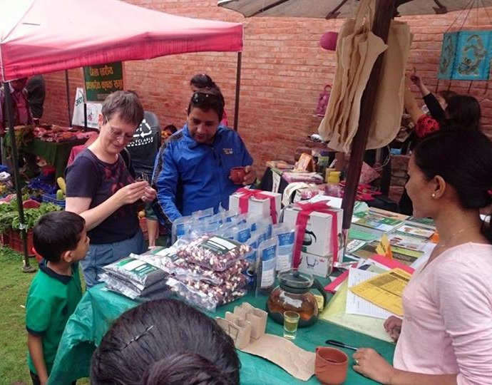
PILOT PROJECT: NEPALI pulses
Participation in expos and fairs
Packaging
Label granting
Marketing
Taragaun agro bazar

Slide 26
NEXT STEPS
Salon Goût et terroirs – Switzerland 2017
Agreements with private sector for distribution of products
Expansion of label into services – ecotourism Slow Food –Slow Travel
Notes:
In Cuba, the project started a mapping activity in the Escambray Mountains, a mountain range in the central region of Cuba, to identify products with potential to be included in the project. Meetings and events with local institutions, local actors and communities, including schools, were organized to raise awareness on the project and the qualities and potential of mountain products.

Slide 27
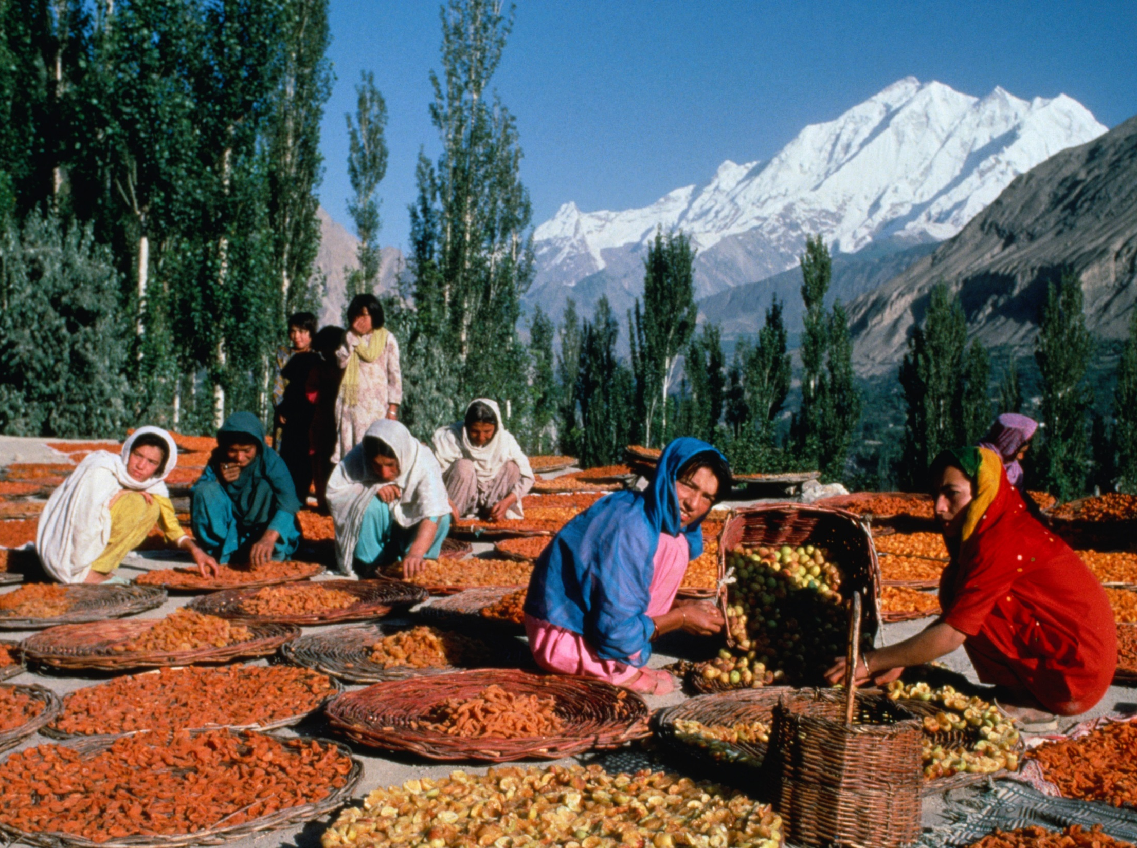
Thank you!

