Slide 1


FAO Approach to Increasing Resilience
of Livelihoods to Disasters and Crises
Notes:
SO5: Increase the resilience of livelihoods to threats and crises affecting agriculture, food and nutrition

Slide 2
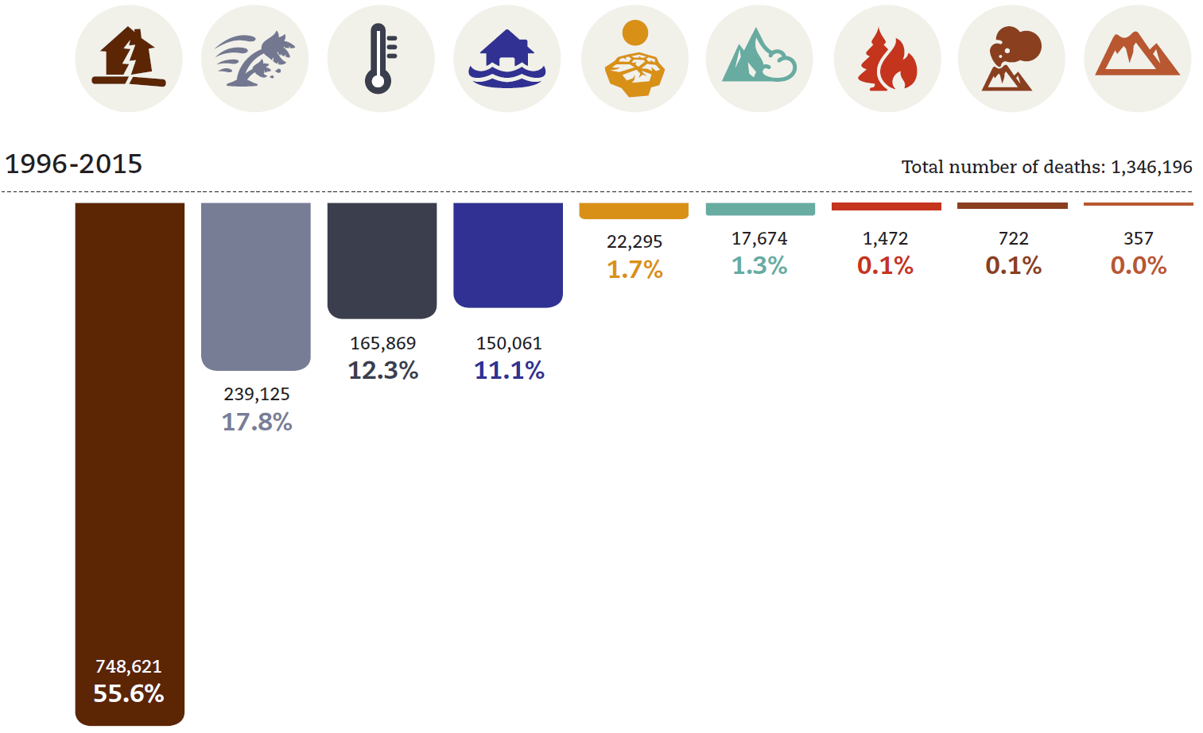
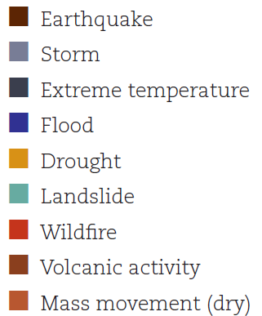
Number of deaths by disaster types
1996 - 2015
From: Poverty & Death: Disaster Mortality, http://emdat.be/

Slide 3
Floods/landslides impacts better controlled:
population affected, 1990 - 2016

Slide 4
Drought impacts persist:
Population affected, 1990 - 2016

Slide 5


Key Messages Recap: from Cancun to Ljubljana
Prevention - move words into action
From disaster management to risk reduction management and risk informed development
DRR - a development issue; integrate into SDGs; deliver through sectoral work
Importance of agriculture sectors to DRR delivery (agriculture risk reduction measures are cost-effective)
Multi-hazard perspective
Insurance and risk transfer – key pillars of comprehensive risk management
Systematic data incl. remote sensing – basis for planning
FAO Approach to increasing Resilience of Livelihoods to Disasters and Crises
Notes:
Support of agriculture livelihoods increases resilience and reduce food insecurity over the longer term (exit strategy of food assistance)
Address the root causes of vulnerability reducing dependency from international assistance and increasing self-help and dignity
Support livelihoods of people in their own location, thus stabilizing people and reducing displacement and migration where security allows
Contribute to climate change adaptation in response to extreme events
Reduce or break the vicious loop of hunger and conflict and poverty-unemployment of youth helping rebuilding peace
Support of agriculture risk reduction measures, including livelihoods diversification, is cost-effective as for every 1USD spent , at least 2 to 4 USD are saved in terms of reduced or avoided disaster impact.
Develop the capacities of institution and communities to combine crises response and disaster risk prevention

Slide 6





FAO strategic objectives
1. Help eliminate hunger, food insecurity and malnutrition
2. Make agriculture, forestry and fisheries
more productive and sustainable
3. Reduce rural poverty
4. Enable inclusive and efficient agricultural
and food systems
5. Increase the resilience of livelihoods
to threats and crises
FAO Approach to increasing Resilience of Livelihoods to Disasters and Crises

Slide 7
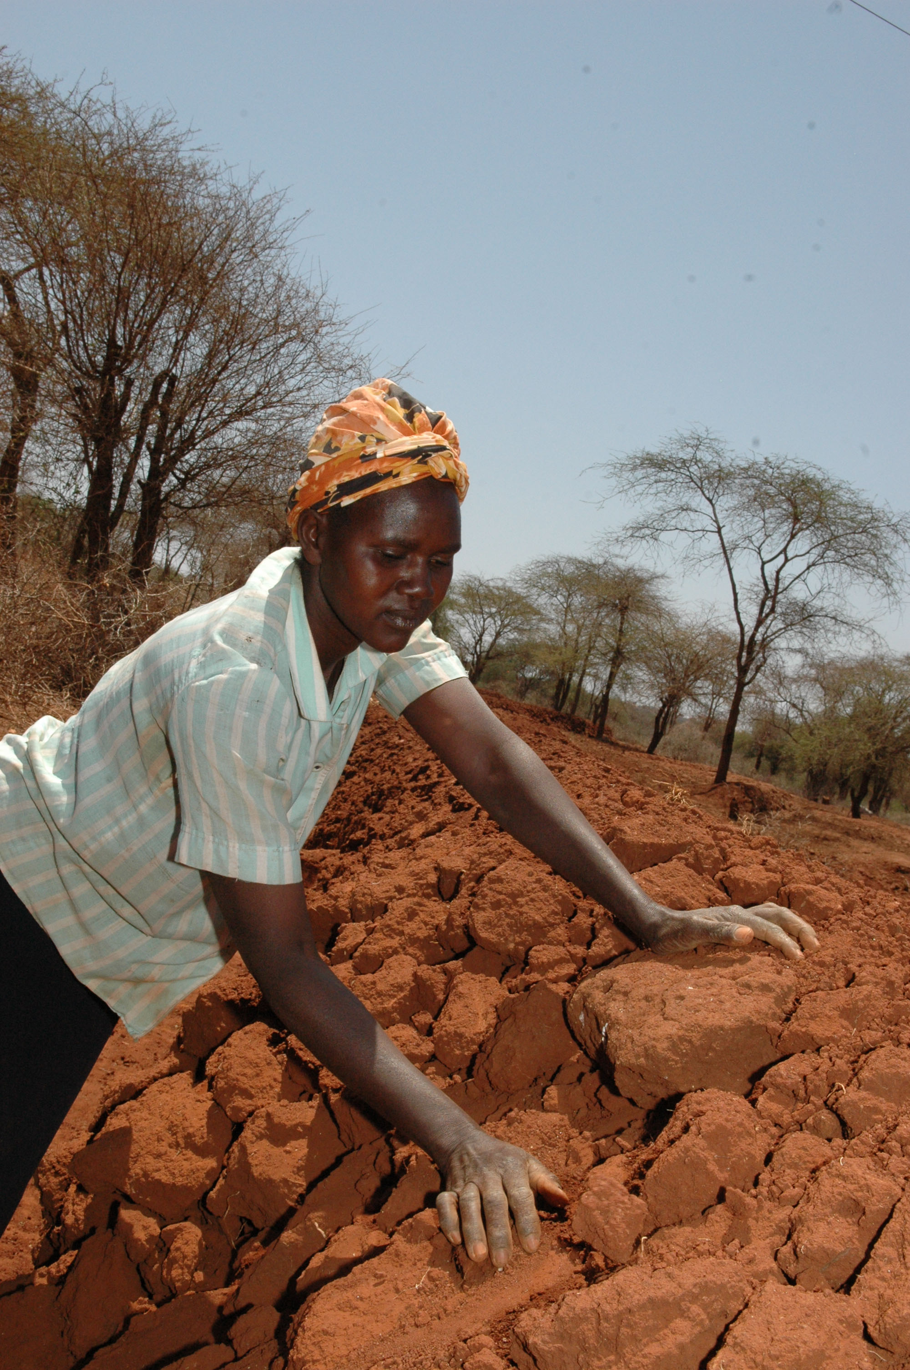

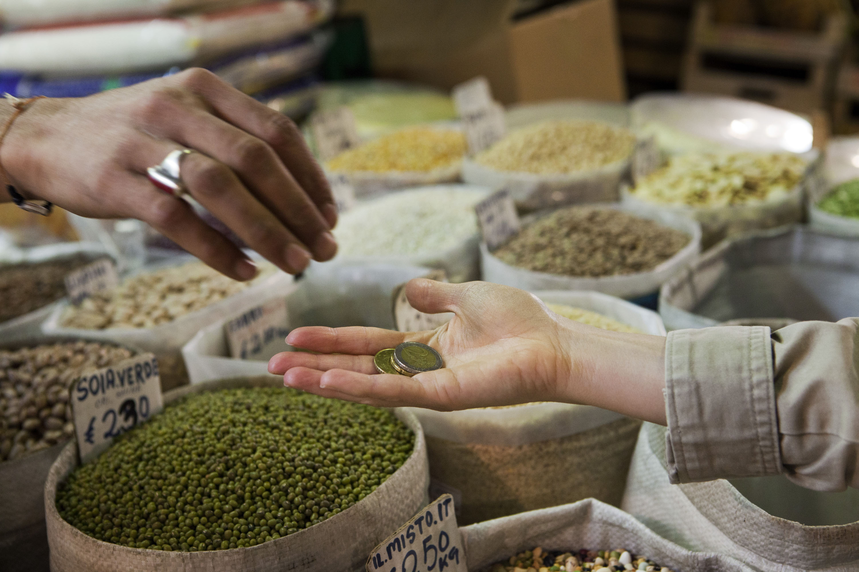
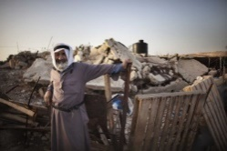
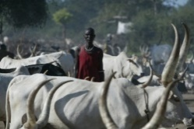
FAO focuses on specific hazards, risks and related
vulnerabilities of agriculture, food and nutrition
Natural disasters
Food chain emergencies
Socio-economic crises
Violent conflicts
Protracted crises
FAO Approach to increasing Resilience of Livelihoods to Disasters and Crises
Notes:
The FAO strategic objective on resilience builds on the Hyogo Framework for action, but goes beyond as it focuses on the multiple and interconnected risks that generate shocks – referred to as “disasters” or “crises”.

Slide 8
Resilience in FAO’s strategic framework
Vision: World free from hunger and malnutrition
Global Goal:
Reduction of hunger and malnutrition
Elimination of poverty through economics and social progress
Sustainable management of natural resources
SO1
Eradicate hunger, food insecurity and malnutrition
SO2
Increase and improve provision of goods and services from agriculture, forestry and fisheries in a sustainable manner
SO3
Reduce rural poverty
SO4
Enable more inclusive and efficient food and agricultural systems at local, national and international levels
SO5
Increase the resilience of livelihoods to threats and crises
Resilience
to shocks
Resilience as an institutional condition for reducing hunger
Resilience in terms of sustainable production and agroecosystem stresses
Resilience in terms of social poverty dimension
Resilience in terms of market and food chain dimension
Resilience to stresses
FAO Approach to increasing Resilience of Livelihoods to Disasters and Crises

Slide 9
Resilience: four outcomes
GOVERN RISKS AND CRISES:
Institutional strengthening and risk and crisis management governance for agriculture, food and nutrition
PREPARE AND RESPOND TO CRISES:
Preparedness and response to crisis affecting agriculture (including livestock, fisheries, aquaculture and forestry), food and nutrition
WATCH TO SAFEGUARD:
Information and early warning systems for agriculture, food and nutrition and transboundary threats
Increase resilience of
livelihoods to shocks
Apply risk and vulnerability reduction measures:
Protection, prevention, mitigation and building livelihoods with technologies, approaches and good practices for agriculture, food and nutrition
7 Core Functions: Standards, Information management, Policy dialogue, Capacity development, Knowledge management, Strategic partnerships, Communication
Cross-cutting themes: Governance, Gender, Statistics, Climate Change
FAO Approach to increasing Resilience of Livelihoods to Disasters and Crises
Notes:
This graphic illustrates how the four outcomes of SO5 are inter-dependent and mutually reinforcing… to increase the resilience of livelihoods to shocks.
It is the essence of “resilience”.
Resilience is not about just one area, it is the synergy and mutual reinforcement of all these outcomes that makes resilience work in a coherent manner at local, national, regional and global levels.
By working together as a multidisciplinary team within the Organization, resilience brings together risk reduction and crisis management across all sectors: agriculture, livestock, fisheries, forestry and natural resources.
The cross-cutting themes on gender and governance and 7 core functions (normative & standard setting, access to data & information, policy dialogue, capacity development, uptake of knowledge & technologies, strategic partnership, advocacy & communication) are driving the delivery of all four outcomes. One FAO key core function is the “MUST WORK TOGETHER AS PARTNERS” to build resilience to fight hunger and malnutrition.

Slide 10
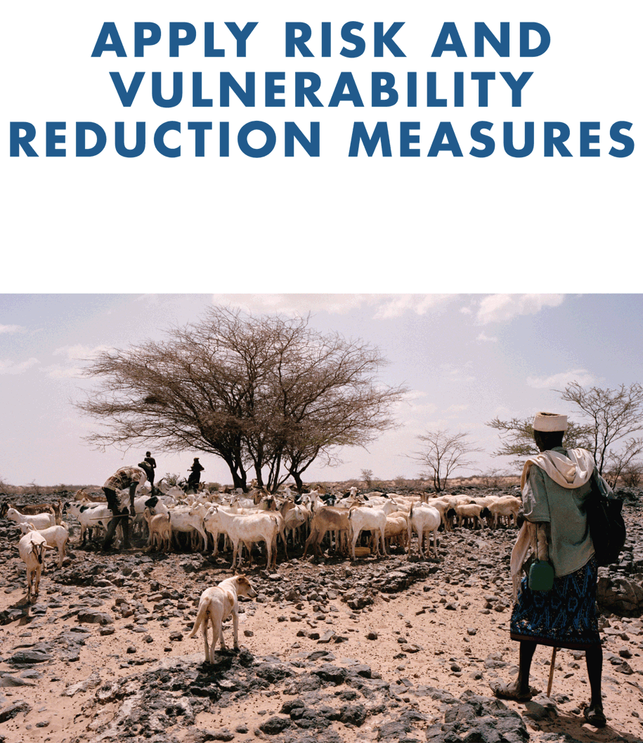
Example of Outcome:
Countries reduce risks and vulnerability at household and community level
Examples:
Agroforestry: Trees can be used as shelterbelts and windbreaks. They can stabilize riverbanks, mitigate soil erosion, protect against landslides and floods.
Rainwater harvesting: Technologies & practices that use less water, reduce water loss, and increase overall water productivity during droughts.
Conflict sensitive measures: Tenure, access to natural resources (water, land, trees, pasture, transhumance routes, …)
FAO Approach to increasing Resilience of Livelihoods to Disasters and Crises
Notes:
Outcome 3: Apply risk and vulnerability reduction measures
Protection, prevention, mitigation and building livelihoods with technologies, approaches and good practices for agriculture, food and nutrition
PIR 2014-15: FAO’s assisted in improving prevention and mitigation capacities and measures and these exceeded by far the biennium targets. Technical measures for risk prevention and mitigation (5.3.1) have been implemented in 46 countries, and 45 countries have applied socio-economic measures that reduce vulnerabilities of communities at risk of threats and crisis (5.3.2).

Slide 11
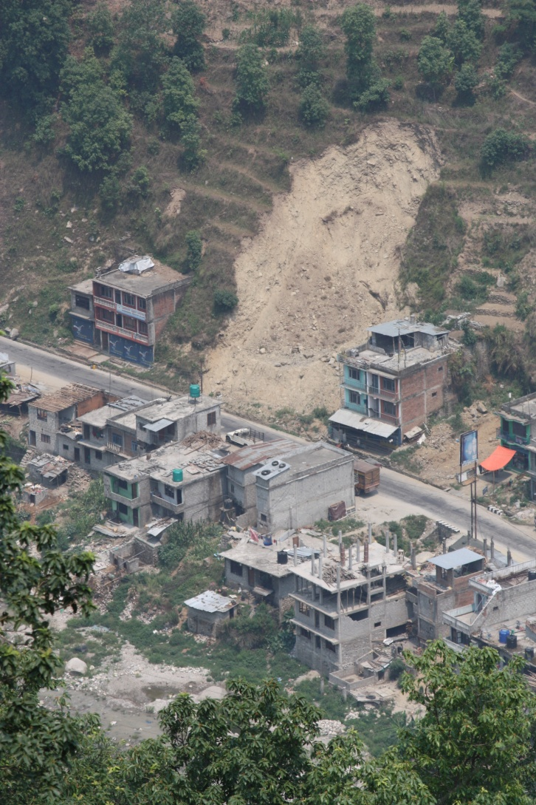
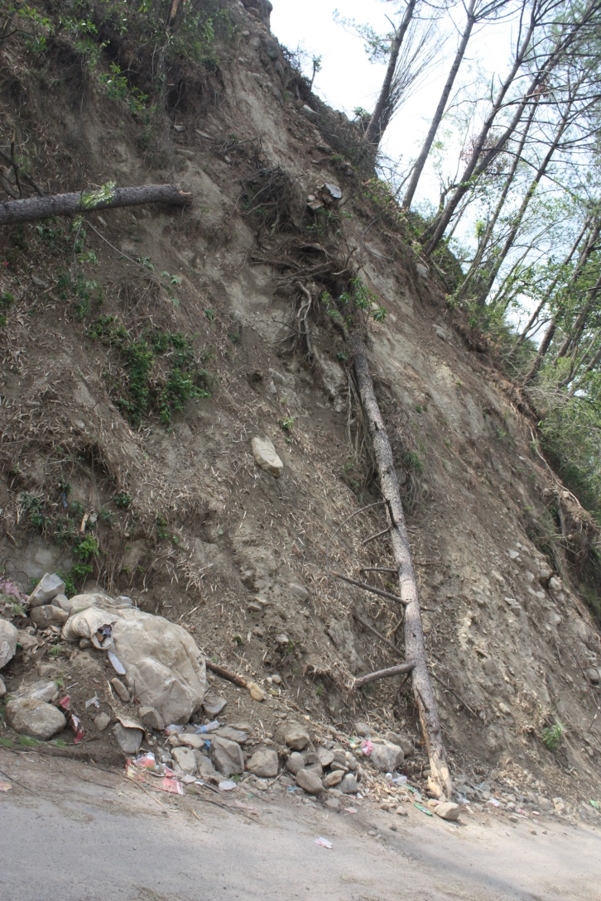
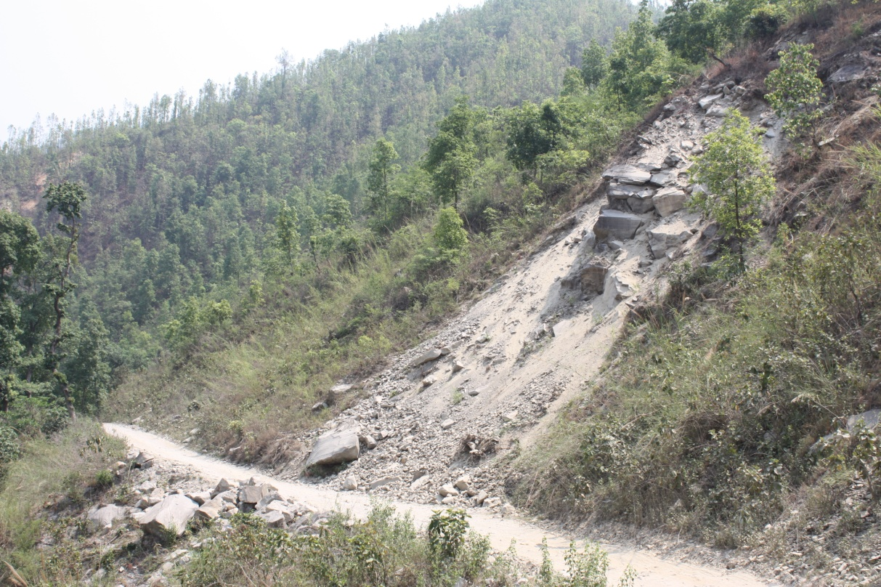
Project Example: Nepal Post-Earthquake Response
FAO Approach to increasing Resilience of Livelihoods to Disasters and Crises

Slide 12
Project Strategy
From short-term response to long-term rehabilitation and resilience
Earthquake as an opportunity to “build back better”
Combine slope stability with NRM and livelihood improvement
Watershed management approach!
FAO Approach to increasing Resilience of Livelihoods to Disasters and Crises

Slide 13
Project Phasing
1. Landslide risk assessment and treatment (2015-2016)
  Implement emergency response activities related to landslides with immediate benefits
2. Landslide stabilization as a component of watershed management in medium-term rehabilitation (2016-2018)
  Bring people back to their production systems through watershed management - build back better
3. Towards long-term preparedness and resilience (2018-2021)
  Scale up and institutionalize the experiences for long-term resilience to future shock and trends (such as climate change)
FAO Approach to increasing Resilience of Livelihoods to Disasters and Crises
Notes:
Phase 1: Identify and treat critical landslides which impact agricultural lands and irrigation infrastructure
Map cracks, establish a monitoring and early warning system, seal off smaller cracks
Remove fallen trees from landslides in the forest
Analyse impact of 2015 monsoon season
Low cost and more resistant housing technologies (wood, bamboo)
Phase 2: Complete landslide stabilisation activities
Continue with monitoring and early warning system, establish hazard maps
Map out springs and monitor flow
Identify critical watersheds (at least 2/affected district)
Watershed management plans
“Village resilience package”
Capacity development
Phase 3: Upscale the experiences from the prioritised watersheds to other sites
Institutionalise the experiences and incorporate the lessons learned in national policy making
Extended capacity building programme on watershed management for resilience creation
Develop a toolkit for landslide stabilisation

Slide 14
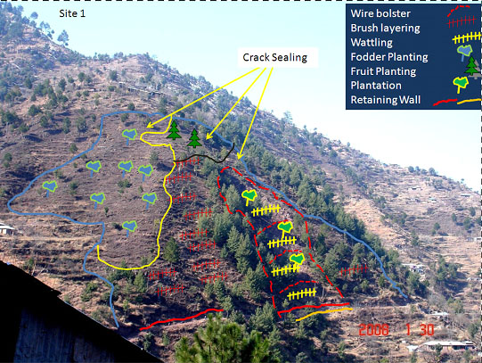
Tools: Watershed Management Plan
FAO Approach to increasing Resilience of Livelihoods to Disasters and Crises

Slide 15
Project Partners
Ministry of Forests and Soil Conservation
Other Government agencies
ICIMOD
The Mountain Institute (TMI)
IUCN
Nepal Water Conservation Foundation
International Consortium on Landslides (ICL)
etc.
FAO Approach to increasing Resilience of Livelihoods to Disasters and Crises

Slide 16
Project Lessons
Support the Government to implement the Post-Disaster Needs Assessment (PDNA) recommendations for forestry and environment
From short-term rehabilitation to long-term resilience
Address the entire DRM-cycle: response, recovery, mitigation, preparedness
Resource mobilization
FAO Approach to increasing Resilience of Livelihoods to Disasters and Crises

Slide 17
Leveraging Global Partners and Advocacy
United Nations voluntary alliance of partners
Dedicated to improving the lives of mountain people
and protecting mountain environments around the world
Established in 2002
293 members - governments, IGOs, NGOs, private sector
Secretariat based at FAO in Rome
FAO Approach to increasing Resilience of Livelihoods to Disasters and Crises

Slide 18

Save the Date: “Mountains under Pressure”
11 Dec 2017 - High-Level Conference in Rome
Co-hosts: Government of Italy and FAO
Invitees: Heads of states and governments, Mountain Partnership members, goodwill ambassadors, UN conventions, IGOs, NGOs, private sector
Objectives:
  Declaration and Call to Action to establish actions and policies to increase resilience in mountains
  Coalition of governments of mountainous countries to raise attention in intl negotiations
  Sustainable Mountain Development agenda to be integrated in 2030 Agenda and Paris Agreement implementation
FAO Approach to increasing Resilience of Livelihoods to Disasters and Crises

