Slide 1
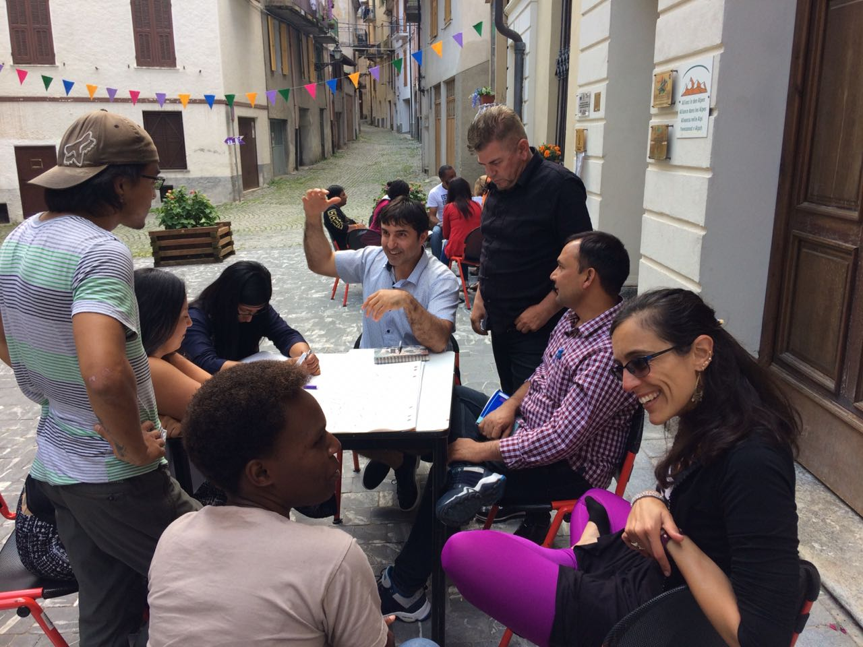
Sustainable Use of Local Plants and Traditional Knowledge to Improve Local Development
Group 2
Alisa Rai
Shankar Datt
Paola Espinosa
Guillermina Elias
Aydin Inchiyev
Petrit Imeraj
David Cañas
Solange Uwera
July 2, 2018
Turin, Italy

Slide 2
Mountain Communities
Strengths | Vulnerabilities
Traditional Knowledge Environmental Friendly Lifestyle Sustainable Management Practices Friendly and Simple | Geographically Isolated Forced Migration Climate Change Socio Economic Issues Poor infrastructures Dependent on Natural Resources

Slide 3
Facilitating Local Development Using Local Resources
Area and Community Selection
Based on the communities´needs, resources and potentiality
Training and Capacity Building
Use traditional knowledge
Enterprise Development
Marketing
Cooperatives/asociations
Access to credit

Slide 4
Circular Economy Using Local Resources
Local Resources
Feasibility Study and Business Plan
Innovative Production/ Processing Waste
Consumption/ Reuse
Using Waste for other products ( compost/biogas)

Slide 5
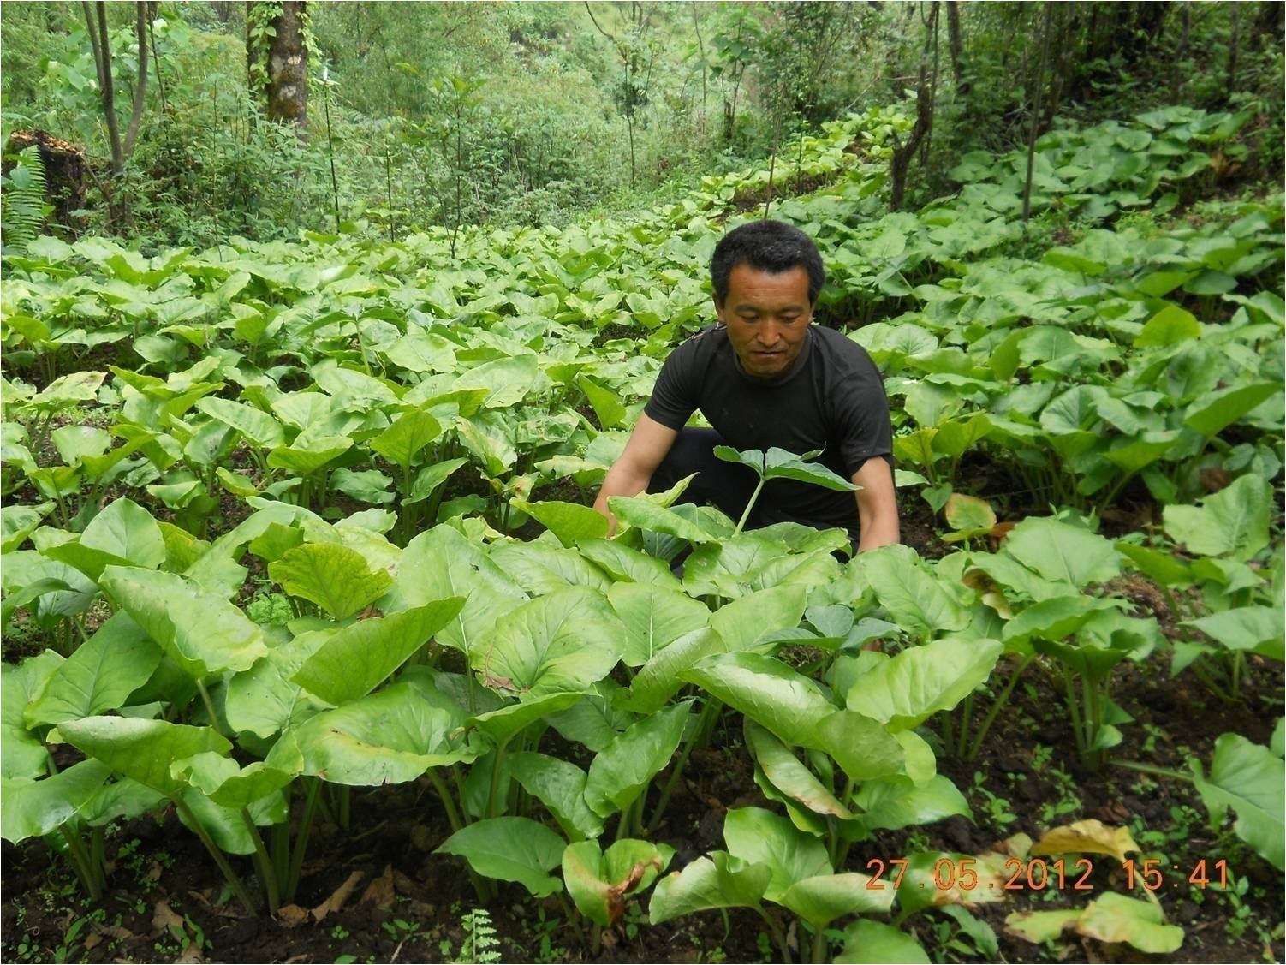
Case Study in Nepal
Cultivation of Medicinal and Aromatic Plants: Biodiversity Conservation and Livelihoods Diversification Option

Slide 6
Feasibility Study and Stakeholder Consultations for area selection
TMI’s Working Modality on Cultivation, Commercialization and Conservation of MAPs Program
Periodic Monitoring and Community based Evaluation
Periodic Monitoring and Community based Evaluation
Project Area Expansion
Value Addition
Stakeholders
. Government Line Agencies
District Forest Office
District Agriculture Development Office
Department of Plant Resources
District Development Committee
Village Development Committee
Division Cooperative Office
. Private Sectors (local, regional, national and international traders)
. Development Partners
. Civil Society Organizations
. Research Institutions
. Donors
. Traditional healers (Aamchii)
Participant’s selection
(Focus on small-holder, marginalized farmers, women)
Phase Out Plan
Final evaluation
Sustainable plans
Lessons learnt documentation and dissemination
Basic Level Cultivation Training
Theory and practical
Nursery establishment
Start up seeds
Monitoring and Data Collection
MAPs production and sales data
Community based MAPs diversity monitoring
Capacity Building
Exposure Visits
Trainings in: Weeding, transplantation, organic manure preparation , legal provisions and regulations ,Cultivation on private land, Sustainable harvesting techniques
Market management and network
Further Capacity Building
Product Origin Certificates
Business Development
Fair Trade Exhibition
Advanced Cultivation Training
Theory and practical
Diversification of species
Start up seeds
Cooperative/Enterprise Development
MAPs Co-operative formation and registration
Support for asset & infrastructure development
Market linkages and value addition
Cross Cutting Issues - Gender Equality and Social Inclusion, Policy Advocacy

Slide 7
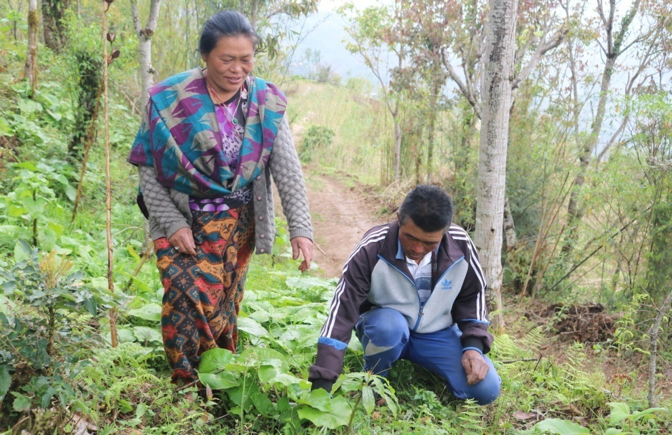
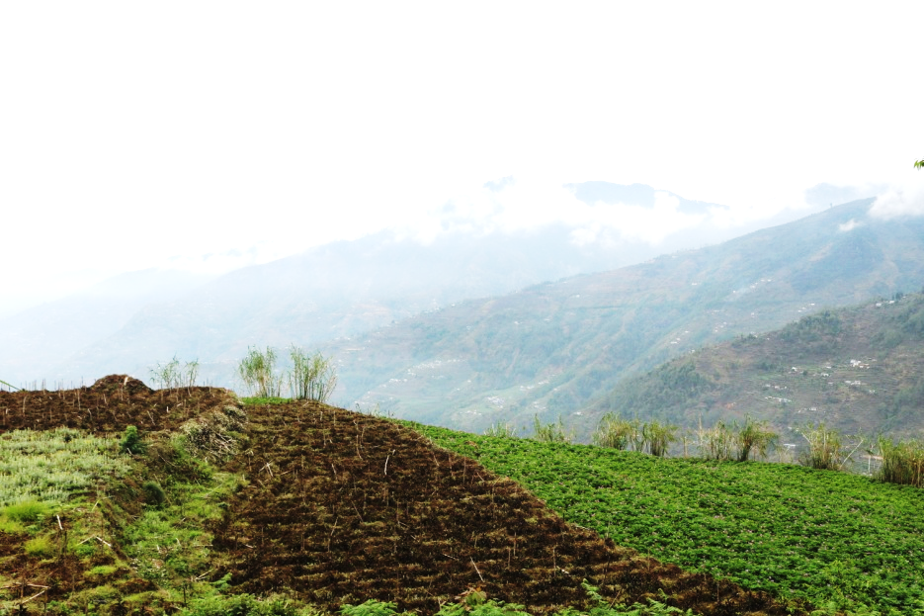
Deo Prakash Tamang Talkarka, Prambung-5, Panchthar

Slide 8
Time Frame
Depends on product, in current case study it is five years payback
Three cycles of production to be sustainable
Expected Benefits
Additional income
Strengthen farmers organization
Reduce intermediary
Expected Solutions
Diversify Income,
Increase resilience for the community

Slide 9
Sustainability
Economic
Can be propagated by seeds;
Diversifies production and income
Social
Environmental
Economic
Environmental
Protects natural forest from illegal harvesting,
uses degraded land and endangered species
Social
Culture and knowledge preservation

Slide 10
Replicating Nepali Experience in The Andes
Cultivation of chocho (Lupinus mutabilis):
Biodiversity Conservation and Livelihoods Diversification Option

Slide 11
 | Himalaya | Andes
Local Resource | Swertia Chiraita | Lupinus mutabilis
Local Knowledge | Medicinal plant cultivation | Nutrient supplement/Nitrogen Fixer
Situation Analysis | Pilot, it is possible | Evaluate Production
Market | Pharmaceuticals | Nutrient Supplement
Fair Price | Farmers Cooperative | Farmers Cooperative
Resources Use Efficiency | Water Harvesting, Land Use | Nitrogen Fixer, Transitional Crop
Waste |  | Composting, Biogas Production

Slide 12
Lupinus mutabilis
Ecuador, Peru, Bolivia
2000 a 3800 m altitude
Short term crop, in between other crops. Restores soil because is a nitrogen fixer
Nutritional/Medicinal
Nitrogen fixer
Wood treatment
Requires water to grow and to be prepared. The water can be reused to treat wood and as insecticide
Water, soil
Green manure, great amount of cellulose, great heating power

Slide 13
Nutritional Value
Other Uses
Pesticides
Biofuel
Antiparasitic
Anti hair loss
Dandruff

Slide 15
Feasibility Study and Stakeholder Consultations for area selection
TMI’s Working Modality on Cultivation, Commercialization and Conservation of MAPs Program
Periodic Monitoring and Community based Evaluation
Periodic Monitoring and Community based Evaluation
Project Area Expansion
Value Addition
Stakeholders
. Government Line Agencies
District Forest Office
District Agriculture Development Office
Department of Plant Resources
District Development Committee
Village Development Committee
Division Cooperative Office
. Private Sectors (local, regional, national and international traders)
. Development Partners
. Civil Society Organizations
. Research Institutions
. Donors
. Traditional healers (Aamchii)
Participant’s selection
(Focus on small-holder, marginalized farmers, women)
Phase Out Plan
Final evaluation
Sustainable plans
Lessons learnt documentation and dissemination
Basic Level Cultivation Training
Theory and practical
Nursery establishment
Start up seeds
Monitoring and Data Collection
MAPs production and sales data
Community based MAPs diversity monitoring
Capacity Building
Exposure Visits
Trainings in: Weeding, transplantation, organic manure preparation , legal provisions and regulations ,Cultivation on private land, Sustainable harvesting techniques
Market management and network
Further Capacity Building
Product Origin Certificates
Business Development
Fair Trade Exhibition
Advanced Cultivation Training
Theory and practical
Diversification of species
Start up seeds
Cooperative/Enterprise Development
MAPs Co-operative formation and registration
Support for asset & infrastructure development
Market linkages and value addition
Cross Cutting Issues - Gender Equality and Social Inclusion, Policy Advocacy

Slide 16
Thank You
Grazie Mille

