Slide 1
Personal presentation
Aydin Inchiyev
GIZ, Programme “ Integrated Biodiversity Management, South Caucasus”
E-mail: aydin_inchiyev@yahoo.com
IPROMO
Bioeconomy in mountain areas – an opportunity for local development
Pieve Tesino /Ormea 18 June -02 July 2018

Slide 2
Education
Baku Branch of the Dagestan State University, Bachelor’s Degree in Finance and Credit
Institute of Futurology, Faculty of Economics
KTF Programme
Employment and main activities
Senior Advisor, GIZ / Programme “Integrated Biodiversity Management, South Caucasus”
Ensure cooperation with partners to improve good working relationships
Advise the partners in the process developing concepts and strategies
Provide technical inputs related to the development of national policies for biodiversity and ecosystem services
Planning and monitoring of programme activities
Formulating TORs, selecting and supervising third parties in the course of carrying out programme activities

Slide 3
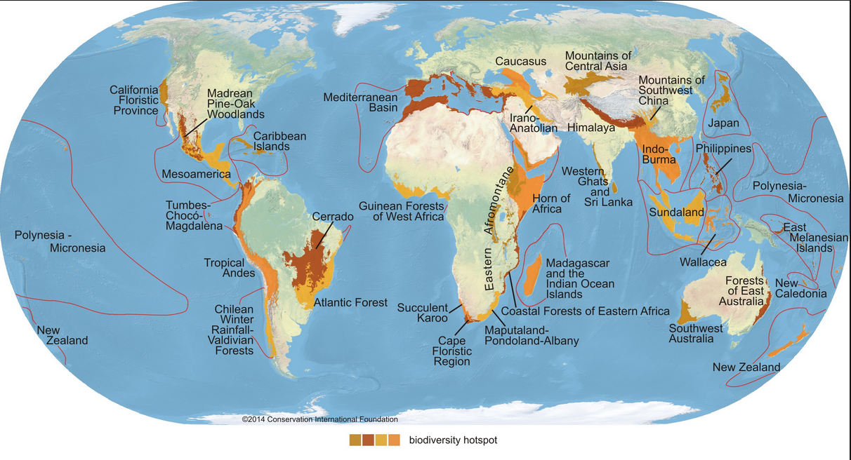
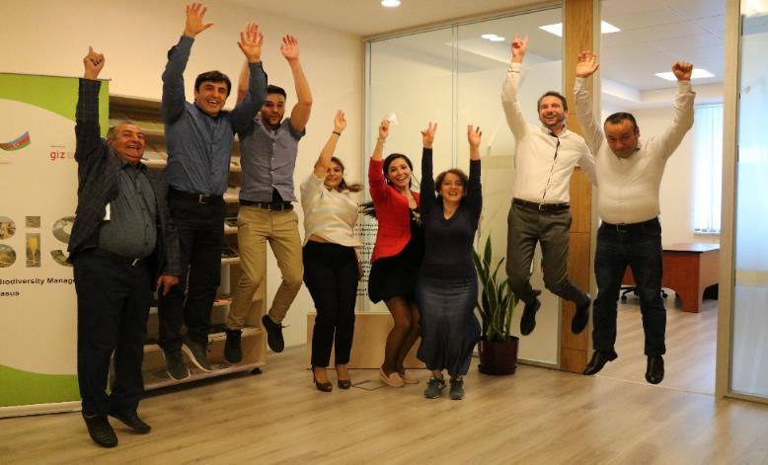
GIZ Programme “Integrated Biodiversity Management, South Caucasus” (IBiS)
Where we work
The Caucasus - One of 35 global biodiversity hotspots

Slide 4
IBiS Azerbaijan team

Slide 5
GIZ IBiS
IBiS Programme is implemented by the GIZ on behalf of the German Government, represented by BMZ
In Azerbaijan, the political partner is the Ministry of Ecology and Natural Resources
Overall Goal: Promote better coordination of biodiversity and ecosystem services management across sectors on the basis of solid data
4 Fields of Intervention:
Testing instruments and coordination processes for the SMBES at local level.
Capacity building of line ministries, their subordinate bodies and of training institutions regarding IMBES.
Public awareness raising on the value and importance of biodiversity and ecosystem services.
Improve the regional exchange on sustainable management of biodiversity and ecosystem services.

Slide 6
Other interests (volunteer work, hobbies etc.)
Scout master in one of the regional groups
Initiator for the establishment and development of the junior ranger group
Like doing sports
Enjoy going to nature

Slide 7
Thank You

Slide 8
GIZ IBiS
Multilevel Approach
Regional level: Exchange of experiences and promotion of regional dialogue.
National level: Promote management of BES across sectors
Local level: Piloting of integrated approaches for the sustainable management of BES together with stakeholders.
General public: Promote a more positive perception on the value of biodiversity among the general public
The overall frame is the Convention on Biological Diversity.
Notes:
- through support of institutional and legal reforms & capacity development.
- through events & campaigns, dialog platforms and strengthening of education institutions.

