Slide 1
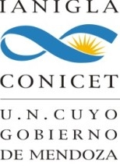
Personal presentation
Guillermina Elias
Argentine Institute for Nivology, Glaciology and Environmental Sciences (IANIGLA) - National Scientific and Technical Research Council, Argentina (CONICET)
Mendoza, Argentina
gelias@mendoza-conicet.gob.ar
guille.elias14@gmail.com
IPROMO
Bioeconomy in mountain areas – an opportunity for local development
Pieve Tesino /Ormea 18 June -02 July 2018

Slide 2
Education
University Degree in International Relations. Congreso University, Mendoza.
Specialist degree in Strategic Environmental Management. Congreso University, Mendoza.
PhD Candidate in International Relations, Faculty of Political Science and International Relations, National University of Rosario, Argentina.
Doctoral fellow at the Argentine Institute for Nivology, Glaciology and Environmental Sciences (IANIGLA) - National Scientific and Technical Research Council, Argentina (CONICET). Mendoza, Argentina, April 2016 up to the present.
Employment and main activities
Corporate and Market Image/Coordinator of Communications/Head of Corporate Affairs and Institutional Relations of international mining companies, 2006-2013.
Professor of International Organizations, Degree in International Relations, Department of Political and Social Sciences, Congreso University, Mendoza. 2006 up to the present.
Researcher at the Environmental and Development Department, International Relations Institute, Law and Social Faculty, National University of La Plata. 2013 up to the present.
FAO environmental consultant for the Strategic Environmental Assessment of Cacique Guaymallén System Integral Program and for Santa Rosa and La Paz Modernization of Irrigation System Project. FAO (Food and Agriculture Organization of the United Nations), PROSAP (Programa de Servicios Agrícolas Provinciales) and Departamento General de Irrigación (Irrigation Department). Mendoza, 2014 - 2016.
Doctoral fellow at the Argentine Institute for Nivology, Glaciology and Environmental Sciences (IANIGLA) - National Scientific and Technical Research Council, Argentina (CONICET). Mendoza, Argentina, 2016 up to the present.

Slide 3
Other interests (volunteer work, hobbies etc.)
Mountaineering and yoga lover.
Arab folk and flamenco dancer.
Active participant of the Lebanese diaspora in Argentina (cultural diffusion).
First Aid and mountain medicine studies.

Slide 4
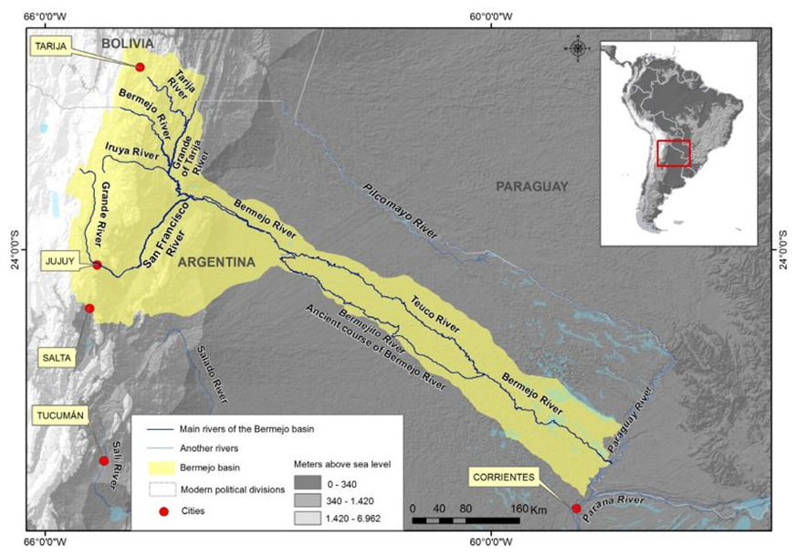
PhD project:
Governance in transboundary basins: Bermejo and Grande de Tarija rivers basin, Argentina - Bolivia.
The main objective is to analyze governance and cooperation between Argentina and Bolivia regarding to integrated water resources management of Bermejo and Grande de Tarija rivers transboundary basin (1995-2018).
Theoretical approaches of transboundary basins from the International Relations: governance- institutional capacities/ cooperation and conflict/geopolitcs:
Cooperation and management of Bermejo transboundary basin.
Rebuilding binational governance mechanisms and institutional capacities.
Stakeholders participation.
Main issues regarding the identification, state, use and management of shared water resources. Basin as a Unit.
Prieto y Rojas, 2015.

Slide 5
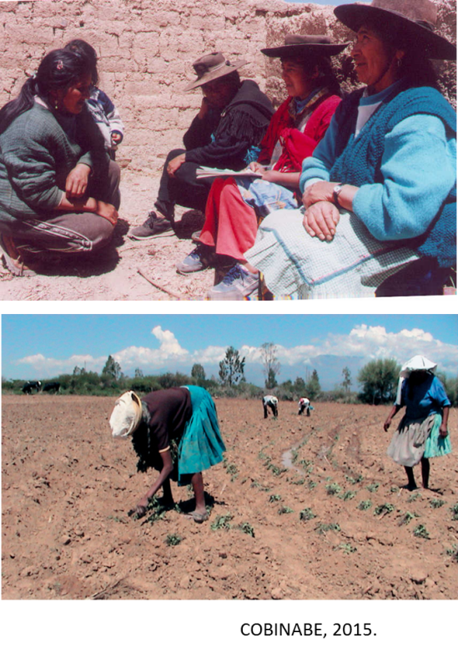
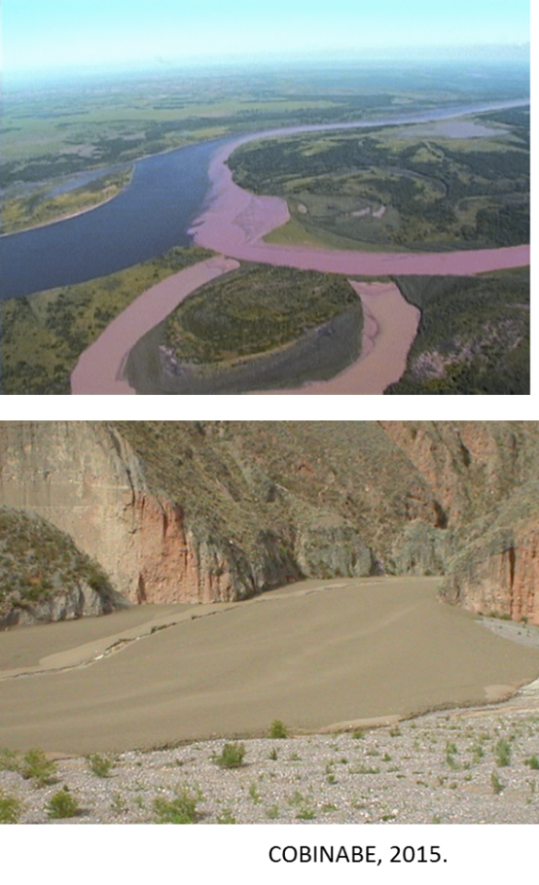
Bermejo river basin.
The Bermejo river basin, shared between Argentina and Bolivia, is an important sub basin of Del Plata international basin.
This basin is 123.162 km² and its main course is 1.300 km, divided in Up Basin (Up Basin Bolivia and Up Basin Argentina) and in Down Basin Argentina.
Erotion index and sediments volume are one of the highest in the world. More than 100 million ton (80% equivalent among total) of sediments deposit at the Paraguay-Paraná-La Plata rivers system.
1.3 millon people live in the basin, mainly rural and small agricultural workers, and indigenous with high poverty index.
Binational Comission of the Bermejo River (COBINABE) was formed between Argentina and Bolivia through the Oran Agreement in 1996.

Slide 6
Bermejo river basin.
Current construction of PhD conceptual and theoretical framework considering:
Paradigm of Integrated Water Resources Management (IWRM): a process which promotes the coordinated development and management of water, land and related resources in order to maximise economic and social welfare in an equitable manner without compromising the sustainability of vital ecosystems and the environment.
The basis of IWRM is that the many different uses of finite water resources are interdependent. IWRM is a systematic process for the sustainable development, allocation and monitoring of water resource use in the context of social, economic and environmental objectives. Under the IWMR paradigm, it is very important de bottom-up construction through communities participation. An integrated and holistic approach and multi-stakeholder processes to advance governance and management of water resources for sustainable and equitable development (Global Water Partnership, 2011).
International Law General Principles on International Watercourses:
Equitable and reasonable utilization and participation.
Obligation not to cause significant harm.
General obligation to cooperate.
Regular exchange of data and information (Convention on the Law of the Non-navigational Uses of International Watercourses, United Nations; 1997).

