Slide 1
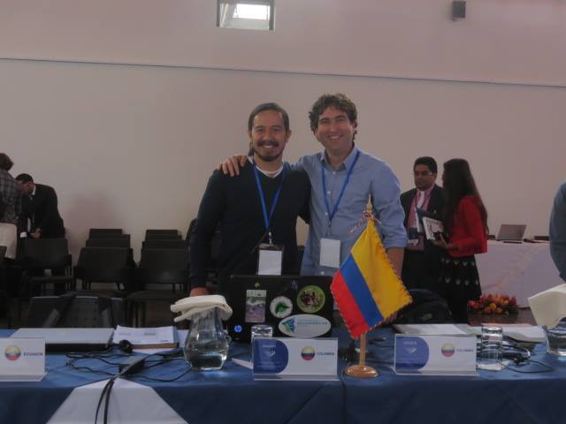
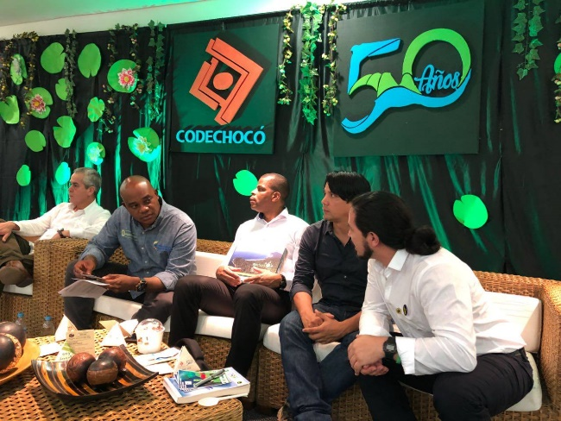
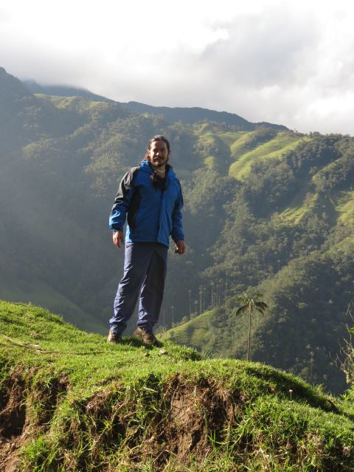
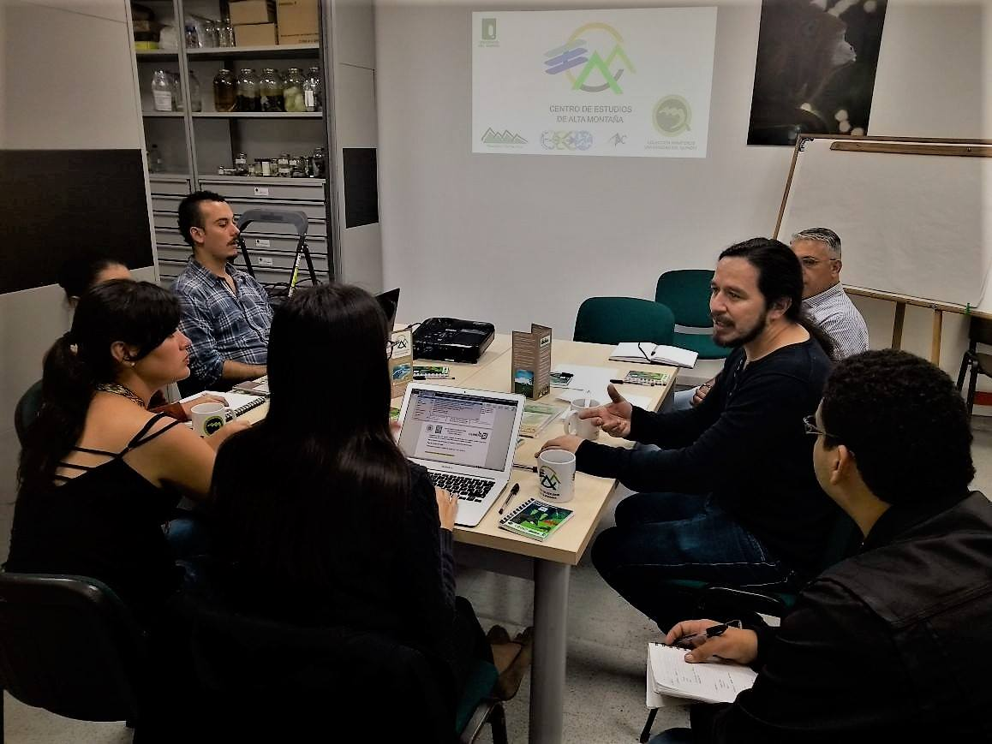
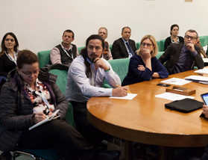
Hugo Mantilla-Meluk
Centro de Estudios de Alta Montaña (CEAM)
ceam@uniquindio.edu.co
IPROMO
Bioeconomy in mountain areas – an opportunity for local development
Pieve Tesino /Ormea 18 June -02 July 2018

Slide 2
Education
PhD Systematics and Evolution
Ms Ecology
Bs Biology
Posdoctoral associate in Museology
Posdoctoral associate in Geography
Employment and main activities
Executive Director Centro de Estudios de Alta Montaña
Curator Collection of Mammals, UQ
Professor Department of Biology UQ

Slide 3
Other interests (volunteer work, hobbies etc.)
Founder Colombian Society of Mammalogists
Founder Latin American Mammals Research Network
Board of directors International Federation of Mammalogists
Group of Experts IUCN
Editor and reviewer 17 journals
Working on a diploma in Jazz music (bossanova)

Slide 4
Presentation of a project you are working on 1/3
Implemention of the Adaptation Plan for Climate Change of the department of Quindío, Colombia
Evaluation of management plans of highland species in Colombia
Declaration of conservation areas in Colombia
PNN Chiribiquete (World Heritage UNESCO)
Serranía de La Lindosa
Formulation of the Colombian Pollitnators Strategy

Slide 5
CENTER OF HIGHLAND STUDIES

Slide 6
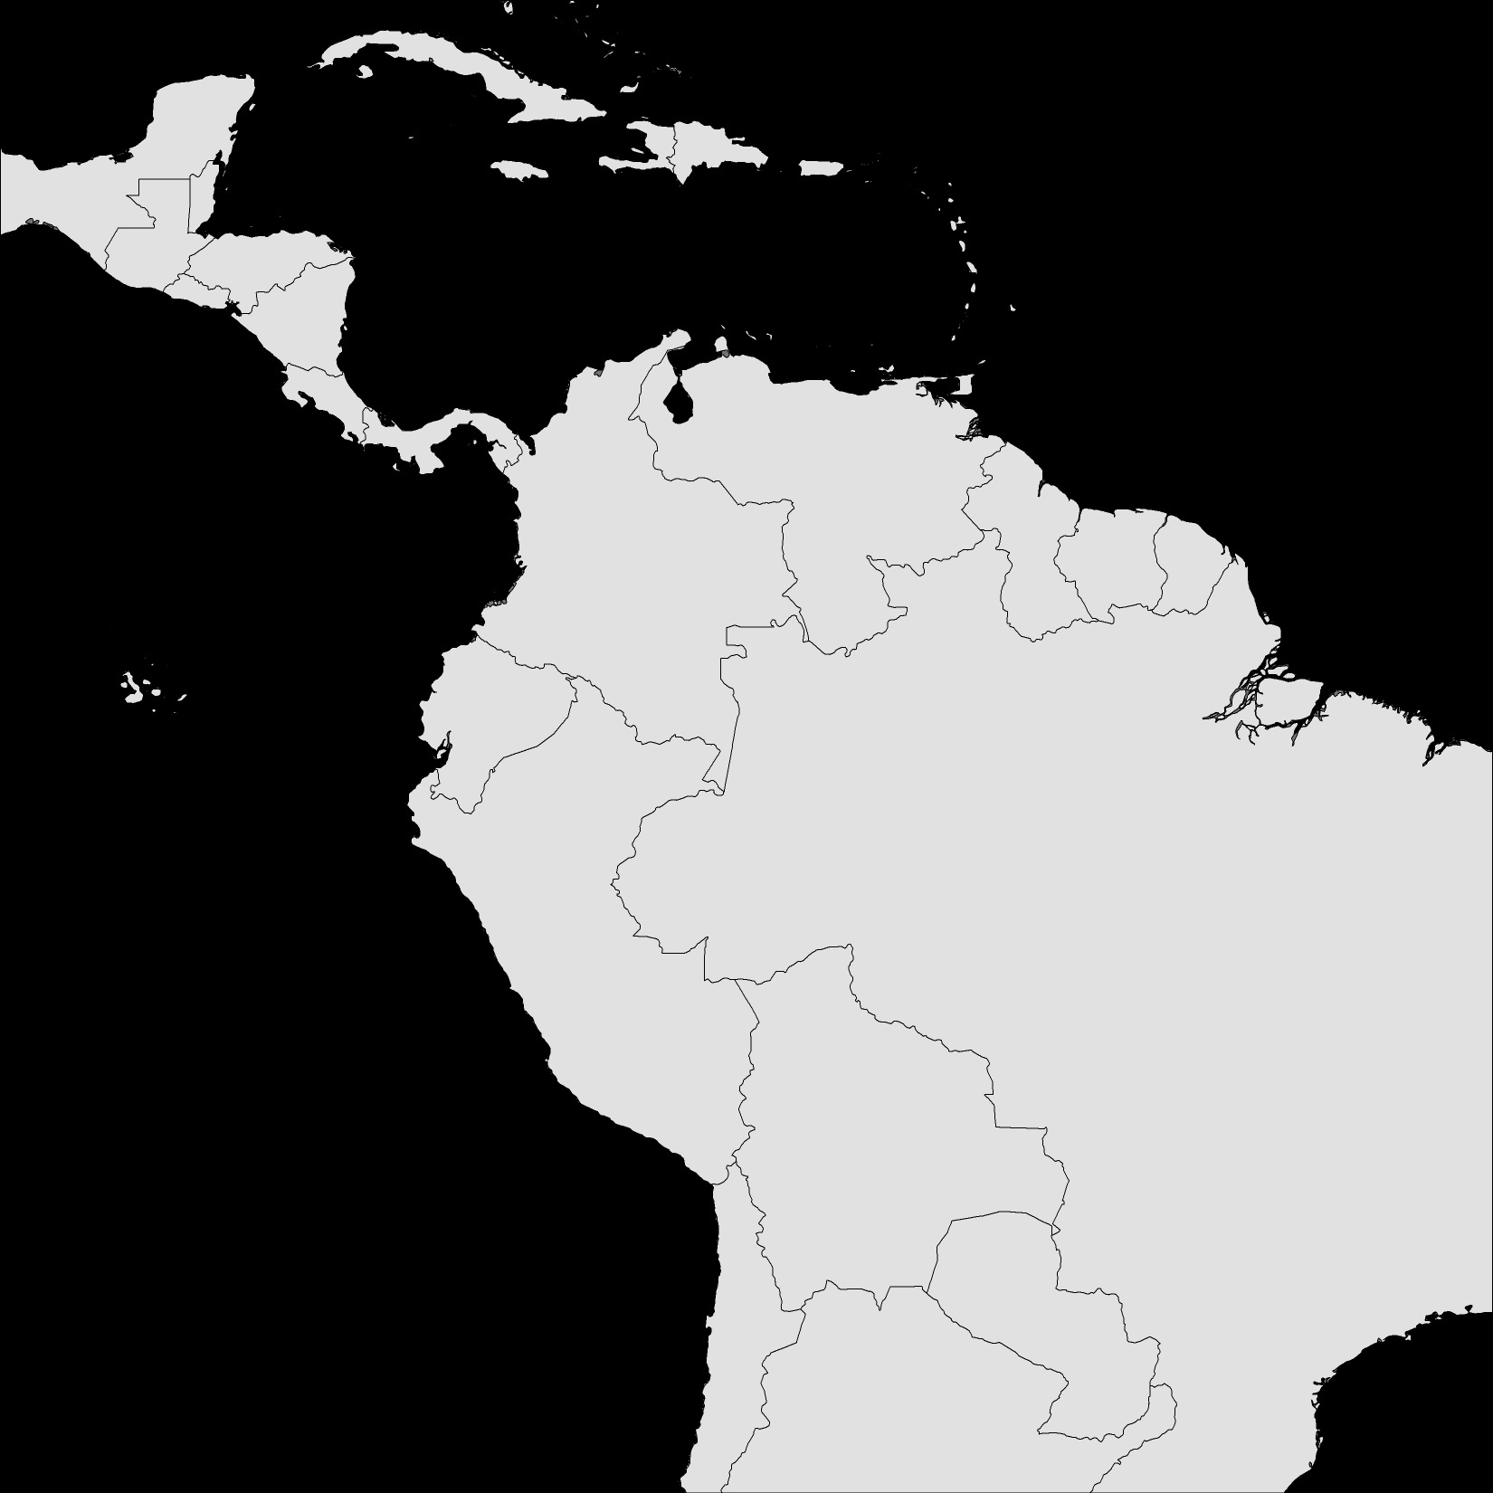
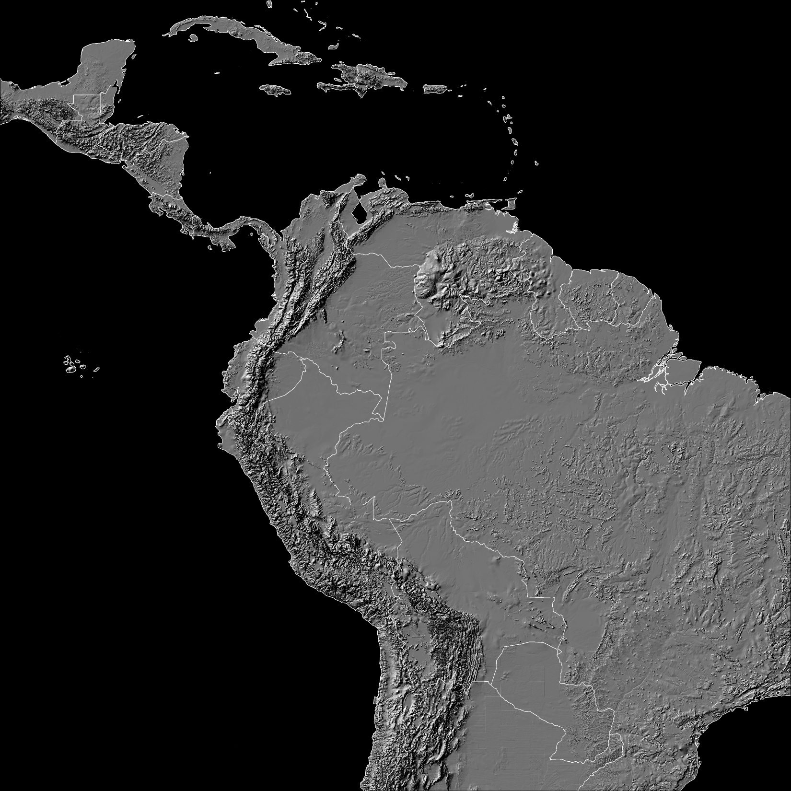
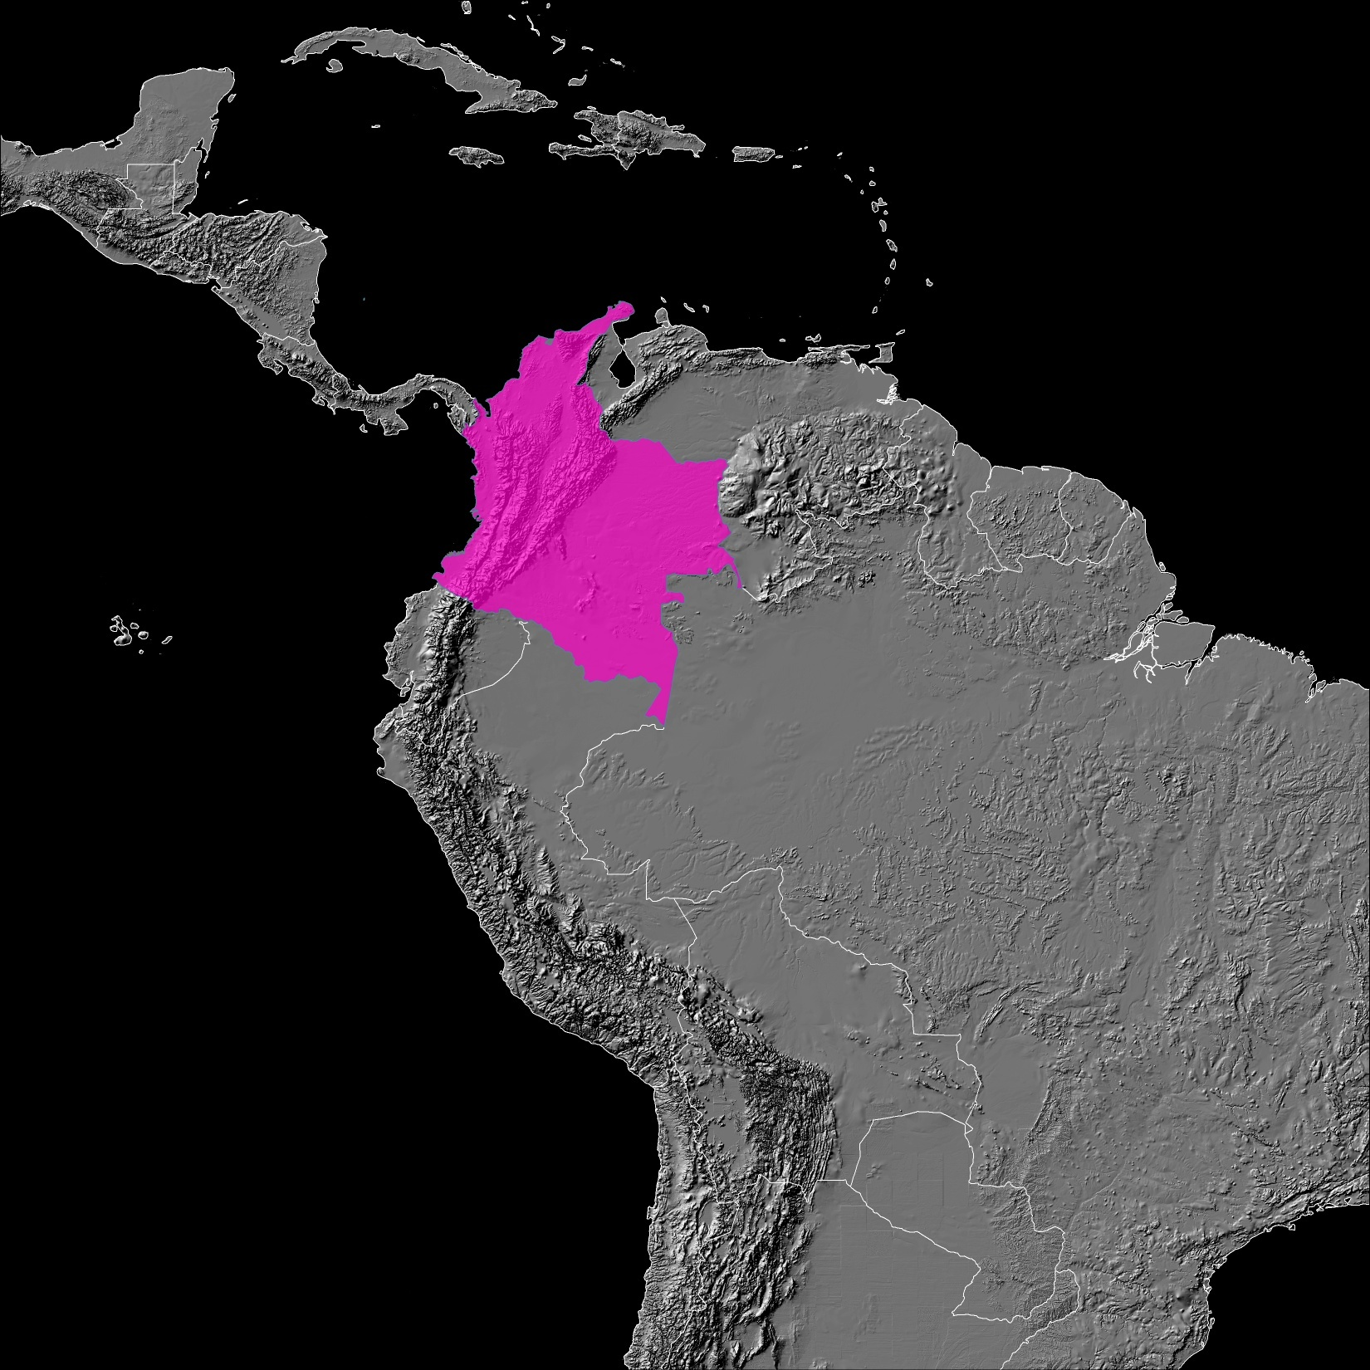

Slide 7
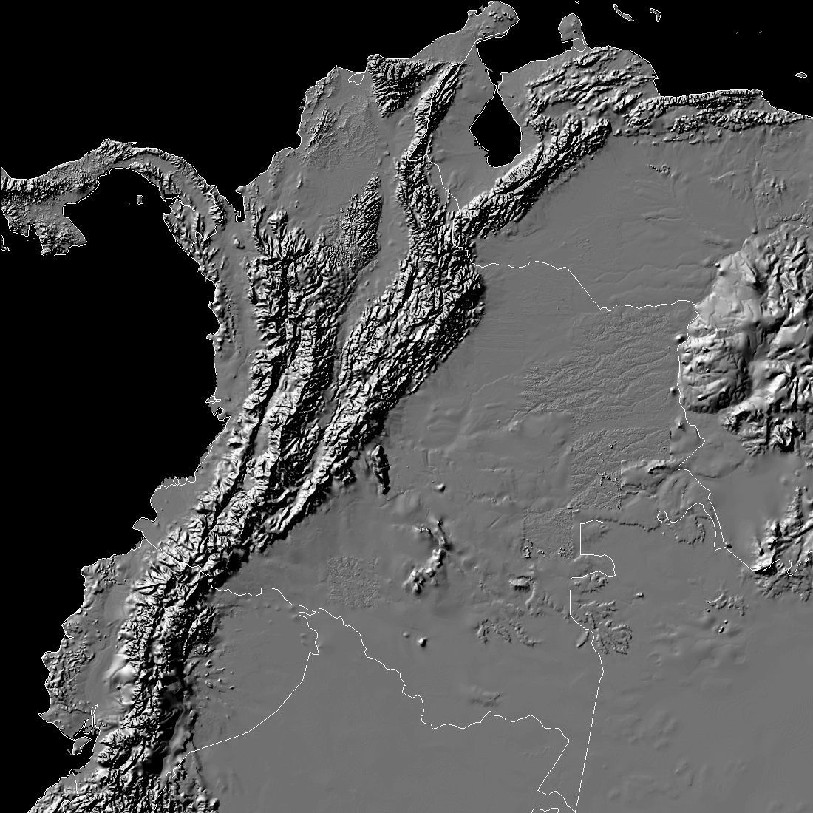
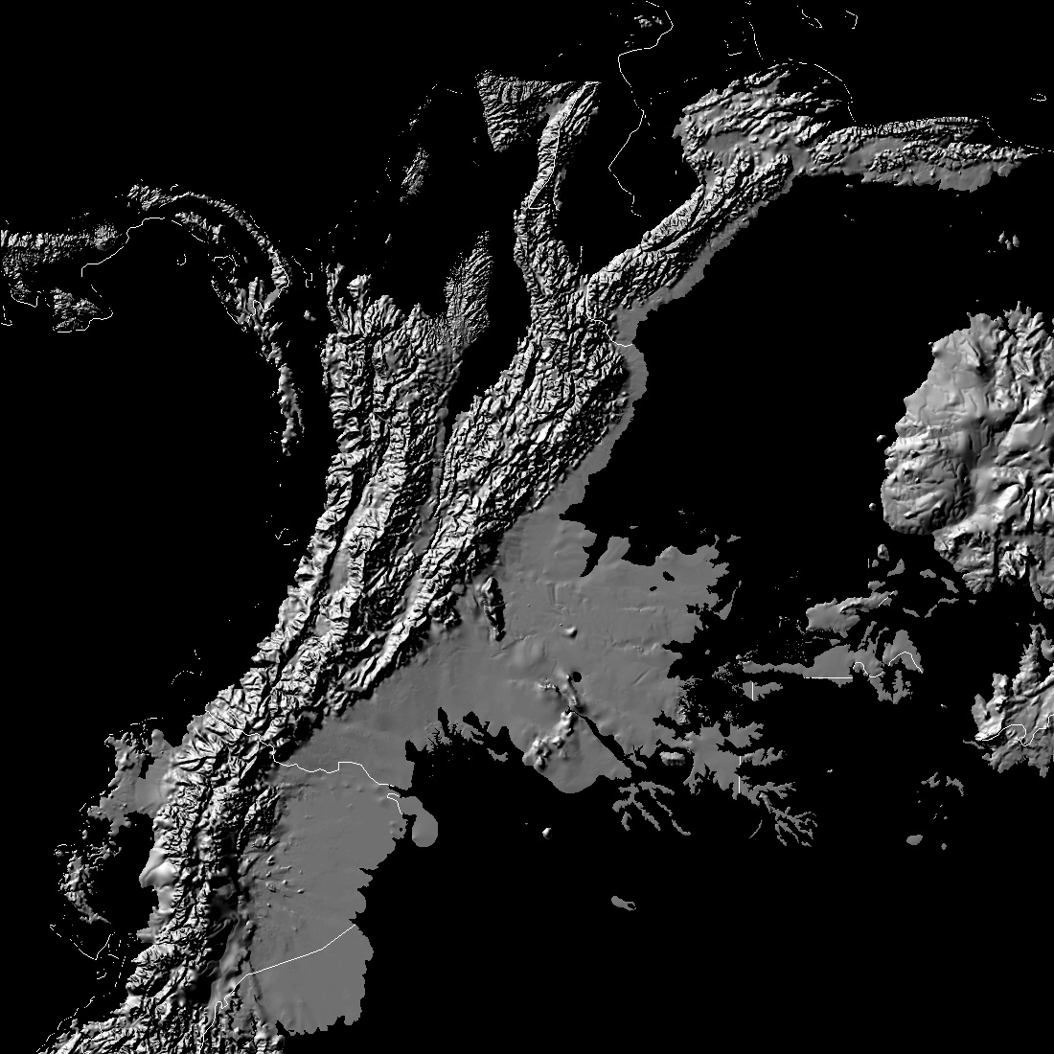
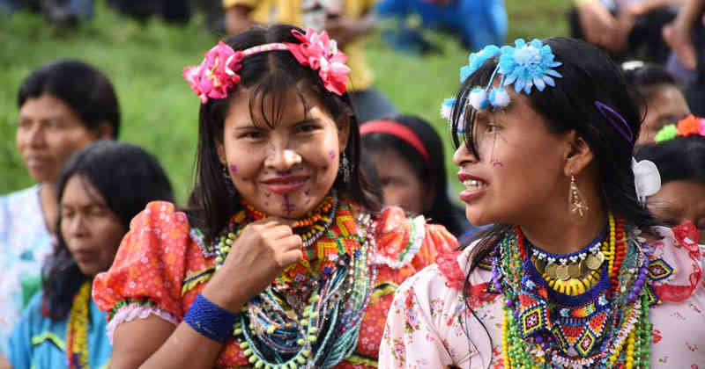
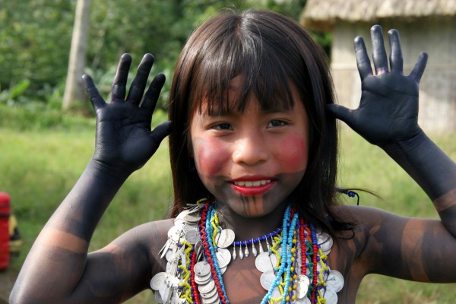
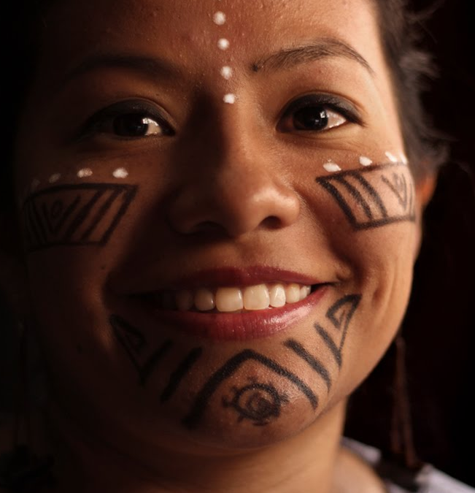

Slide 9
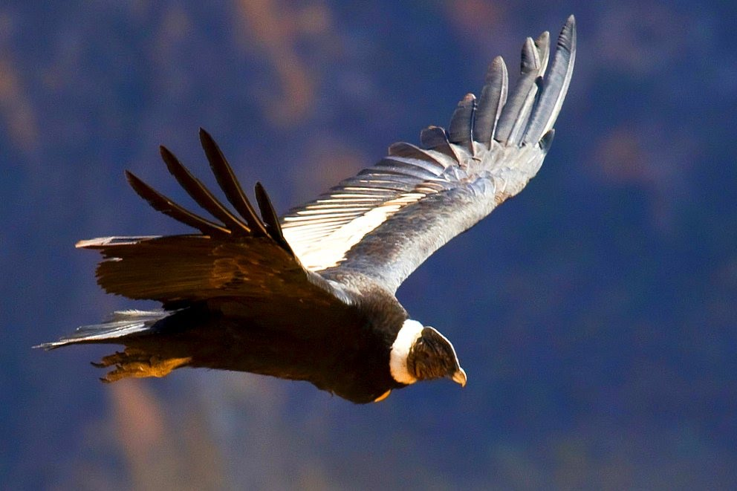
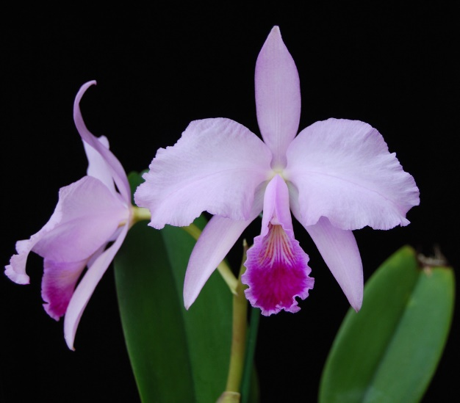
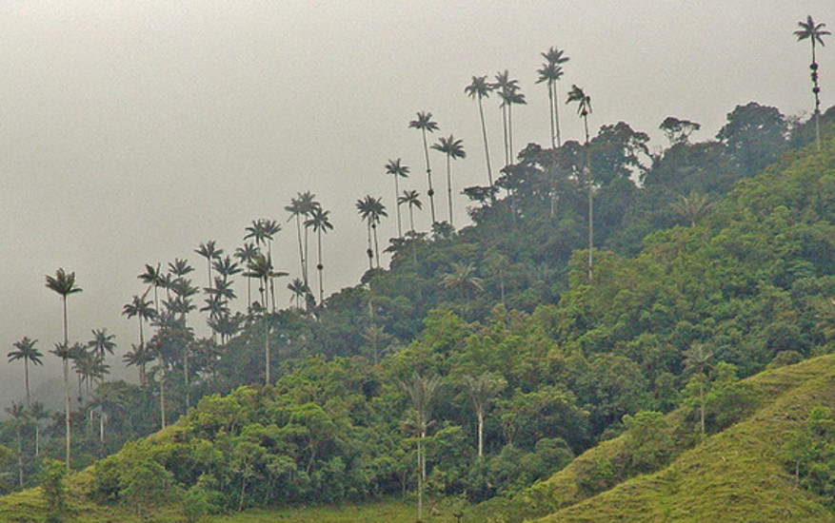
Colombia as a megadiverse country
Quindío wax palm
Catleya trianae
Andean Condor

Slide 10
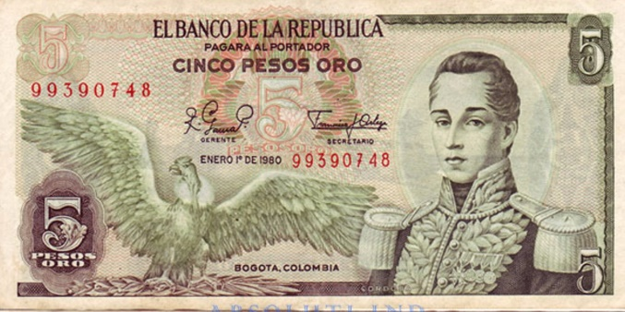
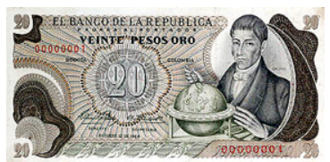
Our identity

Slide 11
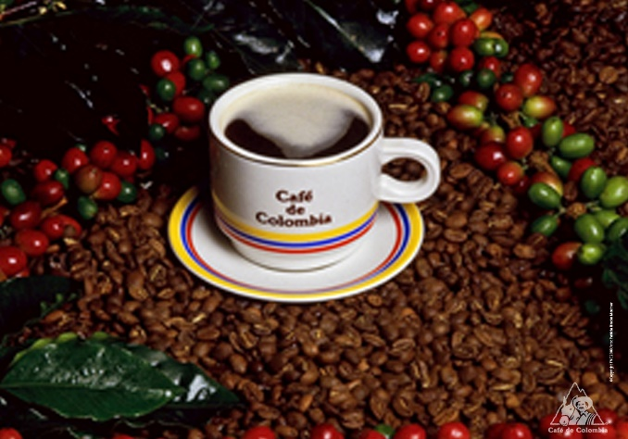
Coffee Cultural Landscape

Slide 12
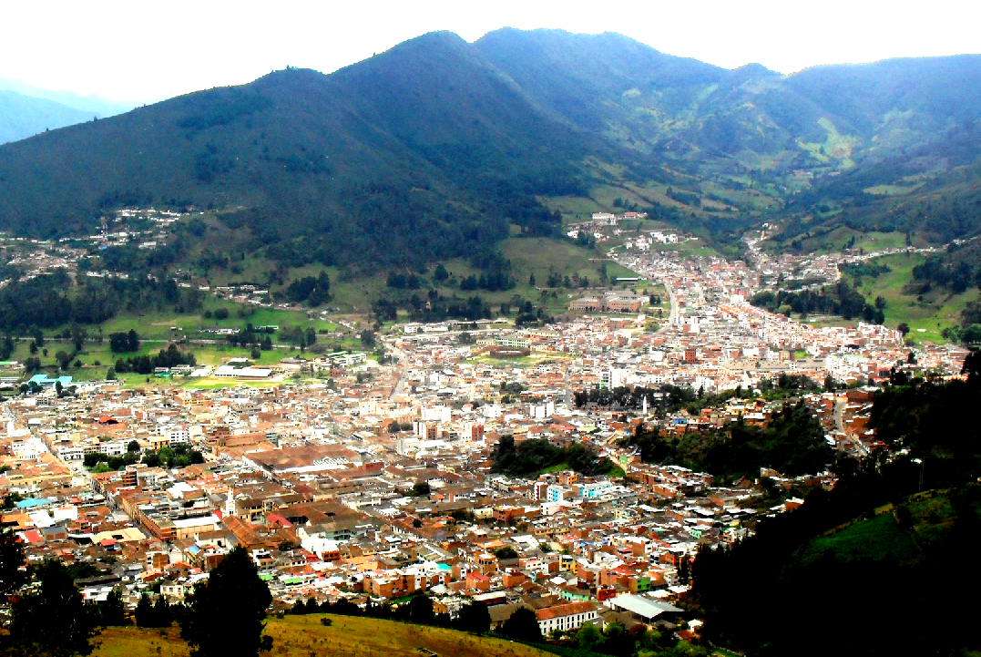
Colombians live on mountains

Slide 13
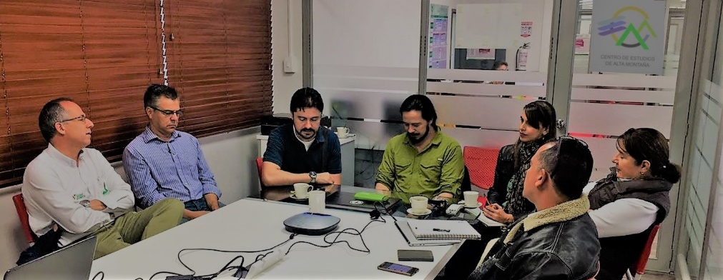
BIODIVERSITY AND BIOLOGICAL GRADIENTS
PUBLIC HEALTH SURVILLANCE
MATHEMATICL MODELING
INFRAESTRUCTURE AND RISK ANALYSIS
CLIMATE CHANGE HYDROLOGICAL REOSURCES
INFORMTICS AND KNOWLEDGE SHARING (VIRTUAL MEDIA)
• 7 areas of research
• +27 Research groups
• +62 Researchers

Slide 14
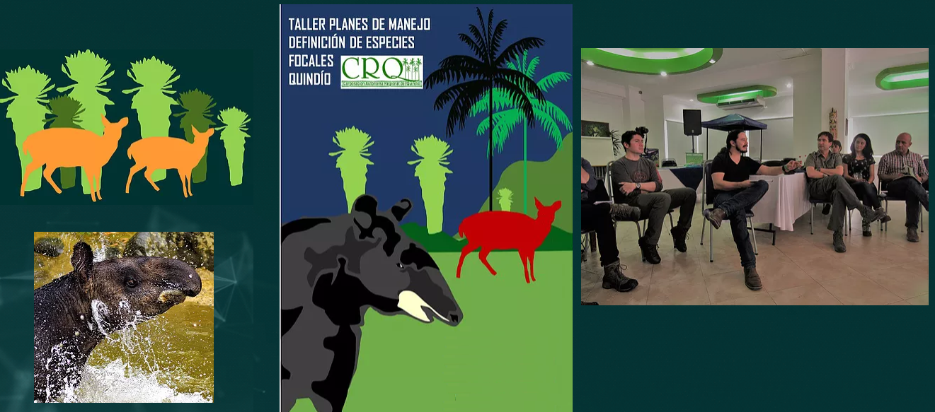
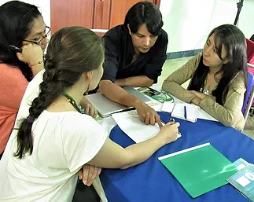
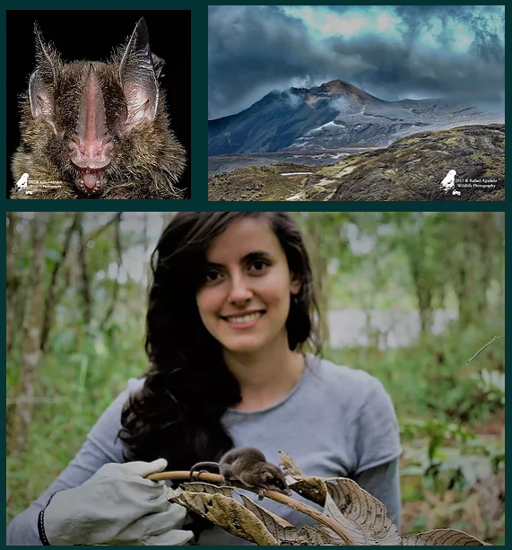
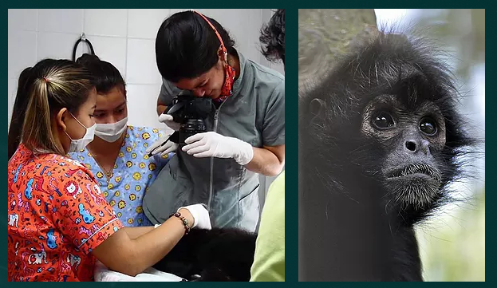
Biodiversity and Climate Change (Monitoring biodiversity)

Slide 15
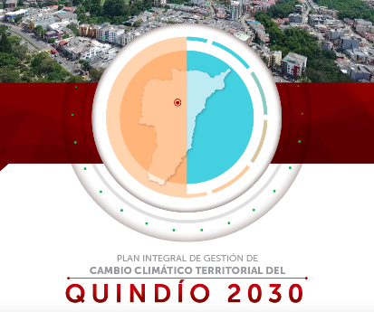
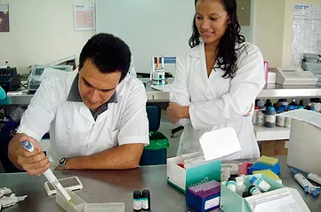
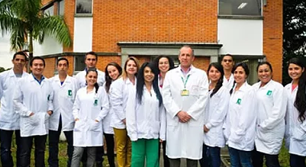
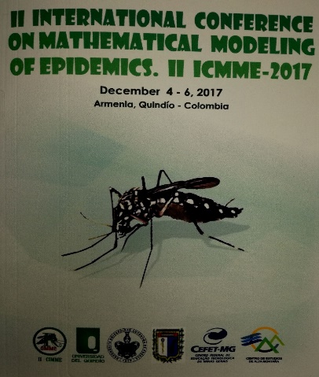
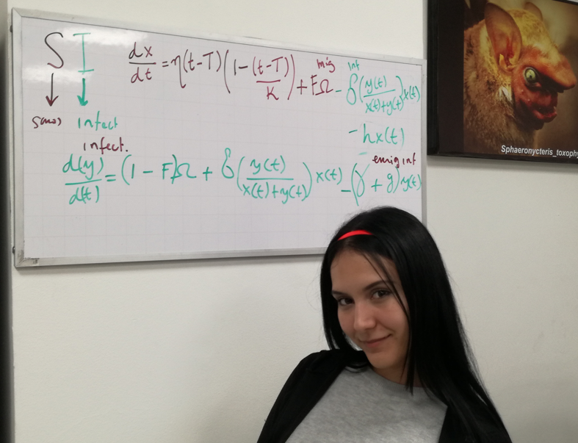
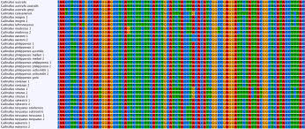
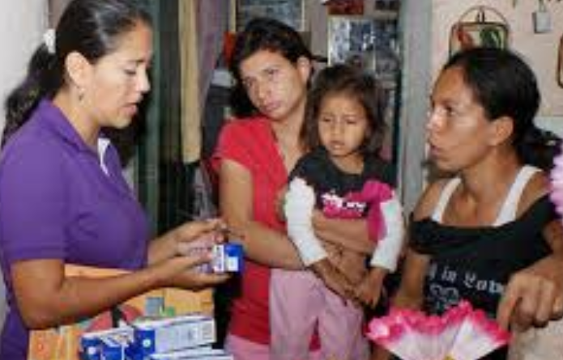
Public health survillance and Climate Change

