Slide 1
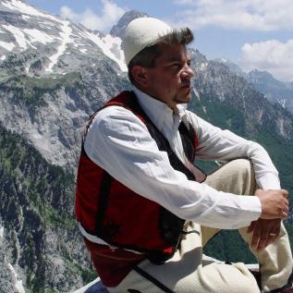
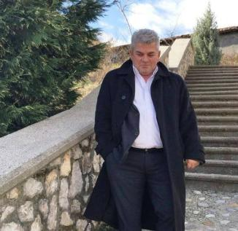
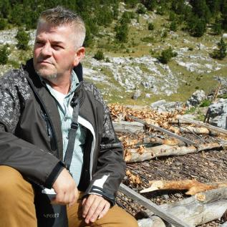
Personal presentation
Eng.Petrit IMERAJ
«Petro»
pimeraj@yahoo.com
IPROMO
Bioeconomy in mountain areas – an opportunity for local development
Pieve Tesino /Ormea 18 June -02 July 2018

Slide 2
Education
October 1989 - February 1994, AlbaniaHigh Agricultural University, Faculty of Forestry Sciences in Tirana, Albania. Forestry, Silvi-culture,,Scientific Master
October 1995 - February 2000, AlbaniaUniversity ”Luigj Gurakuqi”, Faculty of Law, Shkoder, Albania Senior Lawyer level, Scientific Master
January 2017 – February 2018, Albania EMA, EU, Erasmus+, Jean Monnet Program Academy of European Integration and Negotiation (modules I- IX)

Slide 3
Employment and main activities
1st of October 2015 – Ongoing ,Municipality of Shkodra Environment & Forestry Inspectorate, Forestry and Water Management Directorate.
27th of February 2017 - Ongoing Drita Travel Agency, “Albanian Alps Alliance” NGO, “Albanien Alpen Verein” NGO Agency, NGO, Tour operator, Independent guider , Tour guide for Shkodra city and the mountainous area of North Albania City guide, mountain guide, creating maps.
August 2014 – February 2015 Albanian Development Fund, Tirana, Albania , Consultant / Unit of Environment
1st of September1999 – 21st of February 2014 Ministry of Environment, Directorate of Shkodra Forest Service , Judicial Police Officer for crimes against property, environment, fishing, forests, economy etc.
1st of October 1994 – 1st of September 2001 Ministry of Agriculture, Directorate of Forestry Service Shkoder Head of the Protected Areas of the County of Shkoder

Slide 4
Other interests (volunteer work, hobbies etc.)
Head of the Board of Directors at "Albanian Alps Alliance" network. (Mountains Partnership Membership). President of the Environmental Association "PFGE" Nord-Albania. Organizational Capability, working in group skills, which has been awarded as the Head of NGO, Coordinator of Projects, Conferences, Trainings, Workshops at Local and Regional level, lecturer, professional guide for eco-tourism and natural tourism in Northern Albania (wildlife research) for the coastal and mountainous areas. Referred by the most prestigious tourist guides on the Planet. Competent in task sharing according to the capability of each person for successful accomplishment of them, acquired in different projects and sports.

Slide 5
Other interests (volunteer work, hobbies etc.)
Photo Exhibition on Albanian Alps in diverse communities around the world:
London (United Kingdom)
Tirana and Shkodra (Albania)
Leipzig (Germany)
Louny (Czech Reublic)
Certificate of Intermediation and Environmental Conflict Resolution. Ideator and Maintainer of the webpage www.voicealps.org.

Slide 6
Other interests (volunteer work, hobbies etc.)
Photographing nature, dancing and acrobacy etc., good skills at painting, writing, as passions for an artistic background, ideator of promotional videos (https://www.youtube.com/watch?v=dhGP11S4_Qo).
https://www.tourhq.com/guide/al16287/petrit-imeraj
Ambassador at Trip2P company in Albania for the Alps region.
Ambassador of Green Destinations in Albania for the Alps region.
http://www.worldcat.org/title/albania-the-bradt-travel-guide/oclc/195720009

Slide 7
Publications:
Velipoja Natural Reserve (informing brochure, research)
Thethi National Park (pocket guide, research)
Touristic Map of Nikaj-Mertur Valley (creator)
Touristic Map of Shkreli Natural Park Valley (creator)
Touristic Map of Malesi e Madhe Municipality (contributor)

Slide 8
Presentation of a project I am working on:
Expert for evaluation of the biodiversity of the Albanian Alps region, (Flora of the Alps); Coordinating and implementing several activities for promotion of alpine river protection (some in synergy with “RIVERWALK 2016” project of WWF Adria); Gathering data and using expertize in relevant fields to publish regulations on natural municipal parks Shkreli and Nikaj-Mertur sustainable development and functional operation, surveys, lecturing on “The Right of Representation.

Slide 9
Project «One Voice for the sustainable development of Alps»
Creation of green social cards as a new form of online presence, promotion of domestic products and youth engagement in the local community.
Crystallization of the Network for a functioning as a single entity composed of human resources and material gathered from its co-founding organizations.
Strengthening the digital platform "Voice of Alps", www.voicealps.org for creating an image of the alpine network (booking etc).

Slide 10
THANK YOU

