Slide 1
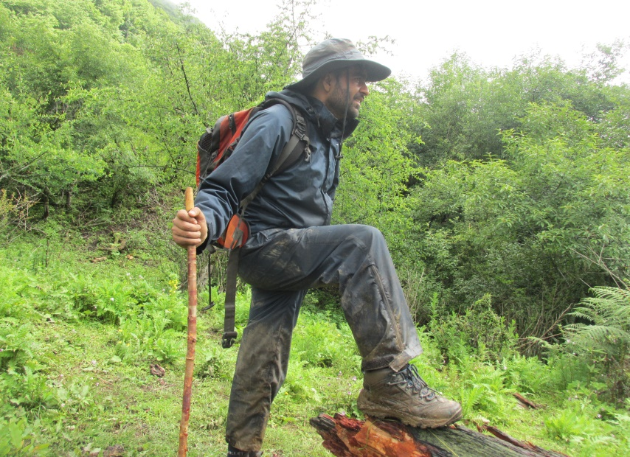
Badri Baral(31 years)
Gokarneshwor 5, Kathmandu, Nepal
badribaral2071@gmail.com/badribaral@neri.com.np
IPROMO
Landscape approach for enhancing mountain resilience
Pieve Tesino /Ormea 02-18 July 2019

Slide 2
Education
Msc.Environmental Science
(Specialization in Biodiversity Conservation and Wildlife Management)

Slide 3
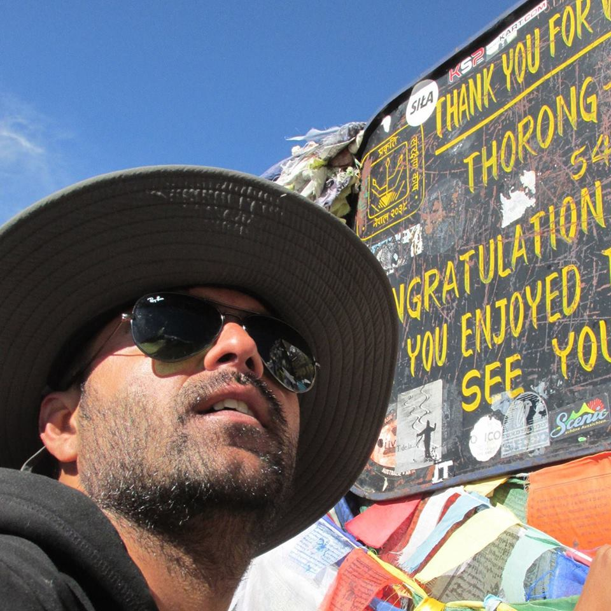
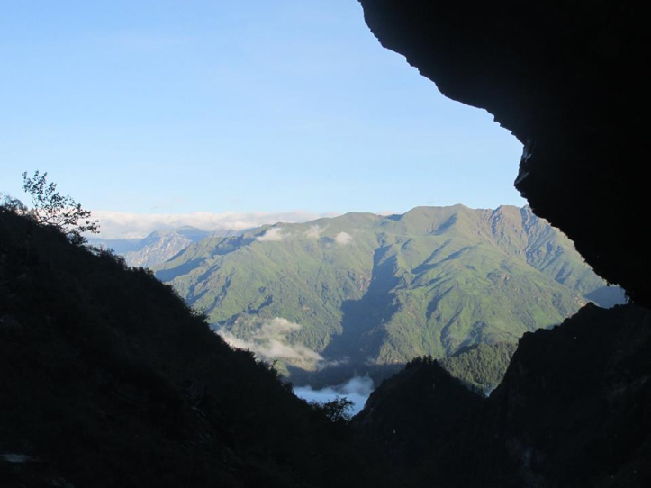
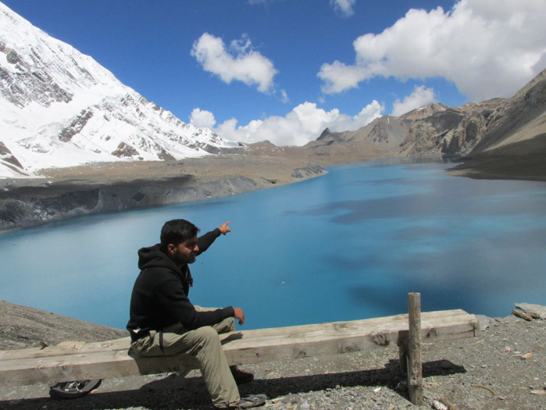
Interests and Hobbies

Slide 4
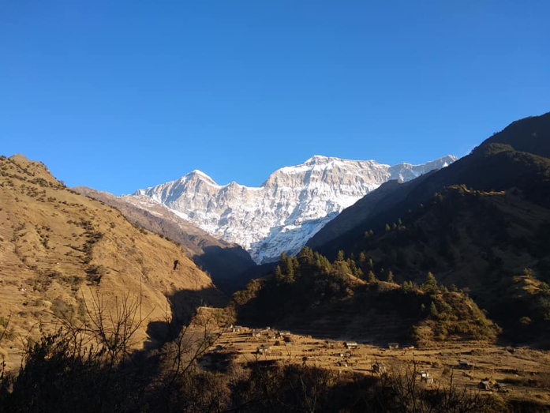
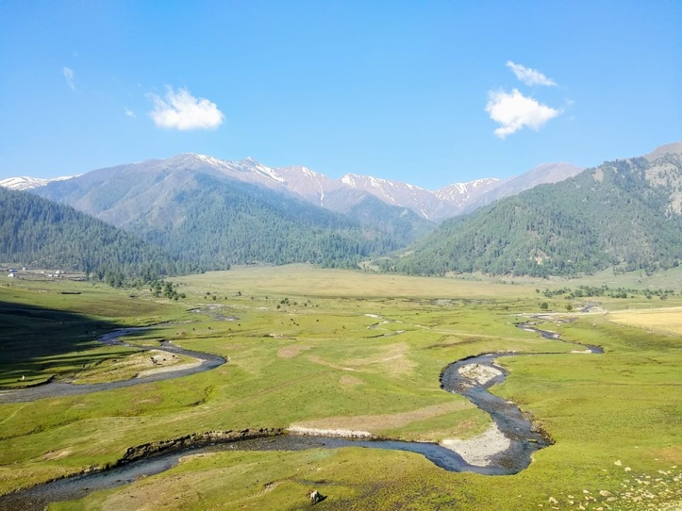
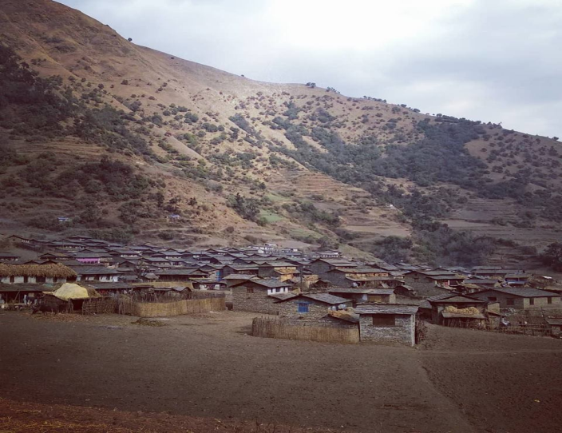
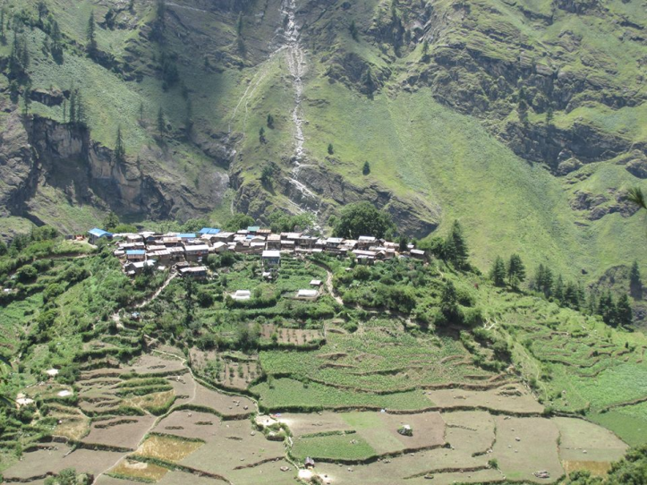
Interests and Hobbies

Slide 5
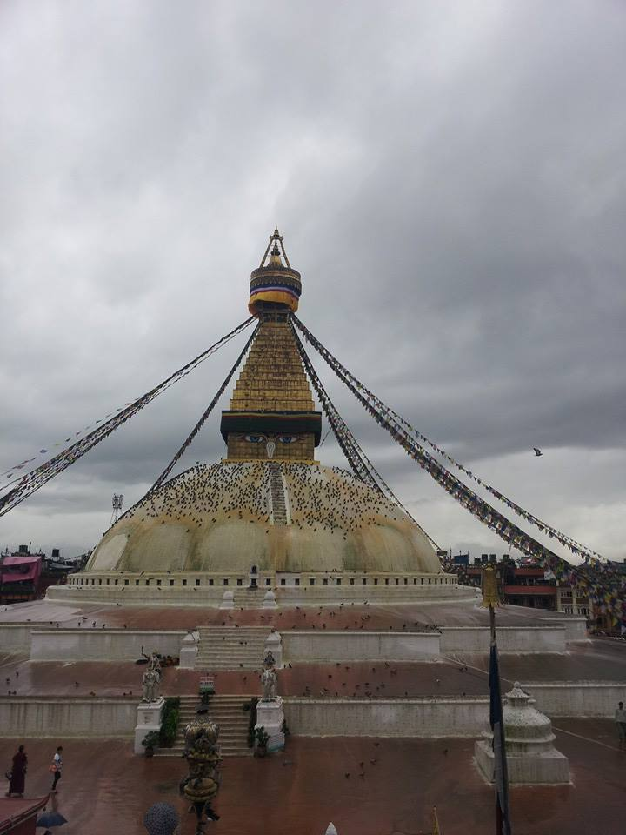
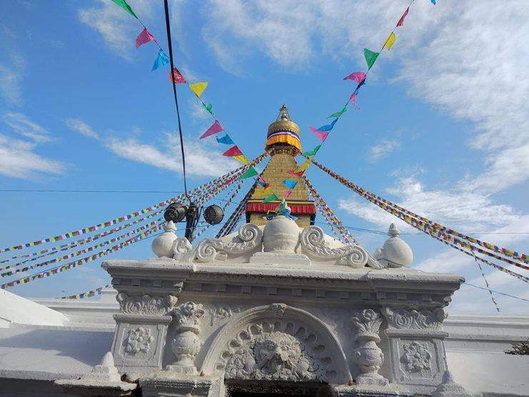
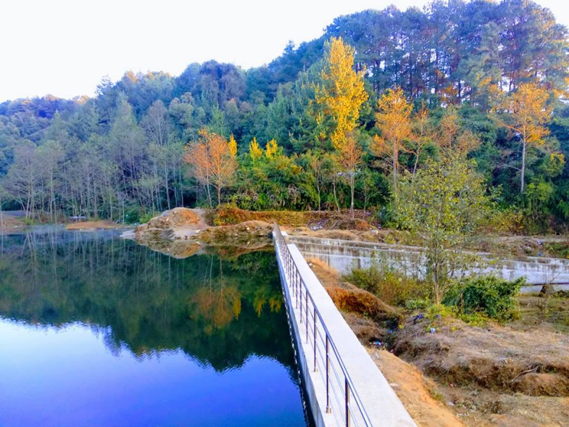
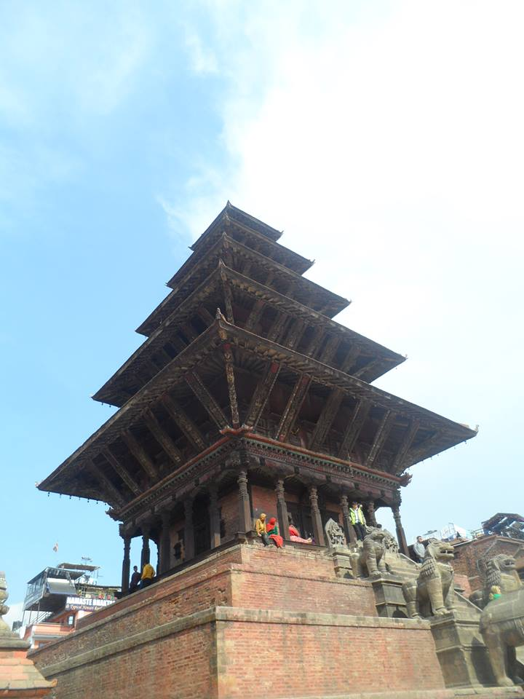
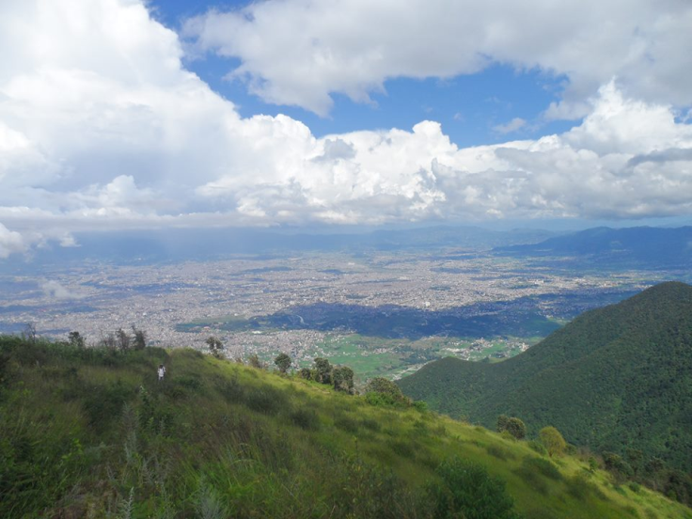
Interests and Hobbies

Slide 6
Recent Involvement
Recently working as team member for Feasibility study for conservation area in Jajarkot and adjoining areas of Jumla and Dolpa.
The project aim at assessing
status of floral biodiversity,
faunal biodiversity,
natural and socio-cultural assets and heritages,
potential tourism products,
perceptions of local communities and stakeholders,
detail requirement of human and financial resources for the management of the proposed conservation area.

Slide 7
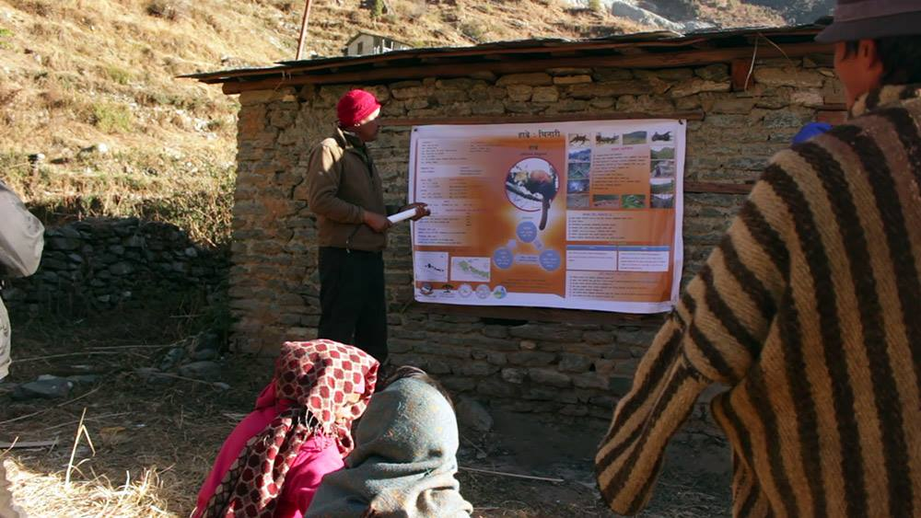
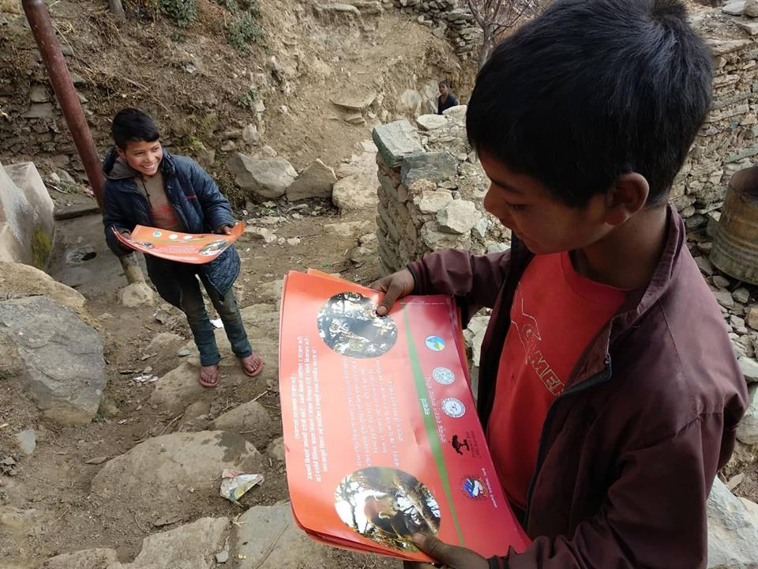
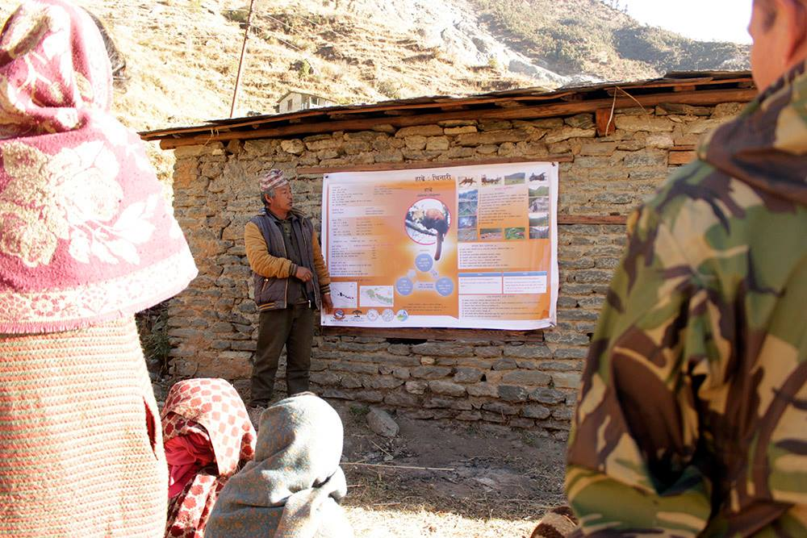
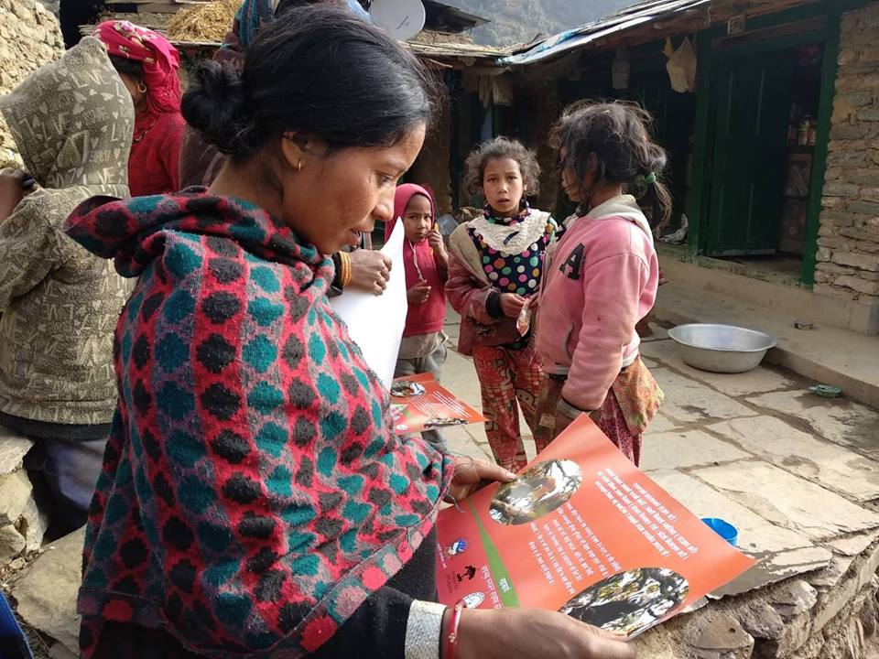
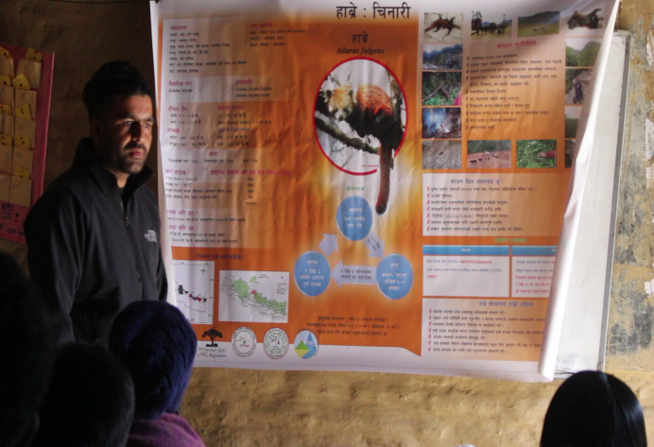
Community stewardship for Red Panda (Ailirus fulgens fulgens Cuvier 1825) conservation outside Protected Area in Dhaulagiri Rural Municipality, Myagdi, Nepal

Slide 8
A proposed Project
Red Panda Action Plan for Jajarkot :A Bottom Up Approach for Conservation of Endangered Species outside Protected Area
A bottom up approach of red panda conservation planning with deeper understanding of human-nature interactions in red panda habitat has been proposed to guarantee success of top-down conservation planning that has been conducted without taking local socio-economic considerations into adequate account.
Has been envisioned to achieve goal of second national red panda conservation action plan
Promises to yield a high conservation effect

Slide 9
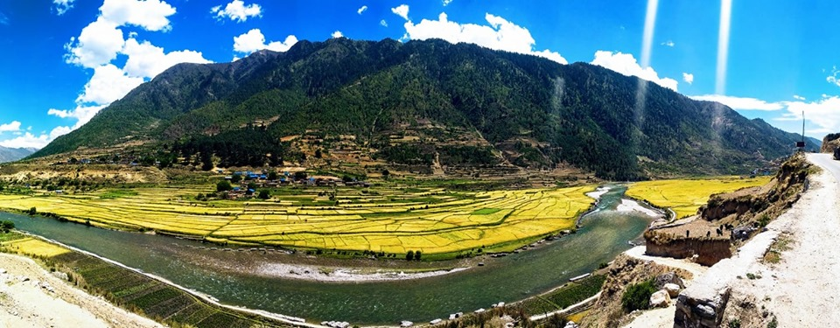
Thank for your attention!

