Slide 1
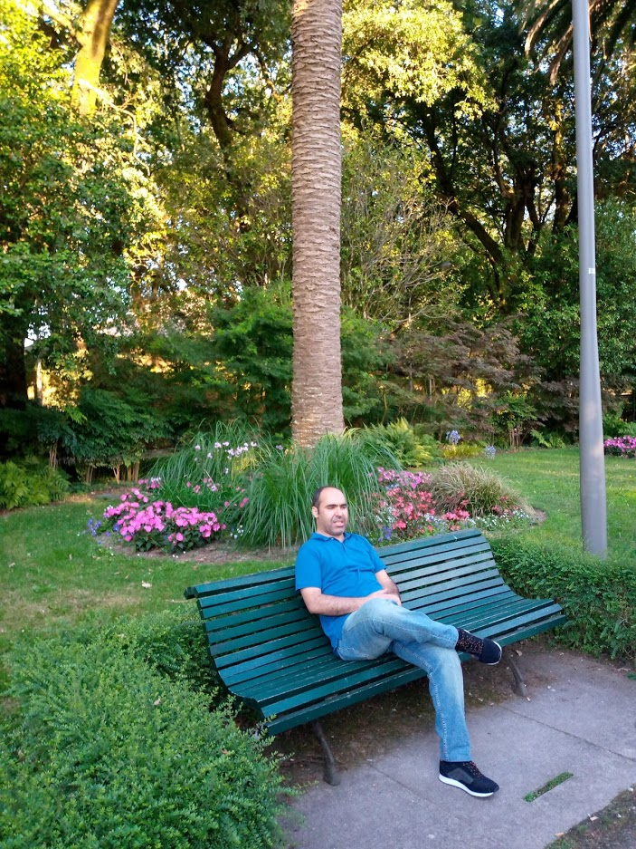
Personal presentation
Mohammed El-fengour
University Mohammed V in Rabat, Morocco.
elfengour.med@gmail.com
Gsm: 00212661933339
https://www.researchgate.net/profile/Mohammed_El-Fengour2/publications
IPROMO
Mountains in a changing climate: Threats, challenges and opportunities
28 September-09 October 2020

Slide 2
Education
In 2009 Ph.D in Physical Geography in Risk Management in Northern Rif Mountains. Since 2015 he spent his post-doctorate at the University of Bologna and Padua Italy in 2017 and 2016; at Porto University in Portugal in 2015 and 2016. In 2014 In Spain at University of Saintiago In Italy
Employment and main activities
is a Professor at University Mohamed the V in Rabat in Rabat, Morocco. He has specific expertise in climate change, natural hazards management, Ecotourism and sustainability. Moreover, he has extensive knowledge on Environmental issues and local development. Since 2012 he is the Project coordinator of many bilateral and multilateral international cooperation. He was the Coordinator of International Cooperation within the project «Social tourism in the mountains of northern Morocco and Açor-Estrela in central Portugal within partnership with Coimbra University in Portugal.

Slide 3
Presentation of a project you are working on 1/3
My research questions are consequently and they will be as a plan of work to achieve during my training and after as skills to teach and use with my target group at my university and society where I am coordinating some projects including the implementation of project with the local population for better mitigation the desertification as a lack of Natural Risks Mitigation.
a) What are the key factors in water management that turn climate change phenomena such as heavy rainfall into natural disasters or desertification?
b) Which eligible alternatives consist in adapting water management and restructuring the landscape to reduce the disaster risks? Which indicators (e.g. landscape metrics) are appropriate to assess the risk exposition?
c) What are key socio-economic factors that drive the vulnerability of local communities against climate change and particularly the resulting water management?

Slide 4
Presentation of a project you are working on 2/3
d) Which factors can be influenced to empower local communities in improving their Natural Risks Mitigation?
e) How efficient are different Natural Risks Mitigation instruments in establishing and sustaining adapted Natural Risk Mitigation in the local communities in Mountains area.
Currently Mr. El-fengour is a coordinator of a project (2019-2021) on Reducing the socio‐economic impacts of climate change in Northern‐Morocco based on integrated planning for better mitigation (Reclimplan)." Within Ibn Khalodoun scientific program, financed by the government of Morocco. Financed by Moroccan Government in cooperation with many partners around the EU,

Slide 5
Thank for your attention!

