Slide 1
Personal presentation
Name : Reeta Khulal
Affiliation: Federation of Community Forest Users Nepal (FECOFUN)
E-mail: reetkc9336@gmail.com
IPROMO
Mountains in a changing climate: Threats, challenges and opportunities
28 September-09 October 2020

Slide 2
Education (Most recent first)
S. No. | Qualification | Year (A.D) | Institute | Area of Specialization
1 | M.Sc. Wildlife, protected area conservation and Biodiversity Conservation | 2018- 2020 | Institute of Forestry, Office of the Dean, Kritipur, Kathmandu | Wildlife management and biodiversity conservation. Wildlife biology, Eco-tourism, GIS
2 | B. Sc. Forestry | 2013-17 | Kathmandu Forestry College, Balkumari, Kathmandu | Ecotourism management and conservation, Advanced Silviculture, wildlife Biology, Community Based Forest Management, Forest Mensuration, Resource economics
3 | +2 science | 2011-12 | Omega international college, Lalitpur Nepal | Recommended course by HSEB Board
4 | SLC | 2010 | LRI school Kalanki, Kathmandu | Recommended course for SLC

Slide 3
Employment and main activities
- Conduct training and workshop given in activities and reporting.
- Frequent field visit.
Organizing programs and activities in accordance with the mission and goals of the organization.
- Implementing and managing changes and interventions to ensure project goals are achieved.
- Meeting with stakeholders to make communication easy and transparent regarding project issues and decisions on services

Slide 4
Status of Community Forest
CF area: about 2.2 million ha
Household: about 2.9 million
No of CFUGs: 22,266
Population: About 14 million people of Nepal are engaged in CFUGs
Some Facts

Slide 5
FECOFUN
FECOFUN is a representative organization of CFUGs
Establishment: 1995
FECOFUN has been being protecting the rights of local communities over natural resources (i.e. Forest, water and land) through advocacy and supporting for their livelihoods.
Innovator organization to practice GESI from federal to local FECOFUN. 50% women involvement in each network committee.
FECOFUN have good experience in sustainable forest management, good governance, livelihood support and CCA.
During the project, FOCOFUN intended to focused on good governance, CCA, ecotourism promotion and livelihood support in Phoksundo-suligaad watershed

Slide 6
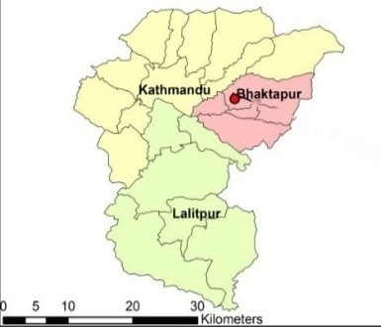
Organizational Structure
Financial/
Monitoring
Committee
Judicial
Committee
1
7
77
530
22,266
Periodic assembly in each 4 year
Annual assembly

Slide 7
Collaboration between FECOFUN and Paani
From March 2017, FECOFUN has been being implementing Paani project with the support and collaboration of USAID/Paani
1st Phase (March 2017- September 2018): FECOFUN/Paani project focused on 6 watersheds (i.e. Middle Karnali 333, Thuli Bheri 344, Thuli Bheri 348, Thuli Bheri 180/Phoksundo-SuliGad 888, SetiNadi-Gud Ganga 322 and SueneyaGaad 329) under the project “Strengthen the capacity of Nepal’s water users to adopt CC at the central and grassroots levels“
2nd phase (June 2018- June 2019):, FECOFUN/Paani project focused on Middle Karnali watershed area under the project “Promoting Environment Friendly Roads and Climate Smart Watershed Management Practices to Increase the Climate Resilience of Community through Grassroots Capacity Building’’
3rd Phase (Dec 2019-June 2020): Promoting Climate Smart Watershed Management Practices to Increase the Community Resilience to Climate Change through Increasing Capacity, Livelihood Promotion and Establish Good Governance

Slide 8
Thank for your attention!

