Slide 1
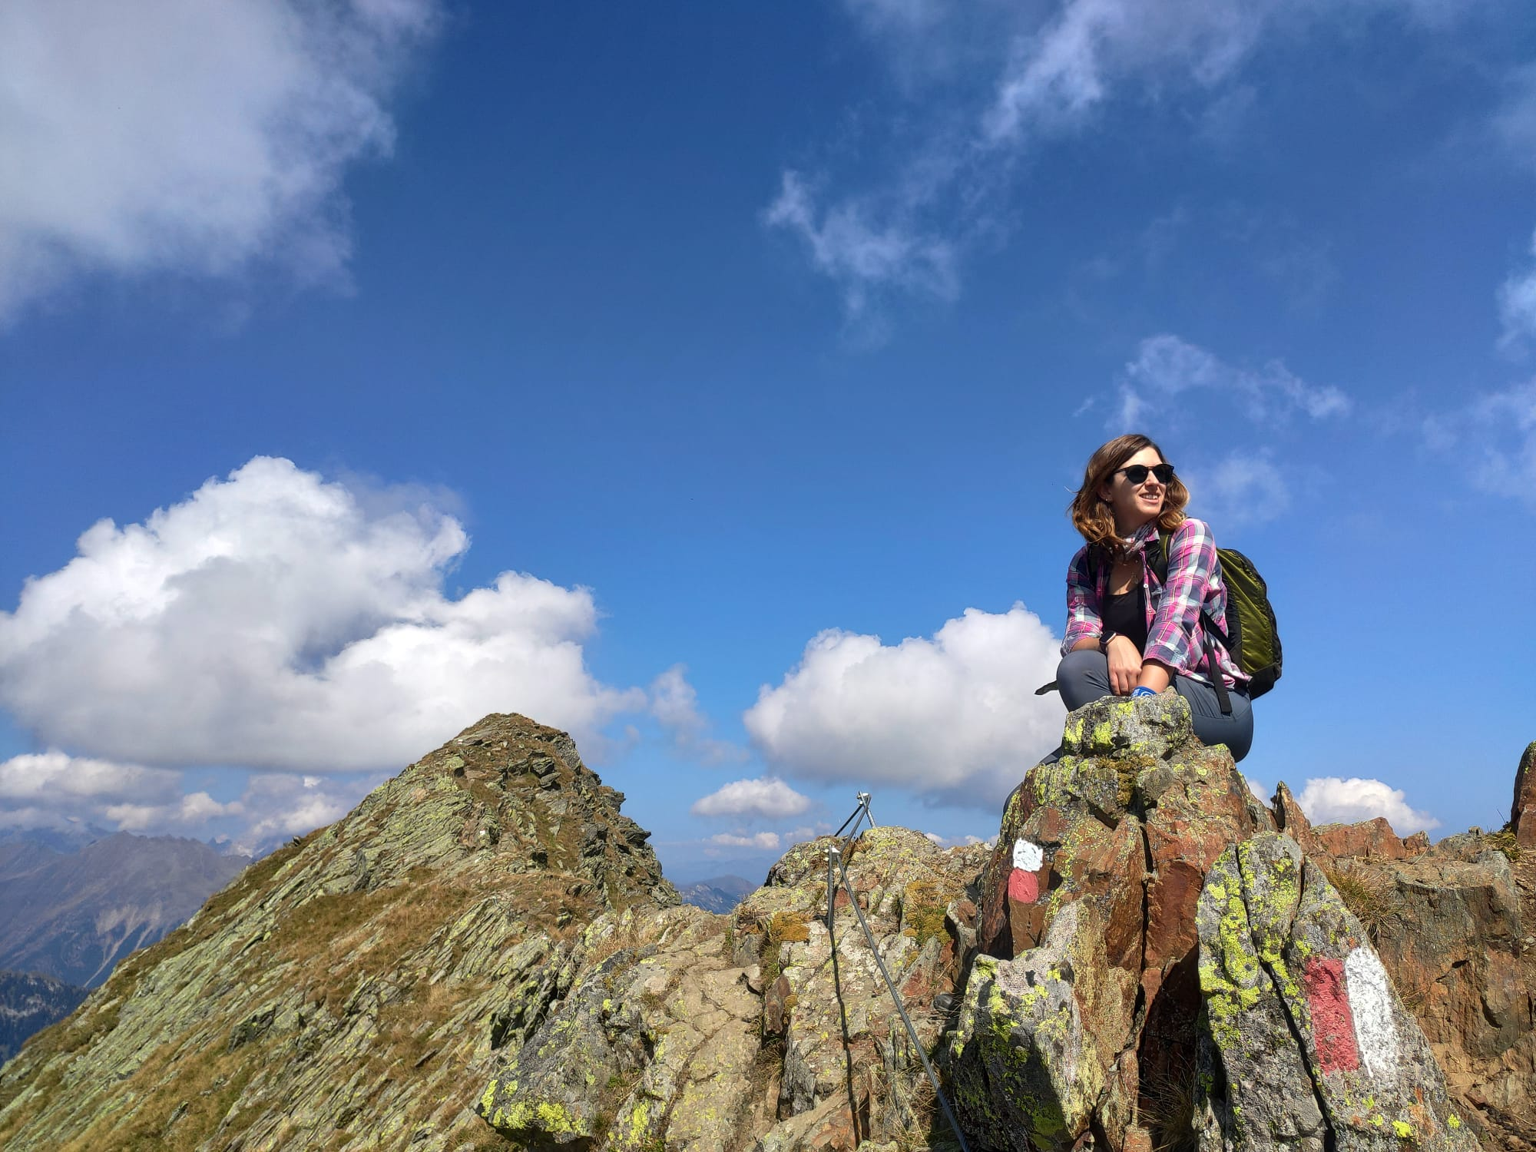
Personal presentation
Paola Fontanella Pisa
United Nations University – Institute for Environment and Human Security (UNU-EHS)
fontanella.pisa@ehs.unu.edu
IPROMO
Mountains in a changing climate: Threats, challenges and opportunities
28 September-09 October 2020

Slide 2
Education
Master of Arts: World Heritage Studies
Brandenburg University of Technology Cottbus-Senftenberg (Germany)
Bachelor Degree: Language, Culture and Society of Asia and Mediterranean Africa
Ca' Foscari University of Venice (Italy)
Employment and main activities
Programme Associate for Global Mountain Safeguard Research (GLOMOS) Programme
United Nations University, Institute for Environment and Human Security (UNU-EHS), Bolzano (Italy)
Scientific and administrative support to the GLOMOS programme. Responsibilities involve advancing research on mountain sustainability and highland-lowland interactions with a particular focus on the Global South, organization of conferences and events facilitating scientific exchange on mountains, and support to communication between GLOMOS and Eurac Research.

Slide 3
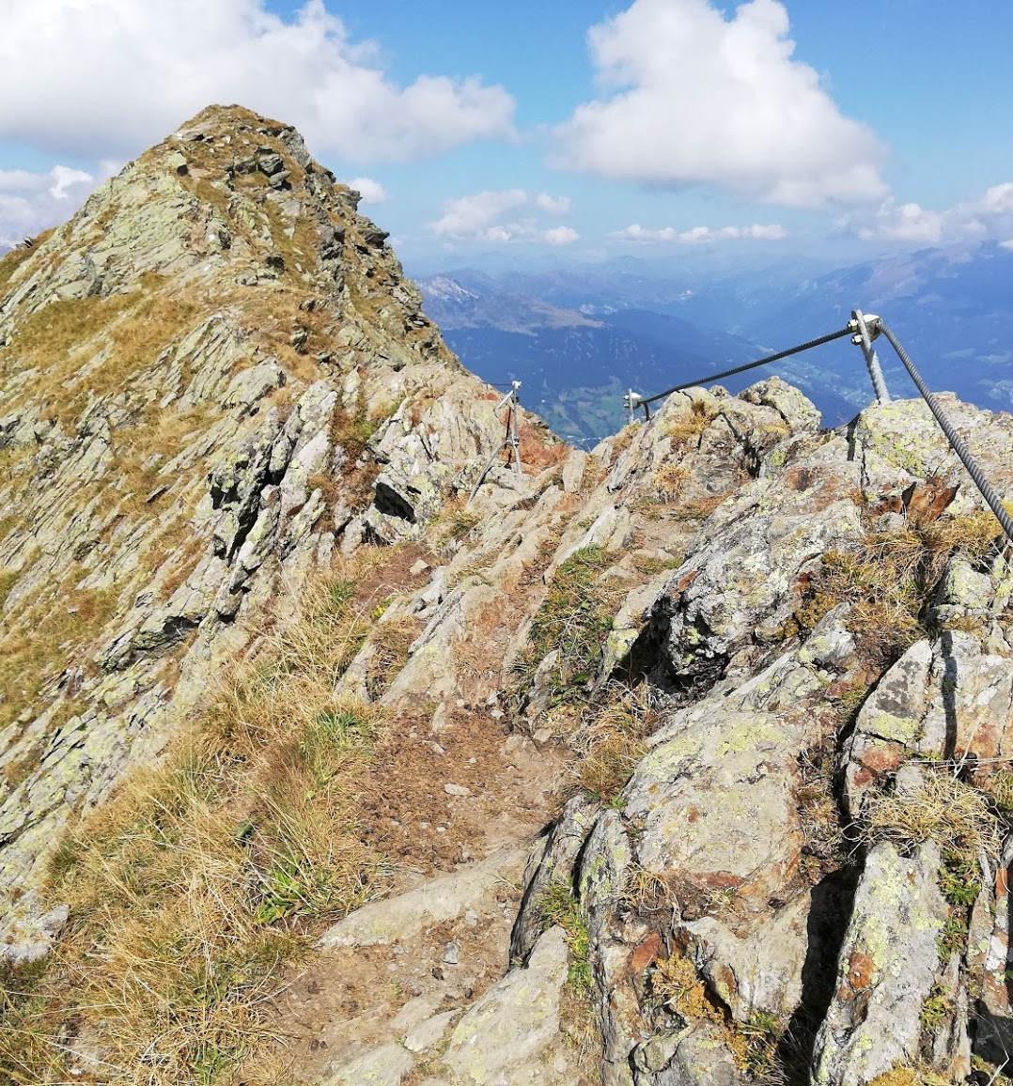
Other interests (volunteer work, hobbies etc.)
Hobbies
Hiking, climbing, skiing
Drawing, painting
Volunteering
Experience in World Wide Opportunities on organic Farms (WWOOF)
Volunteering for post-disaster relief (In Japan Iwate, Miyagi and Fukushima prefecture)

Slide 4
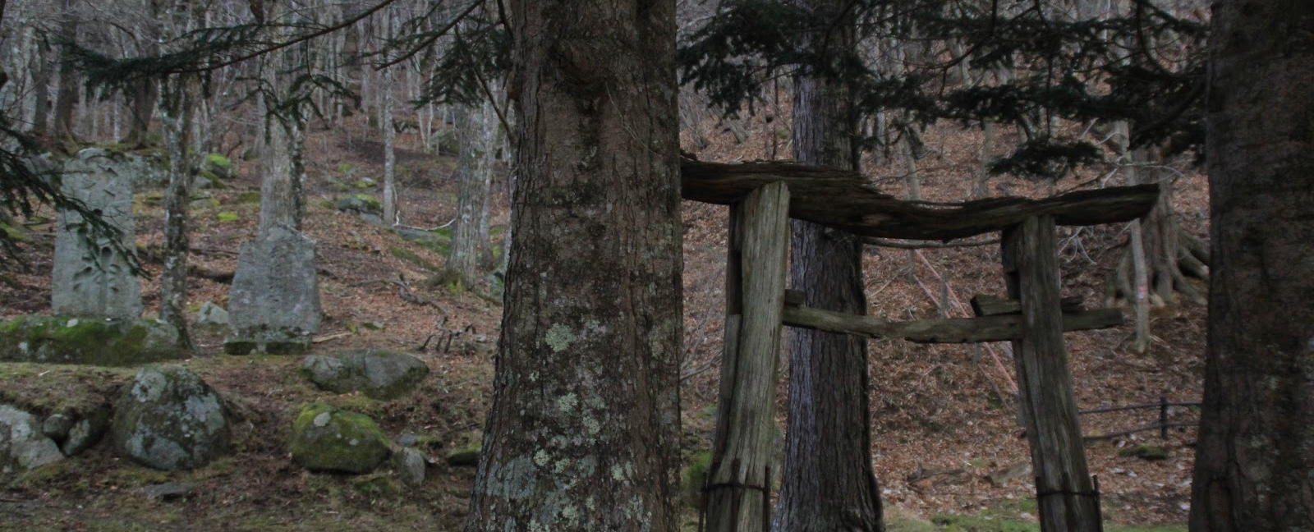
Risk Perception to Climate Change of Communities from Mountain Social-Ecological Systems
A case study from Japanese Satoyama
(Joint PhD Research with UNU-EHS and Tohoku University)
Presentation of a project you are working on 1/3

Slide 5
Mountain ecosystems =
provide critical ecosystem services
For both mountain communities and neighboring communities whose livelihood depends on these ecosystem services
Satoyama is one of the most effective representations of nature-culture linkages.
→ = a production landscape, which space is organized in order to best benefit of natural resources for agricultural production (Takeuchi et al; 2015).
Presentation of a project you are working on 2/3

Slide 6
Impacts of climate change and related disaster risks
→ of social-ecological systems whose dynamics are depending on highland-lowland interactions
Presentation of a project you are working on 3/3

Slide 7
Thank for your attention!
I’m looking forward to getting to know you all through this IPROMO course!

