Slide 1
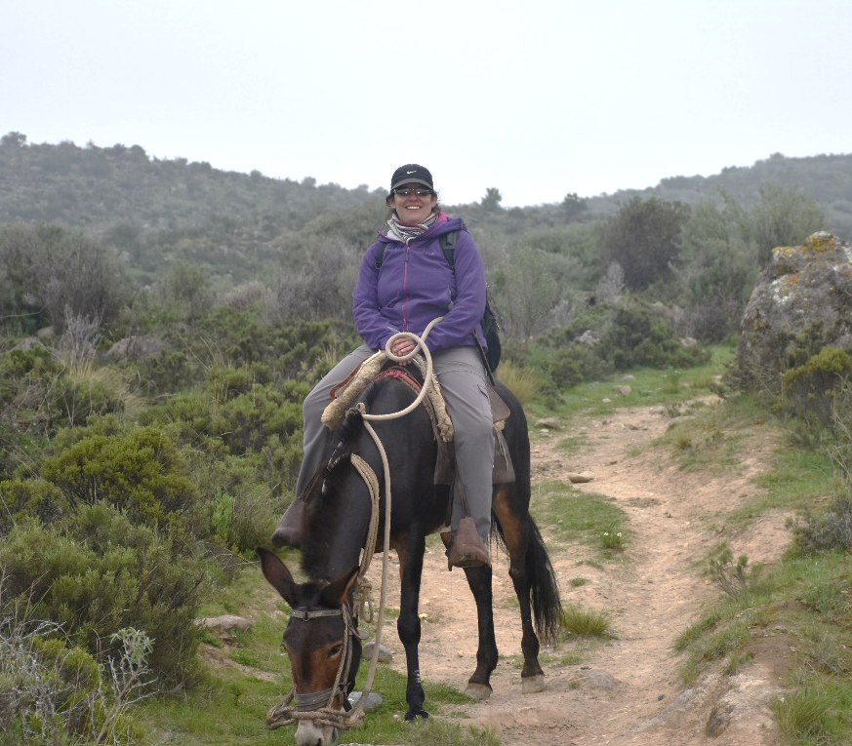
Personal presentation
Beatriz Fuentealba Durand
Instituto Nacional de Investigación en Glaciares y Ecosistemas de Montaña (INAIGEM - Perú)
National Institute for Glacier and Mountain Ecosystem Research
bfuentealba@inaigem.gob.pe
IPROMO
Mountains in a changing climate: Threats, challenges and opportunities
28 September-09 October 2020

Slide 2
Education
PhD in Biological Sciences, specialization area: integral ecosystem management, in the National Autonomous University of Mexico (2014)
Master’s degree in Biological Sciences, specialization area in Restoration Ecology in the National Autonomous University of Mexico (2009)
Biology degree in the Agrarian La Molina University of Perú (2002)
Employment and main activities
Director of Research in Mountain Ecosystem Division – INAIGEM
I’m a principal investigator in topics related with restoration and conservation in mountain ecosystems in the Andes (above 3800 m.a.s.l.)
I’m supervisor of researches related with hydrological ecosystem services, and risk and adaptation to climate change.
I’m advisor of thesis of three undergraduate students
I lead the National interinstitutional technical committee about Mountain and biodiversity (Grupo Técnico de Montañas)

Slide 3
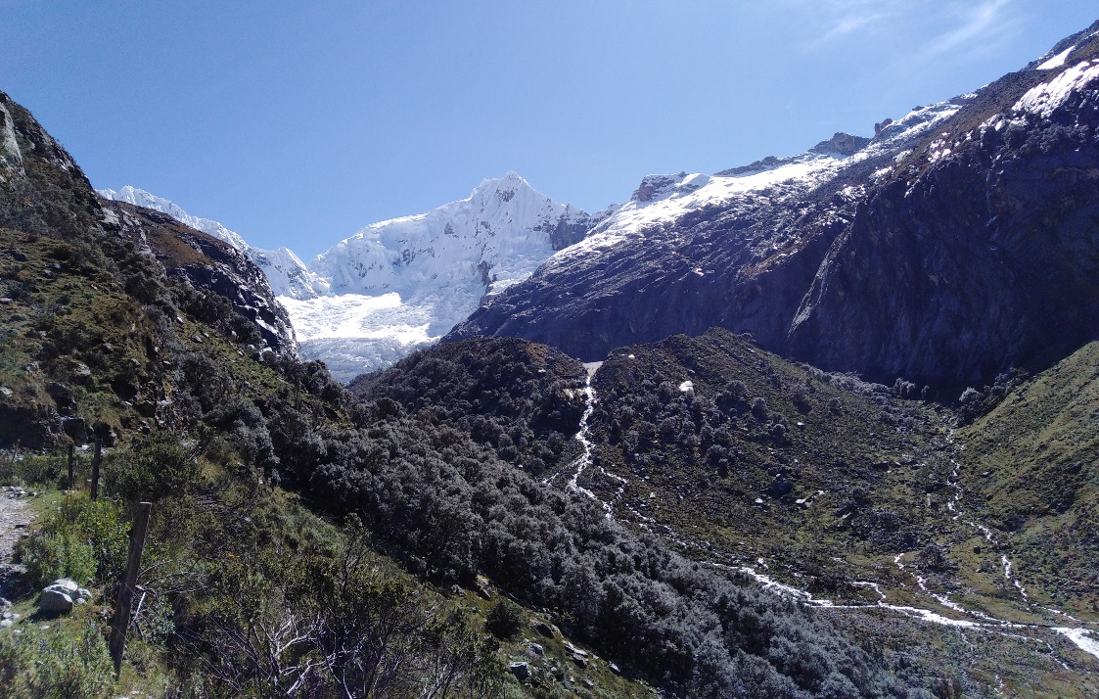
Other interests (volunteer work, hobbies etc.)
I would like to have a greenhouse. I like work with seeds and plants.
I really miss make fieldwork and walk in the mountains, even when I live so near to them.
I enjoy a lot cooking, especially during this pandemic and lockdown.
I love make puzzles,
the bigger the better!!

Slide 4
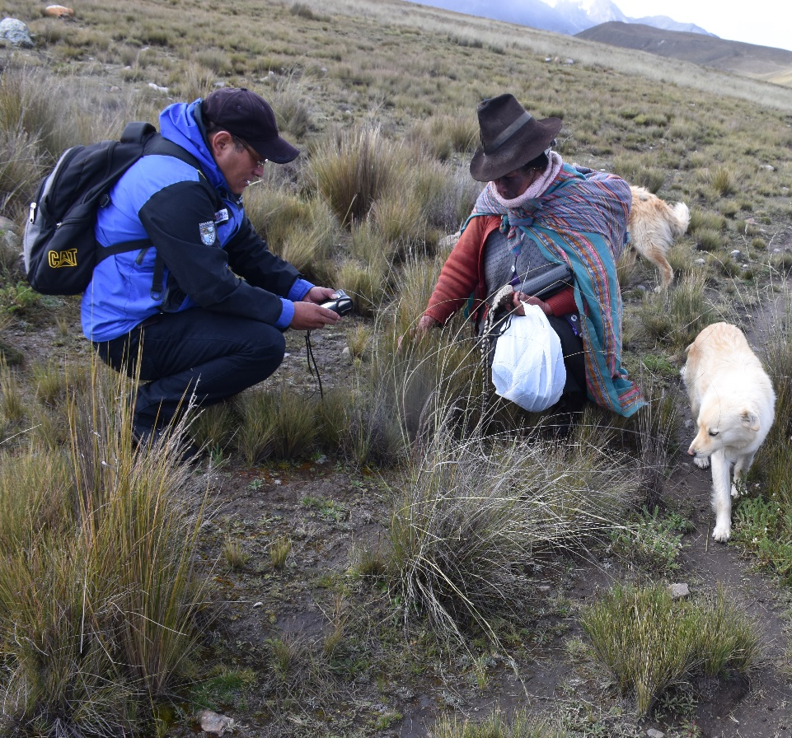
Presentation of a project you are working on 1/3
In our division we have five main research areas, and I’m related in some way with all of them:
Vulnerability analysis and risk management in mountain ecosystems.
This include the valuation of potential impacts in ecosystems and livelihoods. We work with GLOF and acid rock drainage impacts.
Climate change adaptation.
Here we want to recovery some traditional knowledge and local adaptation techniques. To start, we work with shepherds to identify natural grasses which could have frost tolerance.
In addition, we are identifying native plants to establish water / soil phyto-remediation experiments.

Slide 5
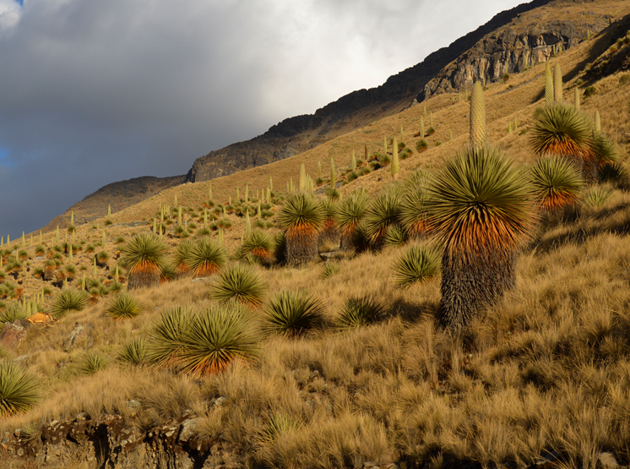
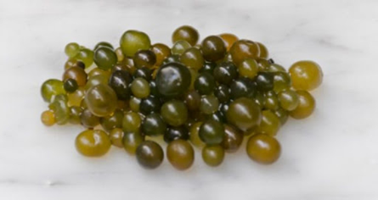
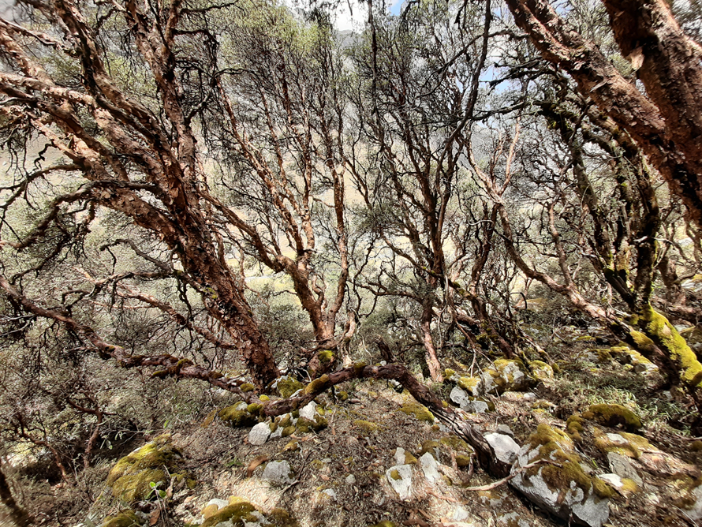
Presentation of a project you are working on 2/3
3) Socio-ecological characterization of mountain ecosystems
Includes: Ecological characterization in Andean forest (domain by Polylepis trees). Cultural valuation of Puya raimondii (endemic specie). Evaluation of natural factors to promote the production of “cushuro” (Nostoc spp.), a native cyanobacteria use in Andean diet.
Evaluation of hydrological ecosystem services in different land uses.
Nostoc sp.
Puya raimondii
Polylepis sp.

Slide 6
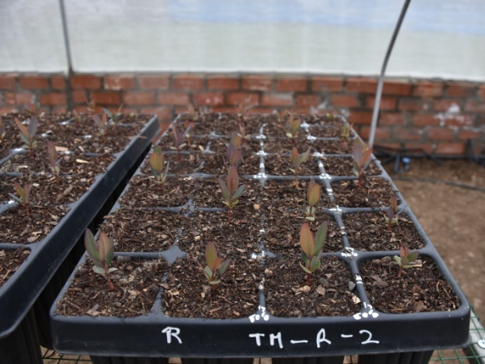
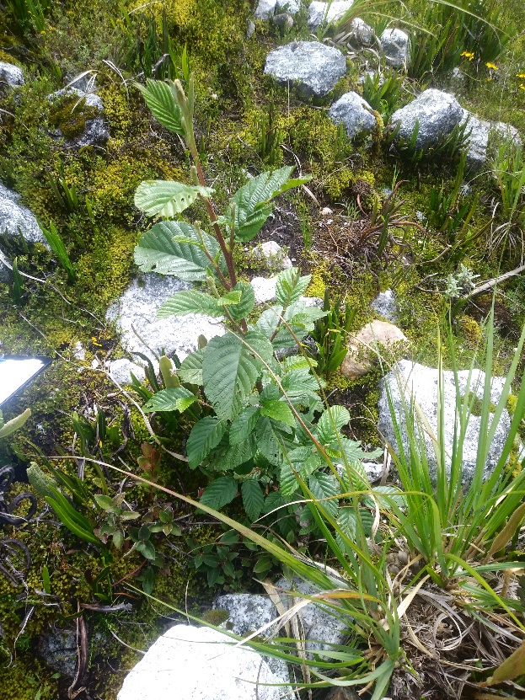
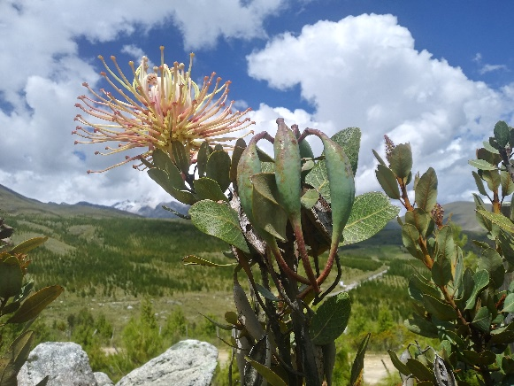
Presentation of a project you are working on 3/3
4) Restoration in mountain ecosystems
Includes: Restoration and enrichment in Andean grassland, and establishment of native woody plants (Alnus sp, Oreocallis grandiflora).
5) Remote sensing tools to characterize mountain ecosystems
We are doing the first national inventory of mountain peatlands called «bofedales» in Peru.

Slide 7
Thank for your attention!
(Optional)

