Slide 1
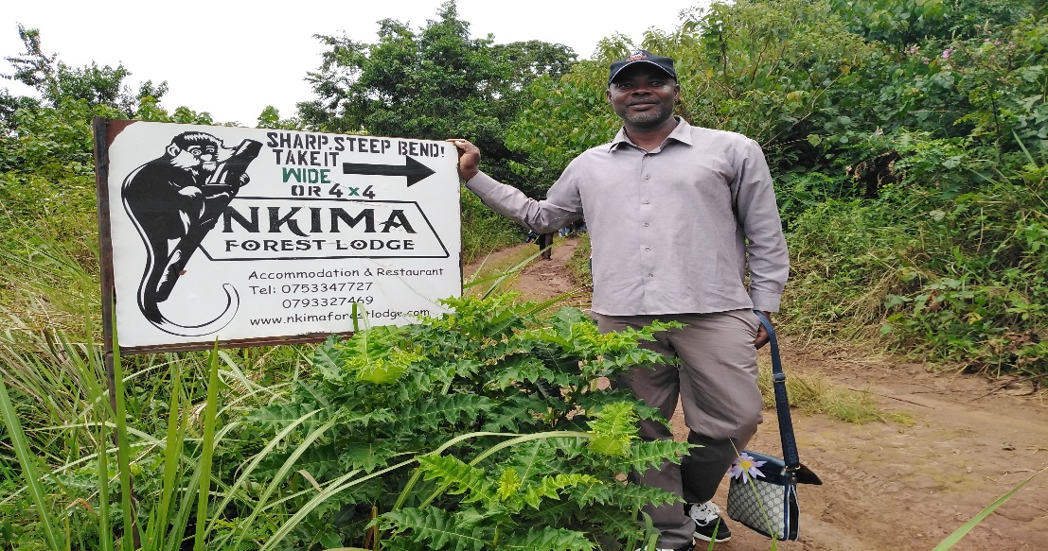
Personal presentation
EKPE, Sonigitu Asibong
Cross River State Government
sonigitu.ekpe@graduateinstitute.ch
IPROMO
Mountains in a changing climate: Threats, challenges and opportunities
28 September-09 October 2020

Slide 2
Education
2015 – date PhD (in view) Wildlife and Forest Resource Management, Michael Okpara University of Agriculture, Umudike, Nigeria
2015 Advanced Diploma, Environmental Governance, The Graduate Institute of International and Development Studies, Geneva, Switzerland
2007 – 2010, M.Sc Forestry and Environmental Management, Michael Okpara University of Agriculture, Umudike, Nigeria
1998 – 2003, B.Sc (Hons) Environmental Protection and Resource Management, University of Calabar, Calabar – Nigeria
2001 – 2002, Higher National Diploma (Upper Credit) Agricultural Extension and Management Technology, Ibrahim Babangida College of Agriculture, Obubra – Nigeria
1997 – 1998, National Diploma (Distinction) Fisheries Technology, Ibrahim Babangida College of Agriculture, Obubra – Nigeria
Employment and main activities
AUGUST 2019 to date – Acting Director (Scientific) Ministry of International Development Cooperation, Calabar - Nigeria
Provide overall coordination of all the phases of the programme cycle (identification, design/formulation, implementation, and monitoring/Evaluation)
Lead partner representative for Biodiversity and Protected Area Management (BIOPAMA) project at subnational level in Nigeria.
Build and maintain positive relationship between developmental parties across the globe, particularly to promote funding proposals and other beneficial relationships.
FEBURARY 2020 – APRIL 2020 National Consultant Food Security and Livelihood Assistant, Food and Agriculture Organization of the United Nations, Abuja – Nigeria
Worked with the UNHCR and other Humanitarian Team in Ogoja to deliver on the Agriculture and livelihood activities to the Cameroonian Refugees and host communities in Cross River and other states.
Supported the implementation of FAO/UNHCR Projects and emergency response activities related to agriculture, livestock and other areas related to the Cameroonian refugees in Nigeria.

Slide 3
Other interests (volunteer work, hobbies etc.)
West and Central Africa Regional Representative, International Union for Conservation of Nature - World Commission on Protected Areas (IUCN – WCPA) Mountains Specialist Group (MtnsSG)
National Focal Person – International Union for Conservation of Nature - World Commission on Protected Areas (IUCN – WCPA)
Member, Tourism and Protected Area Specialist, IUCN – WCPA – TAPAS) Capacity Development Building Working Group.
Member, CIVIL 20
Steering Committee Member, OECD Civil Society Information Society Advisory Council, (CSISAC)
Member of Red Colobus Network and Political Lead Coordinator
Member, Dgroup - A consortium involve in international development through dialogue hosted by FAO, DFID, World Bank, WHO, CTA, INGO, CGIAR, etc.
Member, Forum for Agricultural Researchers in Africa (FARA);
Member, Africa Forum for Agricultural Advisory Services (AFAAS);
Member, Evidence Based Policy in Development Network (EBPDN);
Member, Internet Governance Caucus (IGC);

Slide 4
Title: Need Nutrition Education Programme (NNEdPro) Africa Region and Building a Data-driven knowledge ecosystem to Improving smallholders’ livelihoods in Mountainous Communities
Aims and Objectives
To develop a critical mass of self-sustaining knowledge, skills and capacity in Nutrition and Health, within Africa healthcare and public health workforce, resulting in significantly improved health practices and outcomes.
To deliver targeted and timely information to farmers based on their needs. The empowerment that comes from providing farmers with informed options is transformational, especially for women and youth.
To improve the production of open data in Agriculture, making such data more usable, timely and comprehensive, comparable and interoperable.

Slide 5
Team members at the NNEdPro Global Strategy Day

Slide 6
Our Strategy Plan For 2021 - 2025
Collaborative: Strategic advocacy aims to promote collaborative process that capitalize on the knowledge and expertise
Democratic: As a democratic organization, NNEdPro’s advocacy strategic plan aims to enhance the flow of information across networks and promote open-communication with equal opportunity for input across our multi-professional workforce.
Transparent: Our strategic plan presents a pathway for NNEdPro advocacy efforts with the ultimate goal to increase the transparency of the processes and outputs
Evidence-based: At the core of NNEdPro’s strategic advocacy plan is the principle that the best evidence available informs good decision-making.
Impactful: NNEdPro is well positioned in the international effort to improve population health and ensure that the crucial role of good nutrition is recognized in this context. To improve impact, NNEdPro advocacy efforts will be focused on areas where NNEdPro has recognized expertise, networks and relationships.
NNEdPro advocacy efforts will be directed towards:
Nutrition training and education
harmonization of standards in nutrition training & education.
Nutrition education for all health & social care, public health and education professionals/workers.
Open distance-learning strategy which will offer an innovative combination of flexible teaching methods and a combination of radio programs, hands-on-skills teaching, video materials through a farmer Field school for smallholders
Scaling up pathways to intensifying staple food production, improving food quality, nutrition and increased income from good agricultural practices

Slide 7
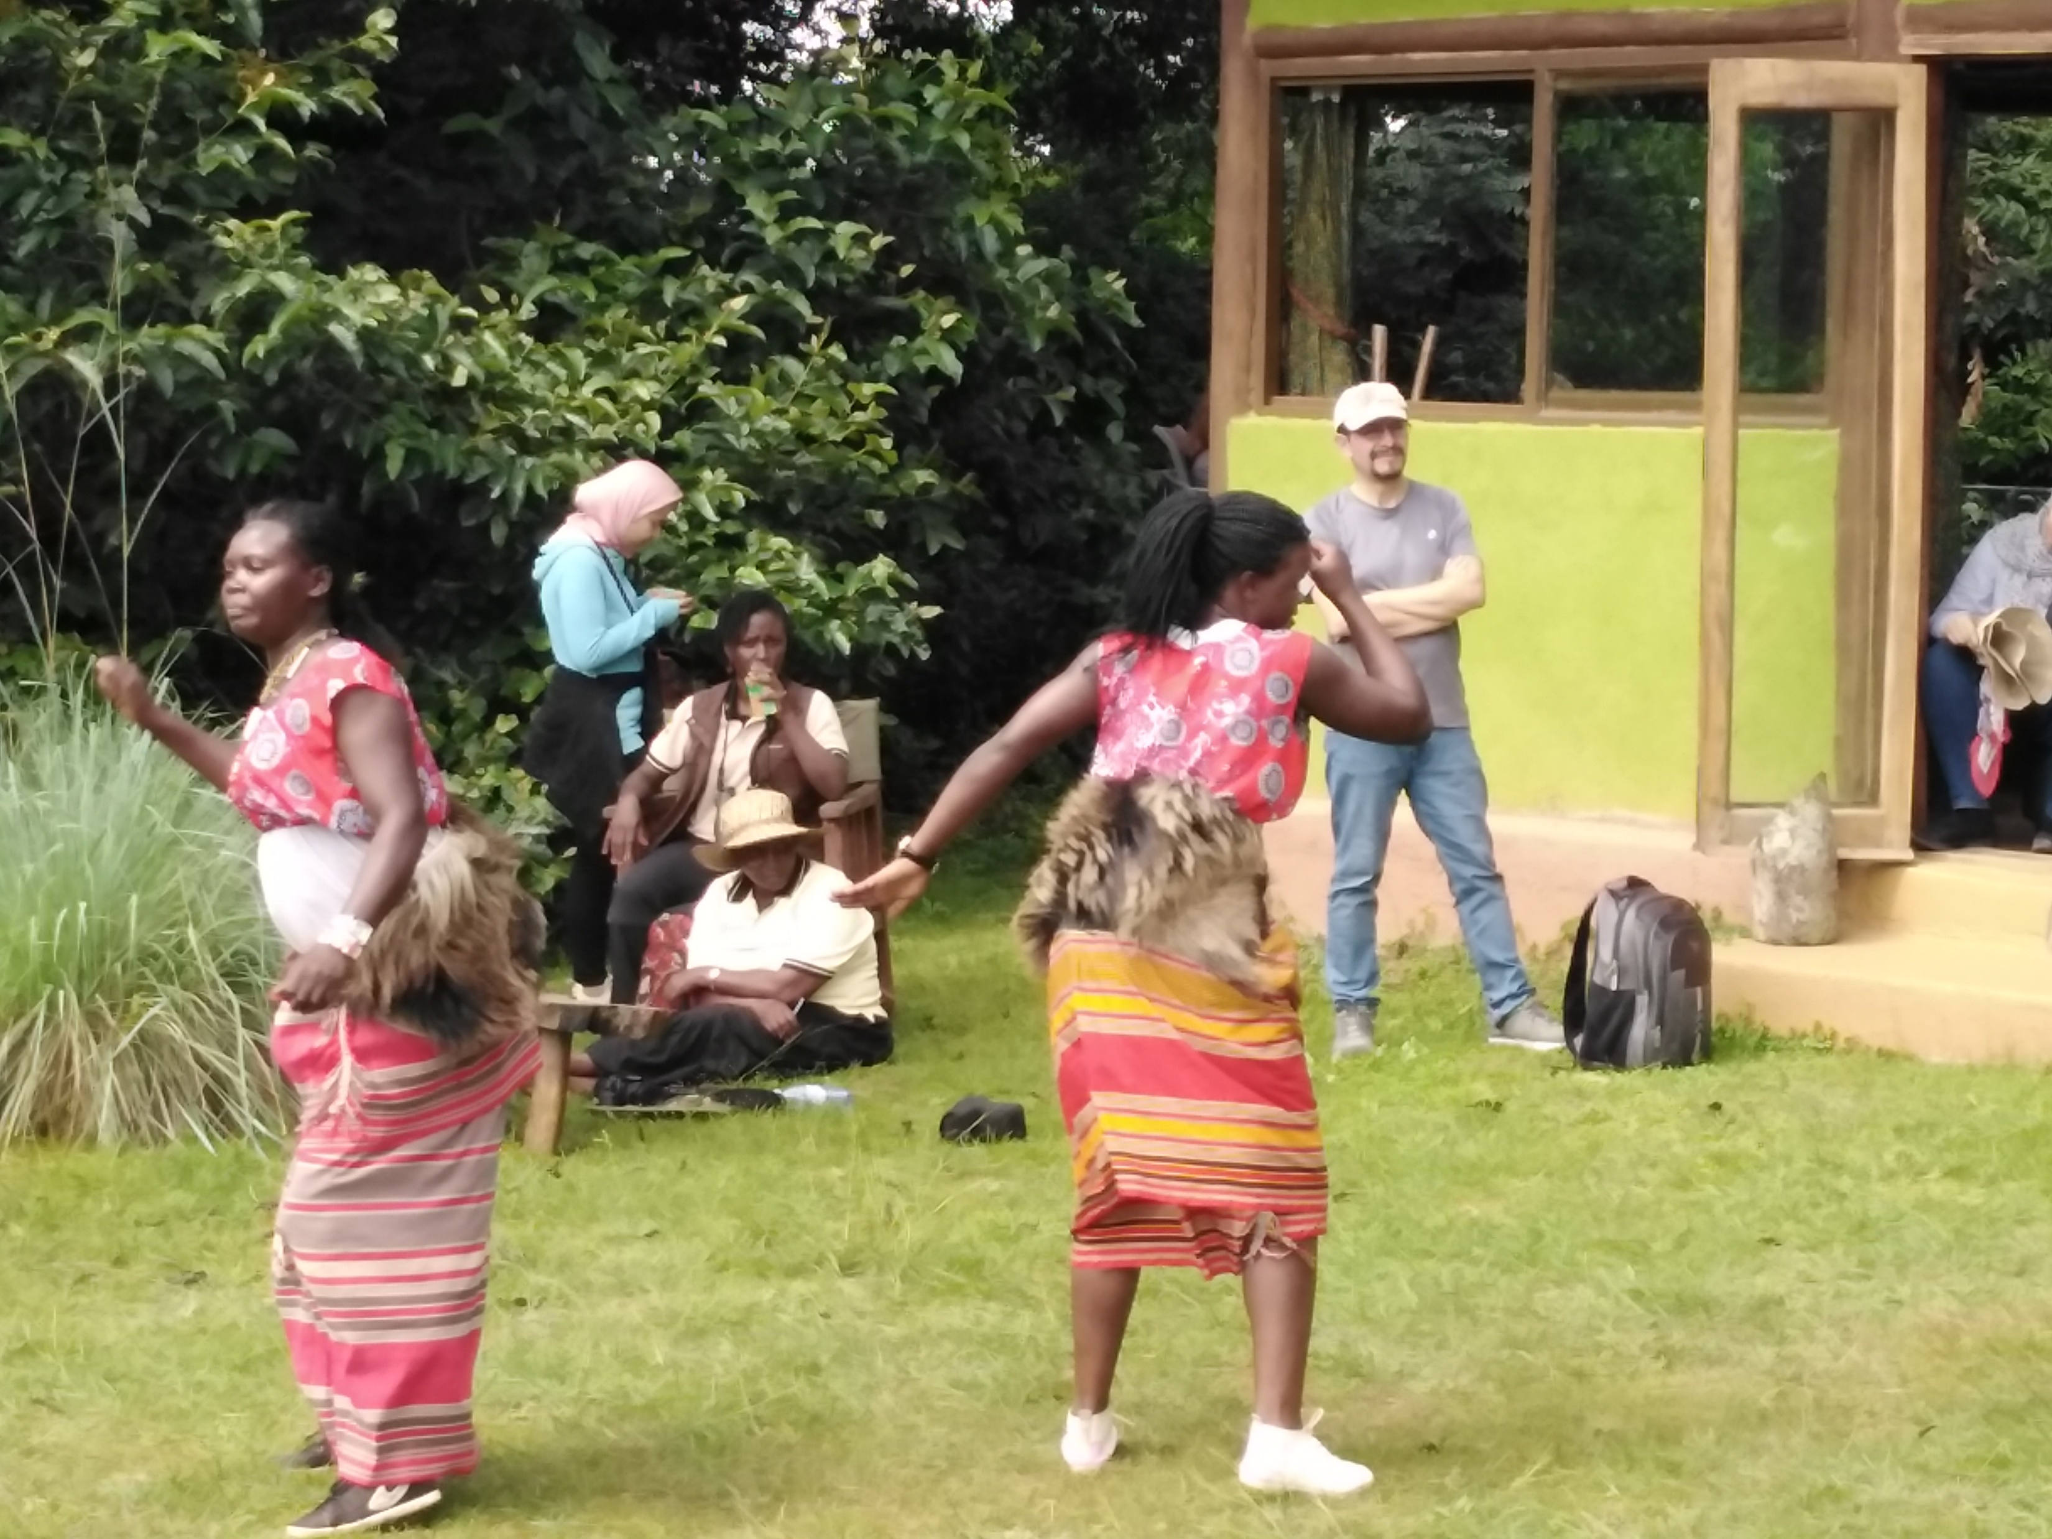
Thank for your attention!

