Slide 1
Personal presentation
Álvaro Poo
GEF proyect “Biological corridors of mountains”
alvaropooa@gmail.com
IPROMO
Mountains in a changing climate: Threats, challenges and opportunities
28 September-09 October 2020

Slide 2
Education
Year 2019: Master in Ecology, Environmental Management and Restoration, University of Barcelona, Faculty of Biology. Spain.
Year 2013: Posgraduate in Agroecology and Territorial Management under SIPAM denomination. Education and Technology Center, CET Chiloé, Chile.
Year 2013: Forestry engineer. Pontifical Catholic University of Chile, Faculty of Agronomy and Forestry Engineering.
Employment and main activities
Freelancer:
Consultant in mountain’s range management plans in Central Chile, GEF Biological Mountain Corridors Project.
Rural extensionist in various projects.
GIS analyst in land planning and agricultural heritage projects
General coordinator of project Rescue and valorization of the Chiloé’s apple through the production of cider with a territorial identity.
Program coordinator in Best Practices, Ecosocial Wetlands Conservation. Chiloé Island.

Slide 3
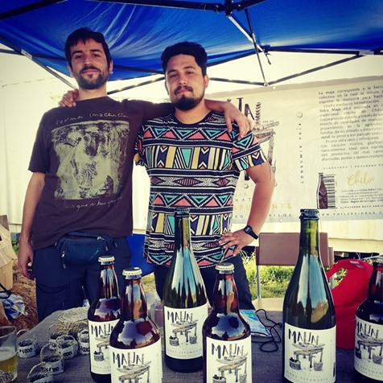
Other interests (volunteer work, hobbies etc.)
Agroecology
bioengineering
Apple cider producer on the Chiloe Island, north Patagonia of Chile: “Sidra Maja”
Trekking and naturalism
Cooperativism
Regional foods

Slide 4
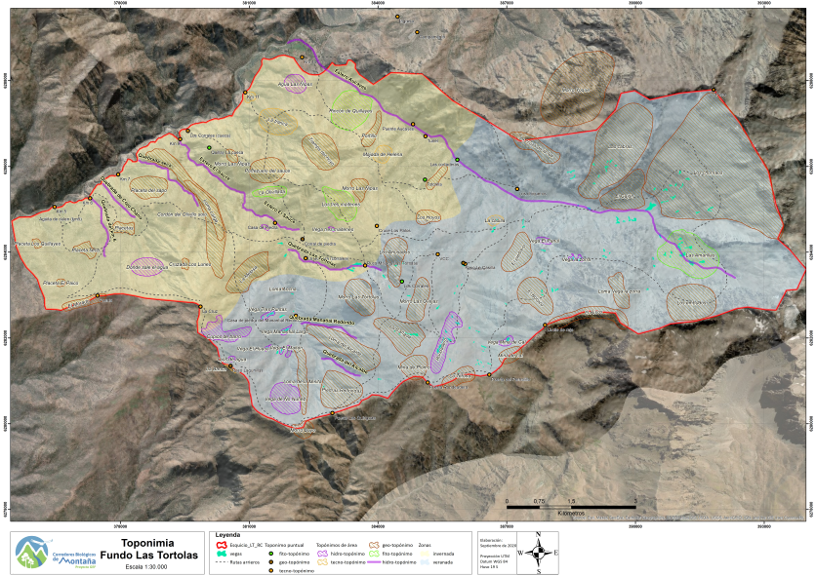
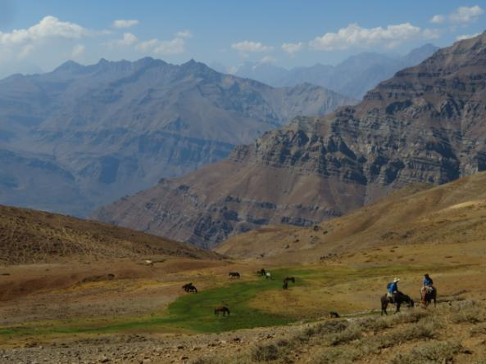
Presentation of a project you are working on 1/3
Mountain’s range management plans in Central Chile, GEF Biological Mountain Corridors Project
Regenerative grazing plan with ranchers community
Overgrazing and common resources
Climate change and drought
livestock and wildlife conflict

Slide 5
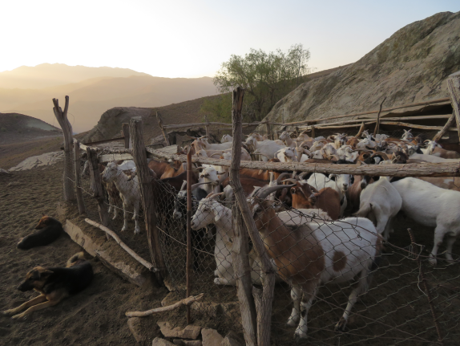
Presentation of a project you are working on 2/3
2. Pilot plan for forest fuel management through grazing
Wildfires prevention through fuel management in WUI
Complement the economic activities of ranchers
Transit from a product-based economy to mixed products and services-based economy

Slide 6
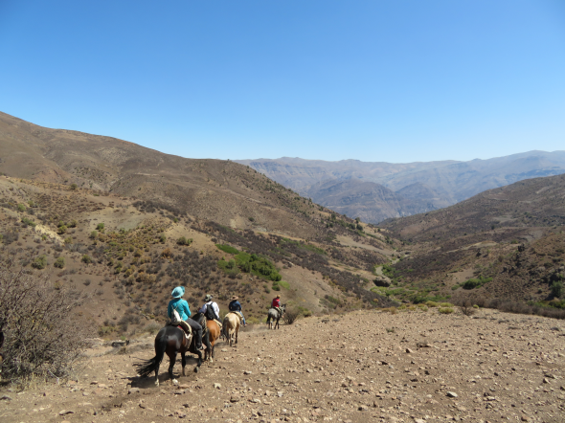
Presentation of a project you are working on 3/3
3. Mountain transhumant livestock tourism proposal
Reconcile conservation and livestock
Valorization of traditional knowledge

Slide 7
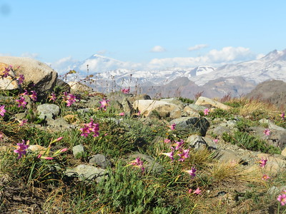
Thank for your attention!
(Optional)

