Slide 1
Personal presentation
Ana Belén Hurtado-M
Instituto Alexander von Humboldt – COLOMBIA
ahurtado@humboldt.org.co
IPROMO
Mountains in a changing climate: Threats, challenges and opportunities
28 September-09 October 2020

Slide 2
Education
Ph.D. on Environmental and Rural Studies – Universidad Javeriana, Colombia (central theme: secondary forests in Colombia)
M.Sc. Biological sciences
BA. Biology
Employment and main activities
Researcher at the Alexander von Humboldt Institute - COLOMBIA
Working at the "high mountain agenda" looking forward to integrating efforts at the national level to have a monitoring system in Colombia's mountain ecosystems.

Slide 3
Other interests (volunteer work, hobbies etc.)

Slide 4
Presentation of a project you are working on 1/3

Slide 5
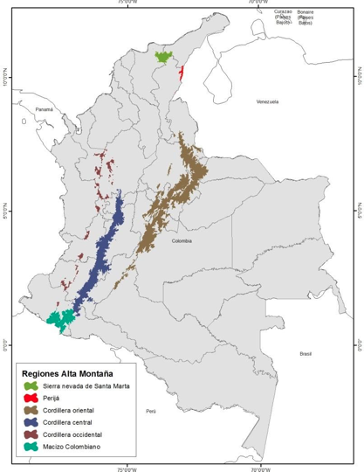
Presentation of a project you are working on 2/3
Main Objetive: To propose a multiscale conceptual framework for analyzing drivers of change and response variables from the local to the national scale, emphasizing the importance of monitoring along altitudinal, land use, and ecosystem restoration gradients
1. Evaluate the dynamics of variables and indicators linked with the ecological integrity, biodiversity, ecosystem functioning, and services of high Andean ecosystems in Colombia.
2. Relate these dynamics with the main drivers of change operating at different spatiotemporal scales, including climate change and demographic, socioeconomic, and land-use change processes.
3.Evaluate the effectiveness of the primary biodiversity conservation, ecosystem management, restoration strategies, and territorial governance schemes in Colombia to guide the decision-making process on local, regional, and national scales.

Slide 6
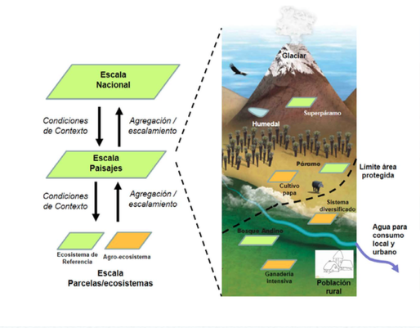
Presentation of a project you are working on 3/3

Slide 7
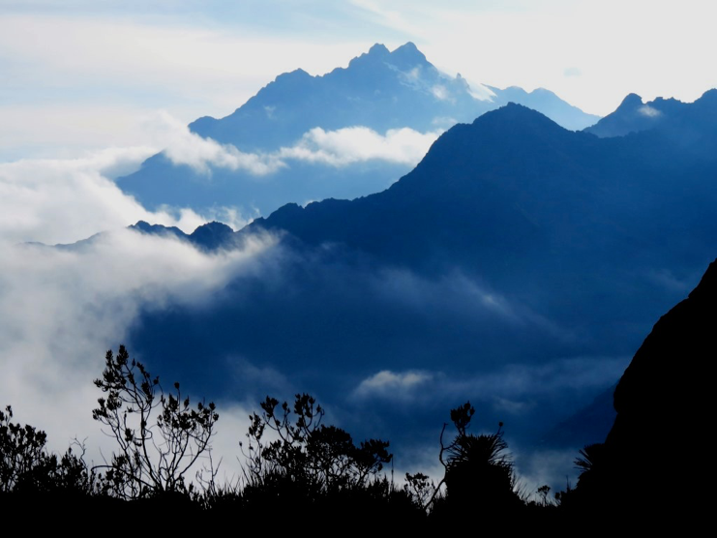
Thank for your attention!

