Slide 1
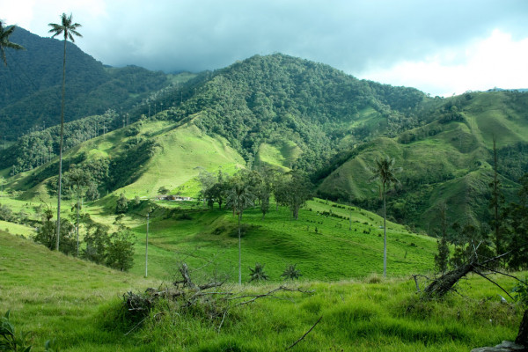
Personal presentation
Jonnathan Stivel Pérez Santamaría
Ministerio de Relaciones Exteriores de Colombia
j_santa88@hotmail.com – jonnathan.perez@cancilleria.gov.co
IPROMO
Mountains in a changing climate: Threats, challenges and opportunities
28 September-09 October 2020

Slide 2
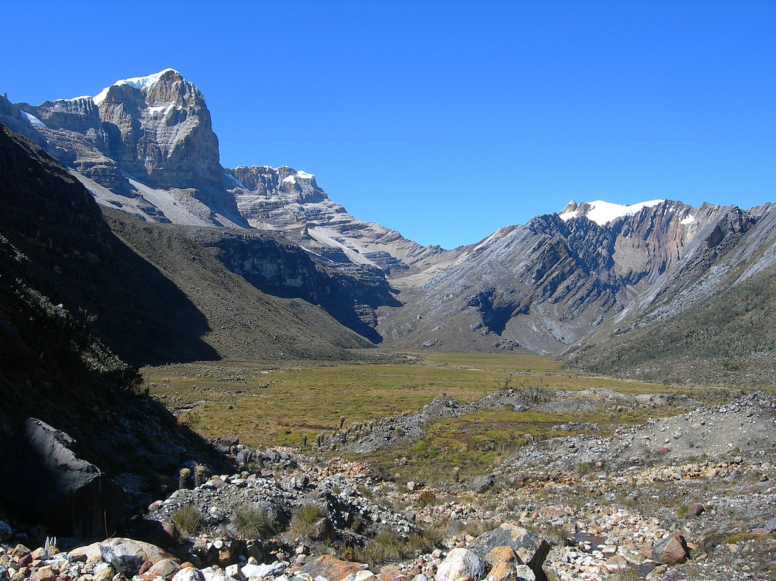
Education
I am a geographer from the Universidad Nacional de Colombia and I have a Master's degree in Interdisciplinary Development Studies from the Universidad de los Andes.
Employment and main activities
I worked, initially, as a social science teacher, both in public and private schools. For some years I worked in public health in Bogotá. However, my passion for political geography led me to the Diplomatic and Consular Career of Colombia, which is why I am a Third Secretary in the Ministry of Foreign Affairs of Colombia.

Slide 3
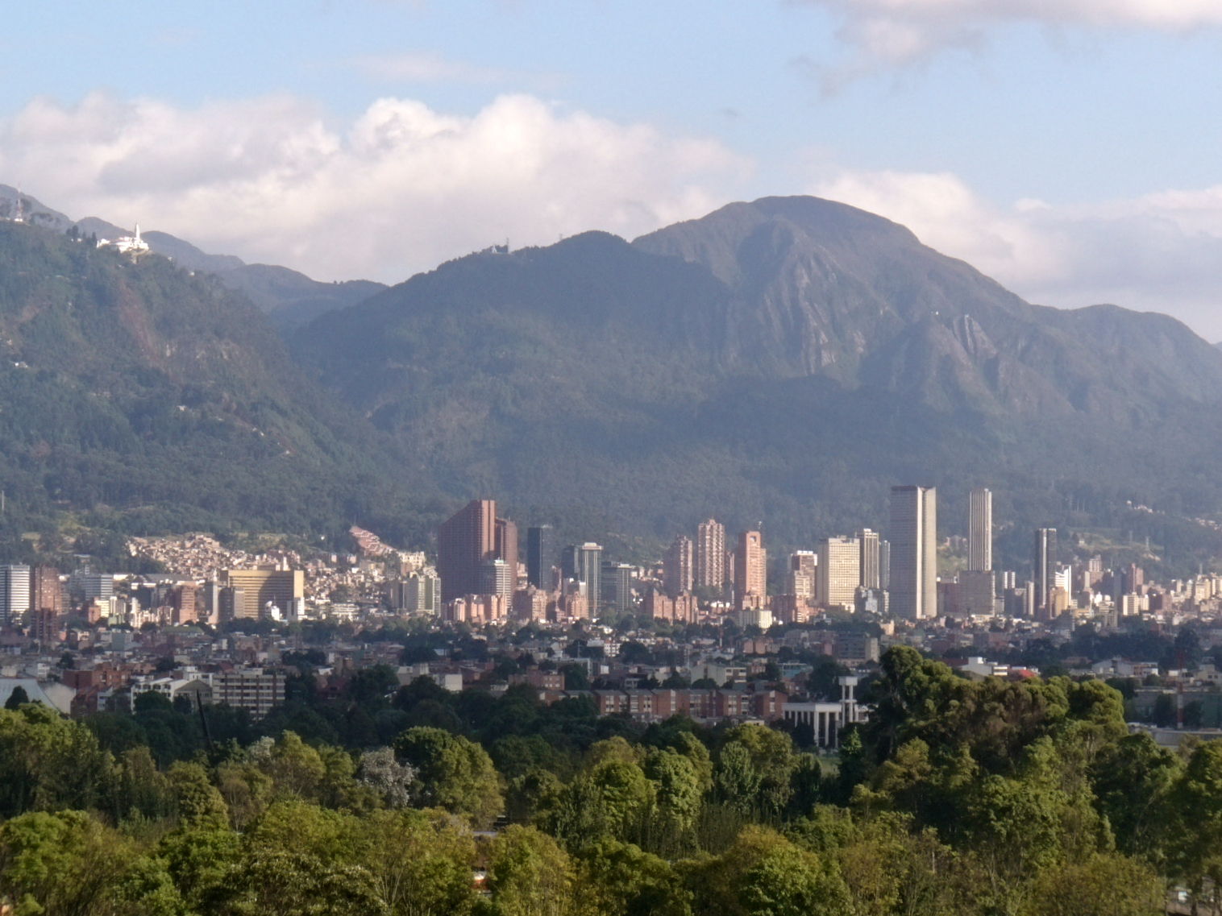
Other interests
I like to walk my city. I walk about two hours a day. I think that observation has been my best tool to create identity with my territory.
In my free time, I am an internet consumer. The speed with which I can access information makes me want to look for every doubt I have about any topic. I especially like documentaries.

Slide 4
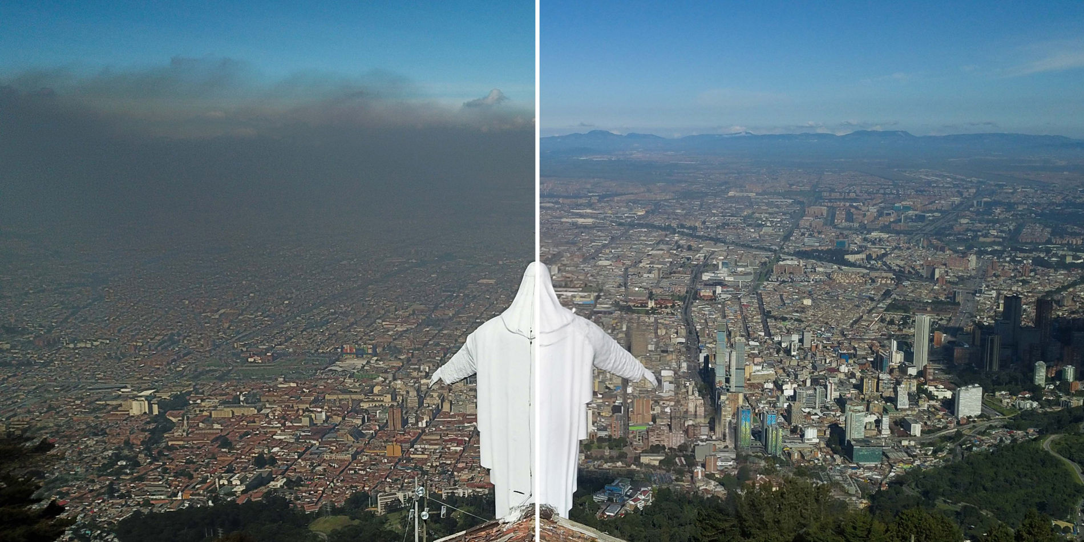
Changes in the phenomenon of thermal inversion in the highlands of the tropical Andes due to climate change
This is a personal research project that I and geographer and meteorologist Leonardo Ruales started in 2019. The objective of the project is to identify and analyze the patterns of change that the recurrent phenomenon of thermal inversion in flat areas of altitude such as the so-called "Sabana de Bogotá" has had.
Thermal inversion is a natural phenomenon that occurs when there have been no clouds the day before, the air is cold and does not rise, so the pollution remains on the surface and the mass of polluted air does not rise to greater heights. Consequently, such pollution affects air quality and has human health, economic and social implications.
We want to initiate a series of data that is permanent and continuous for as long as possible. However, for now we are defining theoretical and methodological variables.

Slide 5
Thank for your attention!
¡Muchas gracias por su atención!

