Slide 1
Personal presentation
Vanesa Ramos Abensur
Rikolto Latam
vanesa.ramos.Abensur@gmail.com
IPROMO
Mountains in a changing climate: Threats, challenges and opportunities
28 September-09 October 2020

Slide 2
Education
Ph.D. candidate in Development and Environment
M.Sc. in Regional Development and Environment
Undergraduate Diploma in Biology
B.Sc. in Biology, with specialization in Ecology
Employment and main activities
Project Coordinator and Researcher
Research project: "Knowledge statement review about liquid organic inputs with a special focus on the Andean region (Ecuador, Peru and Bolivia)", carried out by Rikolto, Michigan State University, and McKnight Foundation

Slide 3
Other interests (volunteer work, hobbies etc.)
Latin-American School for Food Systems Resilience ALLSA 2019, Co-Organizer
ALLSA 2019 was carried out in from September 14th to September 25th of 2019 in the Sacred Valley of Cuzco, Peru in association with the Potato Park and ANDES Association. A total of 24 young environmental leaders from Latin America participated.
The main goal was to create a network for Latin Americans to promote innovative processes for food systems resilience, using co-learning and participatory approaches. This school specifically seeks to validate both ancestral and academic knowledge.

Slide 4
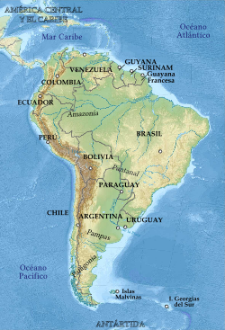
Presentation of a project you are working on 1/3
"Knowledge statement review about liquid organic inputs with a special focus on the Andean region (Ecuador, Peru and Bolivia)“
The objective is to carry out a complete bibliographic and socio-ecological review of agro-ecological liquid bio-inputs.
Rikolto expects to understand more on bio-inputs complexities through this study and make the results available for farmers in an easy format.
Current state: analyzing results

Slide 5
Presentation of a project you are working on 2/3
Exploring strategies to face climate change and improve agrobiodiversity conservation in Quechua communities from the Peruvian Andes (PhD thesis in progress)
Objective: Characterize the strategies that Quechua communities have developed to face climate change and determine its impact on the conservation of agrobiodiversity

Slide 6
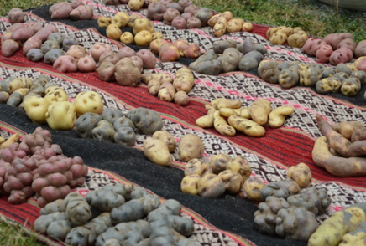
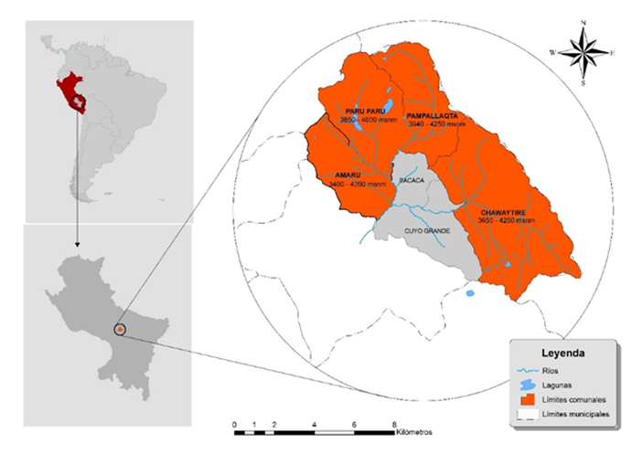
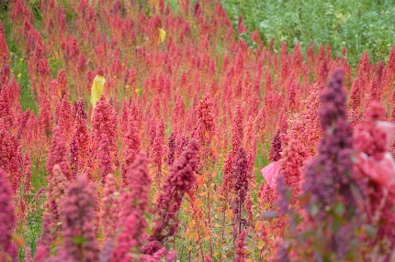
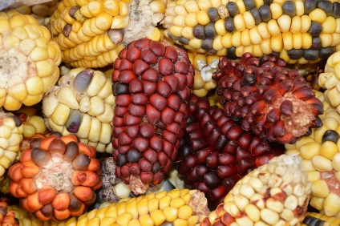
Presentation of a project you are working on 2/3
Exploring strategies to face climate change and improve agrobiodiversity conservation in Quechua communities from the Peruvian Andes (PhD thesis in progress)

Slide 7
Thank for your attention!

