Slide 1
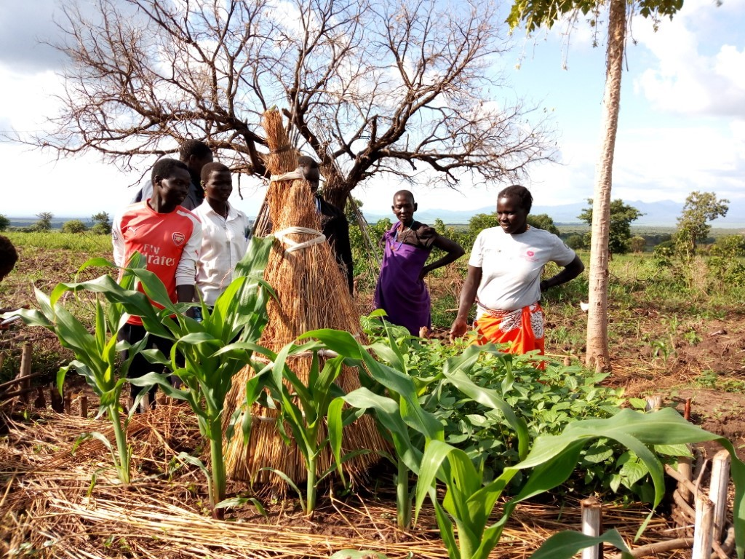
Working Group 1
Project proposal:
engaging youth in sustainable agricultural development in order to reduce social, economic and environmental pressures for communities benefitting from mountain ecosystem services in view of climate change
Photo by: Loupa Pius/ DADO
Alessandra Pollo
Džana Bordanić
Gent Imeraj
Elfengour Mohammed
Francesca Bussola
Loupa Pius
Paola Fontanella Pisa
Sonigitu Asibong

Slide 2
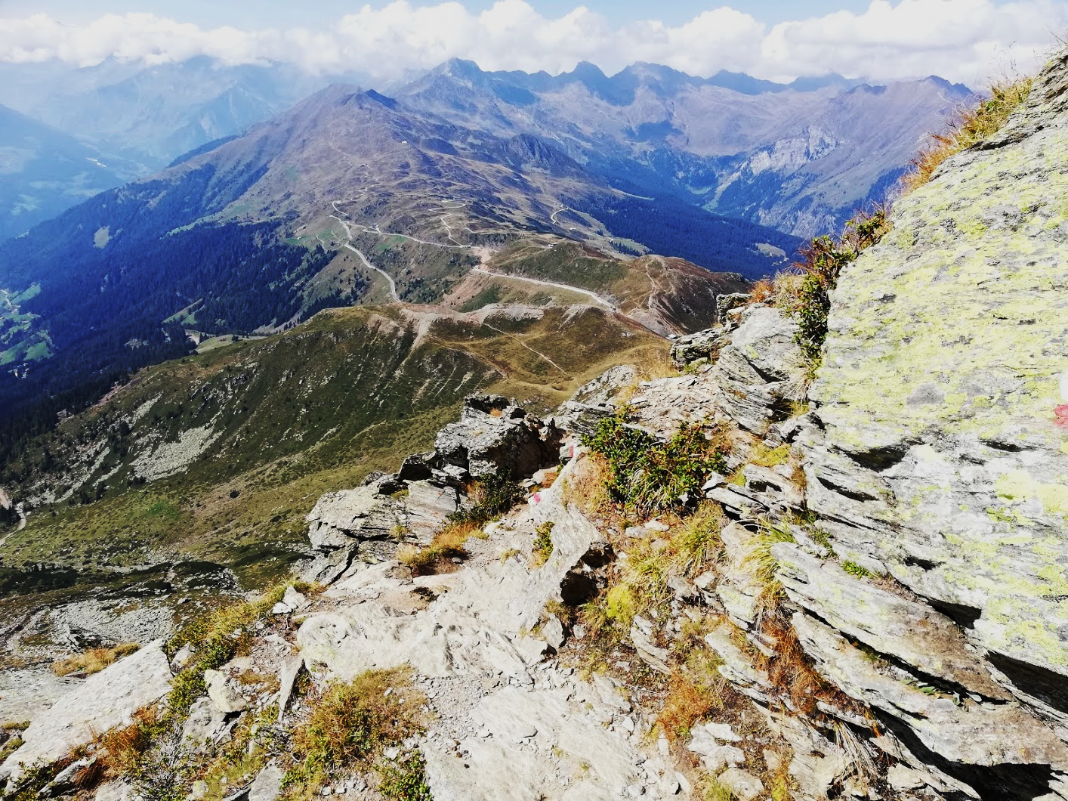
#MountainsMatter
Mountain pressures
Solutions
Climate change
Sustainable management of mountain ecosystems
Sustainable development of agricultural system
Empowerment mountain communities
Food insecurity
Poverty
Socioeconomic marginalization
lead to
out-migration of youth leading to exacerbation of the pressures
Notes:
Speech:
Mountains are the world’s “water towers” and home to 15% of global population. As we have seen over this course, they are rich with ecosystem services, providing for the livelihood of both highland and lowland communities However, we have also seen that mountains are among the most vulnerable to pressures such as climate change, food insecurity and poverty, and marginalization, which leads ultimately to out-migration of youth and growing inequalities. This presents a threat to efforts for sustainable development, and further exacerbates adverse impacts of these pressures.
Having this in mind, our group has decided to develop a project proposal, aiming at acting on sustainable management of mountain ecosystems and agricultural systems, while empowering mountain communities, with a special focus on youth and women, who represent the main actors for sustainable development and adaptation to climate change.
Additional notes:
1 in 2 rural mountain people is facing hunger and malnutrition
Mountains are under pressure for climate changes, hunger, poverty, migration, etc
Mountain peoples are among the poorest and most malnourished in the world
In developing countries, a great majority lives below the poverty line and more than 1 in 2 rural people faces food insecurity (±350 million)
Since 2000, vulnerability to food insecurity has constantly increased in rural mountain areas
More than 90% of the world’s mountain dwellers live in developing countries (±1 billion people)

Slide 3
Rationale of the Project Proposal:
engaging youth in sustainable agricultural development in order to reduce social, economic and environmental pressures for communities benefitting from mountain ecosystem services in view of climate change
ACTION AREA 1: Strengthening youth efforts in climate resilient agricultural production system
ACTION AREA 2: Inclusive climate finance for Youth and Women enterprise schemes
ACTION AREA 3: Strengthening youth and women in sustainable water and land management
ACTION AREA 4: Improving the production of open data in agriculture and biodiversity
ACTION AREA 5: Broadband & Digital Connectivity: Food (Anti)Security?
ACTION AREA 6: Gender-Inclusive Climate Adaptation

Slide 4
Objectives
Increase local production of diversified foods by:
women
youth smallholder farmers
supporting traditional cultivation and breeding practices
Improve the production of open data in agriculture/biodiversity:
Usable
Timely
Comprehensive
Comparable
Interoperable
Updated
Free access ​
1
4
Increase youth involvement in mountain and landscapes resilience through:
capacity building on mountain ecosystems
supporting the development of networks and expertise exchange by a bottom-up process
2
Foster local economic development combining:
traditional rural activities
tourism
raising-awareness initiatives
dissemination projects
Creation of new job opportunities
Increase of sustainable tourism
Valorize local communities' efforts
5
Increase local mountain products market accessibility for women and youth smallholder farmers involved in climate resilient farming
3

Slide 5

Expected results
Improved access to credit along the value chain through community saving and credit schemes
Increased adoption and production of diverse food crops and animal products
to facilitate nutrition and income needs
Increased access and production of indigenous trees for landscape restoration and conservation
Improved access to credit along the value chain through community saving and credit schemes
Empowered farmers with informed options are transformational, especially for women and youth.
Cloud Computing to enable seamless data storage and real-time reporting across the value chain

Slide 6

ACTION AREA 1: Strengthening youth efforts in climate resilient agricultural production system
Sonigitu Asibong Ekpe
Acting Director (Scientific)
Ministry of International Development Cooperation, Cross River State - Nigeria

Slide 7
Research Hypothesis
Research Question : What are the current gaps that needs to be filled to attract youths to rural areas for resilient towards agricultural production systems?
Main Hypothesis: Capacity building of rural youth on climate resilient agricultural practices in order to have a sustainable production process and improved market access for their produce, even under the stress of climate change and extreme climatic events; therefore increasing their economic, social, and environmental resilience.

Slide 8
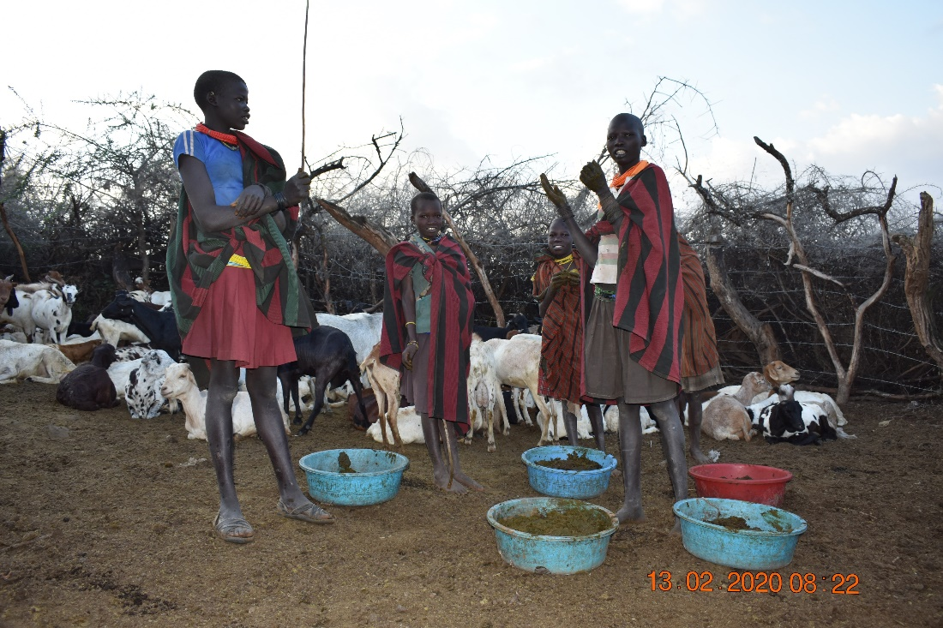
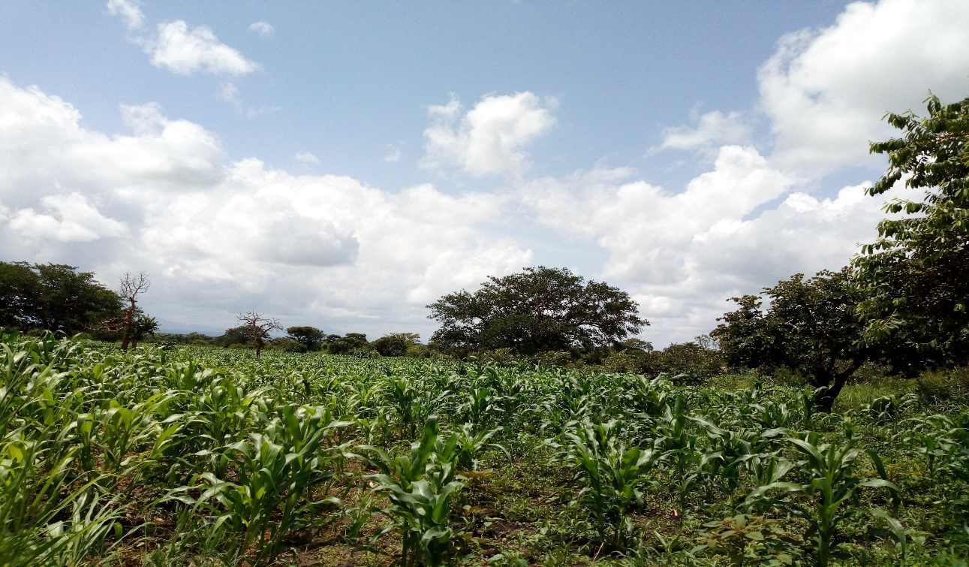
Actions
Identification, mapping of needs of mountain youth and women across the mountain landscapes
Pilot integrated agricultural practices with pilot farmers
Interest youth and women in natural resource management
Implementation of alternative youth and women livelihood options related to environment conservation
Photos by Loupa Pius

Slide 9

ACTION AREA 2: Inclusive climate finance for Youth and Women enterprise schemes
Loupa Pius UG

Slide 10
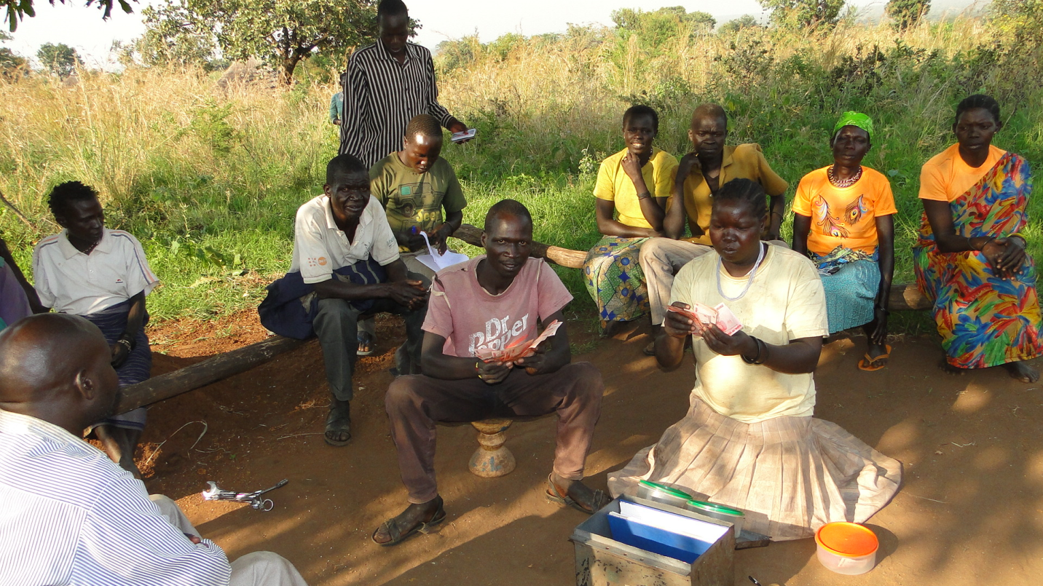
Reasearch Question & Hypothesis
Reasearch Question: Are the women and Youth village Saving and Loan schemes in developing ccountries contributing towards financial inclusion or an abstract in rural development?
Hypothesis: Collective resource mobilization and saving contributes towards rural financial inclusion. VSLA playing role in rural asset protection and food security.
Photo by: Loupa Pius/ DADO

Slide 11




Actions
Gap Analysis: Identification and supporting youth climate smart enterprises that facilitate youth financial inclusion.
Strengthening youth and women Village Saving and Loan associations (VSLAs) schemes for increased asset protection and Income Generation Activities (IGAs)
Lobby and advocacy. key policy gaps to influence policy makers and leaders on the climate finances subject, address Climate finance and resource allocation in developing countries.
Linking financial institutions (Microfinance funds) to Youth and Women smallholder farmers for enterprise development.

Slide 12
ACTION AREA 3: Strengthening youth and women in sustainable water and land management
BAl

Slide 13
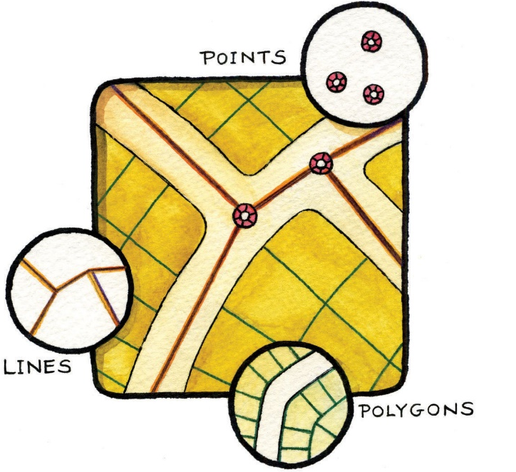
Research Question & Hypothesis
Research Question: Is land and water resource management an urgent soft skill for rural youth and women in developing countries?
Main Hypothesis:
Capacity building of rural youth & women leadership on land and water resource management is ensured in all developing countries

Slide 14
Designing of Support for Rural Youth and Women
Mapping youth capacities and community relations on water and land management:
Social Criteria;
Promote programmed payment for ecosystem services exhibited by youth in own communities:
Inspirational Politics;
Drafting a package that allows supporting water for production and consumption technologies:
Sustainability;

Slide 15
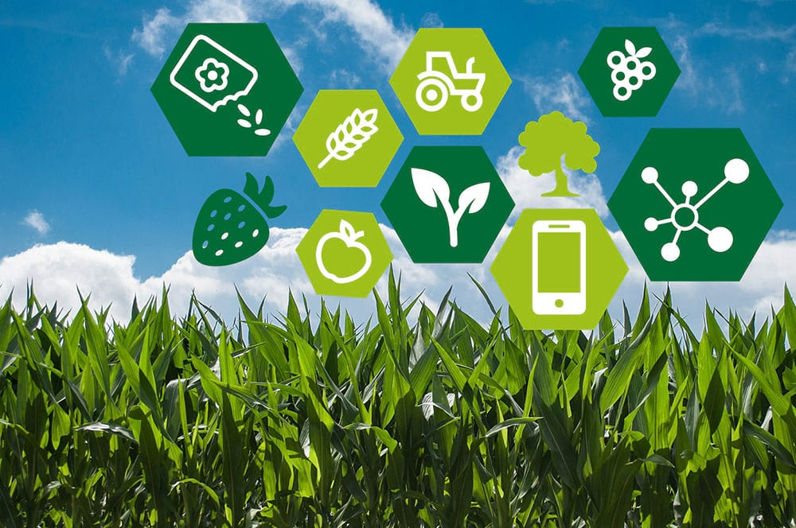
ACTION AREA 4:
Improving the production of
open data in agriculture and biodiversity
Francesca Bussola ITA

Slide 16
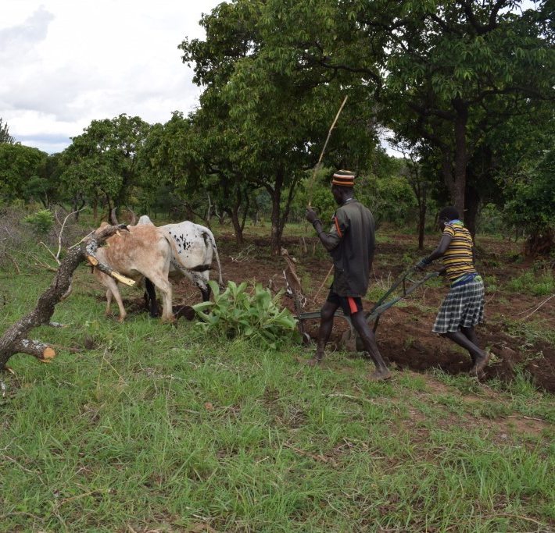


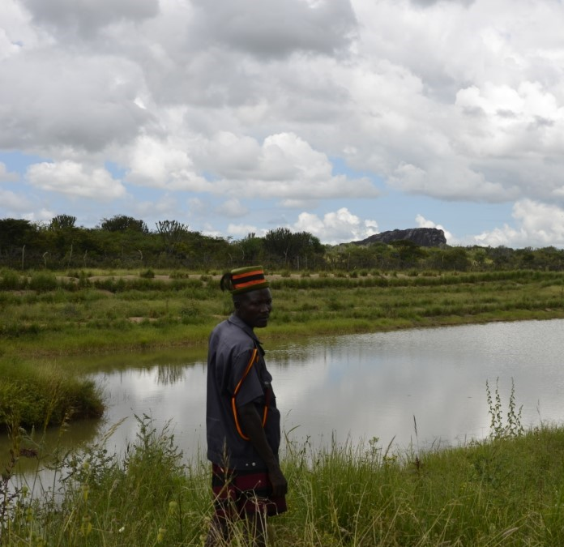
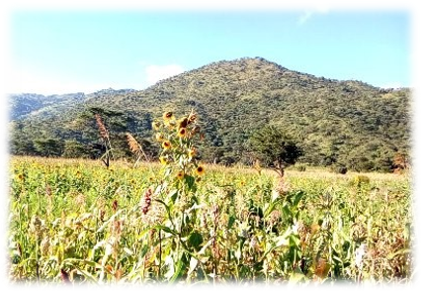
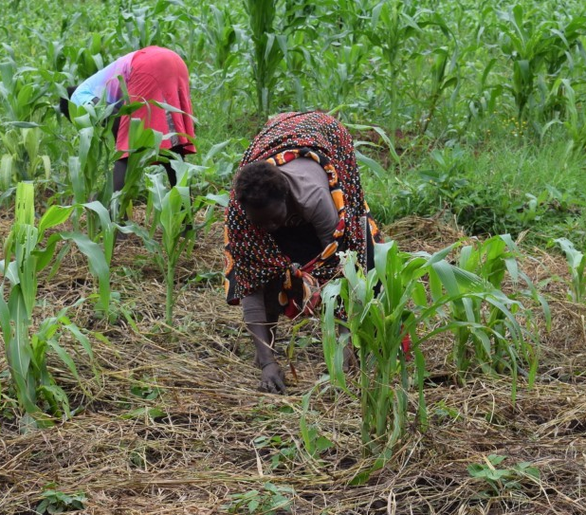
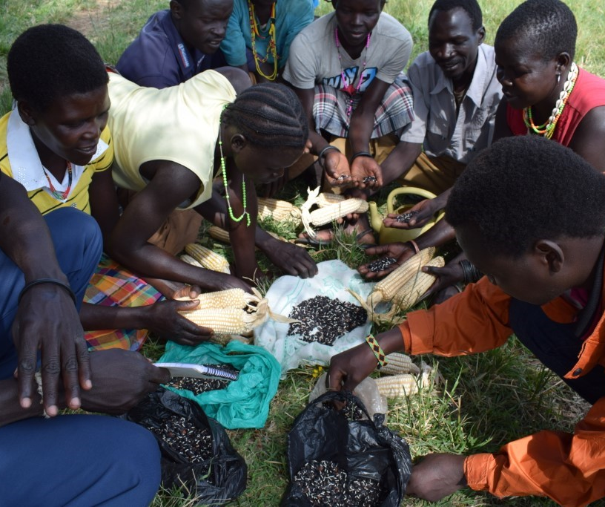
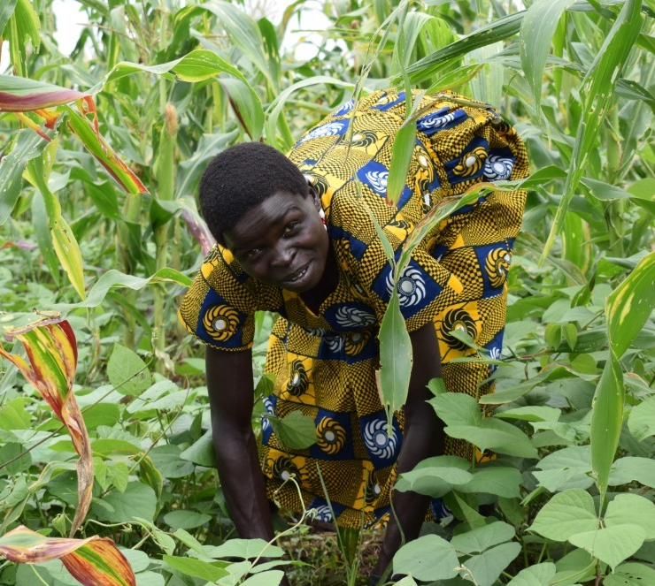
Research Question:
Does the availability of scientific, social and market data the potential to improve the agriculture sector and address food security and nutrition challenges?
Main Hypothesis:
Data sharing and free access to information regarding agriculture production, land use and natural ecosystems increase knowledge, expertise exchange and resilience capacity of mountain communities.

Slide 17

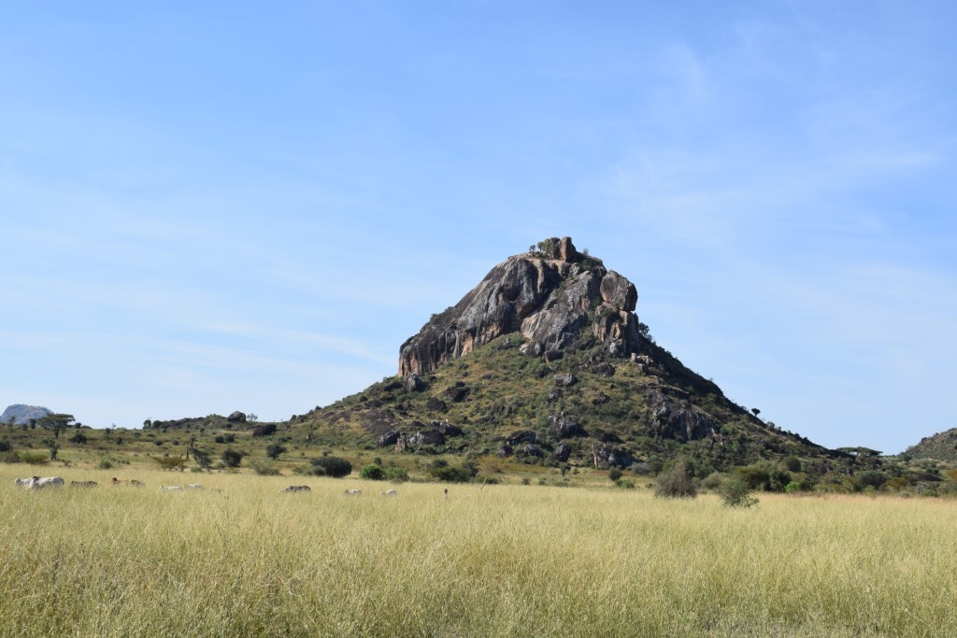


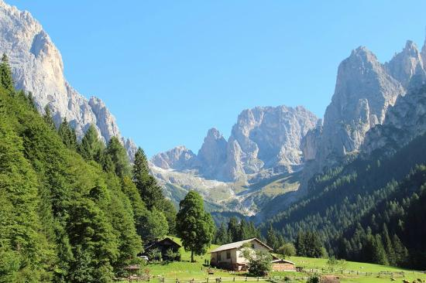
Actions
Nutrition training and education for public health and education professionals/workers
Flexible teaching methods (e-learning, radio programs, video materials) for small farmers and landowners
Increase of rural activities potential, implementation of sustainable practices to face climate change challenges, creation of new job opportunities
Digital platform for data sharing and collection by farmers associations to improve collaboration and the adoption of common integrated approach by public and private actors

Slide 18
ACTION AREA 5: Broadband & Digital Connectivity:
Food (Anti)Security?
Gent Imeraj ALB

Slide 19
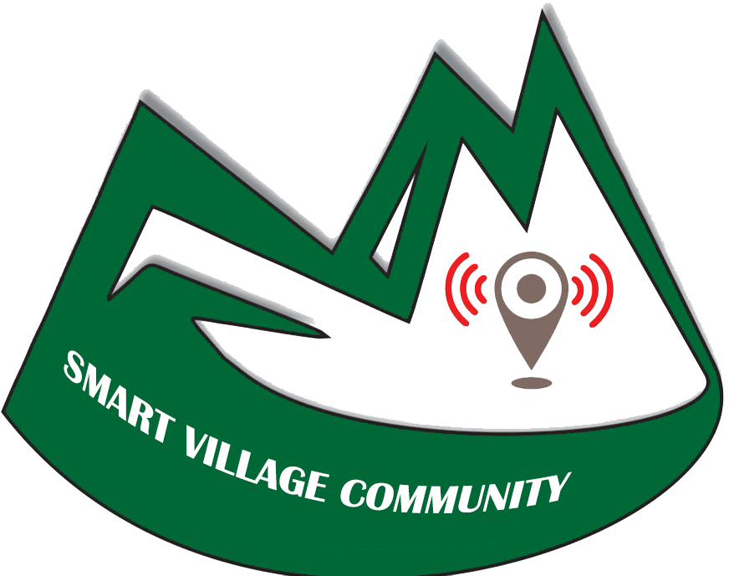
Sustainable Farming and Food System
The current food system is increasingly putting pressure on the environment, worker rights and the viability of small farmers.
One of the ways to make rural areas attractive to young people is to ensure accessibility.

Slide 20

Logic Intervention
ACCESIBILITY
Increased quality and
trust in food services;
DIGITALIZATION
An internet infrastructure covering all rural areas;
INTEGRATING YOUNG PEOPLE
Supporting ICT soft skills to
local rural Entrepreneurs;

Slide 21
ACTION AREA 6:
Gender-Inclusive Climate Adaptation
Džana Bordanić BiH

Slide 22
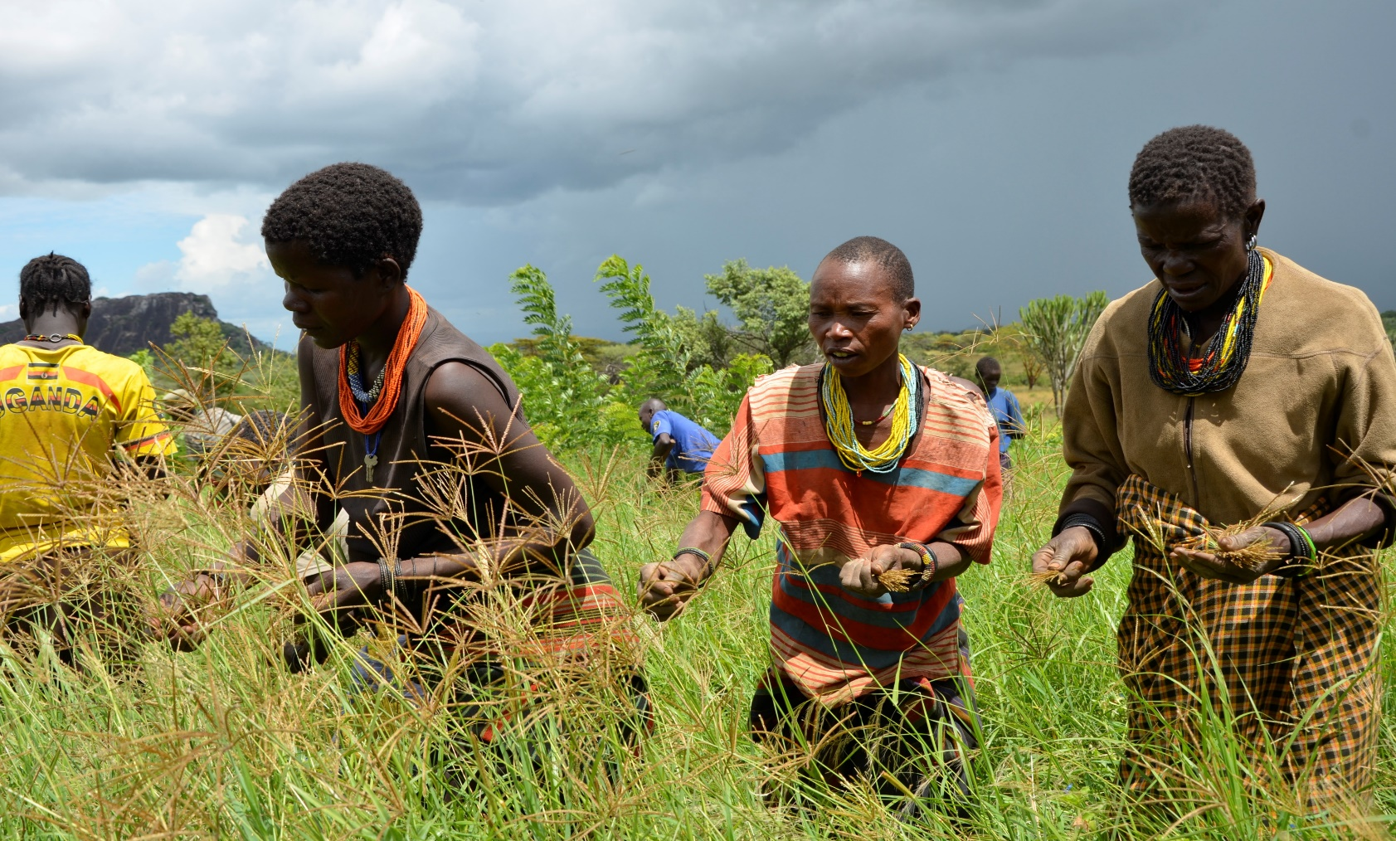
Reasearch Question & Hypothesis
Reasearch Question: Are the women in developing countries vulnerable groups, or they are just invisible force in the development of rural areas?
Hypothesis: Women has vital role as the primary actors in natural resource management and agriculture, adaptation actions are more gender sensitive and inclusive.
Photo by Loupa Pius

Slide 23
Actions
Strengthen and develop male gender champion and women’s leadership
Research and knowledge management
Establish local-level pre- and post assessment mechanisms for climate-change interventions from a gender equality and social inclusion perspective
Promote time-saving, appropriate and alternative technologies
Enhance women’s engagement in local-level climate change planning and implementation processes
Separate or create specific funds and resources for women
Strengthen local-level women’s organizations and networks

Slide 24
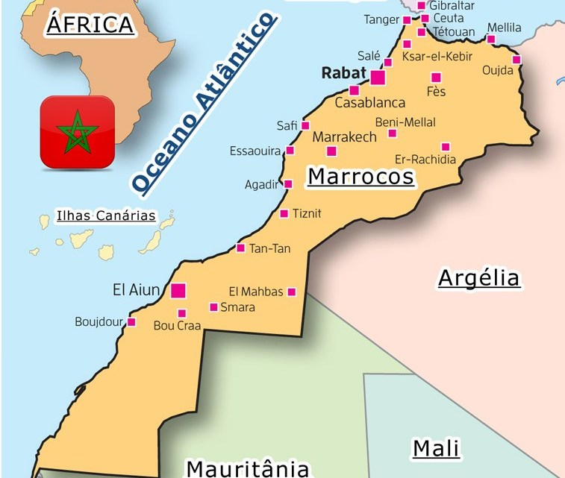
IMPLEMENTATION EXAMPLES:
Case study from Morocco
Elfengour Mohammed

Slide 25
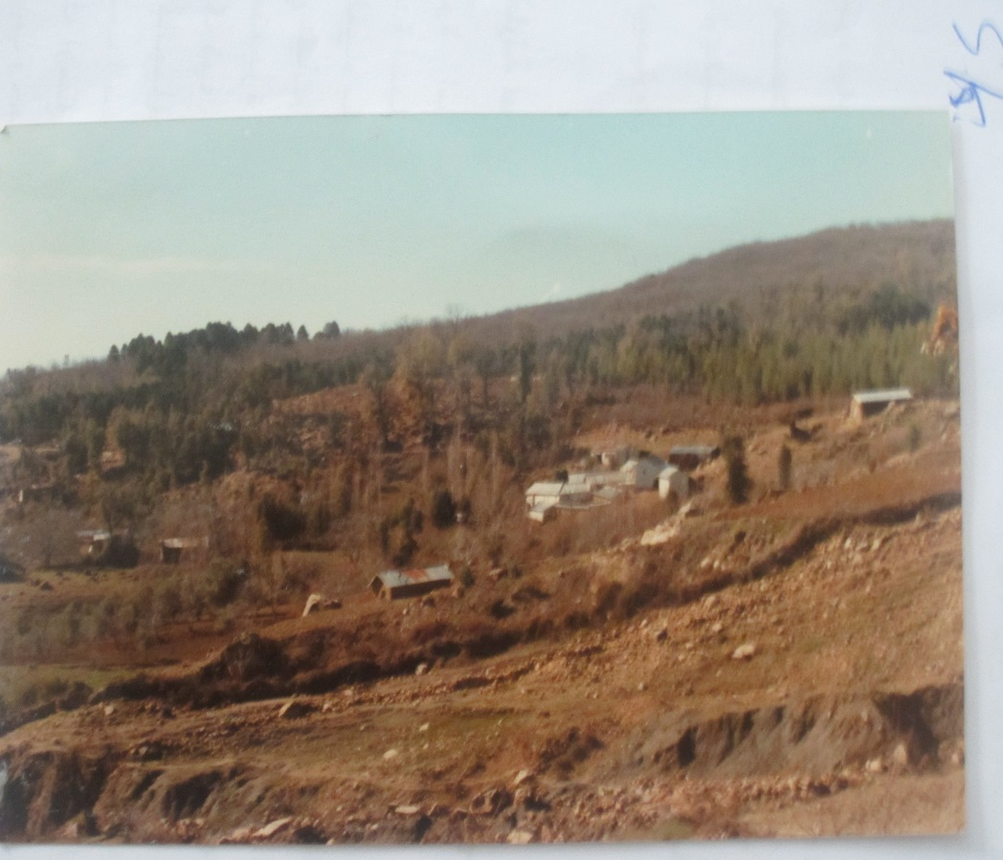
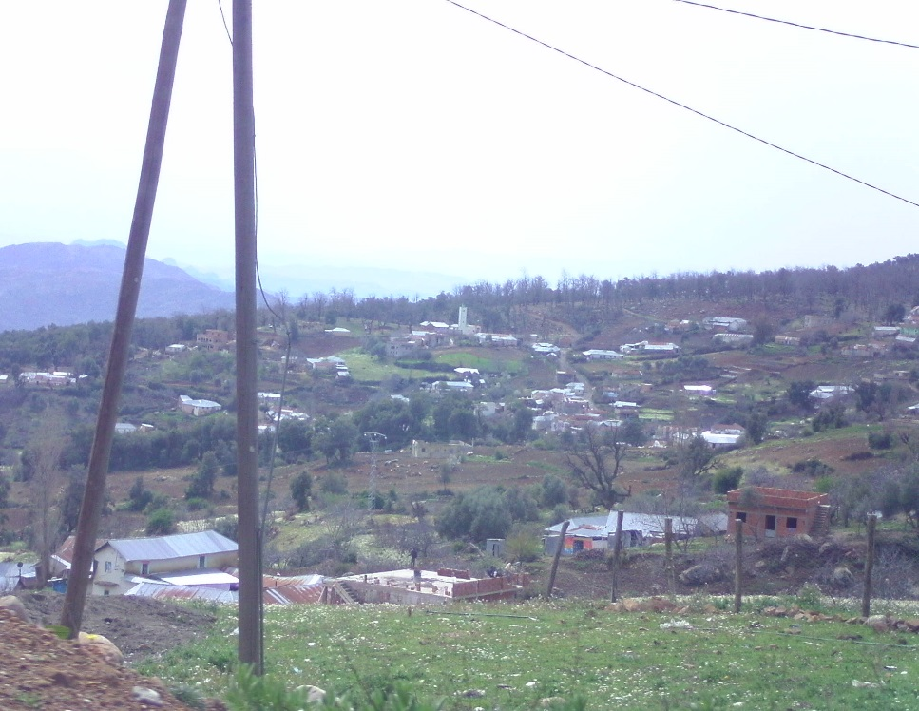
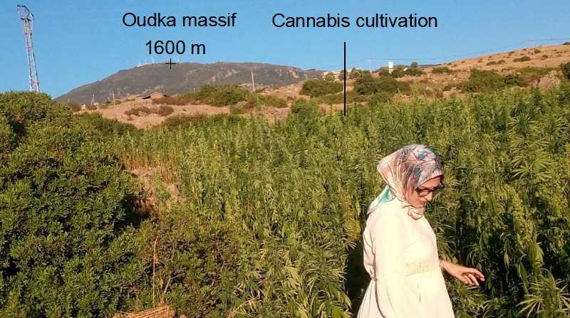
Completed in 1999, in particular, defined a strategic framework in three approaches:
- a heritage approach based on the sharing of responsibility with all the actors involved in land use planning,
- a territorial approach integrating the actors within the framework of a rural development dynamic and
- a participatory and partnership approach involving the support of the user populations, local authorities and the private sector in the planning and sustainable development process.
    The National Forest Program in Mountains in Morocco
Forest clearing in the Rif mountains in Oudka
Human pressure on the slopes of the Rif Mountain
The strengthening and continuation of the experiments and initiatives launched to enhance the value of the forest resources of the RIF.
The consolidation of organizational bodies representing the population around the massifs (associations, user groups, cooperatives, etc.).
The continuation of partnerships and actions committed

Slide 26
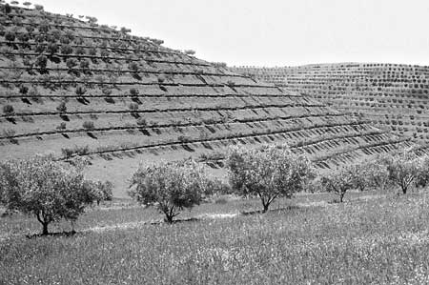
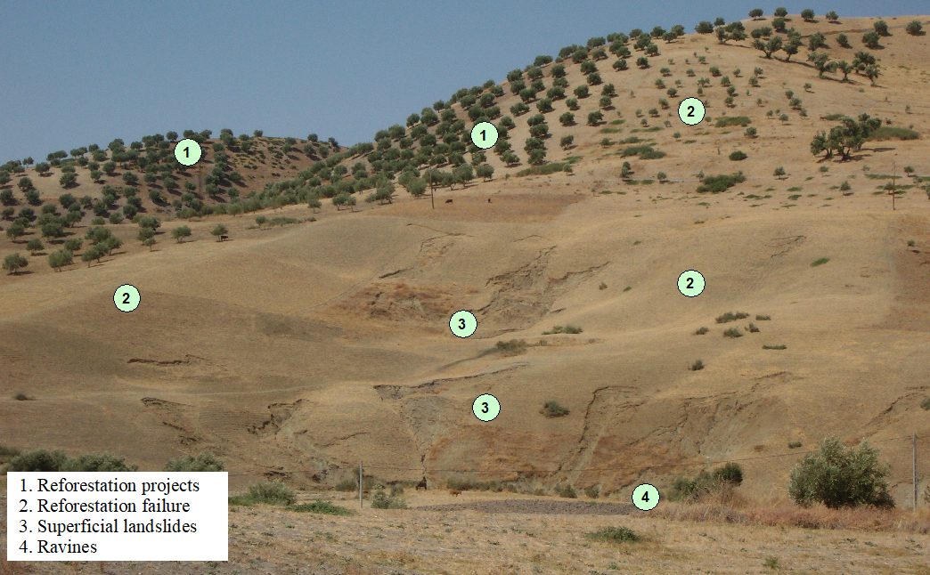
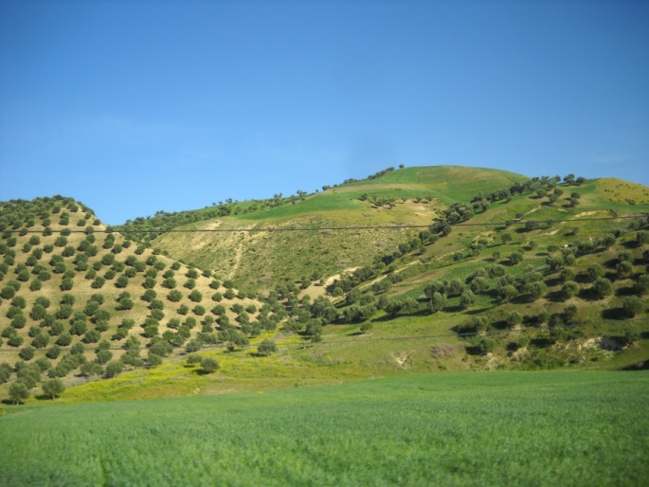
    Inefficacity of the benches
This is the oldest and well-known form of runoff water collection and recovery systems. It was experienced in Rif Mountains. It is used for the cultivation of olive, fig, and carob trees.
This technique was the basis of the DERRO project covers a big part of the Rif mountains in northern Morocco
This technique has encouraged the arboriculture, and hence, there is a strong dynamic for the development of arboriculture. The degree of acceptance of the fruit tree is high, but it is important to dissociate it from the acceptance of the bench itself by the local population

Slide 27
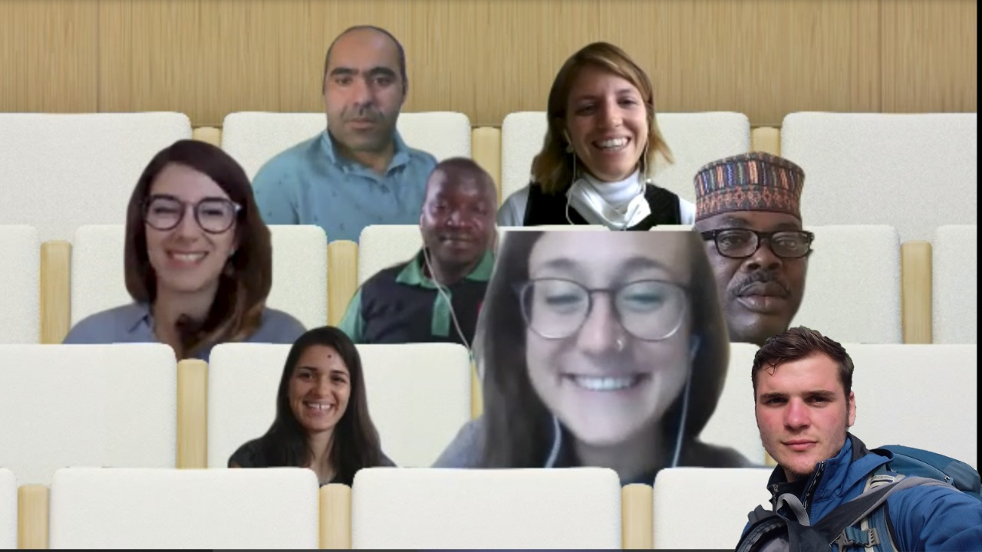
Thank you for your attention!
.
Alessandra Pollo
Džana Bordanić
Gent Imeraj
Elfengour Mohammed
Francesca Bussola
Loupa Pius
Paola Fontanella Pisa
Sonigitu Asibong

