Slide 1
IPROMO 2020
MOUNTAINS IN A CHANGING CLIMATE:
THREATS, CHALLENGES AND OPPORTUNITIES
GROUP 5 PRESENTATION
THE ANDEAN REGION AND THE CHALLENGE OF CLIMATE CHANGE FROM THE PERSPECTIVE OF 3 LOCAL COMMUNITIES

Slide 2
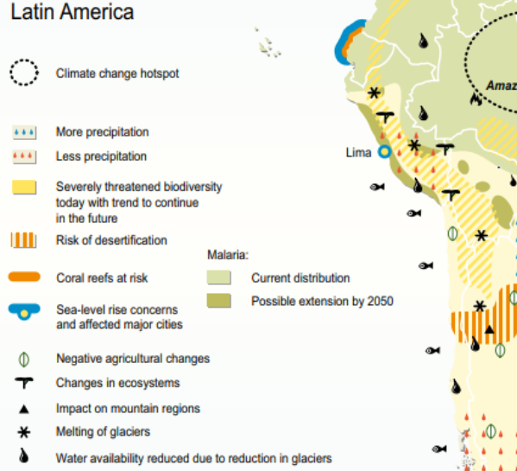
Regional context and impacts of climate change
Ancash
Abancay
Cajón del Maipo
Adapted from PNUD (2009)

Slide 3
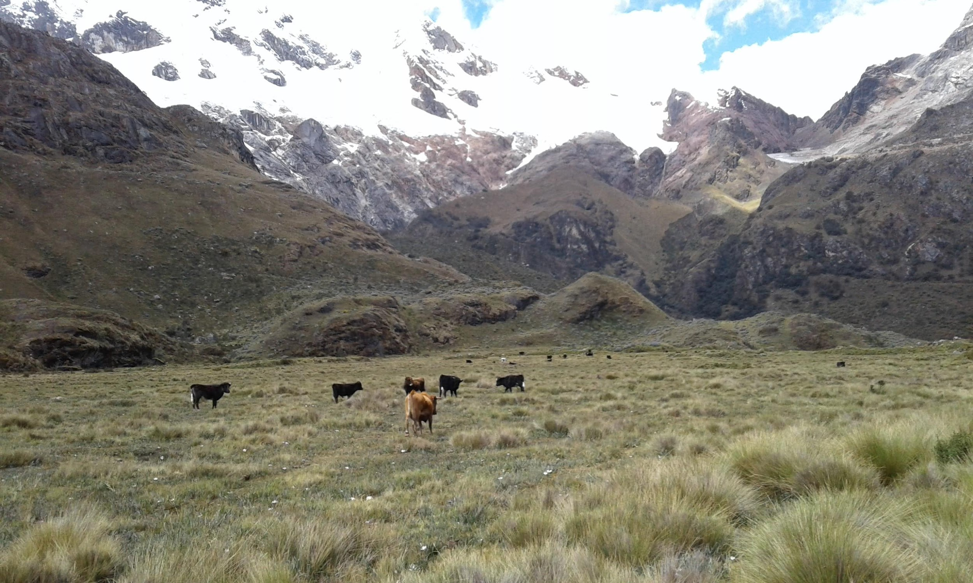
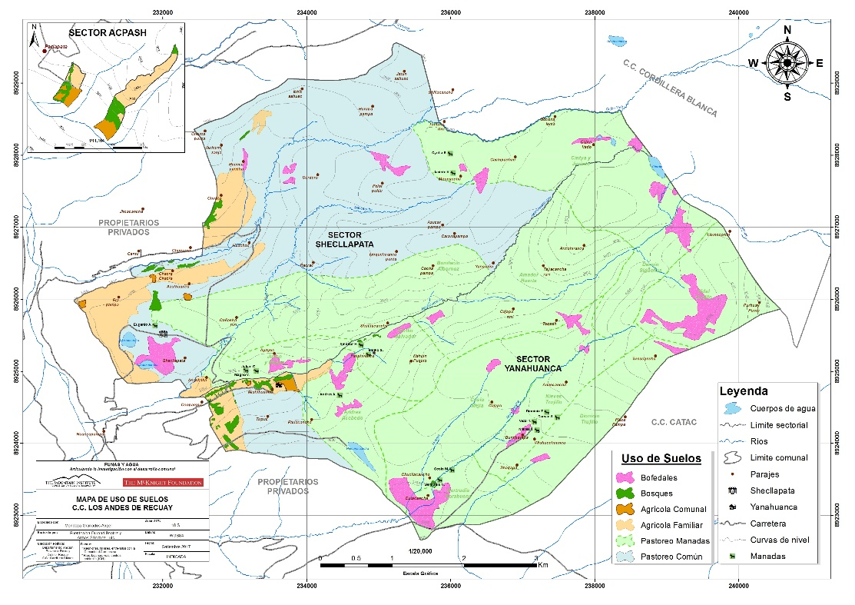
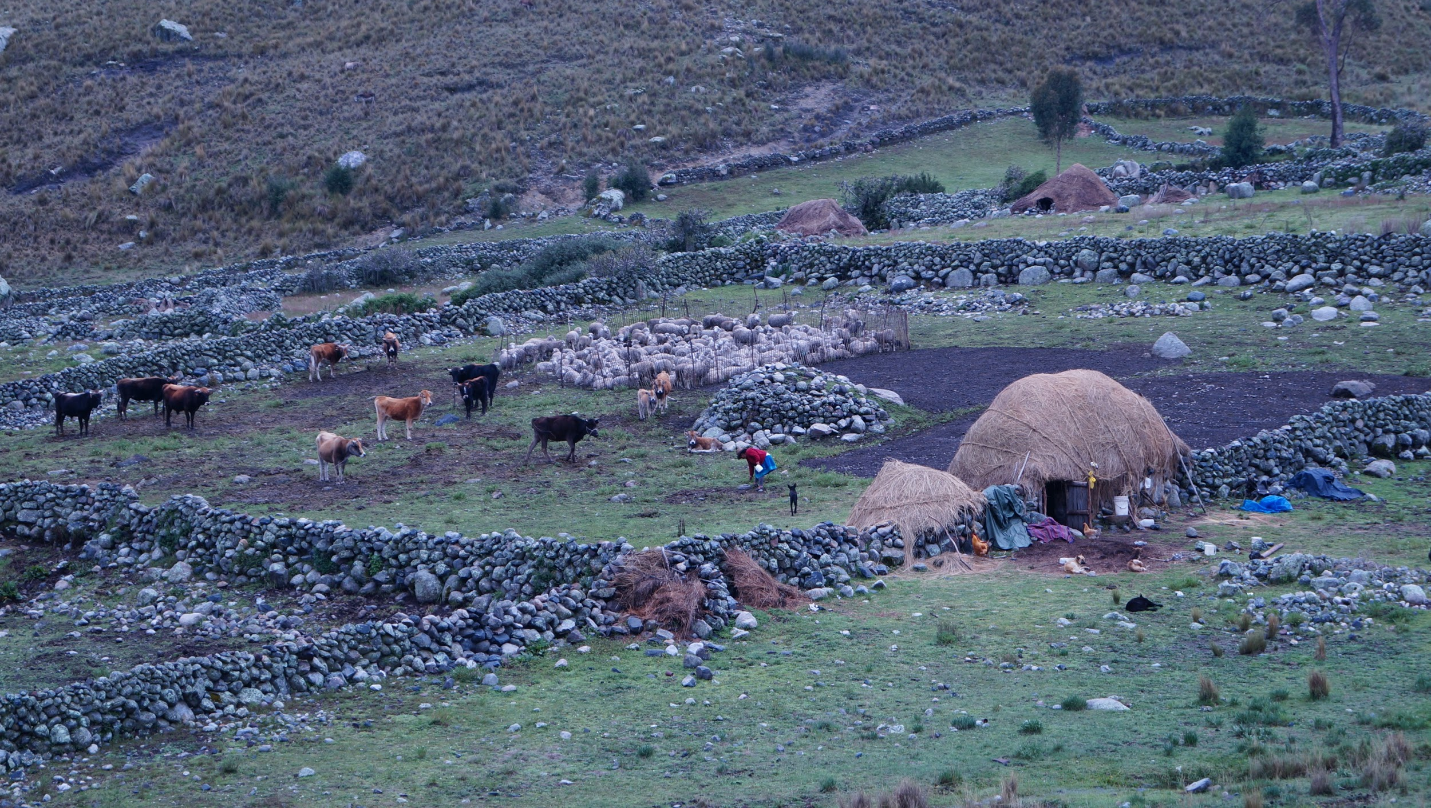
Cordillera Blanca case
3300 masl
4200
4800
Private property
Communal property
Natural Protected Area
Agriculture
HIGHLANDS (>3900 masl)
Livestock
Little town
Forest plantation
Climate variation impact mainly agricultural activities.
Increase of thunderstorms aggravate hard conditions in highlands.
Increase degradation in pasturelands

Slide 4
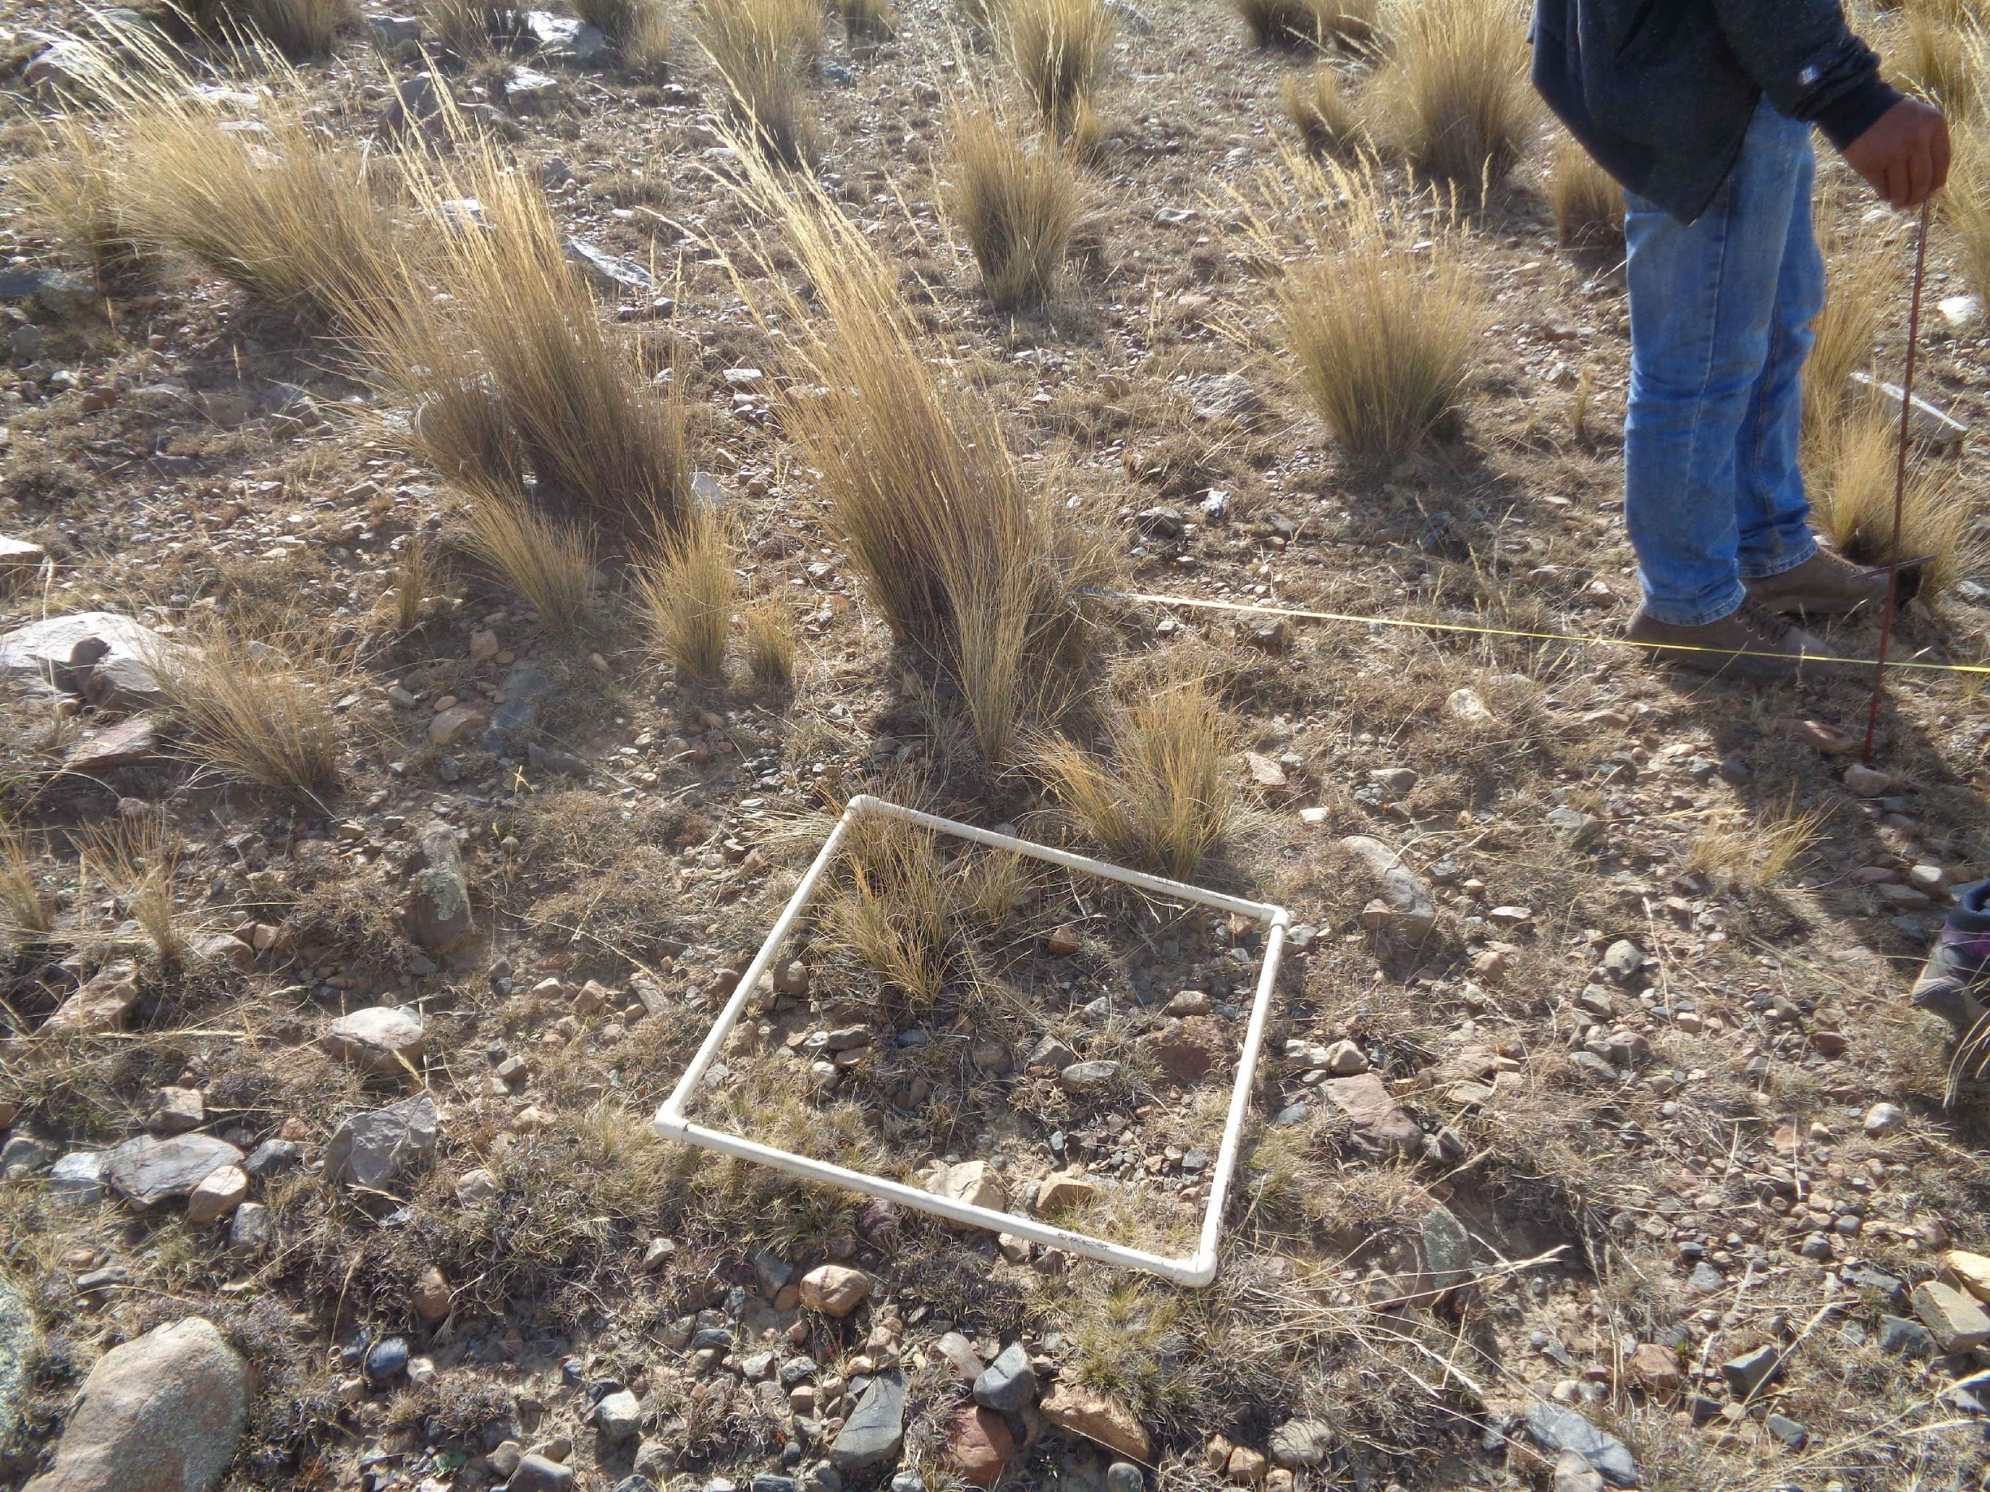
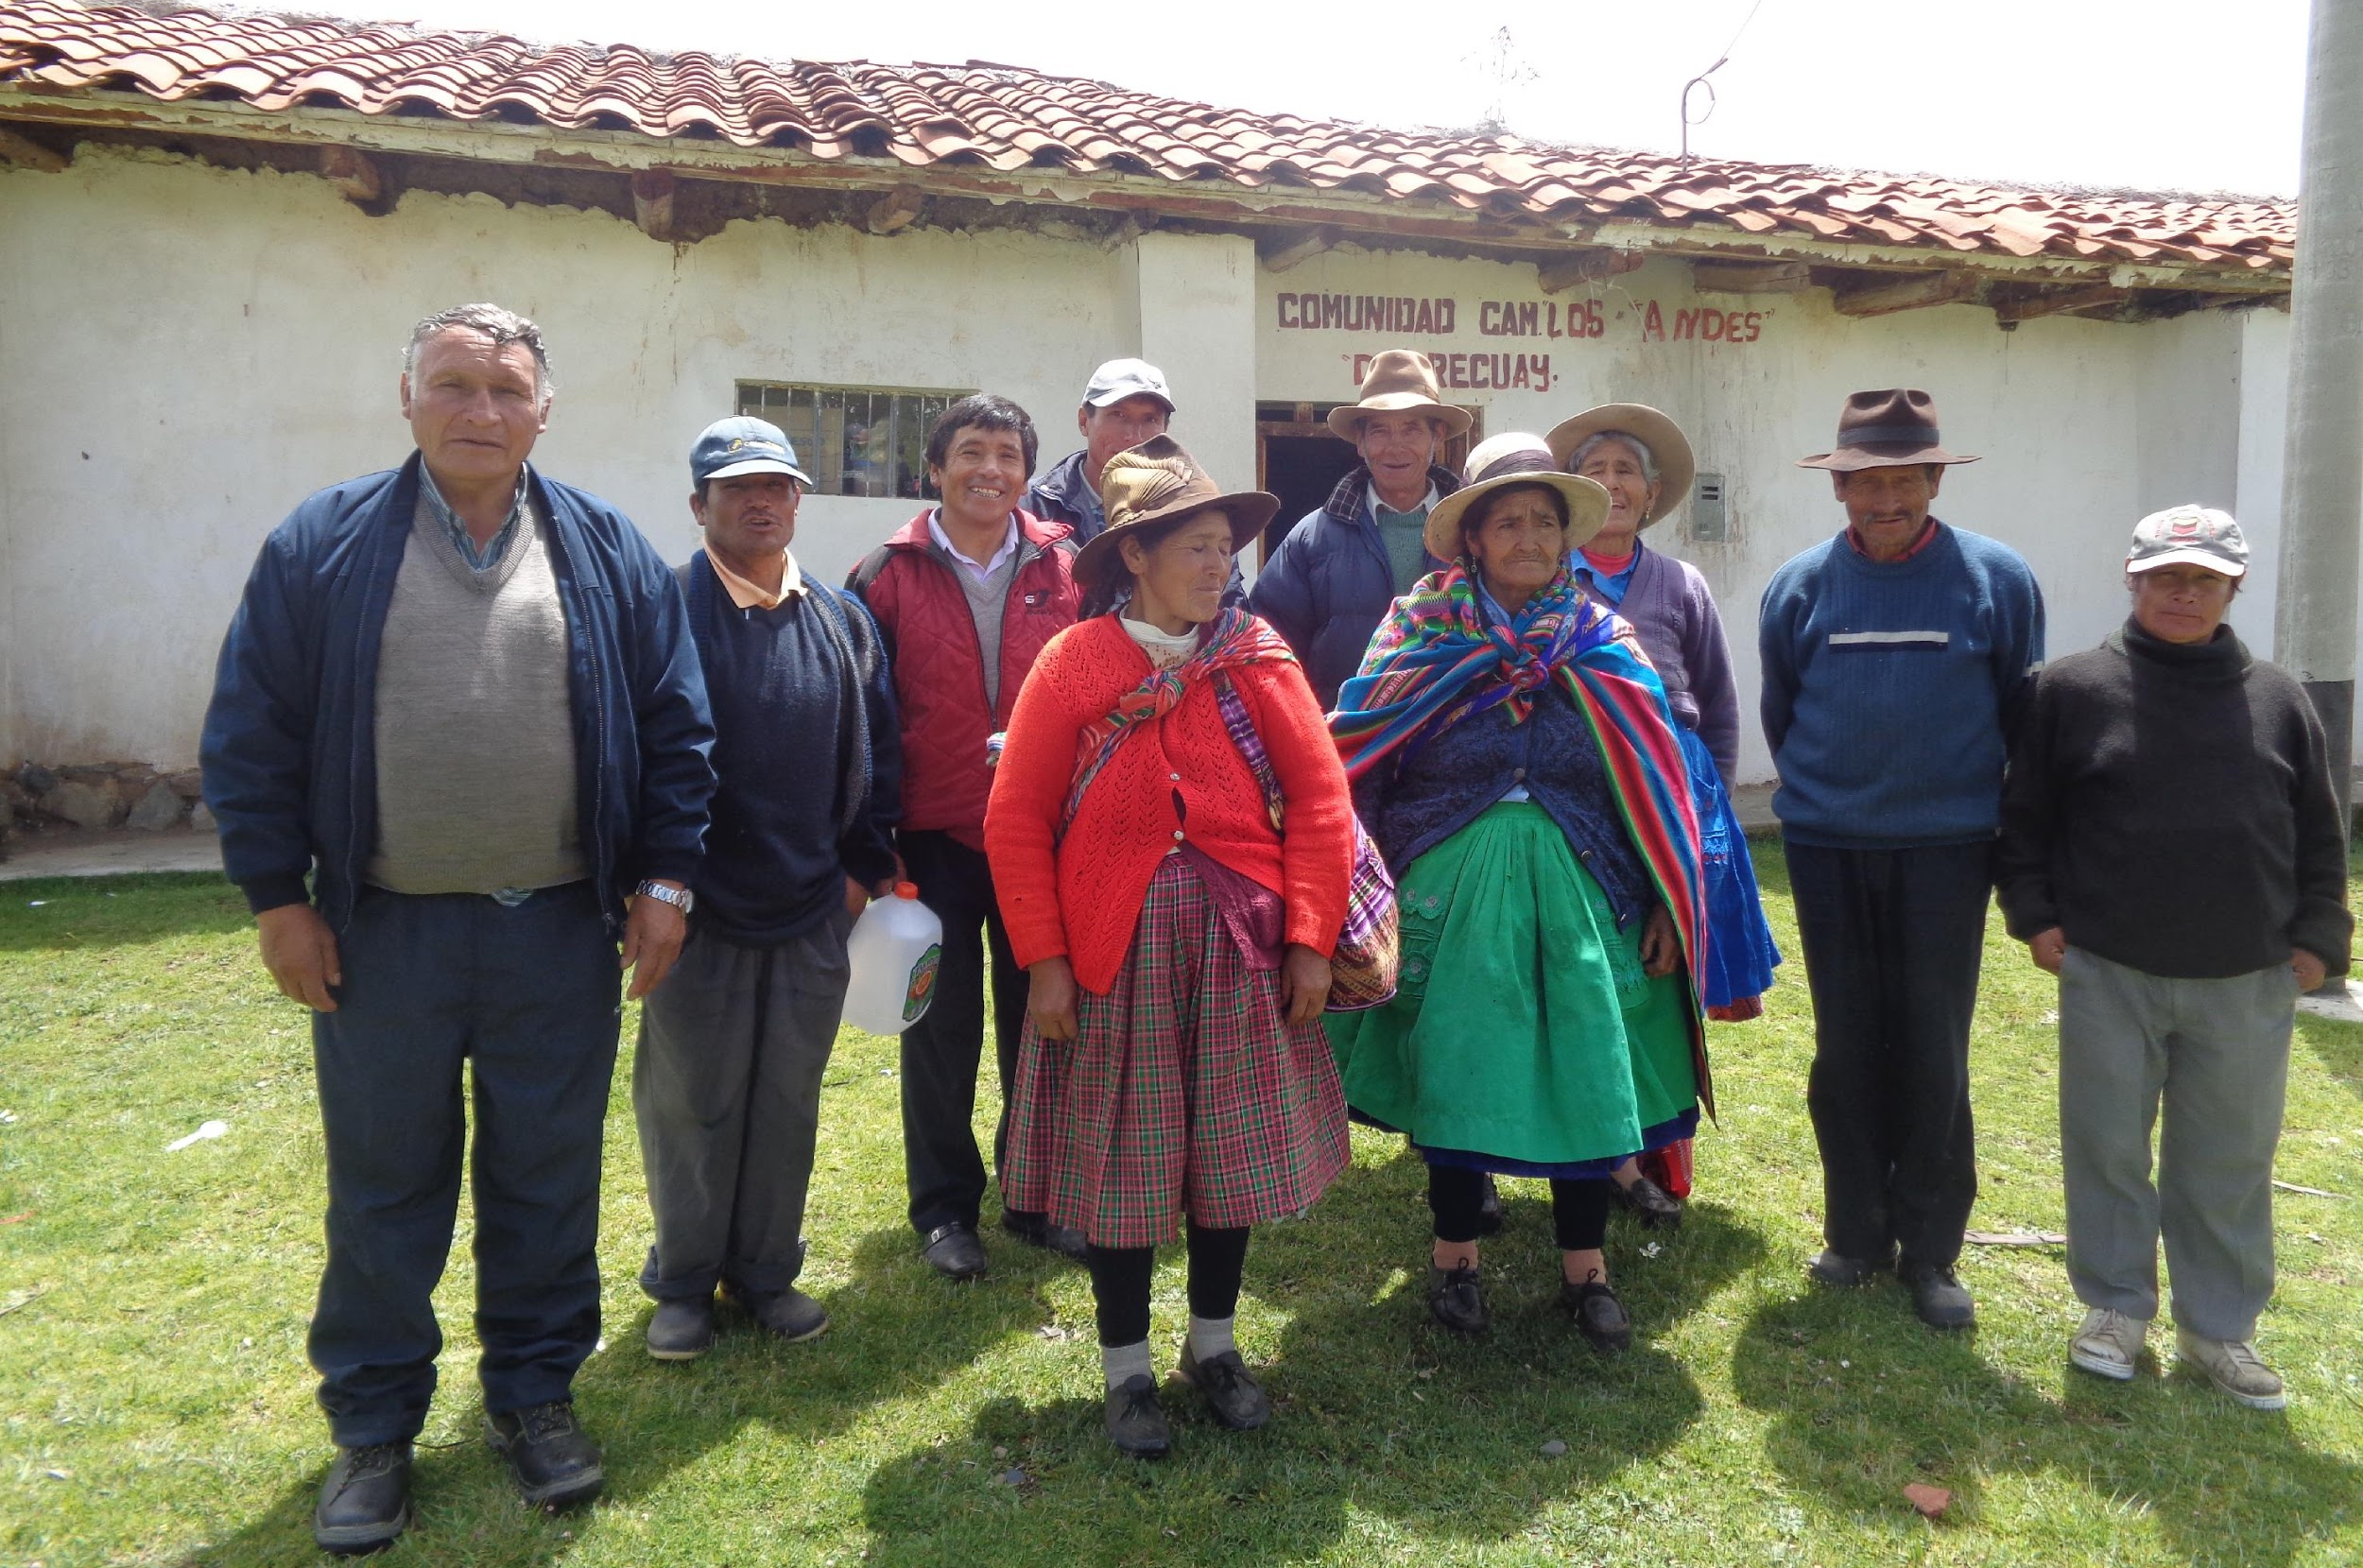
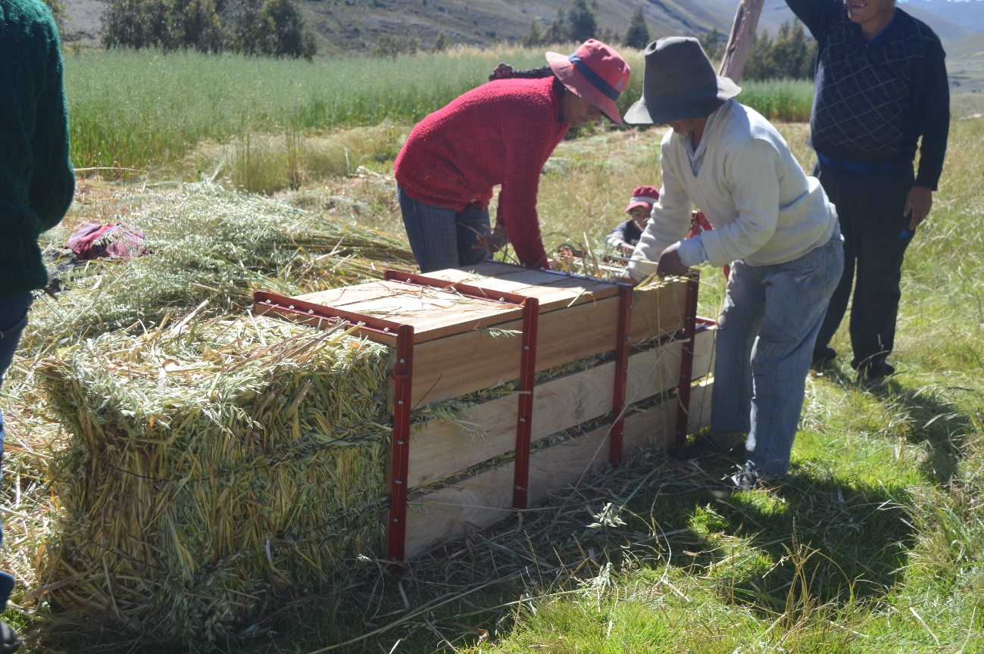
Cordillera Blanca case
Involve new generations.
Capacity building (people and institutions).
Improve gender approach
Recovery of traditional practices (mainly water management)
Restoration in very degraded grasslands

Slide 5
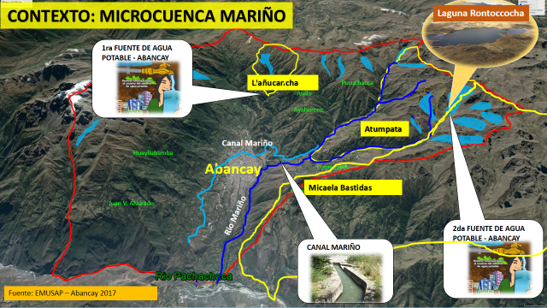
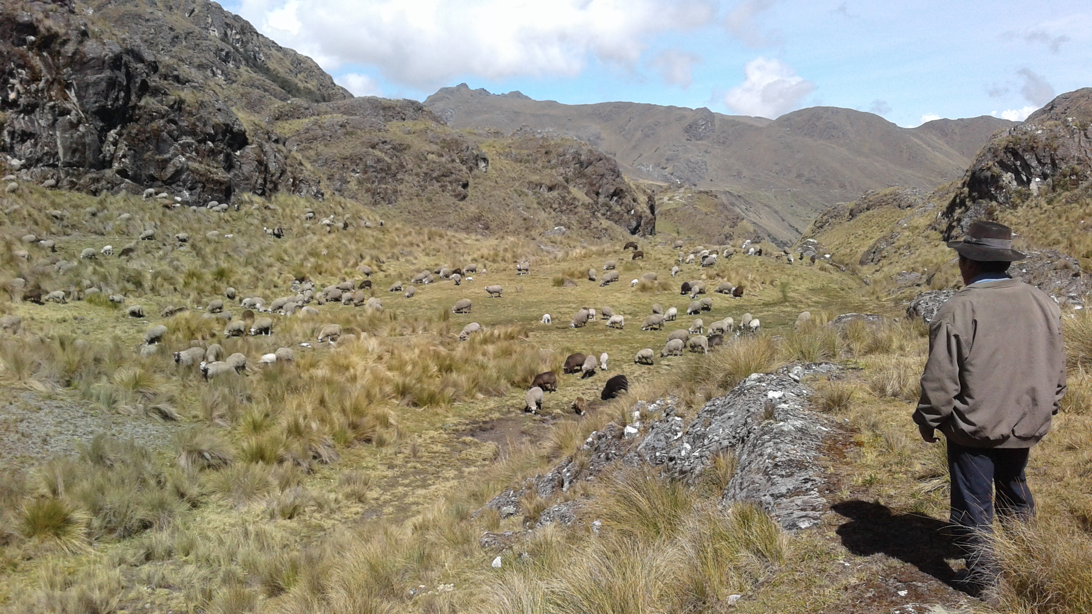
Microcuenca Mariño – Abancay Case
2000 masl
4300
Communal property
Overgrazing in water recharge areas
Decrease in water flow for consumption
Degradation of Andean pastures and forests
High variation of the climate. presence of frost, hail, drought

Slide 6
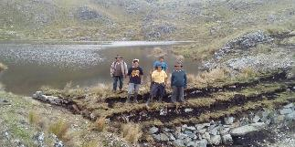
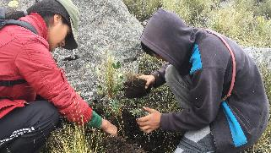
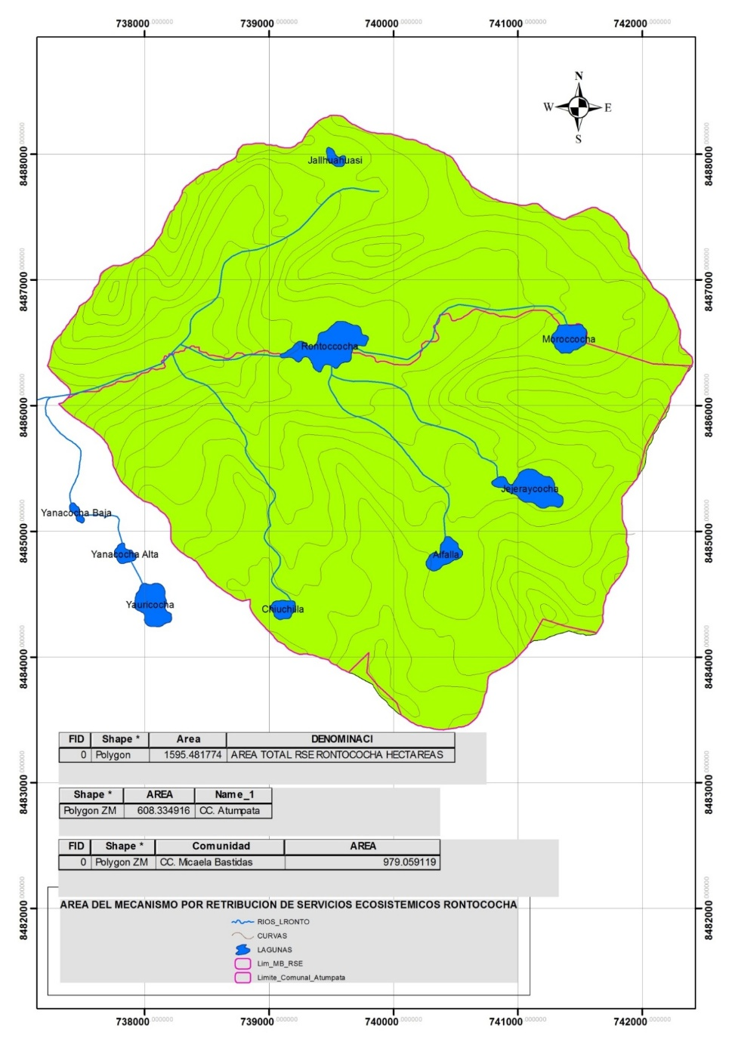
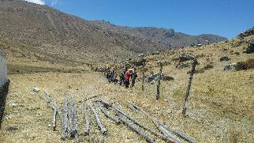
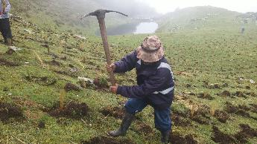
Microcuenca Mariño – Abancay Case
Construction of 15 rustic dikes with local materials, water storage de 141,953.00 cubic meter.
Afforestation of 40 ha of Queuña (Polylepis)
Comunidad de Atumpata
Installation of grassland protection fences in 336 hectares.
Comunidad de Micaela Bastidas
Grassland plantation in 22 hectares (Stipa ichu)
Training of 22 local farmers in planting and harvesting water

Slide 7
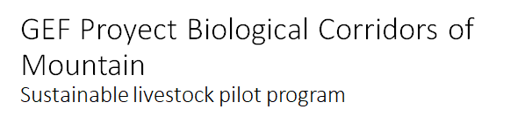

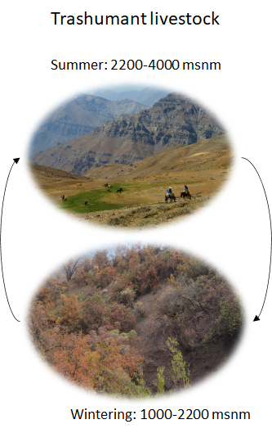
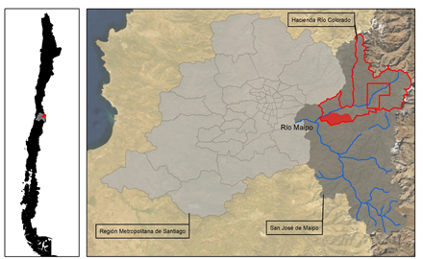
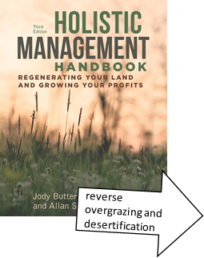
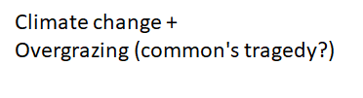
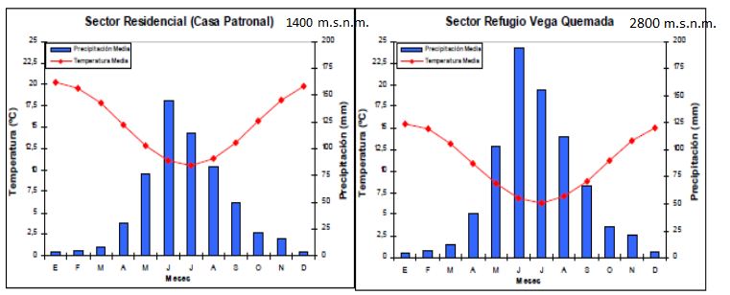
Cajón del Maipo case

Slide 8
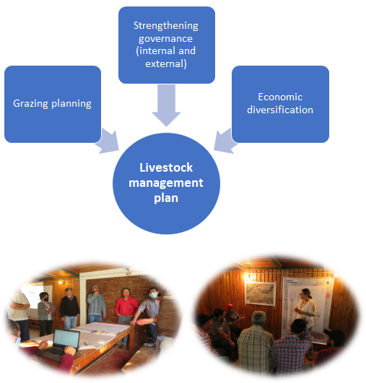
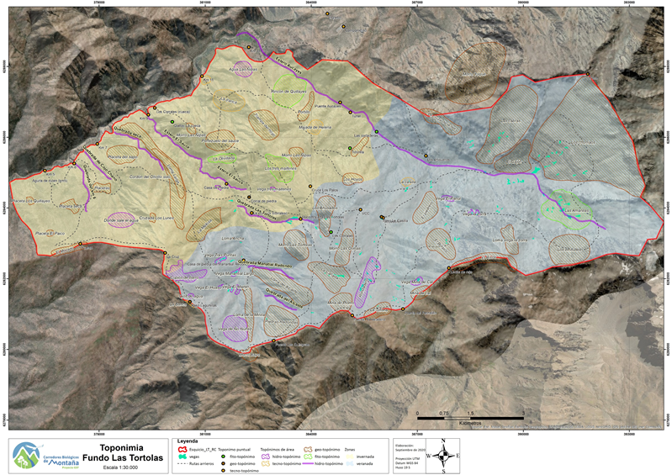
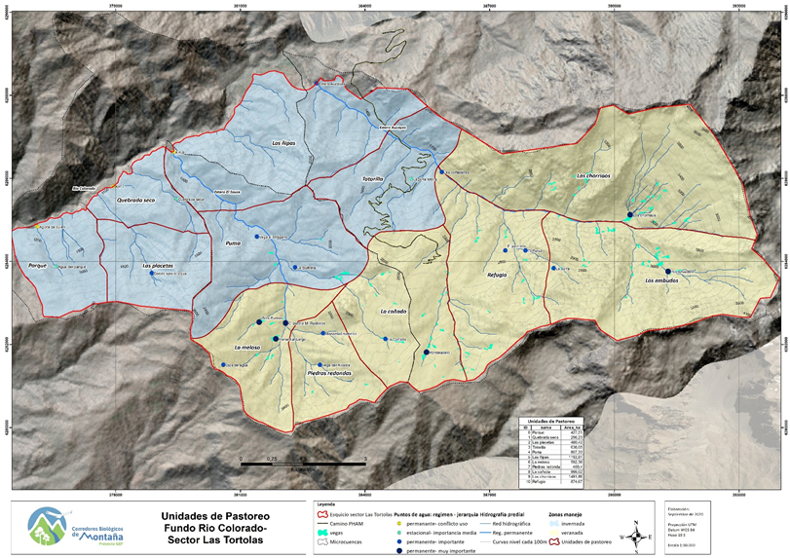
Cajón del Maipo case

Slide 9
Indicators
Risk = Hazard x Vulnerability x Exposure
TEMPERATURE | PRECIPITATION
· Annual average temperature (°C) · Seasonal average temperature (°C) · Daily average temperature for the growing period (°C) · Mean Temperature (°C) | · Average annual precipitation (mm) · Maximum 1-Day Total Precipitation (mm) · Total Precipitation (mm) · Average rainfall (per month) in growing period · Average amount of days with snowfall in the winter months (DJF)
EXTREME VARIABLES · Frost Days (days) · Growing Degree Days (5°C or 10°C) · Cumulative degree-days above 0°C
ECOSYSTEM | SOCIOECONOMIC
· Net Primary Productivity (NPP) · Land suitability (%) · Slope gradient (%) · Land cover classes with a high risk for erosion (%) · Soil water retention characteristic (pF curve) · Wetlands management capacity · Water demand per growing period (m3/Ha) | · Local GDP (US$/year) · Portion of household income spent for basic needs (%) in year X · Institutional management capacity · Number of farmers trained in improved livestock techniques · Number of inhabitants per km2 · Total percentage of women in the community · Percentage of women that are head of the households

Slide 10
Conclusions (1)
1. People that inhabit mountains in Andean region countries face similar social, economic and environmental conditions that influence how these populations adapt themselves to the effects of climate change.
2. Due to this situation, it is relevant to make an adequate assessment of the vulnerabilities of the population in the highland regions to better understand the effects of climate change in their community activities.
3. Based on these experiences, adaptation measures should be implemented to promote integral responses, considering economic, social and environmental factors, taking into account traditional knowledge, gender equality, diversification of economic activities.

Slide 11
Conclusions (2)
4. Open, transparent and participatory processes should be implemented in order to reflect with more accuracy the needs and expectations of the communities.
5. Share experiences to identify common challenges and successful measures. In this regard, it is important to take advantage of existing platforms aiming to share experiences and to promote joint strategies that contribute to improving the health of the mountain ecosystem and people well-being.
6. Andean countries should improve their participation in the Andean Mountain Initiative, which is a platform dedicated to promote dialogue among them and the articulation of strategies towards the conservation of mountains and their sustainable development, to enhance their common response to the challenges posed by climate change.

