Slide 1
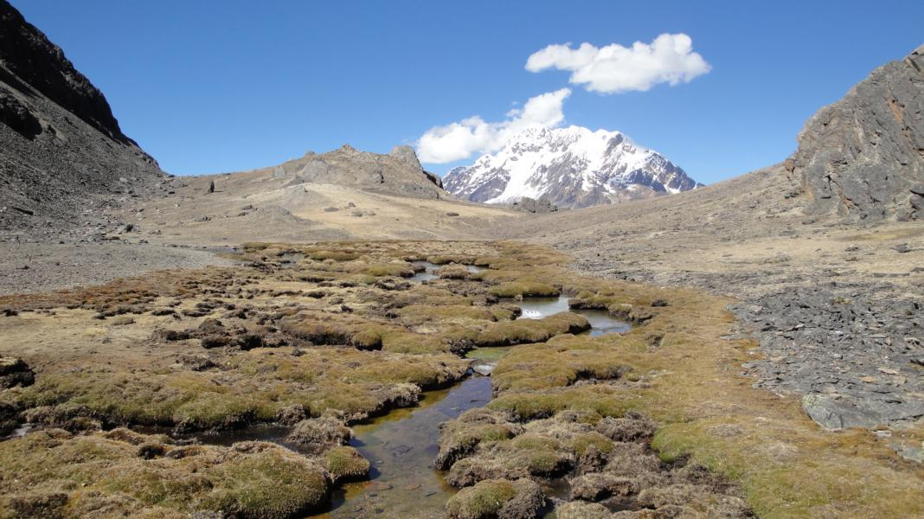
Foto
Mountains, Climate Adaptation, and Sustainable Development: Message from Rio+20 to Doha
Gyan Chandra Acharya. Under-Secretary-General and High Representative for LDCs, LLDCs and SIDS (UN-OHRLLS), UN HQ

Slide 2
Outline
Mountains – harbinger of climate change
Poverty a persistent challenge
Mountain Water – binding resource
Ecosystem services – raw materials for green and low carbon economy
SD & SMD – need synergistic and complementary efforts
Doha COP18
Key messages

Slide 3
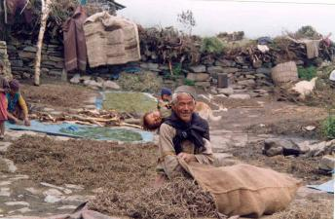
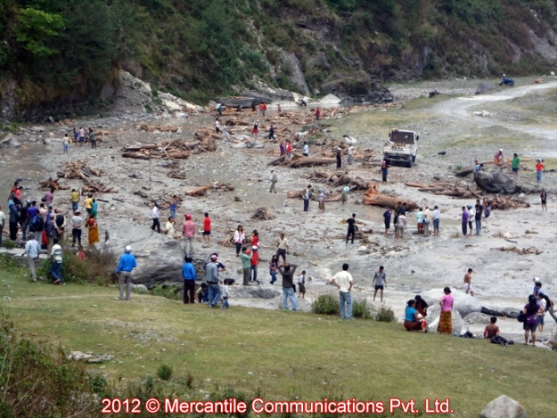
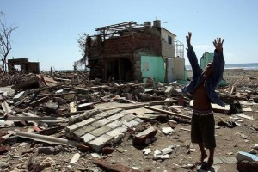
The Latest Predictions On Climate Change Should Shock Us Into Action

Slide 4
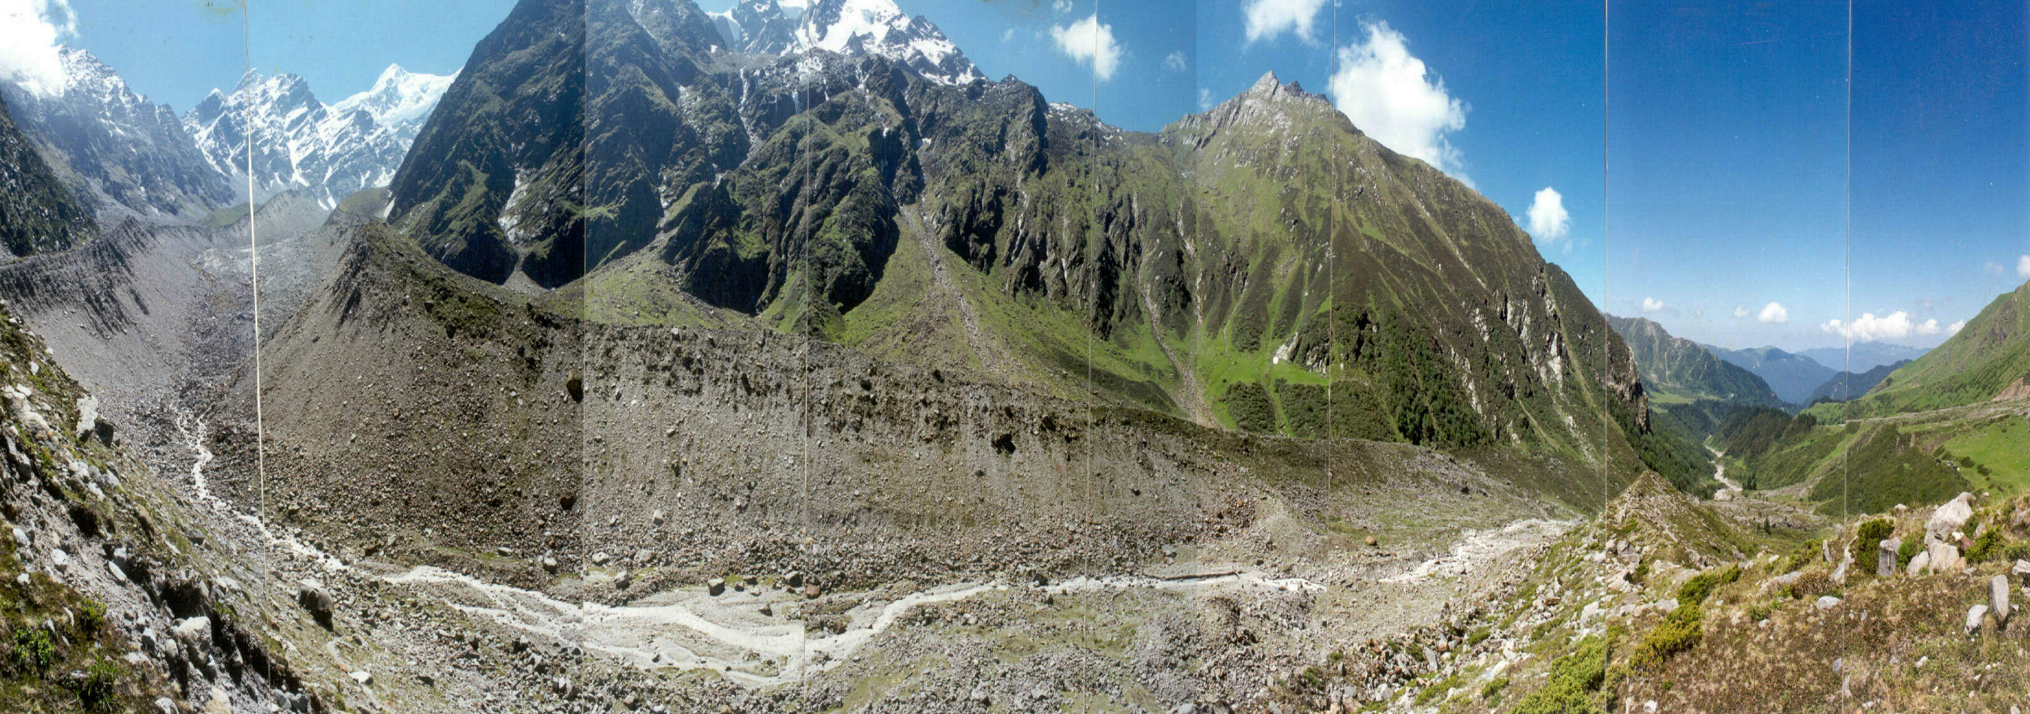
Receding of Dokriani glacier, Uttarakhand, India
1995
1962
Recession of Dokriani glacier over the period 1962-1995
Average rate of recession = 16.5 m/yr (snout monitoring)
Source: Baldev R. Arora; Wadia Institute of Himalayan Geology, 2nd TPE Workshop in Kathmandu 2010

Slide 5
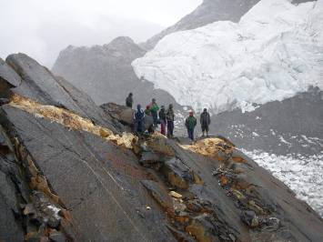
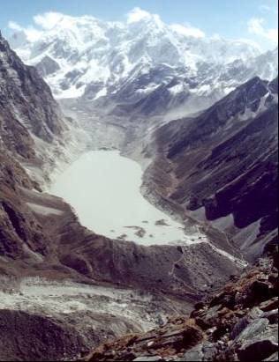
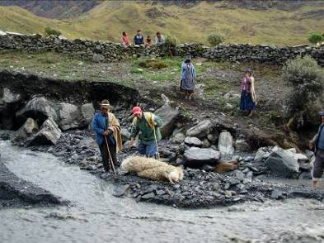
Increasing GLOF incidents, from Andes to Himalayas
Photos: Martín Apaza Ticona

Slide 6
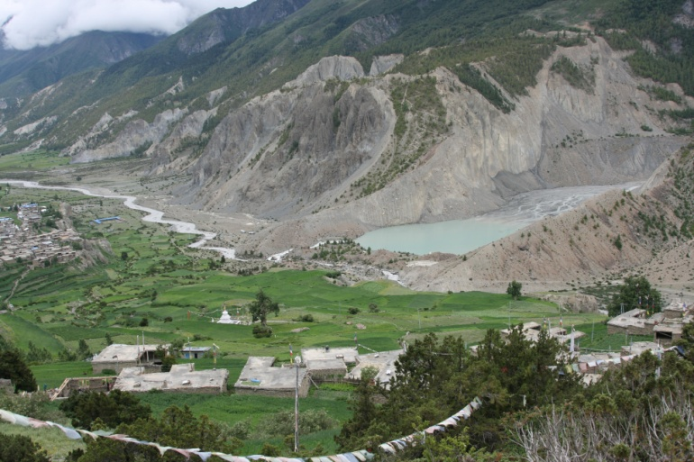
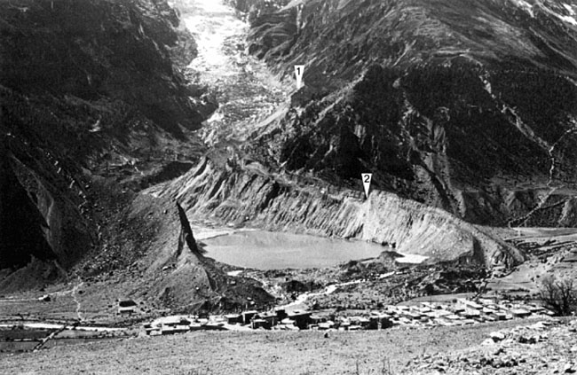
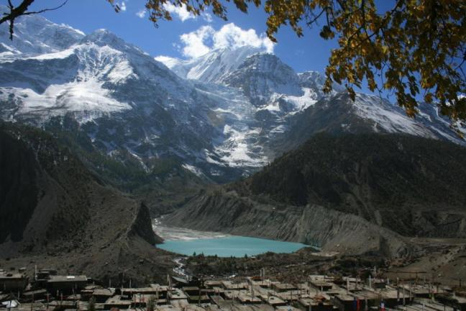
Fast retreating Gangapurna glacier at the northern slope of Annapurna Range, Manang Lake and Manang Village, Nepal
Fast retreating Glaciers in Nepal Himalayas
1957 Tony Hagen
2010 Nabin Baral, ICIMOD
© Pradeep Mool, ICIMOD
Rothlishberger, 1980
Nabin Baral, 2007

Slide 7
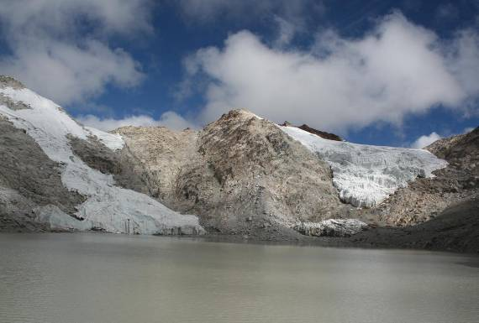
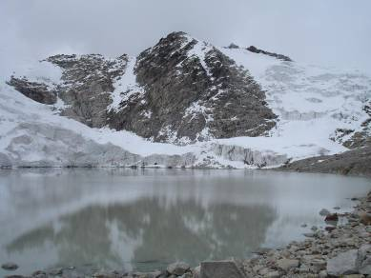
Alarming Impact of Melting in Andes
Laguna Moro Kholla, Cordillera Real, Bolivia
March 2007
October 2009
Photos: Hoffmann

Slide 8
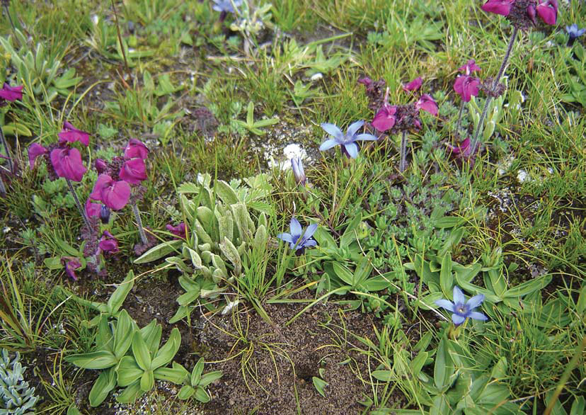
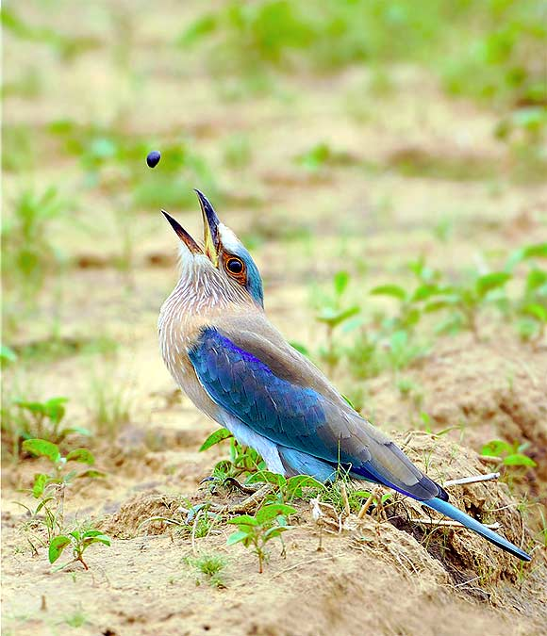
Climate Change is a major threat to rare, endangered and threatened floras and faunas

Slide 9
Climate change will depress agricultural yields in most of the mountain regions
Sources: Müller and others 2009; World Bank 2008c. The figure shows the projected percentage change in yields of 11 major crops (wheat, rice, maize, millet, field pea, sugar beet, sweet potato, soybean, groundnut, sunflower, and rapeseed) from 2046 to 2055, compared with 1996–2005. The yield-change values are the mean of three emission scenarios across five global climate models, assuming no CO2 fertilization (a possible boost to plant growth and water-use efficiency from higher ambient CO2 concentrations). The numbers indicate the share of GDP derived from agriculture in each region. (The share for Sub-Saharan Africa is 23 percent if South Africa is excluded.) Large negative yield impacts are projected in many areas that are highly dependent on agriculture.

Slide 10
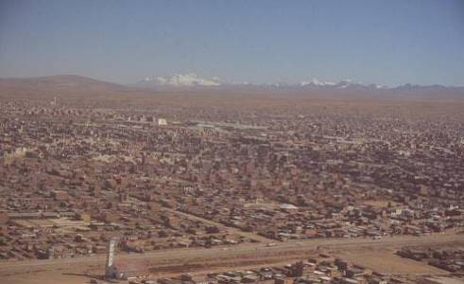
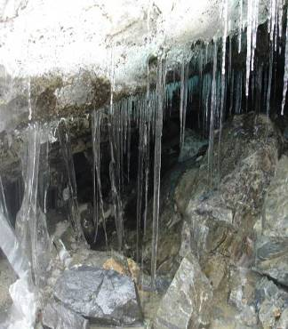
Mountain Waters are Critcal for cities in Andes
Lima, Peru; Quito, Ecuador; La Paz / El Alto, Bolivia: 10-15% (A. Soruco, E. Ramírez)

Slide 11
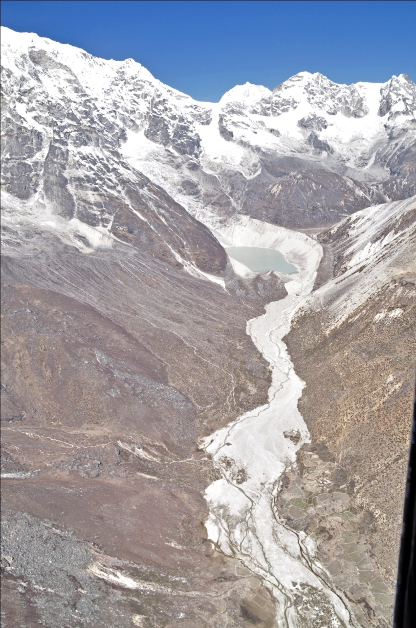
Glaciers and GLOFs: Transboundary and Economic Impacts

Slide 13
Increasing incidence of floods and their trans-boundary impacts

Slide 14
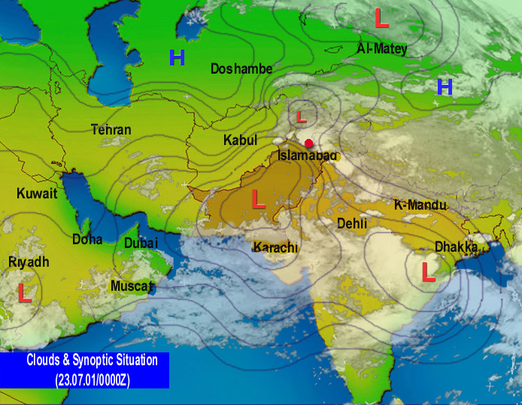
Surface pressure pattern on 23rd July at 0500 PST

Slide 15
4ºC Warmer World Would be Catastrophic to Mountains

Slide 16
Doha Climate Change Talks: What Are The Key Messages from Rio+20?
111. `..the necessity to promote, enhance and support more sustainable agriculture,.. forestry, fisheries,…’ to improve food security, eradicate hunger, and to conserve land, water, plant and .., biodiversity and ecosystems, for enhancing resilience to climate change and natural disasters (Agri. & FS).
119. `…We also recognize the need to maintain natural ecological processes that support food production systems…’ (Water)

Slide 17
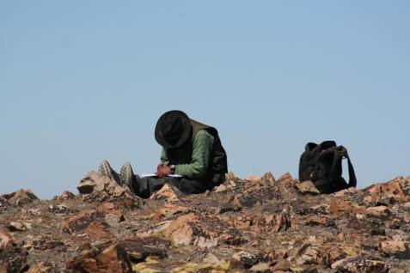
It is too late to adapt to 2 degree; Mountains have to prepare for more to reduce catestrophic disasters !!
It is crucial to face up to the realities of a warming much higher than 2 degrees Celsius.
Scientists other than climatologists need to start working with future scenarios.
Human livelihoods in mountains should be put at the center of attention in planning
adaptation.

Slide 18
“Time Is Running Out: The Doha Climate Talks Must Put An End To Excuses” Guardian, UK

Slide 19
Reducing risk of Glacier Lake Outburst Floods (GLOFs) is a major challenge to Mountains

Slide 20
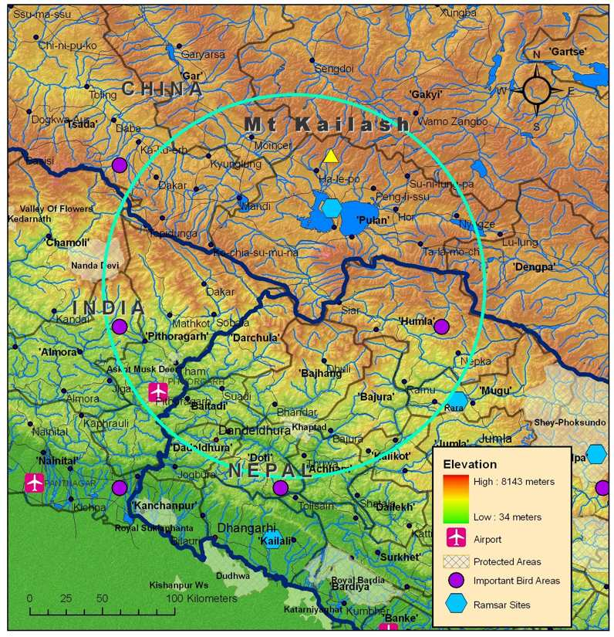
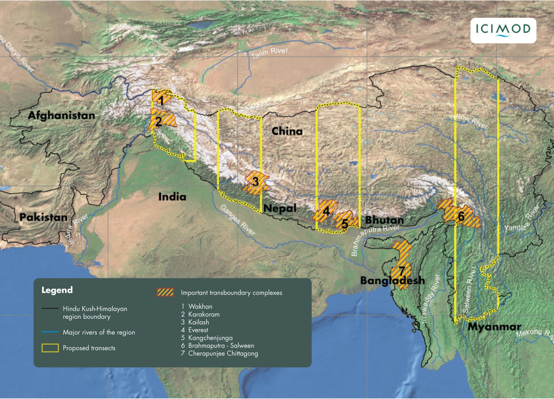
Kailash Sacred Landscape (KSL) Common Problems require common solutions e.g., ICIMOD Kailash Sacred Landscape Conservation Initiative between China – India - Nepal
Scientific data gaps
Vulnerable ecosystems
Trans-boundary LS

Slide 21
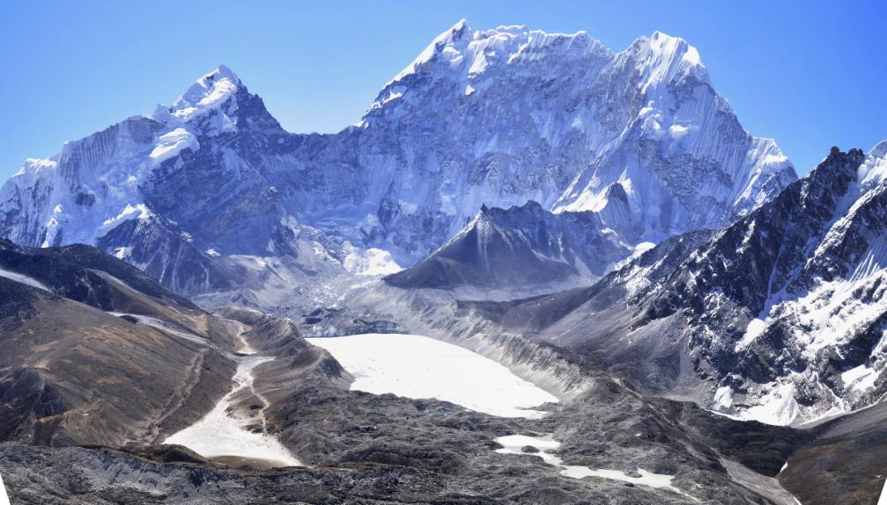
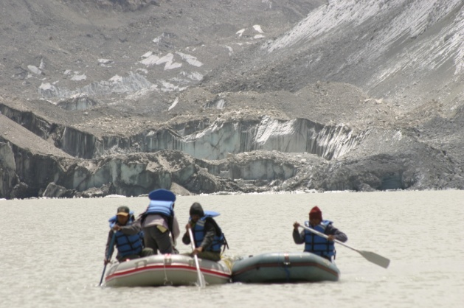
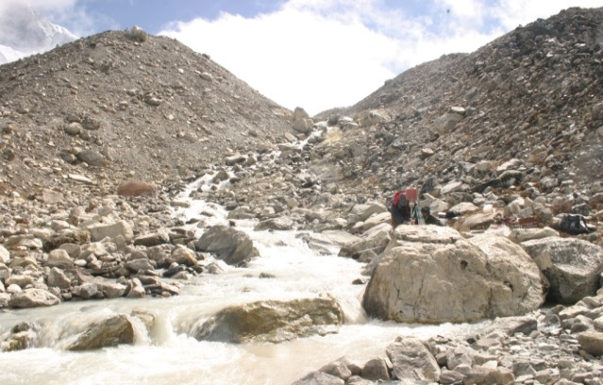
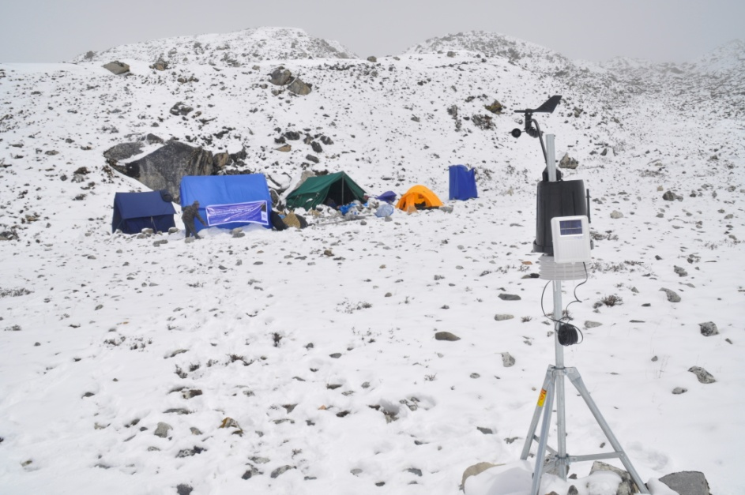
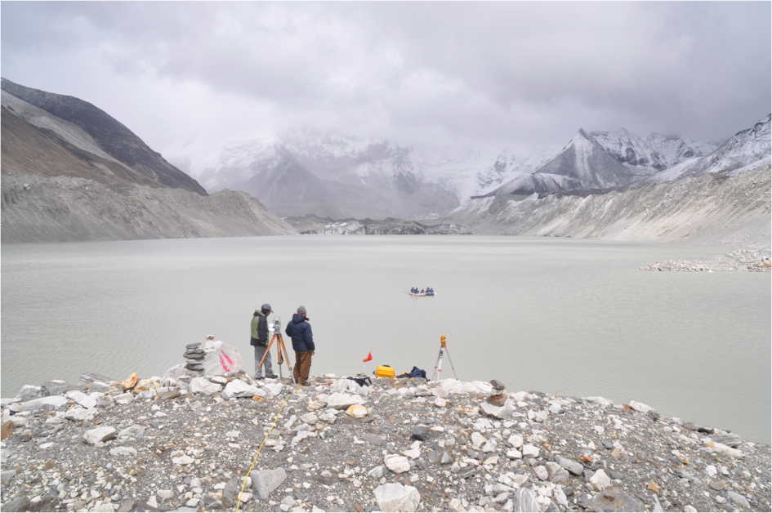
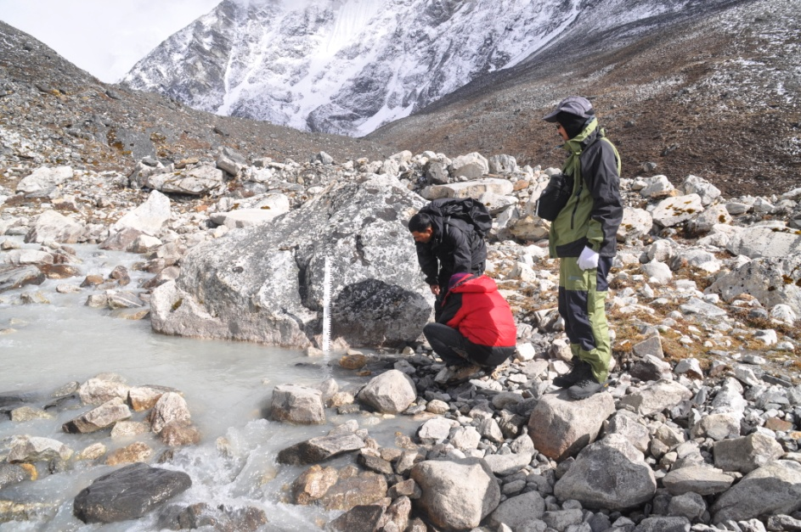
Scientific Investigation in selected glacial lakes and downstream areas for GLOF Risk Assessment
Science has to inform policies and policies need to be converted into good practices to achieve impacts at scale

Slide 22
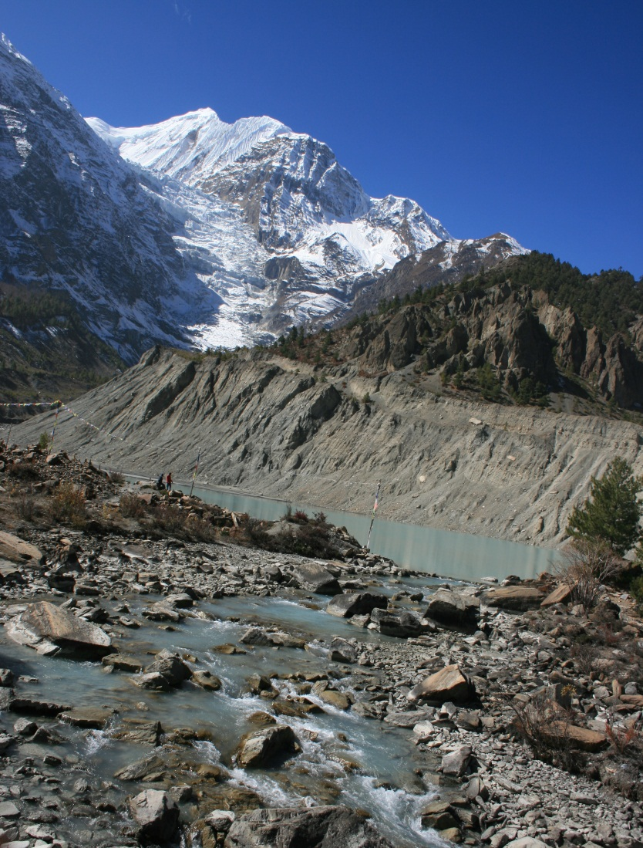
Rio+20 Redefined and Reinvigorated the Mountain Agenda
Mountain Chapter under paragraphs 210, 211 and 212 of ‘The Future We Want’ highlights:
mountains as areas of high poverty, vulnerability, disaster prone, and impacted by climate change;
mountains as ecosystems rich in water, biodiversity, and traditional knowledge; and
call for strengthening existing arrangements, centres of excellence, and international cooperation for conserving ecosystem services and promoting sustainable mountain development
ICIMOD/Nabin Baral

Slide 23
Building Consensus In Climate Change Negotiations in Doha: Sustainable Development is the way forward

Slide 24
Use Early Warning Tools To Their Best Potential to Reduce Disasters in Mountains

Slide 25
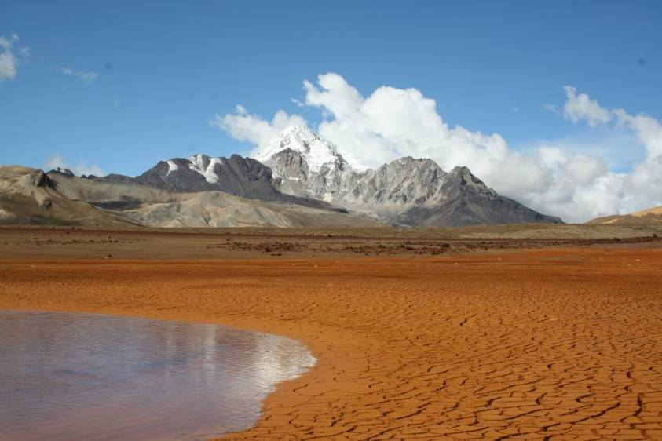
Mountian Water – Binding environment, development, and people togther from upstream to downstreams

Slide 26
Developing Synergistic Relationships Between Biodiversity, Carbon, Forests and People: A must for mountains

Slide 27
Capacity Building is key for Addressing Climate Change

Slide 28
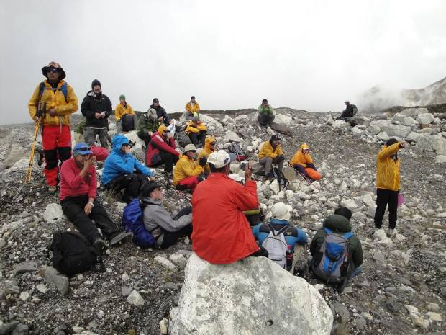
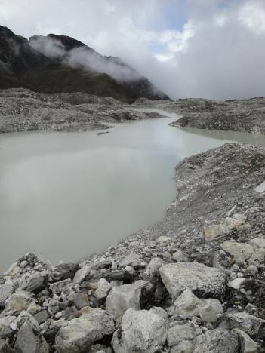
One example of South-South Co-operation: The Andes – Himalayan Imja Lake Expedition
Nepal, September 2011

Slide 29
Rio+20 – a platform of opportunities
Green economy and good environmental governance are the key themes of Rio+20;
Mountains are prime target to promote green economy with low cost, high pay off – both locally and globally
Rio+20 outcome document therefore must recognize the global importance of Mountains;

Slide 30
We need a new Mountain Agenda
Global support for adaptation in mountains to reduce poverty and ensure supply of water, energy and food
True valuation of Mountain ecosystems worth ensures their sustained supply
Huge knowledge gaps and lack of capacity and suitable technologies are the issues
Regional cooperation needed to address climate change, biodiversity loss and economic development;
All these will strengthen the Nexus

Slide 31
Key messages
Mountains matter for water security which will help secure energy and food supply;
Need and integrated and coherent global processes to work on the nexus between adaptation, mitigation, and sustainable development at local, regional and global scales;
Institutional collaboration, global support and political commitments are needed to protect mountains in the South and improve the above nexus

Slide 32
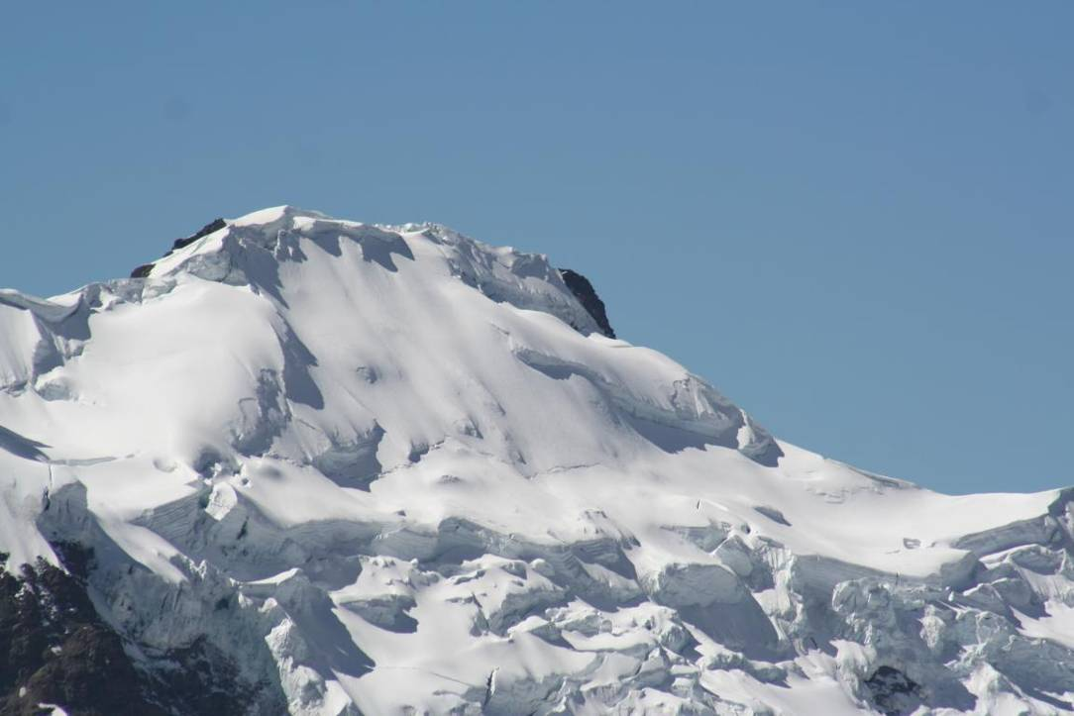
Thank you for your attention!
Photo Courtesy:
dirk.hoffmann@bolivian-mountains.org
Instituto Boiviano de la Montaña - BMI

