Slide 1
Communication with the Australian consumer on GM foods
Sasha Tait, PhD
Food Standards Australia New Zealand
(FSANZ)
Australia

Slide 2
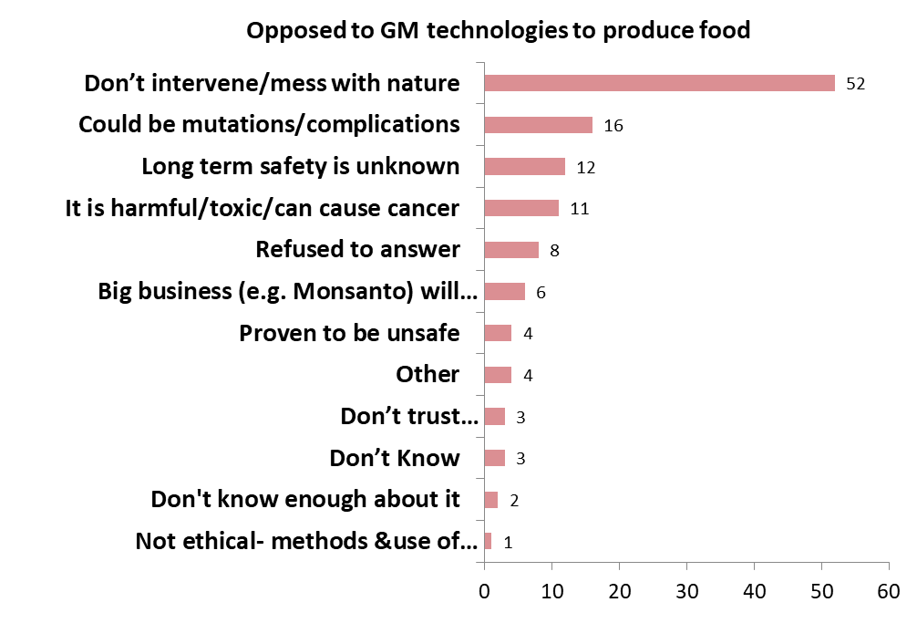
Problem
Targeting of grocery stores
Targeting public consultations
Political lobbying
Organised campaigns
Values-based opposition to genetic modification of food
Response / 1000 (%)
Community Attitudes to Gene
Technology Survey 2019
Office of the Gene Technology Regulator (OGTR)
Australia
http://www.ogtr.gov.au/internet/ogtr/publishing.nsf/Content/reports-other

Slide 3
What did your country do?
Transparency
The public are invited to contribute ideas and concerns before FSANZ finalises a decision
Submissions from public consultation and FSANZ’s responses to those submissions are made publically available on our website
Allows FSANZ to acknowledge and address the publics concerns
Increases public awareness
Animal feeding studies were performed by a lab paid for by the applicant
Animal studies were performed by an accredited lab, following internationally recognised guidelines

Slide 4
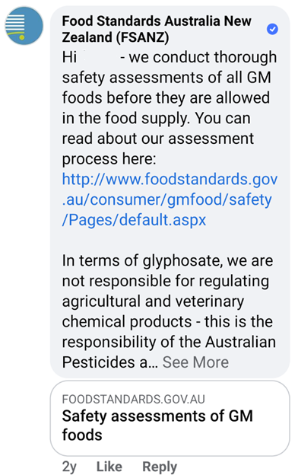
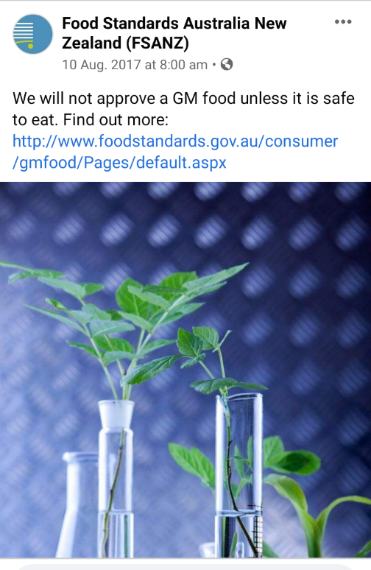
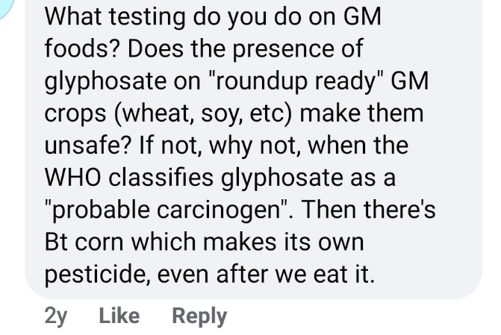
What did your country do?
Increased social media presence
Allows FSANZ to respond directly with concerned consumers

Slide 5
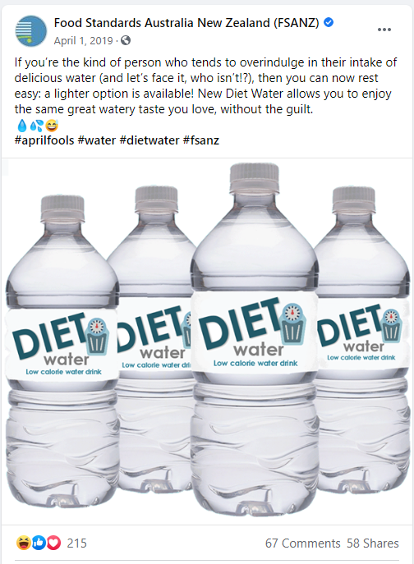
What worked and what did not work in your country?
What worked?
Humour
Simple text
Not too much science

Slide 6
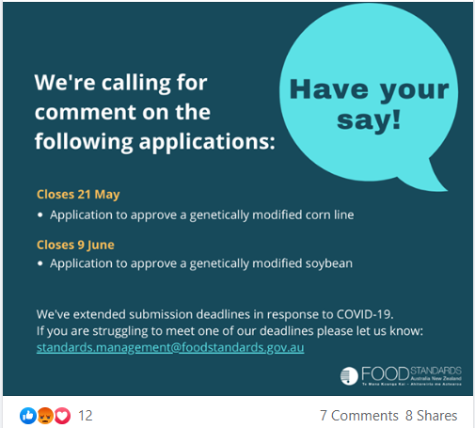
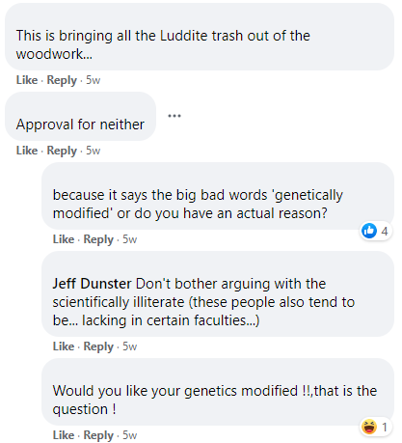
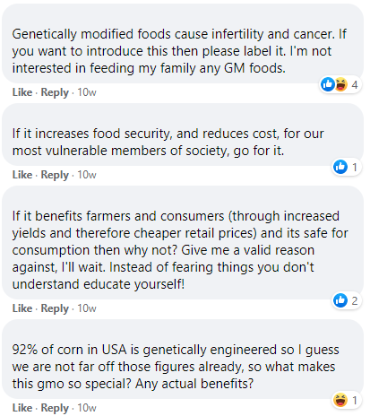
What worked and what did not work in your country?
What did not work?
No interface with Australian curriculum
Limited small group interactions
Most often text over visuals

Slide 7
What do consumers need to know?
GM foods:-
are as safe as their conventional counterparts, including foods produced by mutagenesis and other conventional methods
undergo pre-market safety assessment
are labelled if they contain novel DNA or protein
exempt - oil, sugar, non-protein purified products
exempt - protein enzymes added to food during processing
not exempt - soy leghemoglobin (Impossible Foods burger)
“Genetic modification is one of the many tools available to ensure food security and agricultural sustainability in an uncertain time in human history”

Slide 8
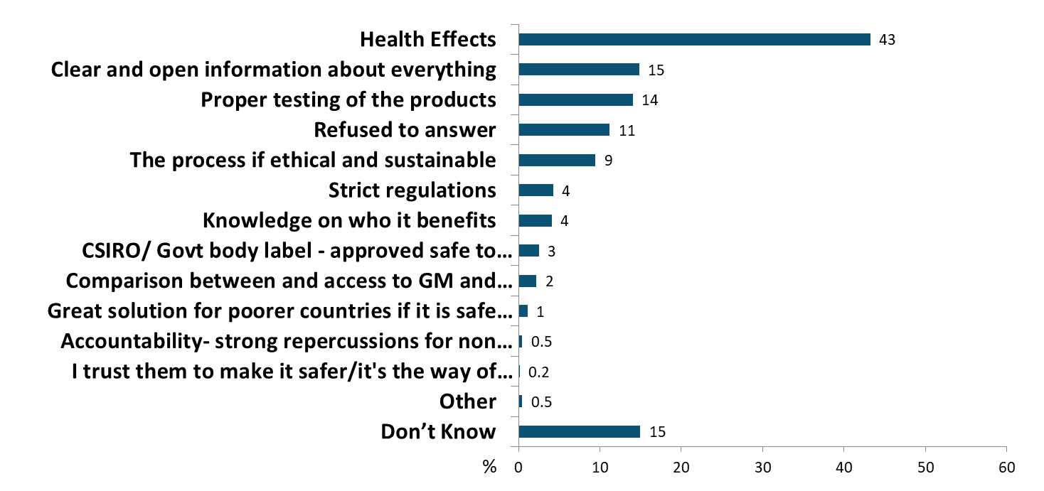
What do consumers want to know?
Community Attitudes to Gene
Technology Survey 2019

Slide 9
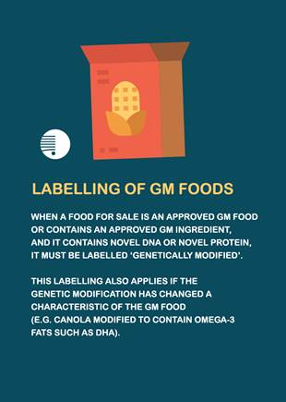
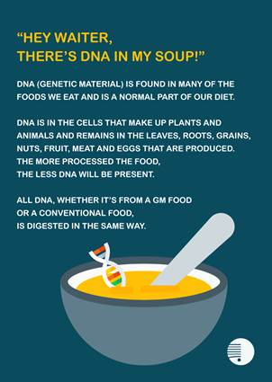
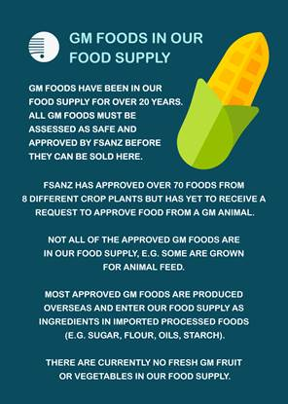
Examples

Slide 10
Essential elements for the toolkit
Keep language non scientific
Use visuals / images over text
Align information to what is taught in schools
Promote the benefits to the consumer & farmer
Identify the developers (not all are the big companies)

