Slide 1

MALAYSIA
SHARING EXPERIENCES IN FOOD BIOTECHNOLOGIES COMMUNICATIONS MATERIAL
Dr. Anita Anthonysamy
FAO GM Foods Platform Focal Point Malaysia
Department of Biosafety Malaysia, Ministry of Environment and Water
12 June 2020

Slide 2
1. Communicating about food biotechnologies
Problems – Developing content
Solutions that worked
Technical knowledge → layman/ simple language
Concepts difficult to grasp with lack of scientific background
Difficult to summarize a vast body of technical information to make sense and convey the actual meaning
Lack of skills, training and funds to develop science communications for scientists
Avoid scientific jargon and try to use everyday language that target group can relate to
Cut out a lot of the scientific explanation and just keep the gist of the information (keeping it short)
Brochures and posters with clear description using images/pictures to explain technical steps involved (such as developing GMOs or food safety assessment)

Slide 3
2. Communicating about
food biotechnologies
Problems - Content
Solutions that worked
Provide balanced view on the subject – cover both pros and cons, don’t hide
Inform public about misinformation not based on sound science, or no scientific proof for the claims
Be persistent to correct misinformation
Rebuttal from third party with no interest to gain
Outsource content development in simple language to professionals who are good in communicating scientific based information
Lack of unbiased information - usually pro or against
Sometimes too much existing information and it is conflicting information from different sources – making communication of intended messages difficult
Communication influencers (NGOs and Independent bodies) convey information based on their stand on the issue

Slide 4
3. Communicating about food biotechnologies
Problems – Interest
Solutions that worked
Lack of interest by public and not seeing the relevance of information provided
Difficulty in keeping public & media interest – it peaks during crisis and then wanes off
Basic understanding of modern biotechnology is low among public and stakeholders causing lack of interest
Information dissemination in limited circles
Pick out issues of concern and develop communication materials
Use colorful pictures, brief and simple explanation, illustrations, flow chart, cartoons
Tailor information
Mailing list of interest group
Use social media platform –popular mechanisms of info dissemination

Slide 5
4. Communicating about food biotechnologies
Problems
Solutions that worked
Pre-conceived ideas and opinion about the issue based on other questionable sources
Not realizing the need to provide critical but credible information
Provide good information that is unbiased and backed by sound science
Ensure only credible information is used by checking the sources. If there is uncertainty, then discard info
Information provided via agency with authority and credibility

Slide 6
5. Communicating about food biotechnologies
Problems
Solutions that worked
Use social media to get good coverage and lower the cost for accessibility and distribution of communications materials
Ensure there is a digital version of good communication material for wider circulation
Difficulty in sustaining periodical and non technical communication materials about science and technology

Slide 7
What did not work
Using technical jargon
Leaving out some technical information - public who had further interest in the topic assumed that the information is not available
Limiting information accessibility to only certain target groups - larger group of public unaware of availability of such information
Attention given to side effects and risks with disregard of benefits of technology used or the food products
Rebutting of misinformation from a party with interest in the final product
Awareness seminars with large groups
General email blasts

Slide 8
1. What Malaysians need to know?
Safety assessment for food from biotechnology – how it is done and assurance of food safety backed with primary and credible data (studies, journal reviews of such food)
Side-effects or potential health hazards
Explaining connection of Antibiotic resistance, bacteria and viruses, toxic chemical residues with GM food
Nutritional value, health and wellness
That credible scientific evidence and source of information is important for food safety assessment
Religious and ethical view of consuming food from biotechnology
Source of the genes used in GM food – halal status

Slide 9
2. What Malaysians need to know?
How food safety is regulated in Malaysia
Labeling of GM food is mandatory by Malaysian law, not a safety issue but to enable consumer choice
Food from biotechnology that is approved to be sold and available in Malaysia
A brief general introduction of food biotechnology, how to develop GM food, it is ok to eat DNA, explanation on why GM food is different, how to differentiate GM food
History of use for food biotechnologies and GM food products that have been in the market – use real examples of successful known products

Slide 10
3. What Malaysians need to know?
What other countries have approved the same food for their local consumption
The wide spread use of food biotechnology (which countries are the exporters/importers)
Types of non-food GM products and its use
Contact or email for further queries on food biotechnology
Food processing technique information and sanitation related to food processing - Small/medium food industry
Sustainable agriculture, food security, food wastage, modern agriculture, precision agriculture

Slide 11
What Malaysians want to know?
Food addictive used and its adverse effect
Types of food processing available and how it affects the quality of food
Country of origin - information can be provided through label of the packaging or advertisement
Specific health benefit (if any) from consuming the product
Availability of alternatives, especially to the products produced via biotechnology
Is biotechnology helping farmers or solving any problems

Slide 12
How information is provided
Facebook posts and links and Twitter links
Infographics (also in non-technical form)
Fact Sheets about specific products
Slide Presentations /Exhibition posters/Bunting made publicly accessible
Brochures and pamphlets
Science newspaper
Books and booklets
Articles in mainstream newspaper and magazines
Data base and Information sources dedicated for biosafety/science/technology information
Emails, meetings, reports, website information, information databases
Compilation of FAQs
Articles in Scientific Journals (with scientific data for evaluation by experts in the field)

Slide 13
Public awareness for biosafety
“Dry” information made interesting
Message -> Idea/Designer -> Content vetting by Regulator

Slide 14
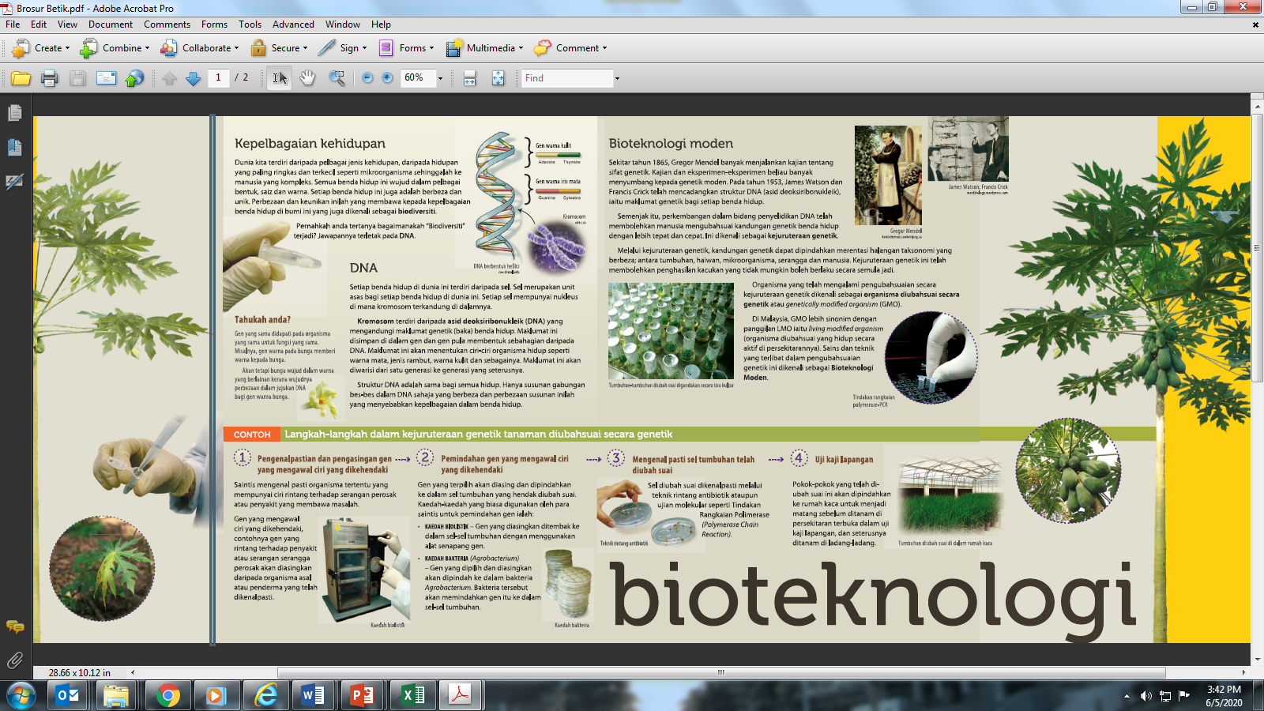
Brochure on biotechnology with pictures and simple explanation in Malay Language
FSQ brochure on food additive (BM and non GM food example)
Biosafety brochure (BM example)
Brochure on food additives developed due to public concern to provide explanation in Malay Language – pictures and tabulated data

Slide 15
Key messages for the toolkit
That food biotechnology is not new and that people have been consuming food from biotechnology for a long time without them being aware
Explanation of safety assessment for foods from biotechnology that are used
Approved products/food are safe, beneficial and supported with scientific evidences
The types of biotechnology methods used to produce various food products and their pros and cons

Slide 16
Key messages for the toolkit
Explanation of the entire supply chain for food productions and system; the issues related to food productions (biotic and abiotic); food nutrition;
Debunk common myths about food biotechnologies
Application of biotechnologies in non-food production, benefit and adverse effect
Credible sources of information on GM food safety

Slide 17
Acknowledgements
Azareena Yahya
Dr. Norliza Abu Bakar
Dr. Yun Shin Sew
Dr. Yuvaneswari Chandramoulee Swaran
Dr. Aida Hamimi Ibrahim
Dr. Mahaletchumy Arujanan
Mageswari Sangaralingam
Dr. Rogayah Sekeli
Dr. Leslie Ooi
Dr. Maizura Ithnin
Shereen Wong
Sharmili Kuppan
Lim Li Ching
Prof. Vilasini Pillai
Dr. Rajinder Singh
Kayathri Panjavaranam
Mohd. Khaidir Abd. Hamid
Mohd Shafiq Mohd Zakaria
Syahnaz Mohd Azali
Prasad Vasudevon
Chin Pick Wun
Dr. Norwati Adnan
Dr. Zuraida Ab Rahman

Slide 18





THANK YOU
www.biosafety.gov.my
anita@kats.gov.my or Anita.Ant@gmail.com
@DOBmy
@DOBiosafetyMalaysia

