Slide 1
NATIONAL BIOSAFETY SYSTEM
Alejandra Ferenczi
Risk Assessment Coordinator
Ministry of Livestock, Agriculture and Fisheries
Uruguay

Slide 2
Problems
Lack of information about the regulatory system.
Lack of internal and external communication
Excess of information to general public and consumer
Country context:
Lack of country guidelines on the subject
Distrust/lack of credibility of the regulatory system
Disorganized communication
Lack of spokespeople

Slide 3
What did your country do?
FAO project to hire a communication consultant
Strategic Communication Plan
Video to explain how the regulatory system works, who we are and what we do
Video, teaching cards and puzzle for school/high school explaining what biotechnology is and how a GM vegetable is generated

Slide 4
What worked and what did not work in your country?
It worked: the videos and teaching material
It did not work: the Strategic Communication Plan was not considered a priority to implement it

Slide 5
What do consumers need to know?
That there is a regulatory system behind
Simple explanations about the technology
Clear and robust explanation of possible negative impacts and benefits of the technology to health and the environment
That there is a spokespersons that communicate constantly

Slide 6
What do consumers want to know?
If there is a negative health impact
If there is a negative environmental impact

Slide 7
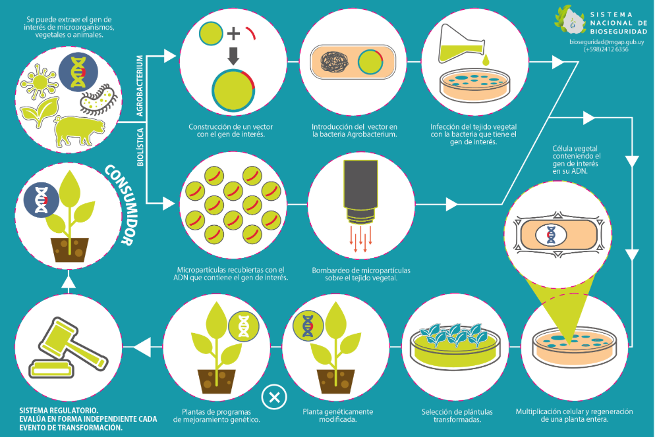
Examples:
Puzzle

Slide 8
Teaching cards
“Us and the genetic improvement”
“Us and the genetic engineering”

Slide 9
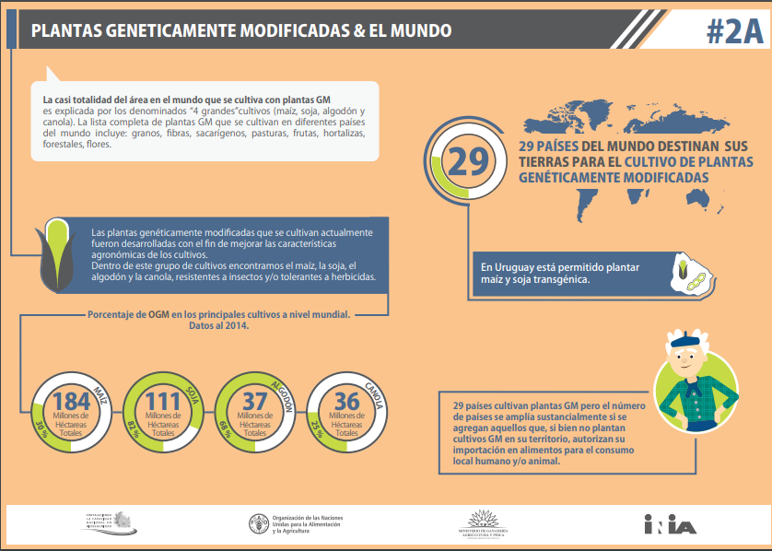
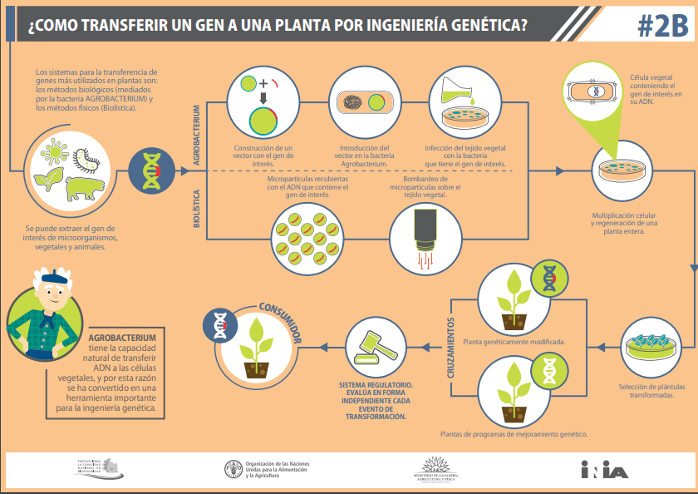
“GM plants & the world”
“How to transfer a gene to a plant using genetic engineering”

Slide 10
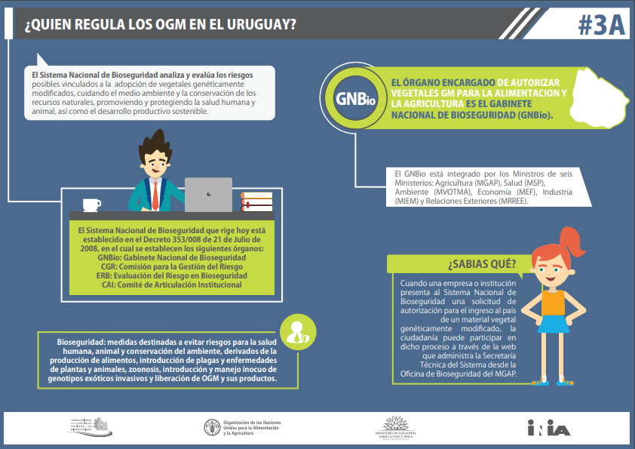
“Who regulates GMO in Uruguay?”
“How are GMOs regulated?”

Slide 11
Videos
Video about the regulatory system (Spanish and English).
https://youtu.be/GLz8LeKuqUU
https://youtu.be/vemb24BwmkM
Educational video on plants improved with biotechnology techniques
https://youtu.be/enLDftQLoxs

Slide 12
Essential elements for the toolkit
To be a toolkit that transmits:
confidence and credibility in the regulatory system
transparency in actions
Process to develop the toolkit:
Interaction with stakeholders since the beginning
Formal instance for its validation by authorities
What it could cover:
Regulatory system and the risk analysis
Explanation of the technology and its uses
Answers to consumer´s questions about health and environment
How it should be promoted and used:
Support for its use at all levels from authorities
Everybody to use the same toolkit

